Slide 1
Course 2 Introduction to Formal Languages and Automata Theory (part 2)
The structure and the content of the lecture is based on http://www.eecs.wsu.edu/~ananth/CptS317/Lectures/index.htm

Slide 2
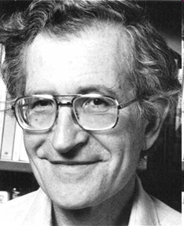
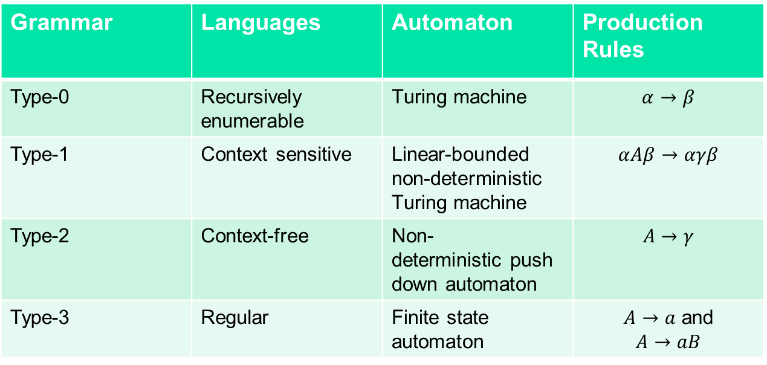




The Chomsky Hierarchy
Recursively- enumerable
Context- sensitive
Context- free
Regular
Grammar | Languages | Automaton | Production Rules
Type-0 | Recursively enumerable | Turing machine | $$α→β$$
Type-1 | Context sensitive | Linear-bounded non-deterministic Turing machine | $$αAβ→αγβ$$
Type-2 | Context-free | Non-deterministic pushdown automaton | $$A→γ$$
Type-3 | Regular | Finite state automaton | $A→a$ and $$A→aB$$
$$ℒ_{0}$$
$$ℒ_{1}$$
$$ℒ_{2}$$
$$ℒ_{3}$$

Slide 3
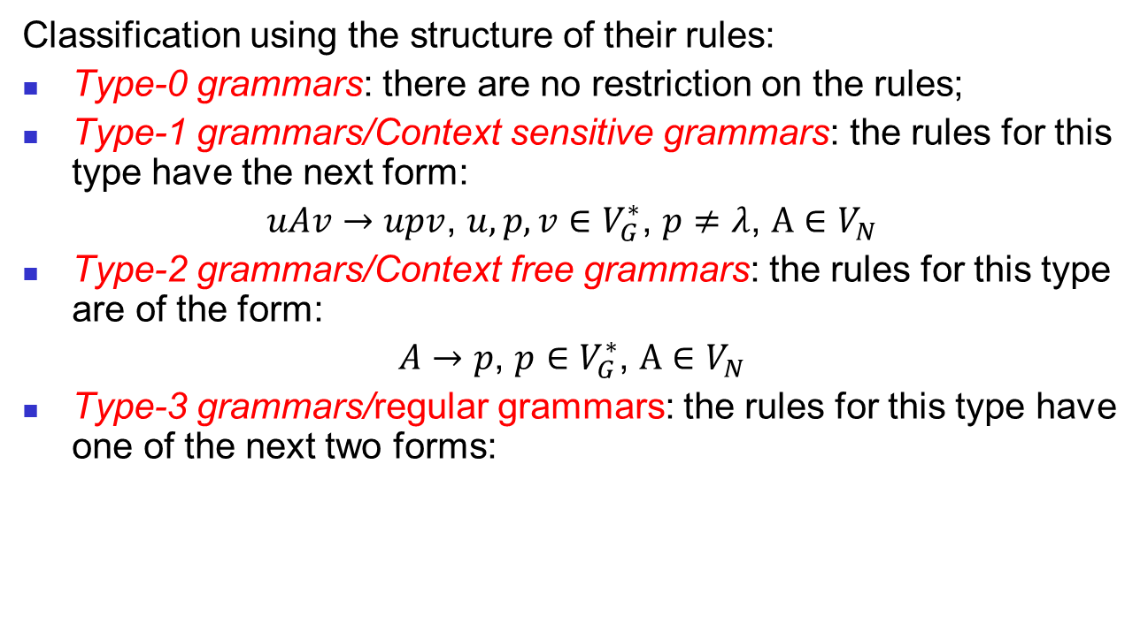
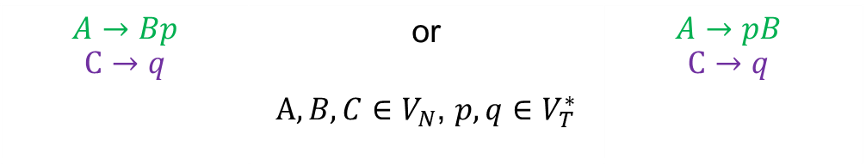
The Chomsky Hierarchy (cont’d)
Classification using the structure of their rules:
Type-0 grammars: there are no restriction on the rules;
Type-1 grammars/Context sensitive grammars: the rules for this type have the next form:
$uAv→upv$, $u,p,v∈V_{G}^{∗}$, $p≠λ$, $A∈V_{N}$
Type-2 grammars/Context free grammars: the rules for this type are of the form:
$A→p$, $p∈V_{G}^{∗}$, $A∈V_{N}$
Type-3 grammars/regular grammars: the rules for this type have one of the next two forms:
Cat. I rules
$$A→Bp$$ $$C→q$$ | or $A,B,C∈V_{N}$, $p,q∈V_{T}^{∗}$ | $$A→pB$$ $$C→q$$
Cat. II rules
Examples: see whiteboard

Slide 4

The Chomsky Hierarchy (cont’d)
Localization lemma for context-free languages (CFL)
Let $G$be a context free grammar and the derivation $x_{1}…x_{m}\underset{⇒}{∗}p$, where $x_{i}∈V_{G}$, $p∈V_{G}^{∗}$. Then there exists $p_{1}…p_{m}∈V_{G}^{∗}$ such that $p=p_{1}…p_{m}$ and $x_{j}\underset{⇒}{∗}p_{j}.$

Slide 5
The Chomsky Hierarchy (cont’d)
On the previos slide: what do you observe on the right-hand side (RHS) of the production rules?

Slide 6
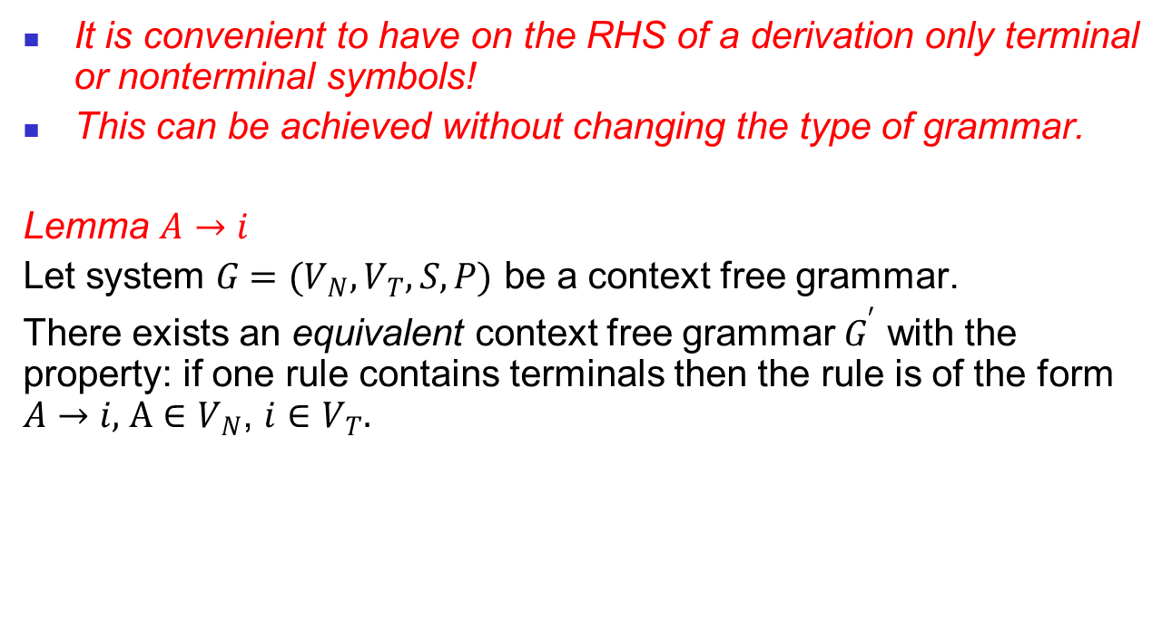
The Chomsky Hierarchy (cont’d)
It is convenient to have on the RHS of a derivation only terminal or nonterminal symbols!
This can be achieved without changing the type of grammar.
Lemma $A→i$
Let system $G=(V_{N},V_{T},S,P)$ be a context free grammar.
There exists an equivalent context free grammar $G^{′}$ with the property: if one rule contains terminals then the rule is of the form $A→i,$ $A∈V_{N}$, $i{∈V}_{T}.$

Slide 7
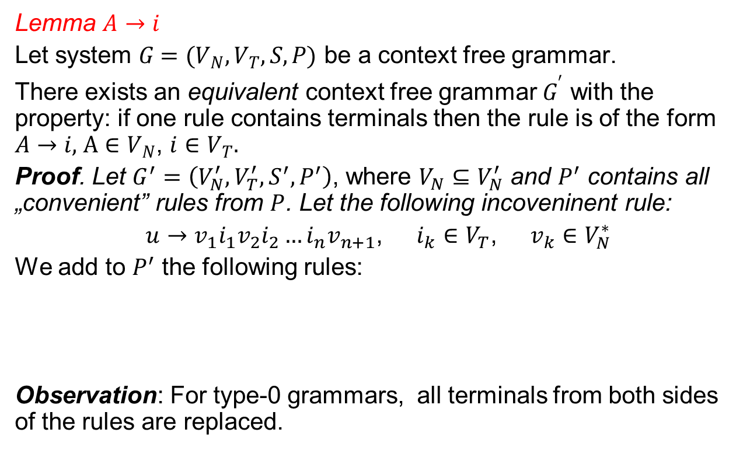
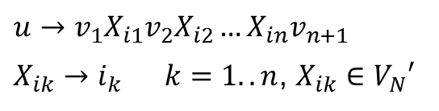
The Chomsky Hierarchy (cont’d)
Lemma $A→i$
Let system $G=(V_{N},V_{T},S,P)$ be a context free grammar.
There exists an equivalent context free grammar $G^{′}$ with the property: if one rule contains terminals then the rule is of the form $A→i,$ $A∈V_{N}$, $i{∈V}_{T}.$
Proof. Let $G^{′}=\left(V_{N}^{′},V_{T}^{′},S^{′},P^{′}\right)$, where $V_{N}⊆V_{N}^{′}$ and $P^{′}$ contains all „convenient” rules from $P$. Let the following incoveninent rule:
$u→v_{1}i_{1}v_{2}i_{2}…{i_{n}v}_{n+1}$, $i_{k}{∈V}_{T}$, $v_{k}{∈V}_{N}^{∗}$
We add to $P^{′}$ the following rules:
Observation: For type-0 grammars, all terminals from both sides of the rules are replaced.
$$u→v_{1}X_{i1}v_{2}X_{i2}…{X_{in}v}_{n+1}$$
$X_{ik}→i_{k}$ $k=1..n$, $X_{ik}∈V_{N}′$

Slide 8

The Chomsky Hierarchy (cont’d)
What is the relationship between $ℒ_{0}$, $ℒ_{1}$, $ℒ_{2}$, $ℒ_{3}$?

Slide 9

The Chomsky Hierarchy (cont’d)
We have $ℒ_{0}⊇ℒ_{1} , ℒ_{2}⊇ℒ_{3}$.
Apparently, a type-2 rule $A→p$is a particular case of type-1 rule $uAv→upv$, in which the context is empty word: $u=v=λ$. This is not correct because of the restriction $p≠λ$ imposed for context free grammars.

Slide 10
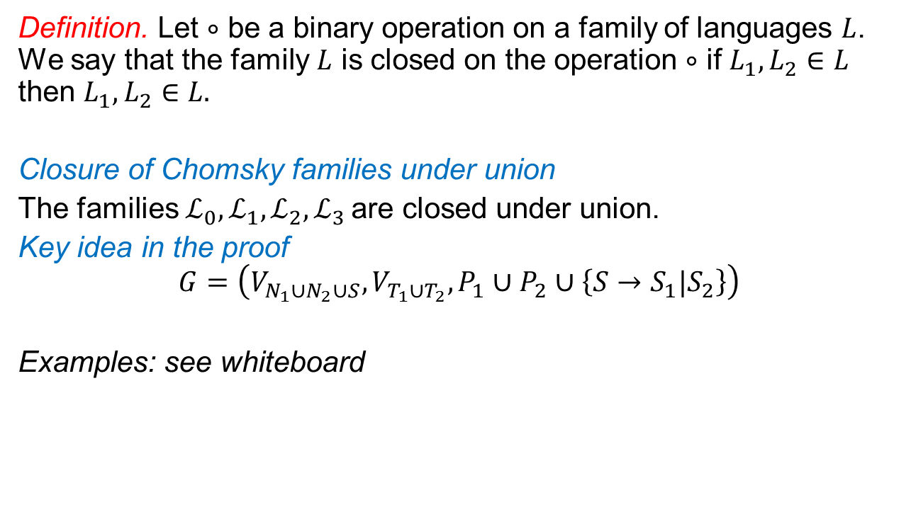
Closure properties of Chomsky families
Definition. Let $∘$ be a binary operation on a family of languages $L$. We say that the family $L$ is closed on the operation $∘$ if $L_{1}, L_{2}∈L$ then $L_{1}, L_{2}∈L.$
Closure of Chomsky families under union
The families $ℒ_{0},ℒ_{1},ℒ_{2},ℒ_{3}$are closed under union.
Key idea in the proof
$$G=\left(V_{N_{1}∪N_{2}∪S},V_{T_{1}∪T_{2}},P_{1}∪P_{2}∪\left\{S→S_{1}|S_{2}\right\}\right)$$
Examples: see whiteboard

Slide 11
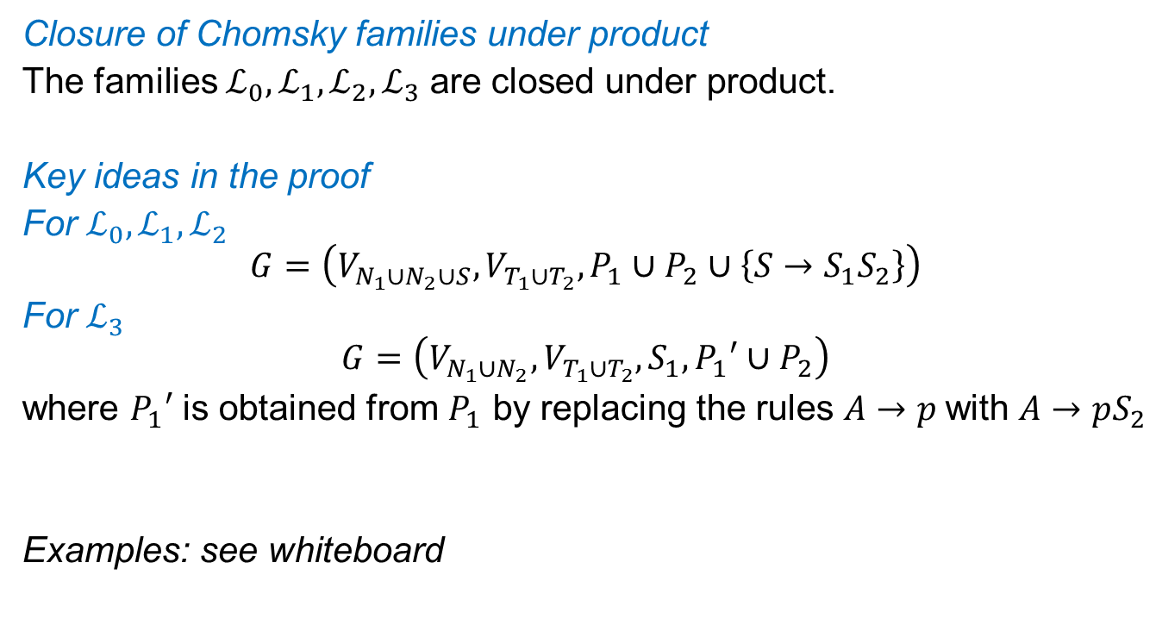
Closure properties of Chomsky families
Closure of Chomsky families under product
The families $ℒ_{0},ℒ_{1},ℒ_{2},ℒ_{3}$ are closed under product.
Key ideas in the proof
For $ℒ_{0},ℒ_{1},ℒ_{2}$
$$G=\left(V_{N_{1}∪N_{2}∪S},V_{T_{1}∪T_{2}},P_{1}∪P_{2}∪\left\{S→S_{1}S_{2}\right\}\right)$$
For $ℒ_{3}$
$$G=\left(V_{N_{1}∪N_{2}},V_{T_{1}∪T_{2}},S_{1}, P_{1}′∪P_{2}\right)$$
where $P_{1}′$ is obtained from $P_{1}$ by replacing the rules $A→p$with $A→pS_{2}$
Examples: see whiteboard

Slide 12
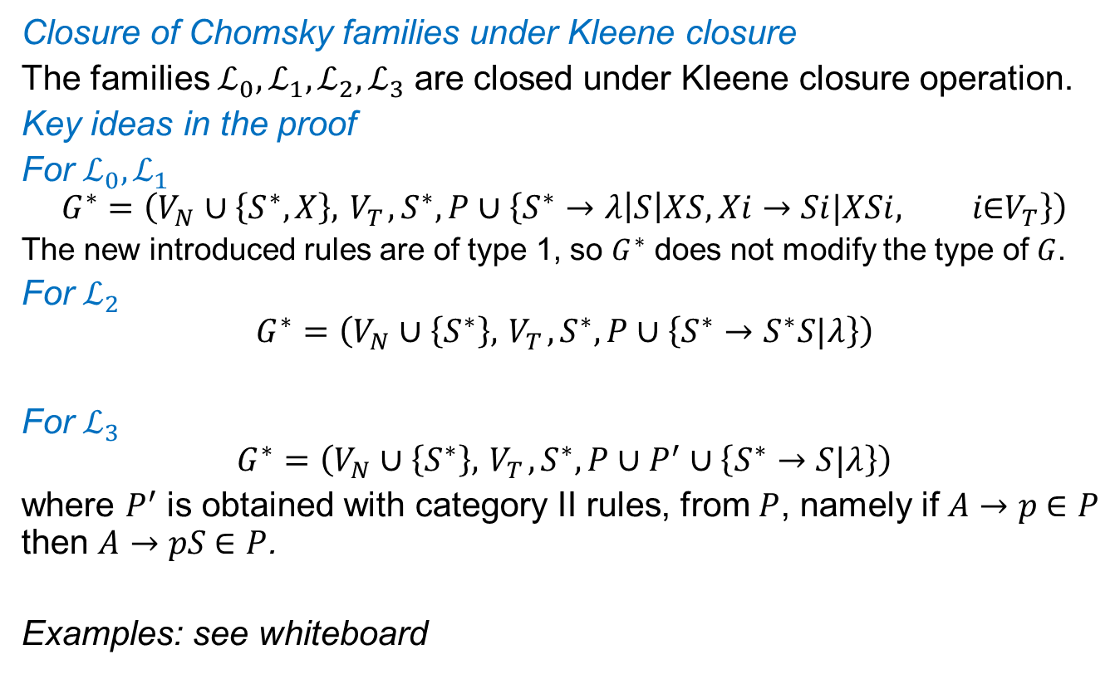
Closure properties of Chomsky families
Closure of Chomsky families under Kleene closure
The families $ℒ_{0},ℒ_{1},ℒ_{2},ℒ_{3}$ are closed under Kleene closure operation.
Key ideas in the proof
For $ℒ_{0},ℒ_{1}$
$$G^{∗}=\left(V_{N}∪\left\{S^{∗},X\right\},{ V}_{T},S^{∗},P∪\left\{S^{∗}→λ\left|S\right|XS, Xi→Si|XSi, i\text{∈}V_{T}\right\}\right)$$
The new introduced rules are of type 1, so $G^{∗}$ does not modify the type of $G$.
For $ℒ_{2}$
$$G^{∗}=\left(V_{N}∪\left\{S^{∗}\right\},{ V}_{T},S^{∗},P∪\left\{S^{∗}→S^{∗}S|λ\right\}\right)$$
For $ℒ_{3}$
$$G^{∗}=\left(V_{N}∪\left\{S^{∗}\right\},{ V}_{T},S^{∗},P∪P^{′}∪\left\{S^{∗}→S|λ\right\}\right)$$
where $P^{′}$ is obtained with category II rules, from $P$, namely if $A→p$∈ $P$ then $A→pS$∈ $P$.
Examples: see whiteboard

Slide 13
Closure properties of Chomsky families
Observation. Union, product and Kleene closure are called regular operations.
Hence, the language families from the Chomsky classification are closed under regular operations.

