Slide 1
Course 3 Finite Automata (part 1)
The structure and the content of the lecture is based on http://www.eecs.wsu.edu/~ananth/CptS317/Lectures/index.htm

Slide 2
Finite Automaton (FA)
Why finite automata are important?
https://www.quora.com/Why-is-it-so-important-to-have-a-good-understanding-of-automata-theory

Slide 3
Finite Automaton (FA)
Informally, a state diagram that comprehensively captures all possible states and transitions that a machine can take while responding to a stream or sequence of input symbols
Recognizer for “Regular Languages”
Deterministic Finite Automata (DFA)
The machine can exist in only one state at any given time
Non-deterministic Finite Automata (NFA)
The machine can exist in multiple states at the same time

Slide 4
Deterministic Finite Automata - Definition
A Deterministic Finite Automaton (DFA) consists of:
Q - a finite set of states
∑ - a finite set of input symbols (alphabet)
q₀ - a start state
F - set of accepting states
δ - a transition function which is a maping between
Q x ∑ and Q
A DFA is defined by the 5-tuple:
{Q, ∑ , q₀,F, δ }

Slide 5
What does a DFA do on reading an input string?
Input: a word w in ∑*
Question: Is w acceptable by the DFA?
Steps:
Start at the “start state” q₀
For every input symbol in the sequence w do
Compute the next state from the current state, given the current input symbol in w and the transition function
If after all symbols in w are consumed, the current state is one of the accepting states (F) then accept w;
Otherwise, reject w.

Slide 6
Regular Languages
Let L(A) be a language recognized by a DFA A.
Then L(A) is called a “Regular Language”.
Locate regular languages in the Chomsky Hierarchy

Slide 7
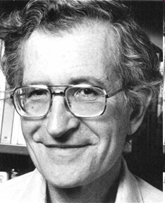
The Chomsky Hierachy
A containment hierarchy of classes of formal languages
Recursively- enumerable (TM)
Context- sensitive (LBA)
Context- free
(PDA)
Regular
(DFA)

Slide 8
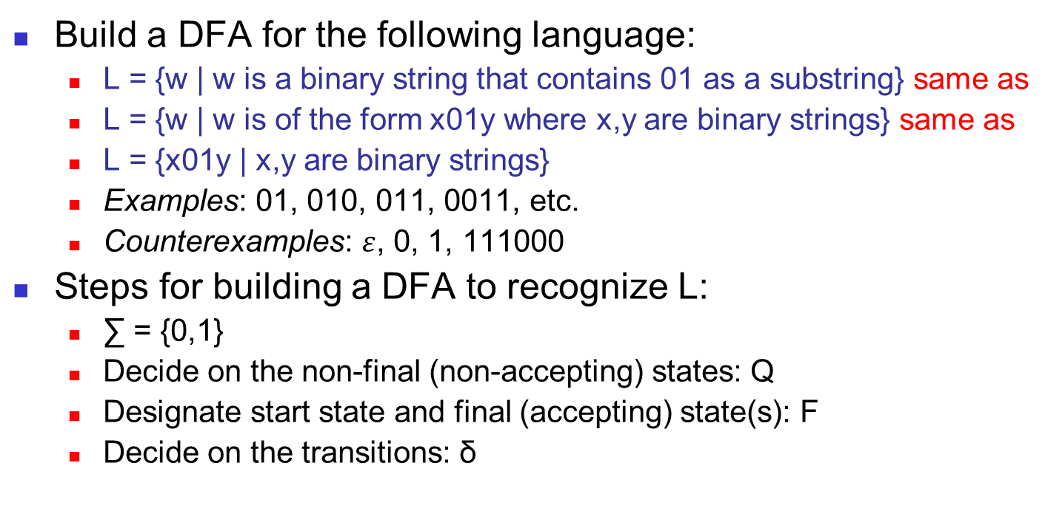
Example #1
Build a DFA for the following language:
L = {w | w is a binary string that contains 01 as a substring} same as
L = {w | w is of the form x01y where x,y are binary strings} same as
L = {x01y | x,y are binary strings}
Examples: 01, 010, 011, 0011, etc.
Counterexamples: $ε$, 0, 1, 111000
Steps for building a DFA to recognize L:
∑ = {0,1}
Decide on the non-final (non-accepting) states: Q
Designate start state and final (accepting) state(s): F
Decide on the transitions: δ

Slide 9
DFA for strings containing 01
Regular expression: (01)*01(01)*
What makes this DFA deterministic?
Q = {q₀,q₁,q₂}
∑ = {0,1}
start state = q₀
F = {q₂}
1
0
0,1
start
0
1
q₀
q₁
q₂
Transition diagram
Accepting
state
Transition table
symbols
0
1
Start state
q₀
q₁
q₀
What if the language allows empty strings?
states
q₁
q₁
q₂
Accepting/final state
*q₂
q₂
q₂
Notes:
What makes DFA derministic: from q0 I can only go to q0 not to q1 or q2; same for q1 and q2.
What if the language allows empty strings? We should stay in the same state if read empty, otherwise we have an NFA.

Slide 10
Example #2
Clamping Logic:
A clamping circuit (https://en.wikipedia.org/wiki/Clamper_(electronics)) waits for a ”1” input, and turns on forever. However, to avoid clamping on spurious noise, we’ll design a DFA that waits for two consecutive 1s in a row before clamping on.
Build a DFA for the following language: L = { w | w is a bit string which contains the substring 11}
State Design:
q₀ : start state (initially off), also means the most recent input was not a 1
q₁: has never seen 11 but the most recent input was a 1
q₂: has seen 11 at least once

Slide 11
Example #3, # 4
Build a DFA for the following language:
L = { w | w is a binary string that has even number of 1s and even number of 0s}
L = { w | w is a binary string that has exactly length 2}
See whiteboard
Notes:
Examle 2.4 pag 50

Slide 12
Extension of transitions (δ) to Paths (δ)
δ (q,w) = destination state from state q on input string w
Base case: δ (q,ε) = q
Induction: δ (q,wa) = δ(δ(q,w), a)
Example: Work out example #3 using the input sequence
w=10010, a=1: δ (q₀,wa) = ? (see whiteboard)
w=10, a=1: δ (q₀,wa) = ? (see whiteboard)
Notes:
Base case: if we are in the state q and read no input we stay there.
Example 2.4 p.52
δ (q₀,wa) = ? Abuse of notation we know that δ is actually a path of transitions

Slide 13
Language of a DFA
A DFA A accepts string w if there is a path from q₀ to an accepting (or final) state that is labeled by w
i.e., L(A) = { w | δ(q₀,w) ∈ F }
i.e., L(A) = all strings that lead to an accepting state from q₀

Slide 14
Non-deterministic Finite Automata (NFA)
A Non-deterministic Finite Automaton (NFA)
is of course “non-deterministic”
Implying that the machine can exist in more than one state at the same time
Transitions could be non-deterministic
1
q_{j}
q_{i}
…
Each transition function therefore maps to a set of states
1
q_{k}

Slide 15
Non-deterministic Finite Automata (NFA)
A Non-deterministic Finite Automaton (NFA) consists of:
Q: a finite set of states
∑: a finite set of input symbols (alphabet)
Q₀: a start state
F: set of accepting states
δ: a transition function, which is a mapping between Q x ∑ and a subset of Q
An NFA is also defined by the 5-tuple:
{Q, ∑ , q₀,F, δ }

Slide 16
How to use an NFA?
Input: a word w in ∑*
Question: Is w acceptable by the NFA?
Steps:
Start at the “start state” q₀
For every input symbol in the sequence w do
Determine all possible next states from all current states, given the current input symbol in w and the transition function
If after all symbols in w are consumed and if at least one of the current states is a final state then accept w;
Otherwise, reject w.

Slide 17
NFA for strings containing 01
Regular expression: (0+1)*01(0+1)*
Why is this non-deterministic?
Q = {q₀,q₁,q₂}
Σ = {0,1}
start state = q₀
F = {q₂}
Transition table
0,1
0,1
start
0
1
q₀
q₁
q₂
Final
state
symbols
0
1
What will happen if at state q₁ an input of 0 is received?
q₀
{q₀,q₁}
{q₀}
states
q₁
Φ
{q₂}
*q₂
{q₂}
{q₂}
Notes:
What will happen if at state q₁ an input of 0 is received?
We have to define a new transition(?)

Slide 18
What is an “error state”?
Note: Omitting to explicitly show error states is just a matter of design convenience (one that is generally followed for NFAs), and i.e., this feature should not be confused with the notion of non-determinism.
A DFA for recognizing the key word “while”
An NFA for the same purpose:
w
h
i
l
e
q₀
q₁
q₂
q₃
q₄
q₅
Any other input symbol
q_{err}
Any symbol
w
h
i
l
e
q₀
q₁
q₂
q₃
q₄
q₅
Transitions into a dead state are implicit

Slide 19
Example #2
NFA for the clamping logic example.
Build an NFA for the following language:
L = { w | w ends in 01}
Compare them with the corresponding DFA.
Other examples
Keyword recognizer (e.g., if, then, else, while, for, include, etc.) @seminar
Strings where the first symbol is present somewhere later on at least once @seminar

Slide 20
Extension of δ to NFA Paths
Basis: δ (q,ε) = {q}
Induction:
Let δ (q₀,w) = {p₁,p₂…,p_{k}}
δ (p_{i},a) = S_{i} for i=1,2...,k
Then, δ (q₀,wa) = S₁ U S₂ U … U S_{k}

Slide 21
Language of an NFA
An NFA accepts w if there exists at least one path from the start state to an accepting (or final) state that is labeled by w
L(N) = { w | δ(q₀,w) ∩ F ≠ Φ }

Slide 22
Advantages & Caveats for NFA
Great for modeling regular expressions
String processing - e.g., grep, lexical analyzer

Slide 23
Differences: DFA vs. NFA
But, DFAs and NFAs are equivalent in their power to capture langauges !!
DFA
All transitions are deterministic
Each transition leads to exactly one state
For each state, transition on all possible symbols (alphabet) should be defined
Accepts input if the last state visited is in F
Sometimes harder to construct because of the number of states
Practical implementation is feasible
NFA
Some transitions could be non-deterministic
A transition could lead to a subset of states
Not all symbol transitions need to be defined explicitly (if undefined will go to an error state – this is just a design convenience, not to be confused with “non-determinism”)
Accepts input if one of the last states is in F
Generally easier than a DFA to construct
Practical implementations limited but emerging (e.g., Micron automata processor)

