Slide 1
Course 4 Finite Automata (part 2)
The structure and the content of the lecture is based on http://www.eecs.wsu.edu/~ananth/CptS317/Lectures/index.htm

Slide 2
Finite Automaton (FA)
Informally, a state diagram that comprehensively captures all possible states and transitions that a machine can take while responding to a stream or sequence of input symbols
Recognizer for “Regular Languages”
Deterministic Finite Automata (DFA)
The machine can exist in only one state at any given time
Non-deterministic Finite Automata (NFA)
The machine can exist in multiple states at the same time

Slide 3
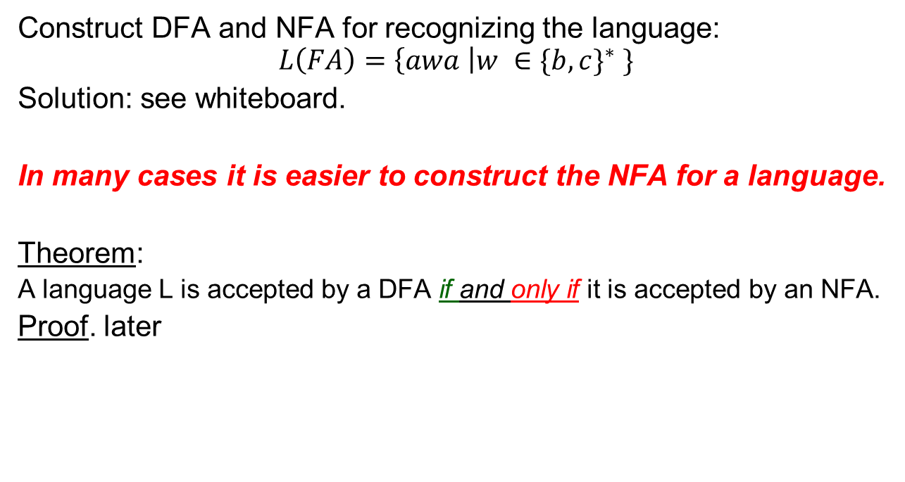
Finite Automaton (FA)
Construct DFA and NFA for recognizing the language:
$$L\left(FA\right)=\left\{awa \right|w ∈{\{b,c\}}^{∗} \}$$
Solution: see whiteboard.
In many cases it is easier to construct the NFA for a language.
Theorem:
A language L is accepted by a DFA if and only if it is accepted by an NFA.
Proof. later

Slide 4
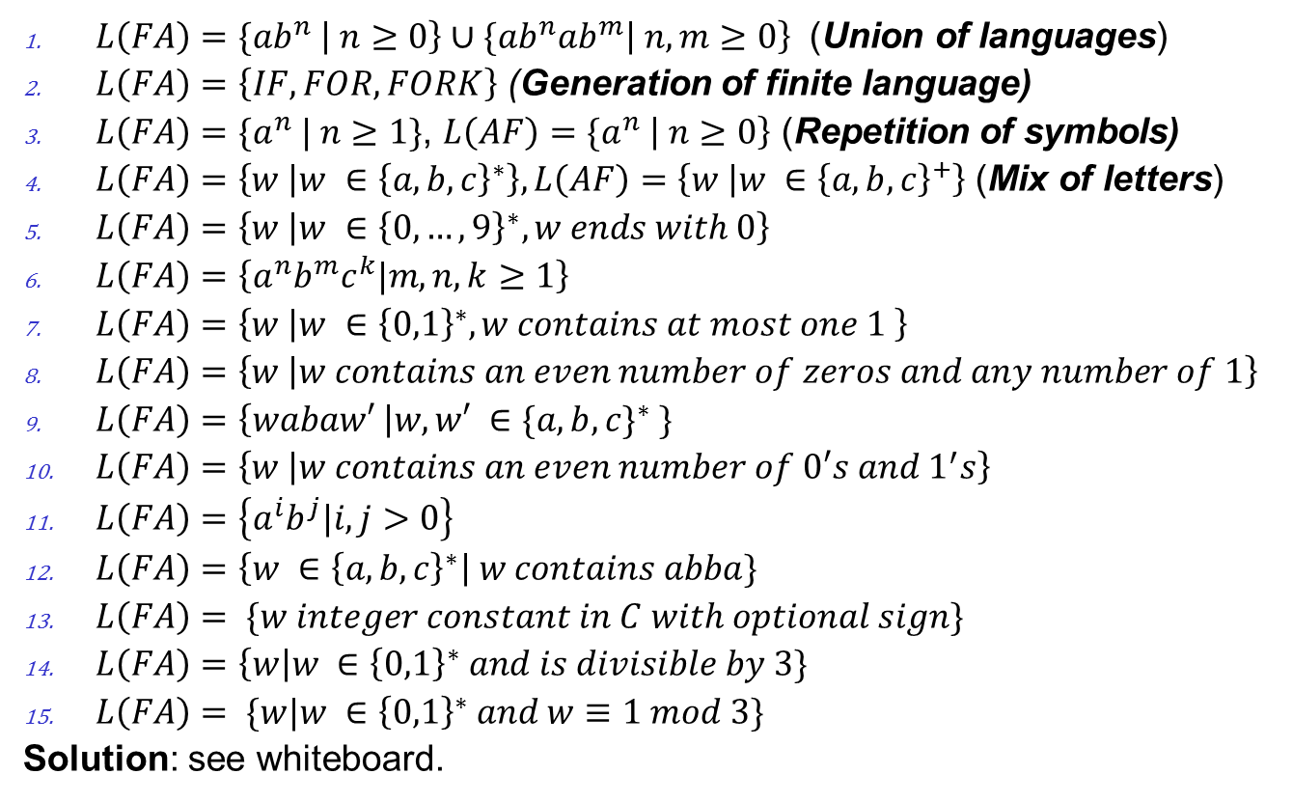
Examples of NFA for different types of languages
$L\left(FA\right)={\{ab}^{n} \left| n≥0\right\}∪{\{ab}^{n}{ab}^{m}\left| n,m≥0\right\}$ (Union of languages)
$L\left(FA\right)=\left\{IF,FOR,FORK\right\}$ (Generation of finite language)
$L\left(FA\right)={\{a}^{n} | n≥1\}$, $L\left(AF\right)={\{a}^{n} \left| n≥0\right\}$ (Repetition of symbols)
$L\left(FA\right)=\left\{w | w ∈{\left\{a,b,c\right\}}^{∗}\right\}, L\left(AF\right)=\left\{w | w ∈{\left\{a,b,c\right\}}^{+}\right\}$ (Mix of letters)
$L\left(FA\right)=\left\{w | w ∈{\left\{0,…,9\right\}}^{∗},w ends with 0\right\}$
$L\left(FA\right)=\left\{a^{n}b^{m}c^{k}|m,n,k≥1\right\}$
$L\left(FA\right)=\left\{w | w ∈{\left\{0,1\right\}}^{∗}, w contains at most one 1 \right\}$
$L\left(FA\right)=\left\{w | w contains an even number of zeros and any number of 1\right\}$
$L\left(FA\right)=\left\{wabaw′ \right|w,w′ ∈{\{a,b,c\}}^{∗} \}$
$L\left(FA\right)=\left\{w | w contains an even number of 0′s and 1^{′}s\right\}$
$L\left(FA\right)=\left\{a^{i}b^{j}|i,j>0\right\}$
$L\left(FA\right)=\left\{w ∈{\left\{a,b,c\right\}}^{∗}\right| w contains abba\}$
$L\left(FA\right)= \{w integer constant in C with optional sign\}$
$L\left(FA\right)=\left\{w\right|w ∈{\left\{0,1\right\}}^{∗} and is divisible by 3\}$
$L\left(FA\right)= \{w|w ∈{\left\{0,1\right\}}^{∗} and w≡1 mod 3\}$
Solution: see whiteboard.

Slide 5
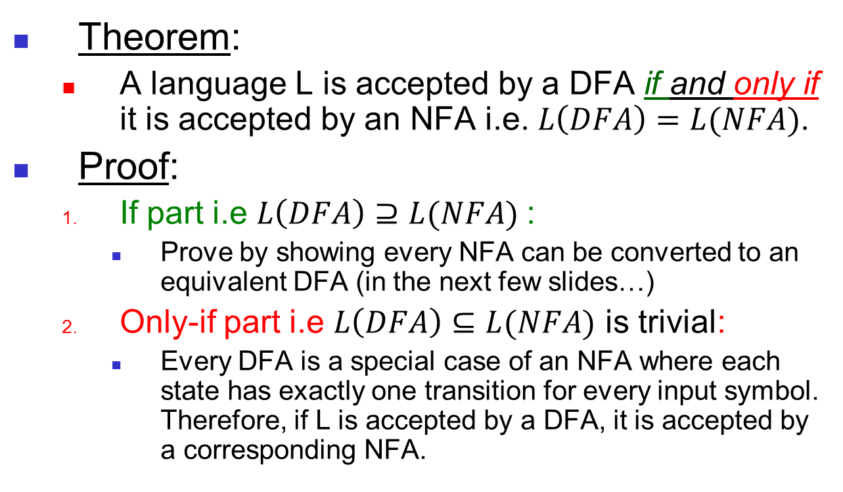
Equivalence of DFA & NFA
Theorem:
A language L is accepted by a DFA if and only if it is accepted by an NFA i.e. $L\left(DFA\right)=L(NFA)$.
Proof:
If part i.e $L\left(DFA\right)⊇L(NFA)$:
Prove by showing every NFA can be converted to an equivalent DFA (in the next few slides…)
Only-if part i.e $L\left(DFA\right)⊆L(NFA)$ is trivial:
Every DFA is a special case of an NFA where each state has exactly one transition for every input symbol. Therefore, if L is accepted by a DFA, it is accepted by a corresponding NFA.
Should be true for any L

Slide 6
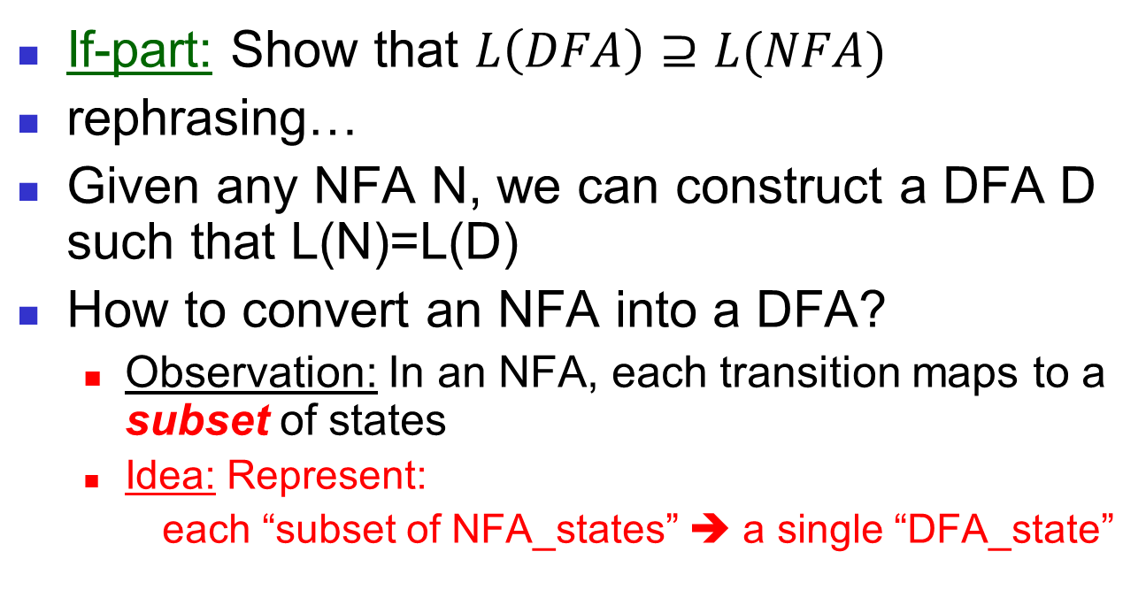
Proof for the if-part
If-part: Show that $L\left(DFA\right)⊇L(NFA)$
rephrasing…
Given any NFA N, we can construct a DFA D such that L(N)=L(D)
How to convert an NFA into a DFA?
Observation: In an NFA, each transition maps to a subset of states
Idea: Represent:
each “subset of NFA_states” ➔ a single “DFA_state”
Subset construction

Slide 7

NFA to DFA by subset construction
Let N = {Q_{N},∑,δ_{N},q₀,F_{N}}
Goal: Build D={Q_{D},∑,δ_{D},{q₀},F_{D}} s.t. L(D)=L(N)
Construction:
Q_{D}= all subsets of Q_{N} (i.e., power set)
F_{D}=set of subsets S of Q_{N} s.t. S∩F_{N}≠Φ
δ_{D}: for each subset S of Q_{N} and for each input symbol a in ∑:
δ_{D}(S,a) = U δ_{N}(p,a)
p $∈$ s

Slide 8
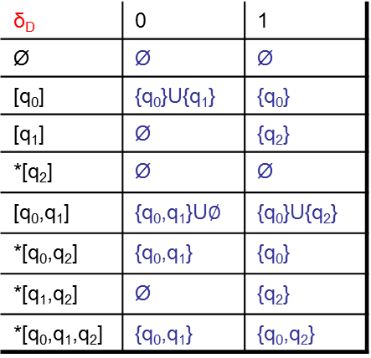
NFA to DFA construction: Example 1
Idea: To avoid enumerating all of power set, do “lazy creation of states”
L = {w | w ends in 01}
1
0
NFA:
DFA:
[q₀]
0
[q₀,q₁]
1
[q₀,q₂]
0,1
0
0
1
1
q₀
q₁
q₂
δ_{D} | 0 | 1
Ø | Ø | Ø
[q₀] | {q₀}U{q₁} | {q₀}
[q₁] | Ø | {q₂}
*[q₂] | Ø | Ø
[q₀,q₁] | {q₀,q₁}U$∅$ | {q₀}U{q₂}
*[q₀,q₂] | {q₀,q₁} | {q₀}
*[q₁,q₂] | Ø | {q₂}
*[q₀,q₁,q₂] | {q₀,q₁} | {q₀,q₂}
δ_{D} | 0 | 1
[q₀] | [q₀,q₁] | [q₀]
[q₀,q₁] | [q₀,q₁] | [q₀,q₂]
*[q₀,q₂] | [q₀,q₁] | [q₀]
δ_{N} | 0 | 1
q₀ | {q₀,q₁} | {q₀}
q₁ | Ø | {q₂}
*q₂ | Ø | Ø
0. Enumerate all possible subsets
1. Determine transitions
2. Retain only those states reachable
from {q₀}
Notes:
It does not make sense to construct q1, q2, {q1,q2} – see next slide

Slide 9

NFA to DFA construction: Example 2
Idea: To avoid enumerating all of power set, do “lazy creation of states”
Construct the NFA recognizing the following language, then transform it into an DFA:
$L=\left\{x ∈{\left\{0,1\right\}}^{∗}\right|the second symbol fromthe right is 1\}$,
Solution: see whiteboard.

Slide 10
NFA to DFA: Repeating the example using LAZY CREATION
L = {w | w ends in 01}
1
0
NFA:
DFA:
[q₀]
0
[q₀,q₁]
1
[q₀,q₂]
0,1
0
0
1
1
q₀
q₁
q₂
δ_{N} | 0 | 1
q₀ | {q₀,q₁} | {q₀}
q₁ | Ø | {q₂}
*q₂ | Ø | Ø
δ_{D} | 0 | 1
[q₀] | [q₀,q₁] | [q₀]
[q₀,q₁] | [q₀,q₁] | [q₀,q₂]
*[q₀,q₂] | [q₀,q₁] | [q₀]
Main Idea:
Introduce states as you go (on a need basis)

Slide 11
Correctness of subset construction
Theorem: If D is the DFA constructed from NFA N by subset construction, then L(D)=L(N)
Proof:
Show that δ_{D}({q₀},w) ≡ δ_{N}(q₀,w} , for all w
Using induction on w’s length:
Let w = xa
δ_{D}({q₀},xa) ≡ δ_{D}( δ_{N}(q₀,x}, a ) ≡ δ_{N}(q₀,w}

Slide 12
A bad case where #states(DFA)>>#states(NFA)
Typically #states(DFA) = #states(NFA)
However, L = {w | w is a binary string s.t., the k^{th} symbol from its end is a 1}
NFA has k+1 states
But an equivalent DFA needs to have at least 2^{k} states

Slide 13
Applications
Text indexing
inverted indexing
For each unique word in the database, store all locations that contain it using an NFA or a DFA
Find pattern P in text T
Example: Google querying
Extensions of this idea:
PATRICIA tree, suffix tree

Slide 14
A few subtle properties of DFAs and NFAs
The machine never really terminates.
It is always waiting for the next input symbol or making transitions.
The machine decides when to consume the next symbol from the input and when to ignore it.
(but the machine can never skip a symbol)
=> A transition can happen even without really consuming an input symbol (think of consuming ε as a free token) – if this happens, then it becomes an ε-NFA (see next lecture).
A single transition cannot consume more than one (non-ε) symbol.

