Slide 1
Course 5 Finite Automata (part 3)
The structure and the content of the lecture is based on http://www.eecs.wsu.edu/~ananth/CptS317/Lectures/index.htm

Slide 2
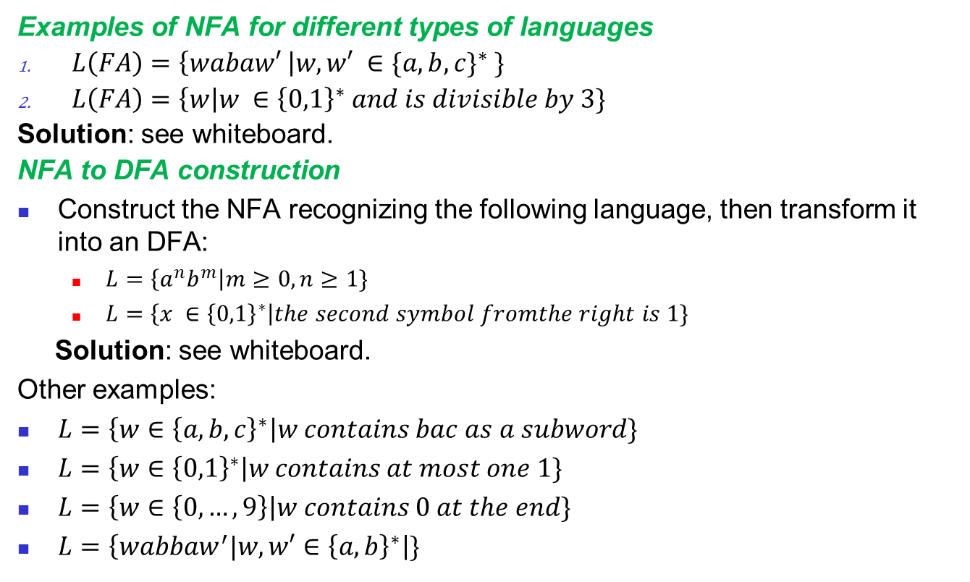
Excursion: Course 4
Examples of NFA for different types of languages
$L\left(FA\right)=\left\{wabaw′ \right|w,w′ ∈{\{a,b,c\}}^{∗} \}$
$L\left(FA\right)=\left\{w\right|w ∈{\left\{0,1\right\}}^{∗} and is divisible by 3\}$
Solution: see whiteboard.
NFA to DFA construction
Construct the NFA recognizing the following language, then transform it into an DFA:
$L=\left\{a^{n}b^{m}\right|m≥0,n≥1\}$
$L=\left\{x ∈{\left\{0,1\right\}}^{∗}\right|the second symbol fromthe right is 1\}$
Solution: see whiteboard.
Other examples:
$L=\left\{w∈{\left\{a,b,c\right\}}^{∗}\right|w contains bac as a subword\}$
$L=\left\{w∈{\left\{0,1\right\}}^{∗}\right|w contains at most one 1\}$
$L=\left\{w∈\left\{0,…,9\right\}\right|w contains 0 at the end\}$
$L=\left\{wabbaw^{′}|w,w′∈{\left\{a,b\right\}}^{∗}\right|\}$

Slide 3
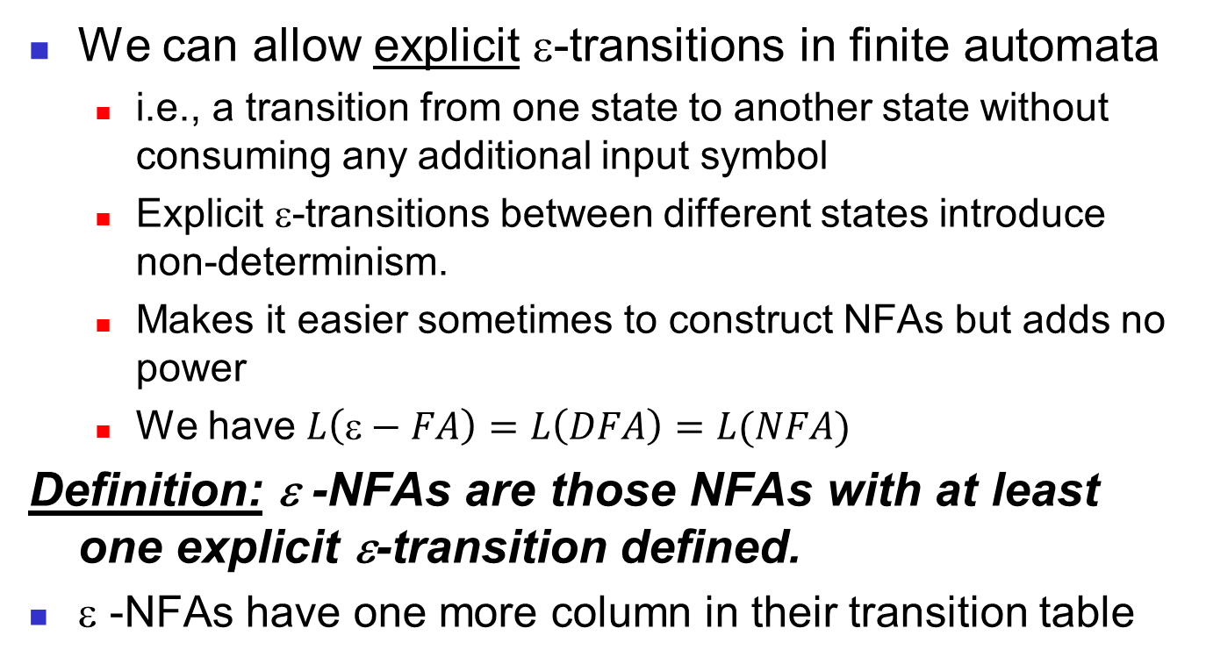
FA with ε-Transitions
We can allow explicit ε-transitions in finite automata
i.e., a transition from one state to another state without consuming any additional input symbol
Explicit ε-transitions between different states introduce non-determinism.
Makes it easier sometimes to construct NFAs but adds no power
We have $L\left(\text{ε}−FA\right)=L\left(DFA\right)=L(NFA)$
Definition: ε -NFAs are those NFAs with at least one explicit ε-transition defined.
ε -NFAs have one more column in their transition table

Slide 4
Example of an ε-NFA
L = {w | w is empty, or if non-empty will end in 01}
0,1
ε-closure of a state q, ECLOSE(q), is the set of all states (including itself) that can be reached from q by repeatedly making an arbitrary number of ε-transitions.
q₀
0
q₁
1
q₂
ε
start
q’₀
δ_{E} | 0 | 1 | ε
*q’₀ | Ø | Ø | {q’₀,q₀}
q₀ | {q₀,q₁} | {q₀} | {q₀}
q₁ | Ø | {q₂} | {q₁}
*q₂ | Ø | Ø | {q₂}
ECLOSE(q’₀)
ECLOSE(q₀)
ECLOSE(q₁)
ECLOSE(q₂)

Slide 5
Example of an ε-NFA
To simulate any transition: Step 1) Go to all immediate destination states.
Step 2) From there go to all their ε-closure states as well.
L = {w | w is empty, or if non-empty will end in 01}
0,1
Simulate for w=101:
q₀
0
q₁
1
q₂
ε
q₀’
start
ε
ε
q’₀
q₀’
q₀
1
1
δ_{E} | 0 | 1 | ε
*q’₀ | Ø | Ø | {q’₀,q₀}
q₀ | {q₀,q₁} | {q₀} | {q₀}
q₁ | Ø | {q₂} | {q₁}
*q₂ | Ø | Ø | {q₂}
Ø
q₀
x
0
ECLOSE(q’₀)
q₁
ECLOSE(q₀)
1
q₂

Slide 6
Example of another ε-NFA
To simulate any transition: Step 1) Go to all immediate destination states.
Step 2) From there go to all their ε-closure states as well.
0,1
Simulate for w=1:
?
q₀
0
q₁
1
q₂
ε
ε
1
start
q’₀
q₃
δ_{E} | 0 | 1 | ε
*q’₀ | Ø | Ø | {q’₀,q₀,q₃}
q₀ | {q₀,q₁} | {q₀} | {q_{0,}q₃}
q₁ | Ø | {q₂} | {q₁}
*q₂ | Ø | Ø | {q₂}
q₃ | Ø | {q₂} | {q₃}
ECLOSE(q’₀)
ECLOSE(q₀)

Slide 7
Example of another ε-NFA
Example of ε-NFA which accepts decimal numbers consiting of:
An optional +,- sign
A String of digits
A decimal point
Another String of Digits (either this string or the string at 2 is empty, but at least one should be nonempty)
Example of ε-NFA which accepts keywords
Solution: see whiteboard

Slide 8
Equivalency of DFA, NFA, ε-NFA
Theorem: A language L is accepted by some ε-NFA if and only if L is accepted by some DFA
Implication:
DFA ≡ NFA ≡ ε-NFA
(all accept Regular Languages)

Slide 9
Summary FA
DFA
Definition
Transition diagrams & tables
Regular language
NFA
Definition
Transition diagrams & tables
DFA vs. NFA
NFA to DFA conversion using subset construction
Equivalency of DFA & NFA
Removal of redundant states and including dead states
ε-transitions in NFA

