Slide 1
Course 5 Regular Expressions
The structure and the content of the lecture is based on http://www.eecs.wsu.edu/~ananth/CptS317/Lectures/index.htm

Slide 2
Applications of Regular Expressions
Unix environments heavily use regular expressions
E.g., bash shell, grep, vi & other editors, sed
Perl scripting – good for string processing
Lexical analyzers such as Lex or Flex
Pattern matching (detection of DoS Vulnerabilities in Java Programs - http://www.cs.utexas.edu/~marijn/publications/evil-regexes.pdf, Web programming, Programming web interfaces)

Slide 3
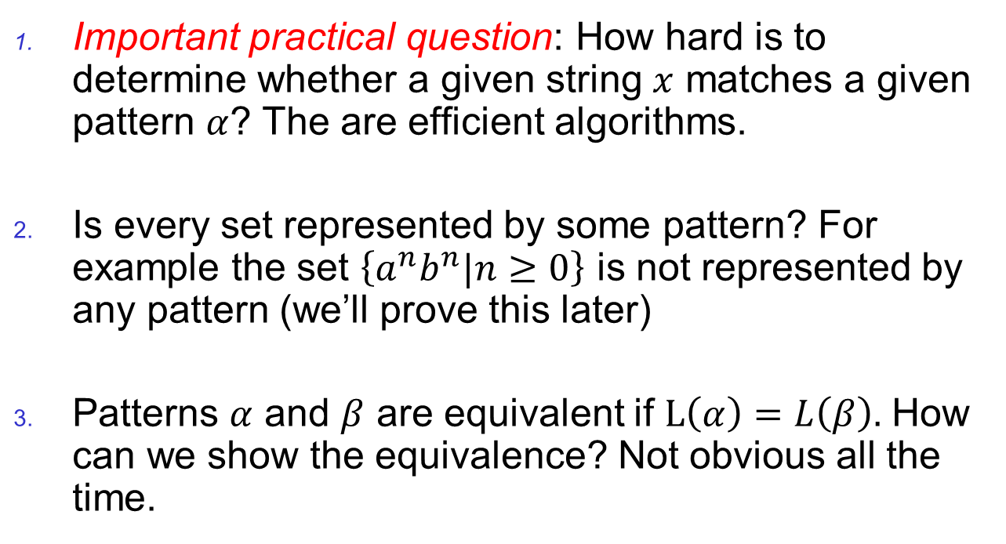
Pattern Matching and Regular Expressions
Important practical question: How hard is to determine whether a given string $x$ matches a given pattern $α$? The are efficient algorithms.
Is every set represented by some pattern? For example the set $\left\{a^{n}b^{n}|n≥0\right\}$ is not represented by any pattern (we’ll prove this later)
Patterns $α$ and $β$ are equivalent if $L\left(α\right)=L\left(β\right).$ How can we show the equivalence? Not obvious all the time.

Slide 4
Regular Expressions vs. Finite Automata
Offers a declarative way to express the pattern of any string we want to accept
E.g., 01*+ 10*
Automata => more machine-like
< input: string , output: [accept/reject] >
Regular expressions => more program syntax-like

Slide 5
Regular Expressions
Regular expressions
=
Finite Automata (DFA, NFA, ε-NFA)
Syntactical expressions
Automata/machines
Regular Languages
Formal language classes

Slide 6
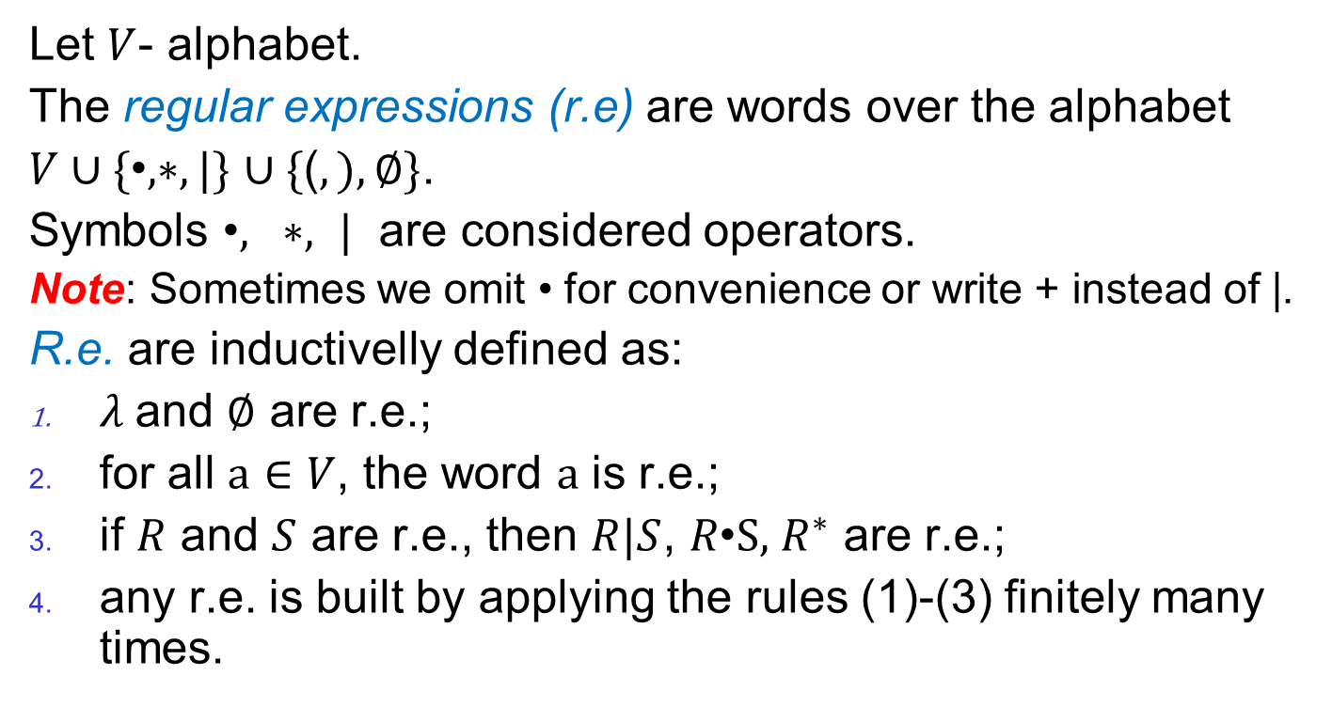
Regular Expressions
Let $V$- alphabet.
The regular expressions (r.e) are words over the alphabet
$V∪\{\text{•}, ∗,|\}$ $∪\{\text{(}, ),∅\}$.
Symbols $\text{•}, ∗, |$ are considered operators.
Note: Sometimes we omit $\text{•}$ for convenience or write + instead of |.
R.e. are inductivelly defined as:
$λ$and $∅$ are r.e.;
for all $a∈V$, the word $a$ is r.e.;
if $R$ and $S$ are r.e., then $R|S$, $R\text{•}\text{S},$ $R^{∗}$ are r.e.;
any r.e. is built by applying the rules (1)-(3) finitely many times.

Slide 7
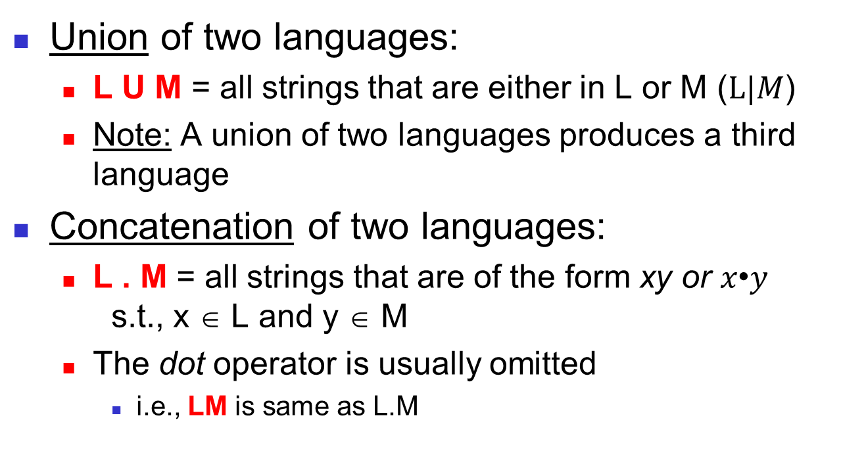
Language Operators
Union of two languages:
L U M = all strings that are either in L or M ($L|M$)
Note: A union of two languages produces a third language
Concatenation of two languages:
L . M = all strings that are of the form xy or $x\text{•}y$ s.t., x ∈ L and y ∈ M
The dot operator is usually omitted
i.e., LM is same as L.M

Slide 8
Kleene Closure (the * operator)
“i” here refers to how many strings to concatenate from the parent language L to produce strings in the language L^{i}
Kleene Closure of a given language L:
L⁰= {ε}
L¹= {w | for some w ∈ L}
L²= { w₁w₂ | w₁ ∈ L, w₂ ∈ L (duplicates allowed)}
L^{i}= { w₁w₂…w_{i} | all w’s chosen are ∈ L (duplicates allowed)}
(Note: the choice of each w_{i} is independent)
L* = U_{i≥0} L^{i} (arbitrary number of concatenations)
Example:
Let L = { 1, 00}
L⁰= {ε}
L¹= {1,00}
L²= {11,100,001,0000}
L³= {111,1100,1001,10000,000000,00001,00100,0011}
L* = L⁰ U L¹ U L² U …

Slide 9
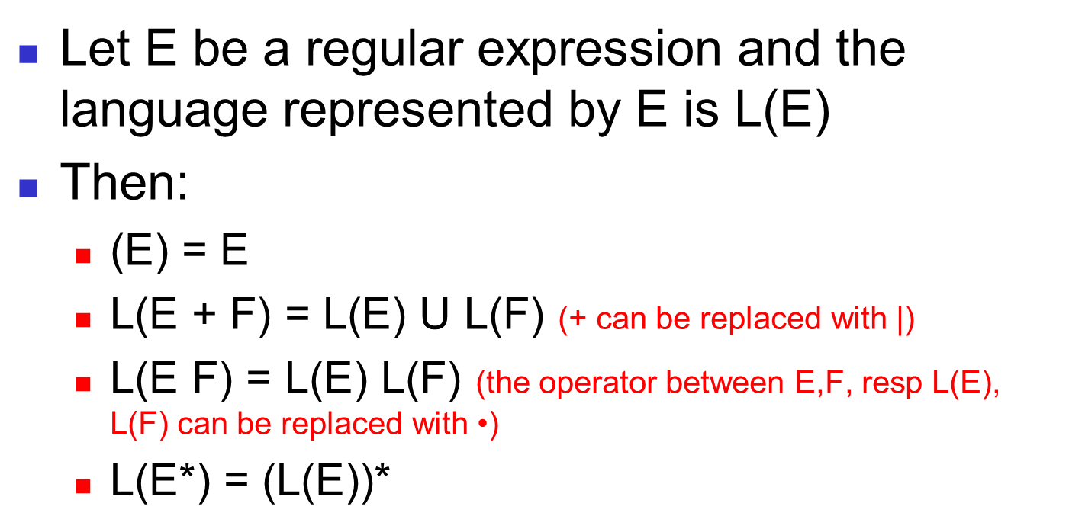
Building Regular Expressions
Let E be a regular expression and the language represented by E is L(E)
Then:
(E) = E
L(E + F) = L(E) U L(F) (+ can be replaced with |)
L(E F) = L(E) L(F) (the operator between E,F, resp L(E), L(F) can be replaced with $\text{•}$)
L(E*) = (L(E))*

Slide 10
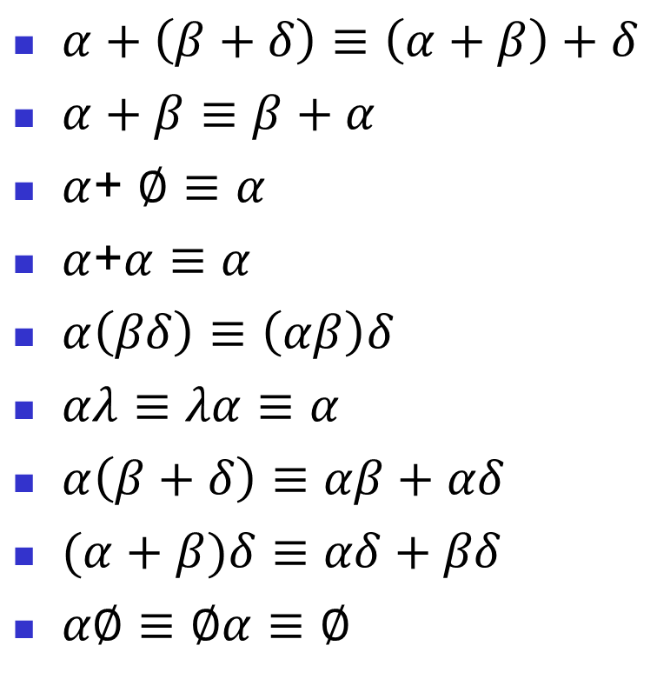

Simplification of regular expressions
$α+\left(β+δ\right)≡\left(α+β\right)+δ$
$α+β≡β+α$
$α$+ $∅$ $≡$ $α$
$α$+$α≡$ $α$
$α\left(βδ\right)≡\left(αβ\right)δ$
$αλ≡λα≡α$
$α\left(β+δ\right)≡αβ+αδ$
$(α+β)δ≡$ $αδ+βδ$
$α∅≡∅α≡∅$
$λ+αα^{∗}≡α^{∗}$
$λ+α^{∗}α≡α^{∗}$
$…$

