Slide 1
Course 6 Regular Expressions (part 2)
The structure and the content of the lecture is based on http://www.eecs.wsu.edu/~ananth/CptS317/Lectures/index.htm

Slide 2
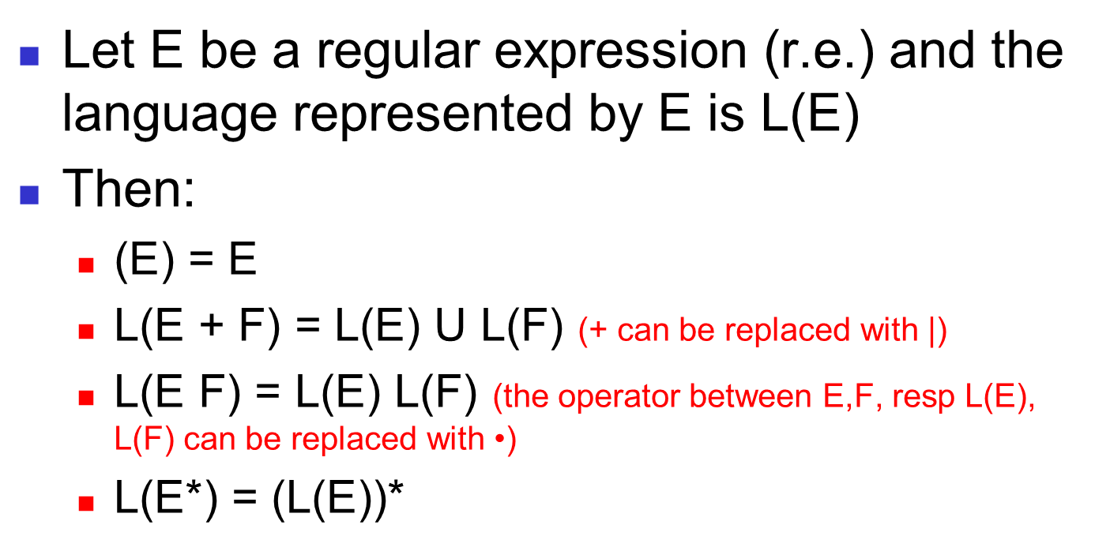
Building Regular Expressions
Let E be a regular expression (r.e.) and the language represented by E is L(E)
Then:
(E) = E
L(E + F) = L(E) U L(F) (+ can be replaced with |)
L(E F) = L(E) L(F) (the operator between E,F, resp L(E), L(F) can be replaced with $\text{•}$)
L(E*) = (L(E))*

Slide 3
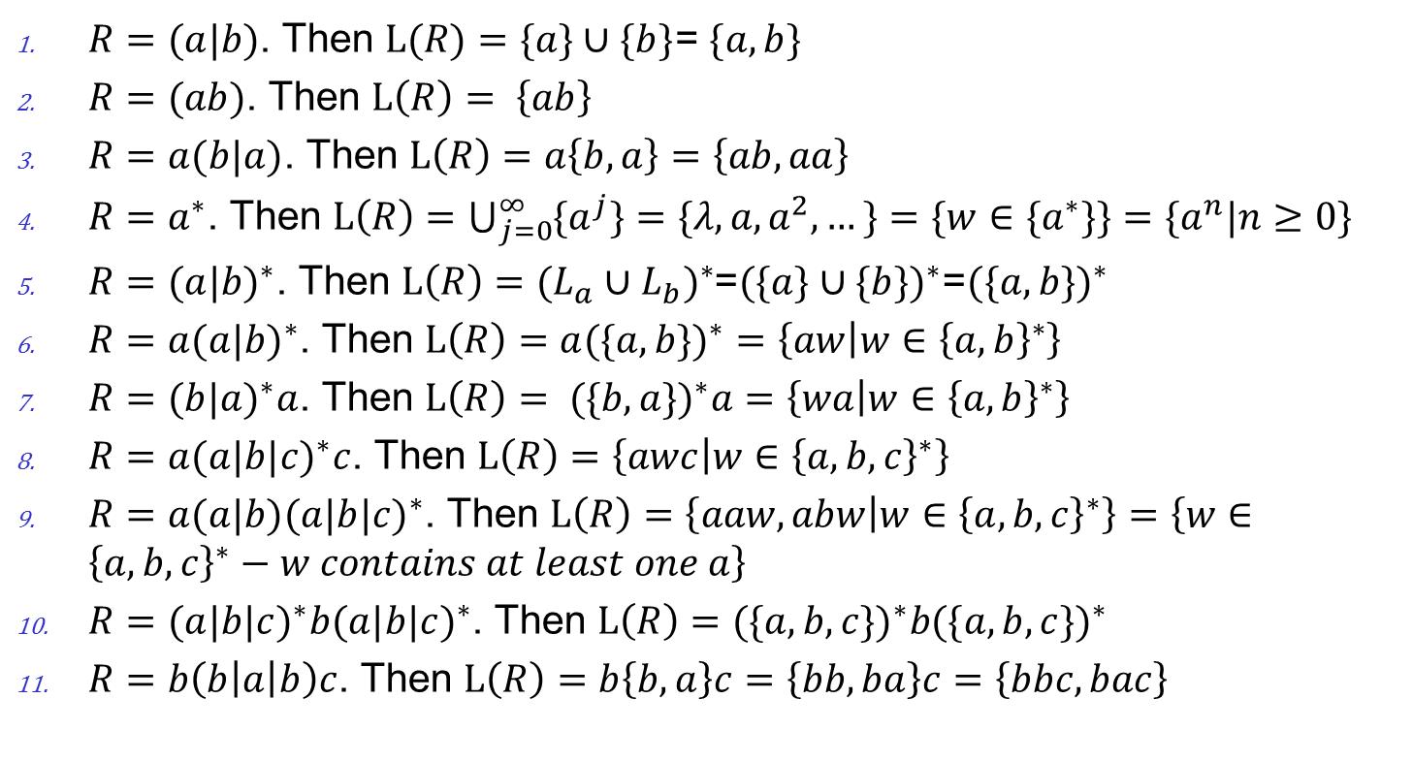
Examples
$R=(a|b)$. Then $L(R)=\{a\}∪\{b\}$= $\{a,b\}$
$R=(ab)$. Then $L\left(R\right)= \left\{ab\right\}$
$R=a(b|a)$. Then $L\left(R\right)=a\left\{b,a\right\}=\left\{ab,aa\right\}$
$R=a^{∗}$. Then $L\left(R\right)=\bigcup_{j=0}^{∞}{{\{a}^{j}\}=\{λ,a,a^{2},…\}}=\{w∈{\{a}^{∗}\}\}=\{a^{n}|n≥0\}$
$R={(a|b)}^{∗}$. Then $L\left(R\right)={(L_{a}∪L_{b})}^{∗}$=${(\{a\}∪\{b\})}^{∗}$=${(\{a,b\})}^{∗}$
$R={a(a|b)}^{∗}$. Then $L\left(R\right)={a(\{a,b\})}^{∗}=\left\{aw | w∈{\left\{a,b\right\}}^{∗}\right\}$
$R={(b|a)}^{∗}a$. Then $L\left(R\right)={ (\{b,a\})}^{∗}a=\left\{wa | w∈{\left\{a,b\right\}}^{∗}\right\}$
$R={a(a|b|c)}^{∗}c$. Then $L\left(R\right)=\left\{awc | w∈{\left\{a,b,c\right\}}^{∗}\right\}$
$R={a(a|b)(a|b|c)}^{∗}$. Then $L\left(R\right)=\left\{aaw,abw | w∈{\left\{a,b,c\right\}}^{∗}\right\}=\left\{w∈{\left\{a,b,c\right\}}^{∗}−w contains at least one a\right\}$
$R={(a|b|c)}^{∗}b{(a|b|c)}^{∗}$. Then $L\left(R\right)={(\{a,b,c\})}^{∗}b{(\{a,b,c\})}^{∗}$
$R=b\left(b\left|a\right|b\right)c$. Then $L\left(R\right)=b\left\{b,a\right\}c=\left\{bb,ba\right\}c=\left\{bbc,bac\right\}$

Slide 4
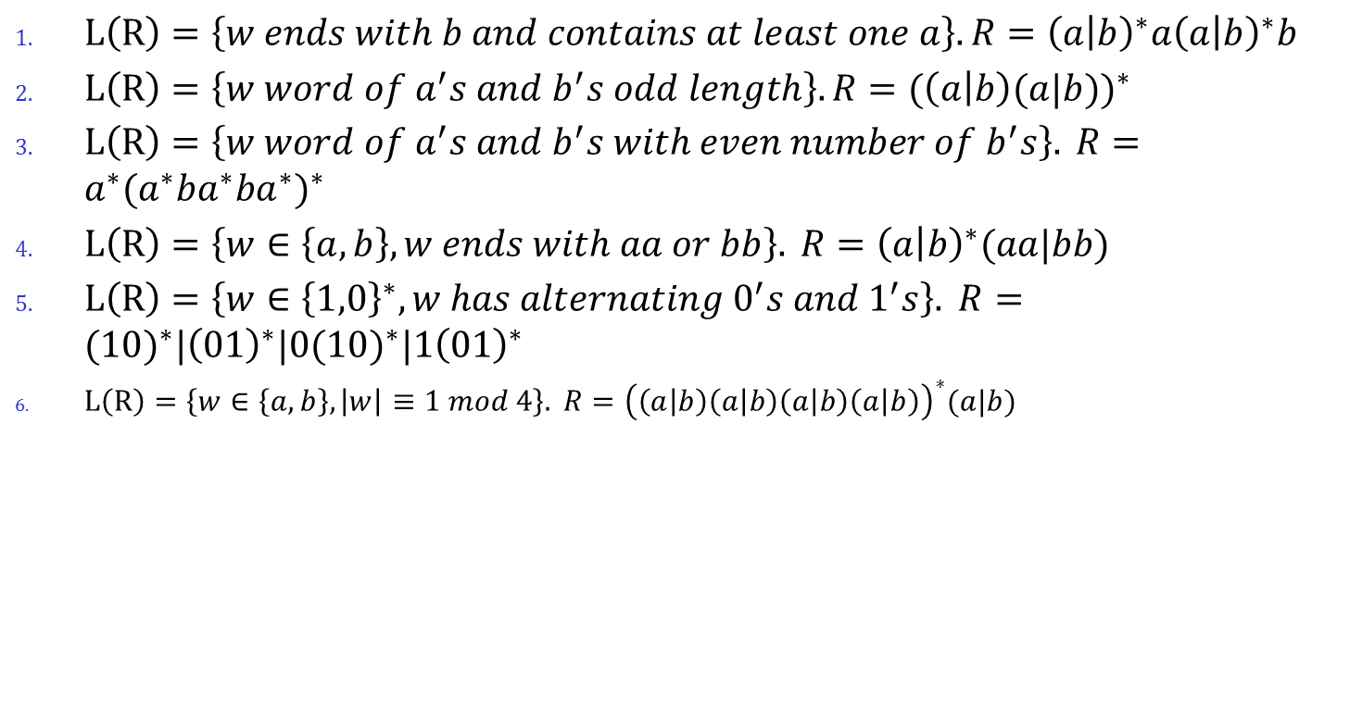
Examples
$L\left(R\right)=\left\{w ends with b and contains at least one a\right\}.R={\left(a | b\right)}^{∗}a{\left(a | b\right)}^{∗}b$
$L\left(R\right)=\left\{w word of a^{′}s and b^{′}s odd length\right\}.R={(\left(a | b\right)(a|b))}^{∗}$
$L\left(R\right)=\left\{w word of a^{′}s and b^{′}s with even number of b^{′}s\right\}. R={{a^{∗}(a}^{∗}ba^{∗}ba^{∗})}^{∗}$
$L\left(R\right)=\left\{w∈\left\{a,b\right\}, w ends with aa or bb\right\}. R={\left(a | b\right)}^{∗}(aa|bb)$
$L\left(R\right)=\left\{w∈{\left\{1,0\right\}}^{∗}, w has alternating 0^{′}s and 1^{′}s\right\}. R={(10)}^{∗}|{\left(01\right)}^{∗}|{0(10)}^{∗}|{1\left(01\right)}^{∗}$
$L\left(R\right)=\left\{w∈\left\{a,b\right\}, \left|w\right|≡1 mod 4\right\}. R={\left(\left(a | b\right)\left(a | b\right)\left(a | b\right)\left(a | b\right)\right)}^{∗}(a|b)$

Slide 5
Precedence of Operators
Highest to lowest
* operator (star)
. (concatenation)
+ operator
Example:
01* + 1 = ( 0 . ((1)*) ) + 1

Slide 6
Finite Automata (FA) & Regular Expressions
To show that they are interchangeable, consider the following theorems:
Theorem 1: For every DFA A there exists a r.e. R such that L(R)=L(A)
Theorem 2: For every r. E. R there exists an ε -NFA E such that L(E)=L(R)
Proofs in the book
ε -NFA
NFA
Kleene Theorem
Theorem 2
Reg Ex
DFA
Theorem 1

Slide 7
DFA to RE construction
DFA
Reg Ex
Theorem 1
Informally, trace all distinct paths (traversing cycles only once) from the start state to each of the final states and enumerate all the expressions along the way
Example:
1
0
0,1
q₀
0
q₁
1
q₂
(1*)
0
(0*)
1
(0 + 1)*
1*
00*
1
(0+1)*
Q) What is the language?
1*00*1(0+1)*

Slide 8

RE to ε-NFA construction
Reg Ex
ε -NFA
Theorem 2
Given a r.e., we can always built an ε-NFA recognizing L(r.e.) using the following diagrams.
ε
a
ε-NFA recogn. lang. ε
ε-NFA recogn. word. a
ε-NFA recogn. lang. $∅$
ε
R
ε
ε
S
R
ε
S
ε
ε-NFA recogn. lang. RS; R,S – r.e.
ε-NFA recogn. lang. R|S; R,S – r.e.
ε
ε
ε
R
ε-NFA recogn. lang. R*; R– r.e.
ε

Slide 9
RE to ε-NFA construction
Reg Ex
ε -NFA
Theorem 2
Example:
(0+1)*01(0+1)*
(0+1)*
01
(0+1)*
ε
ε
0
ε
ε
0
ε
ε
ε
ε
0
1
ε
ε
ε
ε
ε
ε
1
ε
1
ε
ε
ε

Slide 10
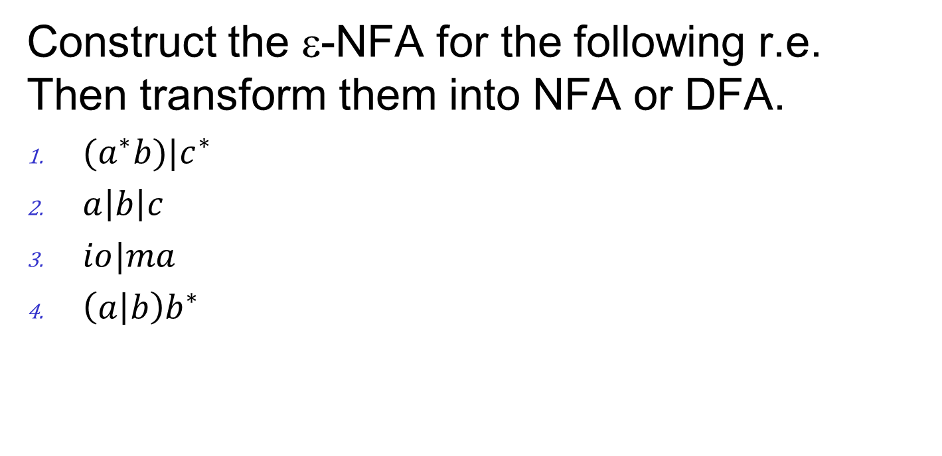
Other examples
Construct the ε-NFA for the following r.e. Then transform them into NFA or DFA.
${(a}^{∗}b)|c^{∗}$
$a\left|b\right|c$
$io|ma$
${\left(a | b\right)b}^{∗}$

Slide 11
Summary
Regular expressions
Equivalence to finite automata
DFA to regular expression conversion
Regular expression to ε-NFA conversion

