Slide 1
Properties of Regular Languages (part 2)
The structure and the content of the lecture is based on http://www.eecs.wsu.edu/~ananth/CptS317/Lectures/index.htm

Slide 2
Topics
How to prove whether a given language is regular or not?

Slide 3
The Pumping Lemma for Regular Languages
What it is? The Pumping Lemma is a property of all regular languages.
How is it used? A technique that is used to show that a given language is not regular

Slide 4
Pumping Lemma for Regular Languages
Let L be a regular language
Then there exists some constant N such that for every string w ∈ L s.t. |w|≥N, there exists a way to break w into three parts, w=xyz, such that:
y≠ ε
|xy|≤N
For all k≥0, all strings of the form xy^{k}z ∈ L
This property should hold for all regular languages.
Definition: N is called the “Pumping Lemma Constant”

Slide 5
Pumping Lemma: Proof
L is regular => it should have a DFA.
Set N := number of states in the DFA
Any string w∈L, s.t. |w|≥N, should have the form: w=a₁a₂…a_{m}, where m≥N
Let the states traversed after reading the first N symbols be: {p₀,p₁,… p_{N}}
==> There are N+1 p-states, while there are only N DFA states
==> at least one state has to repeat i.e, p_{i}= p_{J}where 0≤i<j≤N

Slide 6
Pumping Lemma: Proof…
=> We should be able to break w=xyz as follows:
x=a₁a₂..a_{i}; y=a_{i+1}a_{i+2}..a_{J}; z=a_{J+1}a_{J+2}..a_{m}
x’s path will be p₀..p_{i}
y’s path will be p_{i} p_{i+1}..p_{J} (but p_{i}=p_{J} implying a loop)
z’s path will be p_{J}p_{J+1}..p_{m}
Proof of (3): Now consider another string w_{k}=xy^{k}z , where k≥0
Case k=0
DFA will reach the accept state p_{m}
Case k>0
DFA will loop for y^{k}, and finally reach the accept state p_{m} for z
Hence, w_{k}∈ L
y^{k} (for k loops)
x
z
p₀
p_{i}
p_{m}
=p_{j}

Slide 7
Pumping Lemma: Proof…
Proof of (1):
Since i<j, we have y ≠ ε
Proof of (2):
Since the repetition of states has to occur within the first N symbols in w, |xy|≤N

Slide 8
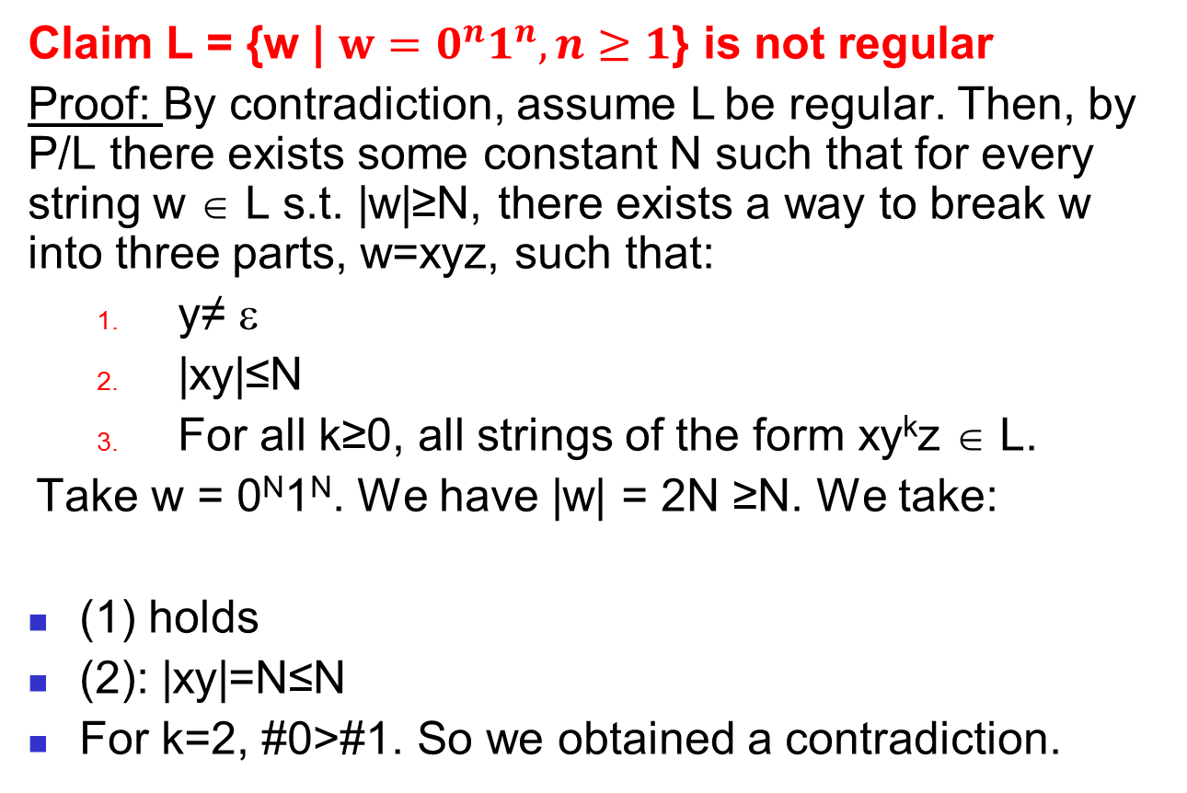
Example 1
Note: This N can be anything (need not necessarily be the #states in the DFA.)
Claim L = {w | $w=0^{n}1^{n}, n≥1$} is not regular
Proof: By contradiction, assume L be regular. Then, by P/L there exists some constant N such that for every string w ∈ L s.t. |w|≥N, there exists a way to break w into three parts, w=xyz, such that:
y≠ ε
|xy|≤N
For all k≥0, all strings of the form xy^{k}z ∈ L.
Take w = 0^{N}1^{N}. We have |w| = 2N ≥N. We take:
(1) holds
(2): |xy|=N≤N
For k=2, #0>#1. So we obtained a contradiction.
w = 0^{N}1^{N} = 0…00...01...1
x
y
z

Slide 9
Example 2
Prove L = {0^{n}10^{n} | n≥ 1} is not regular
Proof: By contradiction, assume L be regular. Then, by P/L there exists some constant N such that for every string w ∈ L s.t. |w|≥N, there exists a way to break w into three parts, w=xyz, such that:
y≠ ε
|xy|≤N
For all k≥0, all strings of the form xy^{k}z ∈ L.
Take w = 0^{N}10^{N}. We have |w| = 2N+1 ≥N. We take:
(1) holds since y=01
(2): |xy|=N≤N, since x has length N-1 and y=2
For k=2, w=xyyz is not a word in L.
w = 0^{N}10^{N} = 0…0010...0
x
y
z

Slide 10
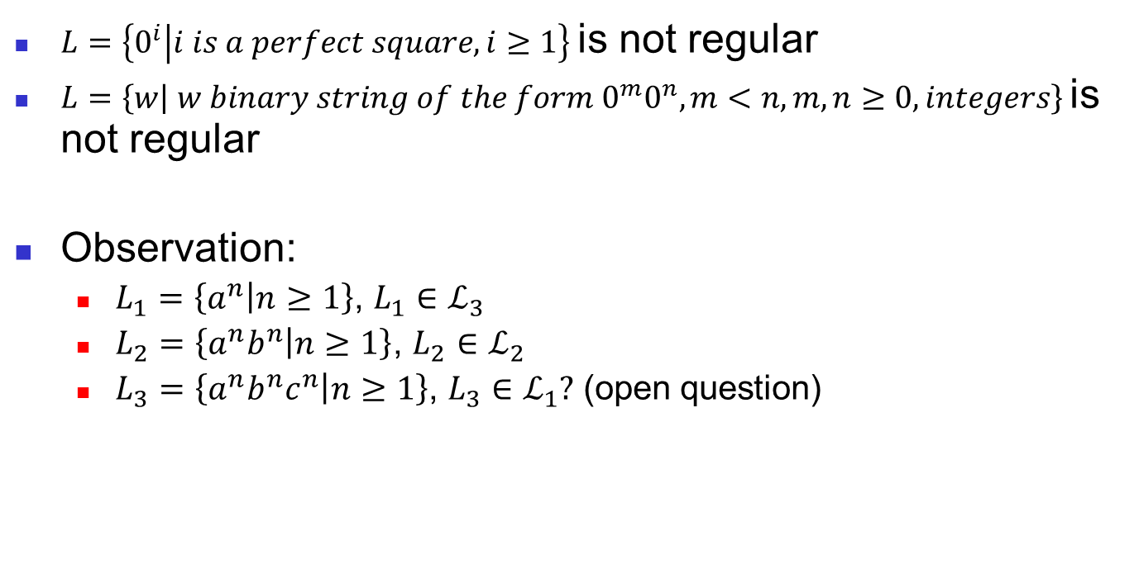
Other examples (@seminar)
Note: A perfect square is a number that can be expressed as the product of two equal integers.
$L=\left\{0^{i} | i is a perfect square,i≥1\right\}$is not regular
$L=\left\{w | w binary string of the form{ 0}^{m}0^{n}, m<n, m,n≥0, integers\right\}$is not regular
Observation:
$L_{1}=\left\{a^{n} | n≥1\right\}$, $L_{1}∈ℒ_{3}$
$L_{2}=\left\{a^{n}b^{n} | n≥1\right\}$, $L_{2}$ $∈ℒ_{2}$
$L_{3}=\left\{a^{n}b^{n}c^{n} | n≥1\right\}$, $L_{3}∈ℒ_{1}?$ (open question)
Notes:
Just in case you are wondering why it's not a context free grammar, here's a quick explanation:
A context free grammar is a grammar that can be recognized by a push-down automaton, which is a finite state automaton with the addition of a stack.
An example of a CFG is a^n b^n. If you think about it, we can push a token on our stack for every 'a' that we see and pop a token off the stack for every 'b' we see. We will fail at any point if we - push a token after popping (a 'b' followed by an 'a') - finish processing the string but we still have tokens on the stack (more 'a's than 'b's) - try to pop an empty stack (more 'b's than 'a's)
If you think about how to recognize a^n b^n c^n with a push-down automaton, you will probably realize that is impossible after some playing around.
Hope that helps.

Slide 11
Summary
How to prove languages are not regular?
Pumping lemma & its applications

