Slide 1
Module-08
Object Oriented Programming

Slide 2
Outline
Encapsulation
Inheritence
Polymorphism
Abstraction

Slide 3
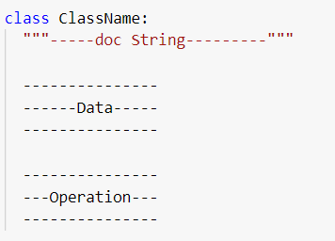
Encapsulation
Group the related data member along with related functionality known as binding
How to group?
Class

Slide 5
Class Variable
Static Variable
Non Static Variable
Local Variable

