Slide 1
Time scheduling to avoid traffic
Sandeep Pal

Slide 2
The Idea
To avoid traffic on roads, we can use past records so as to know, what would be the most suitable time to avoid the traffic.
Once already on the road , not much can be done to avoid road traffic in cities like Mumbai . So, why not get on the road only when there is least traffic.

Slide 3
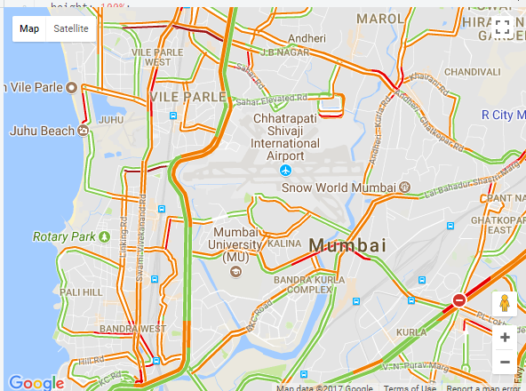
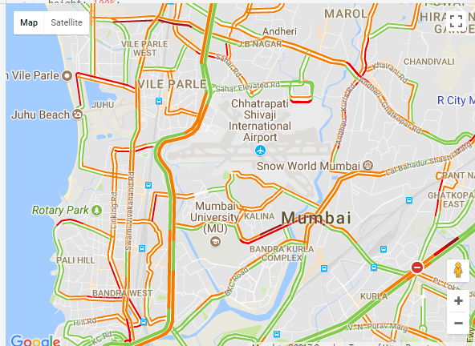


Dynamic situation of traffic
9:02
9:12
9:19
9:30

Slide 4
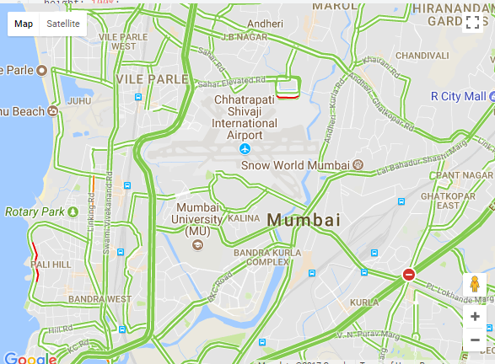
Or today at 7:15am

Slide 5
Requirements
Database : A database system to store the data associated with each road, which would include the traffic density and timings.
Machine Learning : To predict what would be the expected travel time.
Google traffic layer : API to provide the real time traffic scenario on roads to maintain the database

Slide 6
Flow
User puts in the source and destination of his journey.
Users put in the timings and check the traffic status at that timings relative to best possible timings.
Then user can select which would be the best suited timings for them to travel.

Slide 7
Major Applications
People who have flexible office timings can benefit from this to select the most suitable timings.
Tourists can select the timings to travel in new cities so that they don’t get exhausted by the traffic itself.

