Slide 1
Wiki on processes and products for Life Cycle Assessment (LCA) Overview
MERCE-FRA/DIS/SAS
MFR2025-ARC-0738

Slide 2
Outline
Some challenges in LCA – Initial motivation
Overview of the project
Vision
Data structure
Data import example
Tentative parametric approach

Slide 3
Some challenges in LCA – Initial motivation
LCA results without transparency on the processes used (life cycle inventory - LCI) has limited scientific value.
Impact results give non explainable information. Cannot be analyzed by experts.
Given processes, one can compute and explain impact results.
Used processes seem to be as important as methodology considered (e.g., PCR/PSR).
Using same methodology but different databases, one can observe up to x100 difference.
No peer review for private databases.
However, there exist several papers in the public domain providing processes used in the scope of LCA.
Proposal: Centralize processes in a collaborative « wiki of product and processes ».
Focus on « downstream » processes unlike e.g., ecoinvent which focuses on « upstream » processes.
Biosphere in: Water
Prod A
Prod B
Prod X
Prod C
Process A
Prod Y
Proce B
Biosphere out: C02
PCR: Product category rules.
PSR: Product specific rules.

Slide 4
Overview of the project (1)
Project link: https://github.com/merce-fra/Wiki-on-processes-and-products-for-LCA
Still at prototype stage. Goal is to illustrate approach.
Project consists of four main parts:
The Wiki: to organize processes and products, that can be found in the public domain, to be used for the Life Cycle Inventory (LCI) part of a Life Cycle Assessment (LCA) study.
The import function for Brightway-formatted data.
Visualization function: automatically build a dependency tree starting from a chosen product or process node, with identification of alternative process nodes.
AI-based Wiki Edition: AI to assist in the management of the Wiki. It automates tasks such as page generation (for not brightway-compliant data), inconsistency detection, and product similarity analysis.
Notes:
This project consists of four main parts:
1. **The Wiki**
A structured Wiki system to organize **processes and products**, that can be found in the public domain, to be used for the **inventory** part of a Life Cycle Assessment (LCA) study.
You can access it directly in the [Wiki of this GitHub](https://github.com/merce-fra/Wiki-on-processes-and-products-for-LCA/wiki). Note that the GitHub Wiki is stored in a separate repository, which can be cloned using the link: https://github.com/merce-fra/Wiki-on-processes-and-products-for-LCA.wiki.
2. **The import function for Brightway-formatted data**
The script `import_data_wiki.py` (in the folder `Database_edition/`) relies on the brightway format to generate wiki pages from brightway-compatible data in Excel. See the section "Details on the import script for Brightway-formatted data" below for technical details.
3. **Visualisation function**
The script `Wiki-on-processes-and-products-for-LCA/Build_tree/build_lca_tree.py` automatically build a **dependency tree** starting from a chosen product or process node, with **identification of alternative process nodes**. The output is in the Mermaid format. Click [here](https://github.com/merce-fra/Wiki-on-processes-and-products-for-LCA/wiki/out_tree/graph_pd_dell_3620_computer.svg) to see an example generated from the page [Dell computer](https://github.com/merce-fra/Wiki-on-processes-and-products-for-LCA/wiki/pd_dell_3620_computer).
On the identification of alternative process nodes: If a **product node can be produced by several processes** (e.g., if several processes are listed in the 'List of processes' section of the product page), **this product node appears in red in the graph**. This indicates that one must then decide which subtree to follow among the possible options when building an inventory. The output is generated in the wiki folder `Wiki-on-processes-and-products-for-LCA.wiki\out_tree\graph_name_of_the_node.mmd` (not visible on Github, you need to pull the wiki).
4. **AI-based Wiki Edition**
This tool integrates AI to assist in the management of the Wiki. It automates tasks such as page generation (for not brightway-compliant data), inconsistency detection, and product similarity analysis, ensuring the wiki remains consistent, accurate, and up-to-date.

Slide 5
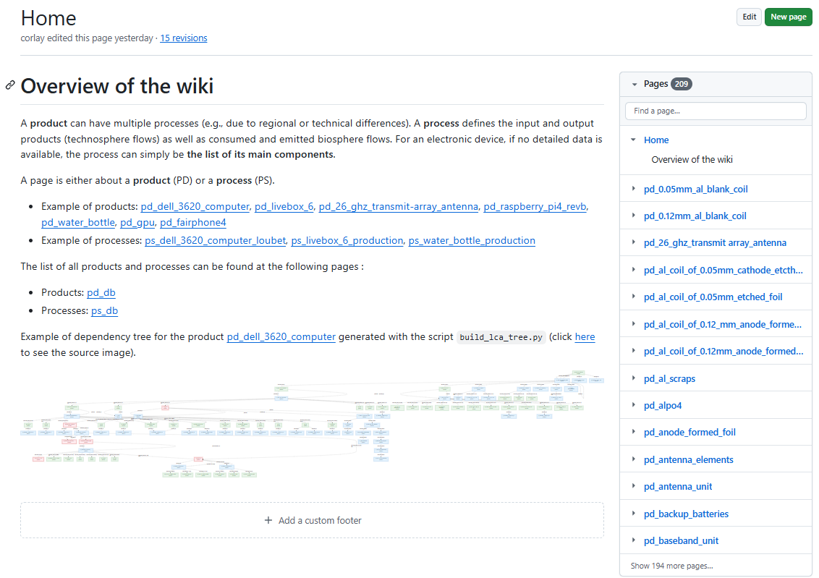
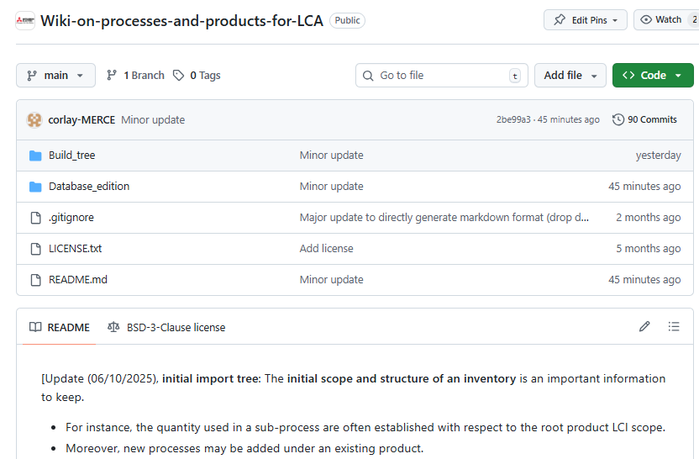
Overview of the project (2)
Wiki home page
GitHub home page

Slide 6
Vision (1)
Example where LCI 1 and LCI 2 contain mutually benecicial data
Currently, performing a LCI includes the following challenges:
Scientific contributions are often referenced by the end product, but may also include sub-process data valuable for other studies.
Several processes may exist to produce the same product.
This open wiki is designed to efficiently list and compare multiple approaches for performing the inventory of a product. It references data at the process level.
Easy to compare existing options and select the most suitable approach.
LCI 1
LCI 2
Root product 1
Root product 2
Produced_by
Produced_by
Process Y
Process
Consumes
Consumes
prod
prod
prod
prod
Produced_by
Produced_by
Produced_by
Produced_by
Proce
Proce
Proce
Proce Y
prod
prod
Common process in LCI 1 and LCI 2
LCI: Life Cycle Inventory

Slide 7
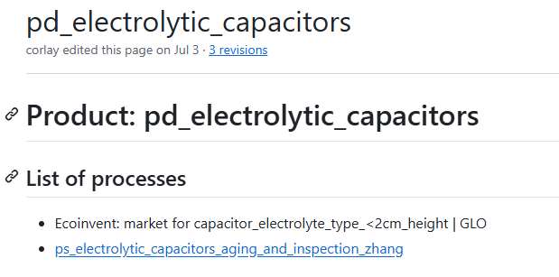
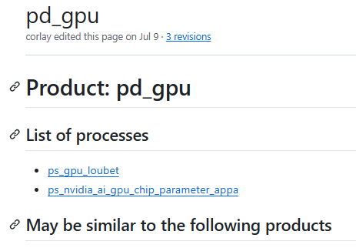
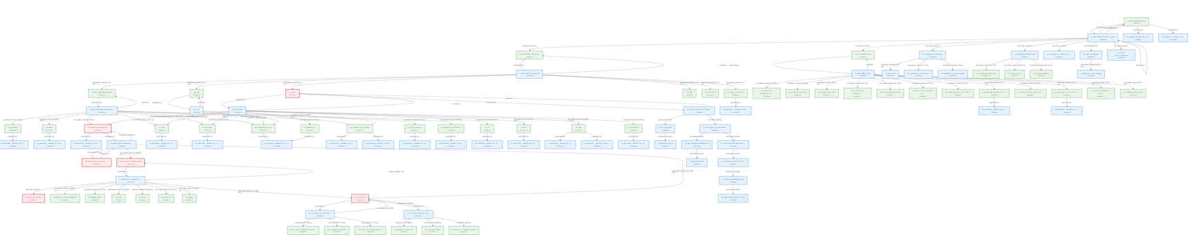
Vision (2) - Illustrative example
Electrolytic capacitors
The ecoinvent reference to produce an electrolytic capacitors was originally added when importing the inventory of the Dell computer.
A second inventory was imported as data from a research paper dedicated to this topic. The import script automatically detected that the process produces a product already present in the wiki.
Visualization script identifies that two alternative processes now exist for this node in the tree starting at the Dell computer node. Red nodes in the graph.
This enables researchers studying the Dell computer to easily update their LCA with the alternative process for the electrolytic capacitors and compare the results.
Link to the tree: raw.githubusercontent.com/wiki/merce-fra/Wiki-on-processes-and-products-for-LCA/out_tree/graph_pd_dell_3620_computer.svg

Slide 8
Data structure (1)- Overview
Bio in: Water
Prod A
Prod B
Prod X
Prod C
Process A
Prod Y
Proce B
Bio out: C02
Process
Process may or may not produce a product.
It is composed of technosphere flows and biosphere flows.
Technosphere flow:
Consumption of products and processes.
Biosphere flow:
Consumption and emission of biosphere elements.
Original root and process node.
Product
One product is always produced by a process.
Several processes can be proposed for the same product (technical or geographic difference).

Slide 9
Data structure (2)-Product and process Mardown pages
Page of process A:
Technosphere flow:
Production
Product X
Product Y
Consumption
Product A
Quantity
Product B
Product C
Process B
Biosphere Flow:
Emission
CO2
Consumption
water
Original root product and process nodes
Product: XXX
Process: XXX
Information:
Publi ref…
Page of product X:
Process A
Process B
Original process for product as root node.
Original LCI scope
Original tree
Process C
Process E = Ecoinvent process (non clickable)
Blue: clickable
Note: does not include parametric approach

Slide 10
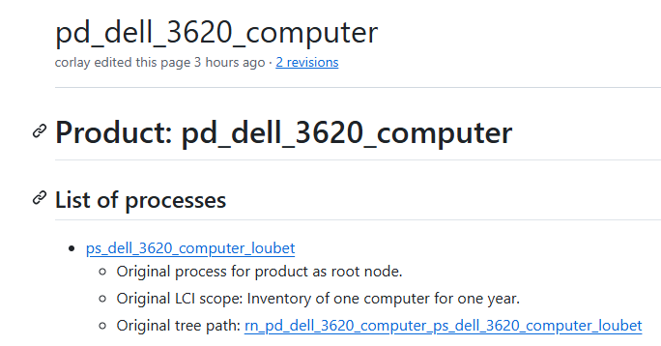
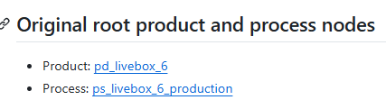
Data structure (3)- Original scope and structure of inventory
The original scope and structure of an inventory is an important information to keep.
For instance, the quantity used in a sub-process are often established with respect to the root product LCI scope.
New processes may be added under an existing product ➔ lose track of original path in tree.
Page structure (see pd_livebox_6 or Dell computer for examples):
When importing an inventory, the LCI scope shoud be specified.
The root process of a root product is clearly indicated.
This LCI scope is added under the original process of the root product of the inventory.
The original tree path is computed and added under the original process of the root product of the inventory (link to rn_ file).
A link to the original root product and process nodes is added in each child process page.
LCI: Life Cycle Inventory

Slide 11
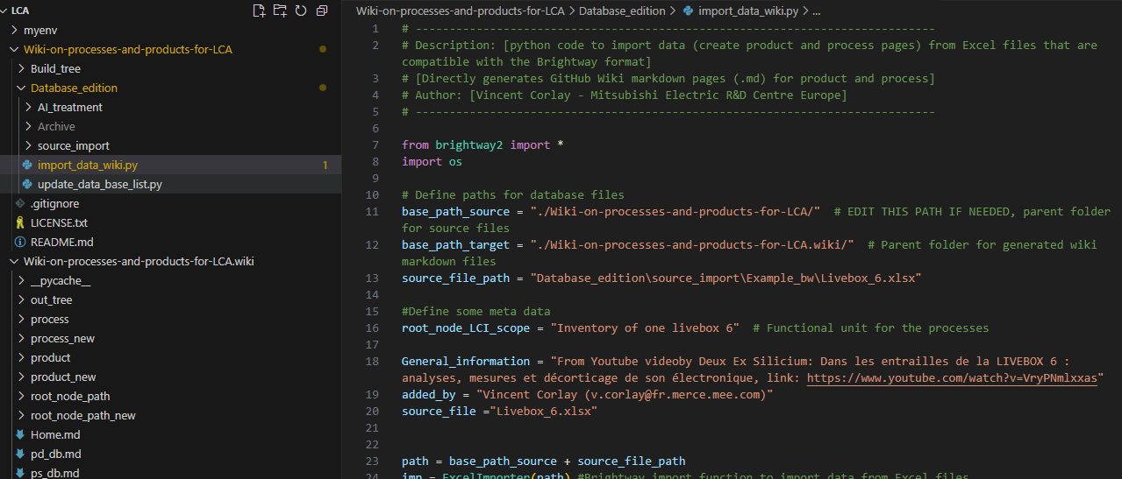
Data import example
GitHub Project with code to import/edit pages
Wiki Project
Mardown pages located in process & product folders.
New pages created in process_new & product_new folders.

Slide 12
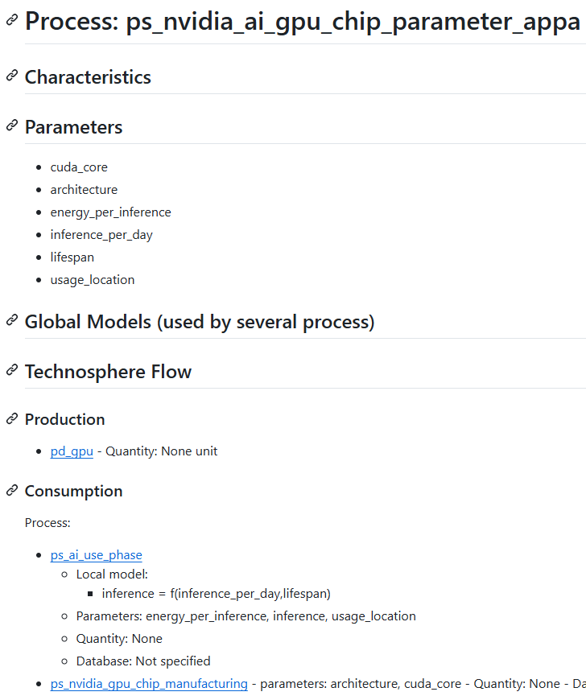
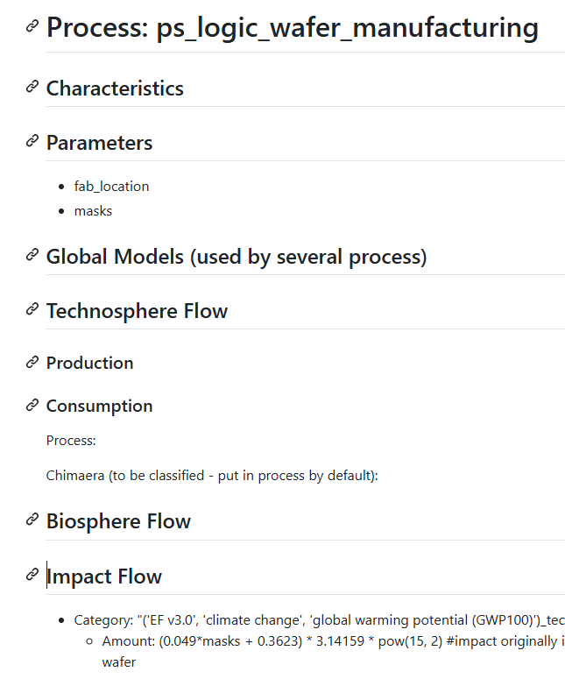
Tentative parametric approach
The example of Appa’s parametric GPU model has been added to the wiki to help identify necessary adaptations.
This process is now listed under the GPU product page of the wiki.
In the Appa GPU process branch, the wiki page structure updated as follow to handle the parametric model.
New “Parameters” section: List of the input parameter names.
New “parameters” field: Added to the metadata following a process name in the “Consumption” section.
Models (based on Appa’s “Parameter Matching”):
If a model is used by a single process, it is added as a local model under that process.
If a model is used by multiple processes, consider creating a Global Model section to avoid duplication.
New “Impact Flow” section: Allows for impact formulas based on parameters (e.g., see logic_wafer).

Slide 14
Possible approach for LCA of base station (process mapping)
Antenna
copper
Base station
Base station assembly process
Processor
iron
Baseband Unit
CPU
Power Supply System
Air conditioning units
Cooling System
Cooling System assembly process
Biosphere flow for assembly
Heat exchangers
Biosphere flow
« Downstream »: Obtained by dismantling the base station
« Middlestream »: IT specialized database ? (Negaoctet? Boavista? Paper from literature?)
« upstream »: General data base (e.g., ecoinvent)

