Slide 1










COFORGE · AMERIPRISE FINANCIAL
the-agentic-
delivery-pipeline
Jira story in. Tested, scanned, review-ready code out.
Deepak Kumar · 22 October 2026
Built on Claude models, via GitHub Copilot and Kiro
Notes:
Thank Sajal for the time. One line: this is what I've built at Ameriprise: nine AI agents and a pipeline that take a Jira story to tested, scanned, review-ready code. I'll run it as questions and answers, so it stays quick.

Slide 2




Deepak Kumar
WHO'S PRESENTING
Coforge since 30 May 2024
At Ameriprise Financial from day one
Frontend team, 40–50 developers
Claude Certified Developer
The team using these agents today
Foundations · Anthropic · passed 9 Oct 2026
Built the-agentic-delivery-pipeline
882
Solo, with some help from DevSecOps
score
pass mark 720
Notes:
Quick context on me: Coforge since May 2024, placed at Ameriprise since day one, on the frontend team of 40 to 50 developers. I designed and built everything in this deck myself. I'm also an Anthropic Claude Certified Developer: 882 against a pass mark of 720.

Slide 3

?
QUESTION 01
What does a 13-point story cost us today?
Notes:
Pause for a second and let the question land.

Slide 4



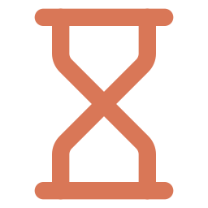

40 man-hours, and most of it isn't writing code
What does a 13-point story cost us today?
40
Hunting for context
Jira, Figma, Confluence and SwaggerHub, one tab at a time
Chasing incomplete stories
Gaps surface mid-build, then wait on the reporter
man-hours
Fixing scan findings
SonarQube, Veracode and Xray, one issue at a time
5 man-days for one
13-point story
Waiting on a Jenkins expert
Read the logs, find someone, wait for their slot
Writing unit tests by hand
Slow, repetitive work to reach coverage
Notes:
A 13-point story takes about 40 man-hours, five man-days. Most of that time goes on everything around the code: finding context, chasing gaps in the story, fixing scan findings, waiting for a Jenkins expert, writing tests by hand.

Slide 5
?
QUESTION 02
What if it took one day?
Notes:
Let it sit. Then click.

Slide 6
Same 13-point story. One man-day.
What if it took one day?
Day 1
Day 2
Day 3
Day 4
Day 5
Before
40 hours
Day 1
story done
free for the
next story
free for the
next story
free for the
next story
free for the
next story
With agents
8 hours
−80%
effort per story. The bigger the story,
the bigger the saving.
Notes:
With the agents, the same 13-point story takes about 8 hours, one man-day. That's 80% less effort, and the bigger the story, the bigger the saving. The four days don't disappear; they go to the next story.

Slide 7
?
QUESTION 03
How?
Notes:
The shortest question in the deck. Hold it.

Slide 8
Nine atomic agents. Each does one job, end to end.
How?
jira-agent
figma-agent
swagger-hub-agent
Jira
Figma MCP
SwaggerHub
Reads the story, done and backlog stories, and the code
Builds from the node ID with real library components
Writes API calls straight from the spec
confluence-assistant
sonar-reporter
the-ci-analyzer
Confluence
SonarQube
Jenkins
Pulls linked docs as precise context; publishes docs
Fetches issues, fixes them, rebuilds, repeats
Reads the console, fixes, commits, reruns
veracode-analyser
xray-analyzer
code-coverage-agent
Veracode · SAST
JFrog Xray · SCA
Unit tests
Uploads, waits for the scan, fixes the flaws
Fixes dependency flaws through our own MCP
Writes tests and loops until 95% coverage
Built solo · Claude models via GitHub Copilot and Kiro
Notes:
We didn't start with one giant AI. We built small atomic agents first, each owning one job end to end and connected to one tool. Then we composed them. Walk the rows: understand the story, build it, keep it clean and secure.

Slide 9
?
QUESTION 04
What happens when the agents work together?
Notes:
This is the architecture slide.

Slide 10

A master agent conducts. Specialists do the work.
What happens when the agents work together?
MCP
one live tool connection each
Jira
Figma
Confluence
SwaggerHub
Subagents
each in its own context
prompt-submit hook
Developer submits a prompt
Master agent
Comment on Jira, assign back to the reporter
Input
complete?
Input JSON
Build loop
tests → code → Playwright
max 5 tries
Exit
No
Yes
Notes:
When a developer submits a prompt, a hook fires and the master agent takes over. It sends specialist subagents to Jira, Figma, Confluence and SwaggerHub, each through its own MCP connection. If anything is missing, it comments on the Jira story, assigns it back to the reporter and stops. If the input is complete, it hands one Input JSON to the build loop: tests, code, Playwright, up to five tries.

Slide 11
?
QUESTION 05
What if the story itself is incomplete?
Notes:
Most pipelines guess here. Ours doesn't.

Slide 12




It stops early and sends the story back
What if the story itself is incomplete?
WEB-1234 · Account summary card
No tokens burned on guesswork
The run exits before any build work starts
jira-agent commented just now
Before I build this, two things are missing:
Acceptance criteria for the error state
The Figma link for the mobile layout
Assigning back to the reporter.
No hours spent on the wrong build
The reporter fixes the story first
Checks more than one story
Assignee → Reporter
Done and backlog stories, plus the code itself
Illustrative example
Notes:
Before any build work, jira-agent checks the story against completed and backlog stories and the code itself. If something is missing, it comments on the story and assigns it back to the reporter, then exits. No tokens spent guessing, and no developer hours spent building the wrong thing. The comment shown is an illustrative example.

Slide 13
?
QUESTION 06
Who fixes the build when it breaks?
Notes:
Everyone in delivery has lived this one.

Slide 14






the-ci-analyzer fixes it and re-runs the build
Who fixes the build when it breaks?
BEFORE
NOW
Read console output
Log in to Jenkins
Read the console logs
Find a Jenkins expert
Re-run the build
Fix the failure
Wait for their availability
Apply the suggested fix
loops until green
Commit and push
~90% less effort
Notes:
Before: log in to Jenkins, read the logs, find a Jenkins expert, wait for them, apply the fix. Now the-ci-analyzer reads the console output, fixes the failure, commits, pushes and re-runs the build, and keeps looping until it's green. That's about 90% of the effort gone.

Slide 15
?
QUESTION 07
And code quality and security?
Notes:
The scans every release has to clear.

Slide 16
Scan, fix, rebuild, rescan, until it's clean
And code quality and security?
SonarQube
Veracode
JFrog Xray
Code quality
SAST
SCA
sonar-reporter
veracode-analyser
xray-analyzer
Fetch issues → fix
→ build → recheck
Zip → upload → scan
→ fix → rescan
Read flaws via in-house MCP
→ fix → rescan
~90% less effort. The 10% left is PR review.
Notes:
Same pattern three times. sonar-reporter pulls SonarQube issues and fixes them. veracode-analyser zips the artifacts, uploads them to Veracode, waits for the scan and fixes what it finds. xray-analyzer resolves the SCA flaws through an in-house MCP built on the JFrog APIs. Each loops until clean. About 90% of the effort is gone; what's left is PR review.

Slide 17
?
QUESTION 08
Two man-months of unit tests?
Notes:
Two man-months. Hold that number.

Slide 18
95% coverage in under two weeks, at a tenth of the cost
Two man-months of unit tests?
TIME
COST
Human only
$11,200
8 weeks · 2 man-months
people: $35/hr × 8 hrs × 5 days × 8 weeks
code-coverage-agent
~$1,120
< 2 weeks
AI credits on GitHub Copilot, or less
Writes tests, measures coverage,
repeats until it reaches 95%
10× cheaper
Notes:
Unit tests used to need two man-months of human effort. code-coverage-agent writes tests, measures coverage and loops until it reaches 95%, in under two weeks. At our $35 an hour billing rate, two man-months is $11,200. The agent used about $1,120 of AI credits on GitHub Copilot, or less.

Slide 19
?
QUESTION 09
So what does the developer do now?
Notes:
This is the question every engineer asks.

Slide 20
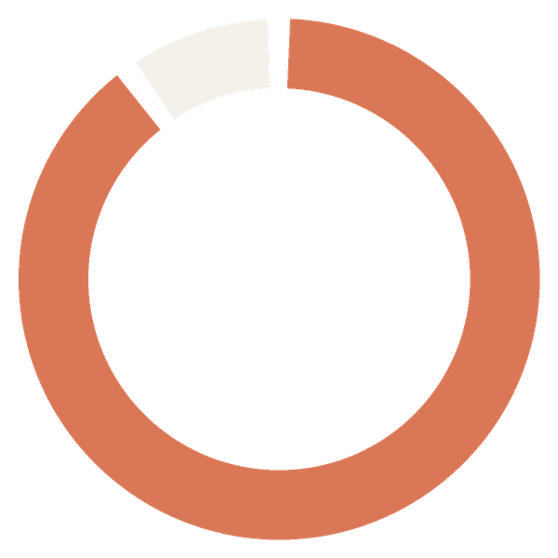
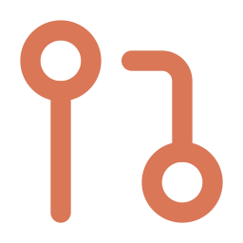


Developers move from writing code to reviewing it
So what does the developer do now?
BEFORE
NOW
Writes the code
Reviews the PR
Writes the tests
Makes the calls
~10%
Fixes scan findings
Owns quality
left for the developer:
PR review
Debugs broken builds
■ agents 90% ■ developer 10%
Notes:
Across these loops, the agents do about 90% of the work. The developer's roughly 10% is the pull-request review: making the judgement calls and owning the quality bar. The developer still decides; they just stop doing the repetitive parts.

Slide 21
?
QUESTION 10
Doesn't AI get expensive?
Notes:
Every leader asks this. Good.

Slide 22

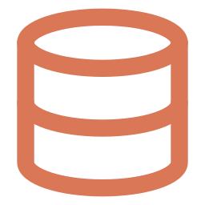



Tokens are spent only where they earn their keep
Doesn't AI get expensive?
Fail fast
BUDGET TODAY
Incomplete stories exit before any build work
Monthly per-seat quota
Prompt caching
Stable context is reused, not paid for again
GitHub Copilot AI credits, Kiro
Right-sized models
$35 per dev seat / month
Cheaper models for subagents, set in each agent's definition
Figma MCP, dev seats only
Trimmed tool output
Logs and scan results filtered before the model sees them
Per-task token caps
Not available in Kiro yet
Never switch models mid-session
It throws away the cache and costs more
Notes:
Five habits keep cost down. Fail fast on incomplete stories. Cache stable context so it isn't paid for twice. Give subagents cheaper models, set in each agent's definition. Trim tool output before the model sees it. And never switch models mid-session, because that throws away the cache and ends up costing more. Budget today is a monthly per-seat quota; per-task token caps aren't available in Kiro yet.

Slide 23
?
QUESTION 11
Won't the AI drown in context?
Notes:
The quiet failure mode of most AI tools.

Slide 24
Every agent works in a small, clean context
Won't the AI drown in context?
ONE AGENT DOING EVERYTHING
MASTER + SPECIALISTS
Xray report
Overflow
Master agent
holds only the Input JSON
Veracode results
Everything piles into one window. Quality drops, cost climbs.
Sonar report
Jenkins logs
jira
figma
swagger-hub
confluence
Swagger spec
own context
own context
own context
own context
Figma payload
Subagents return results, not their whole context
The Input JSON is the contract between steps
Tool output is trimmed before it reaches the model
Confluence docs
Jira story
Notes:
If one agent did everything, every Jira story, Confluence page, Figma payload, Swagger spec, Jenkins log and scan report would pile into one context window. Quality drops and cost climbs. Instead the master agent holds only the Input JSON, and each specialist works in its own context and returns just its result.

Slide 25
?
QUESTION 12
Is anyone actually using it?
Notes:
Fair question for any pitch.

Slide 26


Live with Ameriprise's frontend team, and scaling
Is anyone actually using it?
40–50
9
developers using it
atomic agents, live
1
Live
40–50 developers on the frontend team
Not yet all of Ameriprise. Scaling now.
builder, designed and built solo
Jira → UI pipeline, end to end
Notes:
This isn't a demo. Ameriprise's frontend team of 40 to 50 developers uses it. All nine agents are live, and the Jira-to-UI pipeline is running end to end. It isn't across all of Ameriprise yet; we're scaling.

Slide 27
?
QUESTION 13
What's still slow?
Notes:
Honest answer coming.

Slide 28


Next: other teams plug in through their own MCP servers
What's still slow?
TODAY
NEXT
RE: RE: FW: timeout calling the accounts service
Data & services
DNS team
RE: FW: who owns this DNS record?
FW: still waiting on data & services
Long mail chains
while the SLA clock runs
Downstream APIs
Any team
Each team publishes an MCP server; our agents work with it directly, with no mail chain.
Notes:
What's still slow is anything that crosses team lines. Downstream services sit behind other teams, and resolving issues means long mail chains. The next step is for each team, such as data and services or the DNS team, to publish its own MCP server, so our agents can work with them directly. That needs Ameriprise leaders to plan the bandwidth.

Slide 29
?
QUESTION 14
What could Coforge do with this?
Notes:
The question that matters most for Coforge.

Slide 30

Turn it into a Coforge accelerator for every account
What could Coforge do with this?
1
2
3
Proven
Packaged
Offered
Live at Ameriprise with a 40–50 developer frontend team
Rebuilt as a Coforge-owned accelerator that fits any client
Sold to other accounts as a Coforge product
I'd like to help build it.
Why now
Hiring is nearly frozen. Clients expect more from the same teams.
Notes:
It's proven at Ameriprise. The opportunity is for Coforge to package the approach as its own accelerator, Coforge-owned and client-agnostic, and offer it to other accounts as a product. With hiring nearly frozen, clients expect more from the same teams, and this is how we deliver it. I'd like to help build it.

Slide 31
Thank you
Questions?
Deepak Kumar · Coforge @ Ameriprise Financial
the-agentic-delivery-pipeline
Notes:
Prepared answers for Q&A:
Does this cut our billing? Hiring is nearly frozen, so the same team has to deliver more scope. Packaged as a Coforge accelerator, it becomes something we sell, not just hours saved.
Governance and rollout? Rollout governance sits with Ameriprise DevSecOps and MLOps. Every change still goes through human PR review.
Can we reuse what you built? The agents were built for Ameriprise. What carries over is the approach and the know-how; a Coforge version would be built fresh and client-agnostic.
What does it run on? Claude models, through GitHub Copilot and Kiro. Figma MCP costs $35 per dev seat per month.

