Slide 1
MercedTime
The all-in-one stop for UCM course info

Slide 2
About
If anyone is unfamiliar with berkeleytime.com, it is an online course discovery platform that wraps all the relevant course information into a small, easy to use package. Students at UC Berkeley are spoiled by this incredibly useful web application so we want to build our own for the students here at UC Merced.

Slide 3
Use Cases
Better Design (the default course schedule is not designed well)
Ease of use - having different filter options one click away increases course discoverability
More pluggable - connect the data with other services such as Rate My Professor
Automated course tracking - users will be able to track openings in and receive notifications for their courses

Slide 4
Tasks
Database
Backend & API
Frontend
Web Design

Slide 5
Database Design

Slide 6
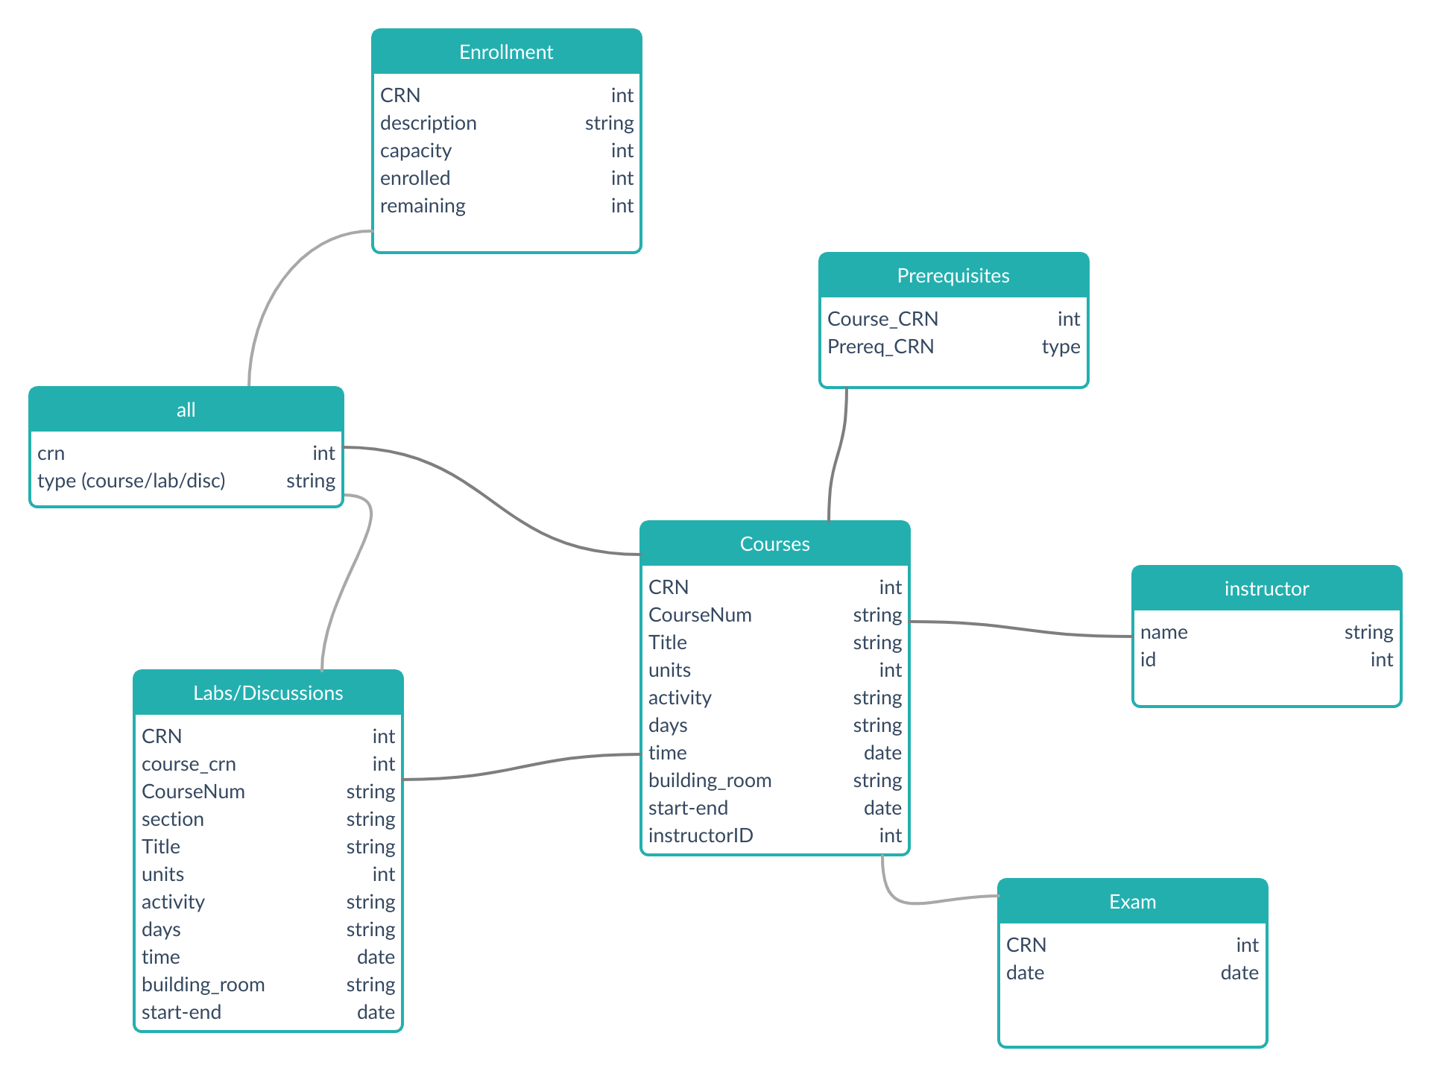
UML & Relational Model

Slide 7
Pain Points
Our database design relies on CRNs as the primary key which is not going to be in our control
Splitting the Labs/Discussions from Lectures may have a performance cost
Implementing notifications and Canvas integration may present unforeseen complications

Slide 8
Future Plans
Notifications
Integration with Canvas and RateMyProfessor
Get average course grades and reviews
Mobile App??

Slide 9

Project
Authors
github.com/mercedtime
Noah McCullah
Harrison Brown

