Slide 1
Control Loops
Nick Schatz
FRC 3184

Slide 2
Agenda
The what/why of control loops
Simple control loops (Classical control theory)
Applications of control loops
Implementation

Slide 3
Me
FRC 3184 Lead Programmer
Not a control systems engineer

Slide 4
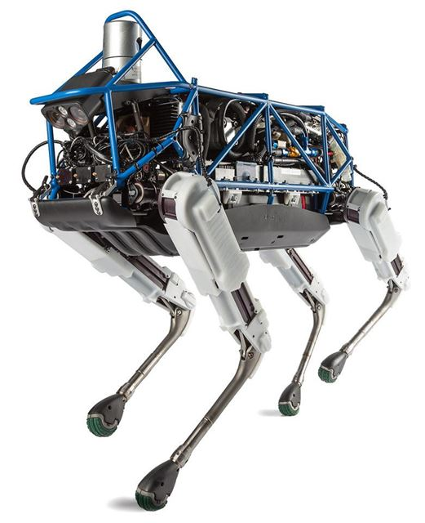
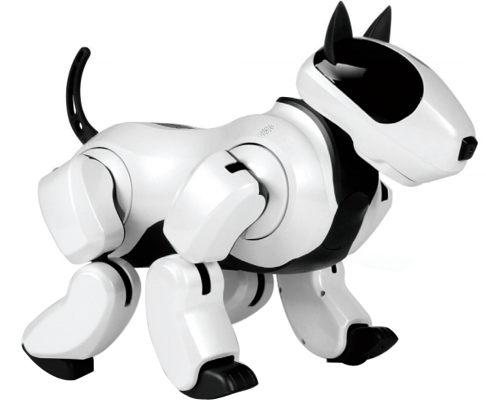
Why?
Notes:
971 2015 https://youtu.be/35e2R_bPdwA?t=21m32s
Boston Dynamics https://www.youtube.com/watch?v=fRj34o4hN4I

Slide 5
Prologue: Sensors
Encoders (single-axis position and speed)
Gyroscope (Rotation about 1 [important] axis)
LIDAR/Ultrasonic (Distance)
Current (Power)
Accelerometer (useless)

Slide 6
What is a control loop?
Move to a certain position (“servo”)
Maintain a certain speed
Higher level problems
Motion profiling
Turn to angle
Path following
Requires closed-loop control (sensor feedback)

Slide 7
What We Want
Approaches setpoint quickly
Goes to within acceptable error of setpoint
Rejects disturbances and minor changes to system
Doesn’t overshoot the setpoint too much

Slide 8
Feed-Forward Control (Open-Loop Control)
Accounts for known system behavior*
Not robust
Doesn’t reject disturbances or deal with unexpected behavior

Slide 9
Feedback
Accounts for things that we don’t consider in theory
Rejects disturbances
Requires a continuous sensor (encoders, gyros)

Slide 10
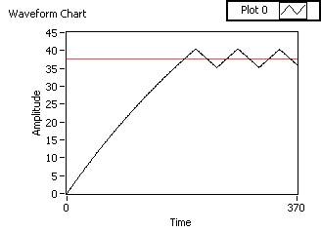
Simple Control Loop (“Bang-Bang”)
Error = Setpoint - Measured
If Error > 0, set power forward
If Error < 0, set power backward (or turn off)
If Error = 0, stop
Problem: Oscillation

Slide 11
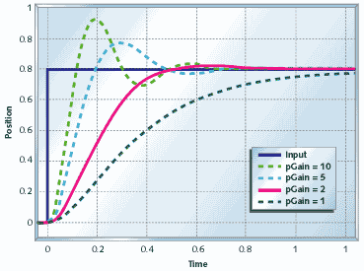
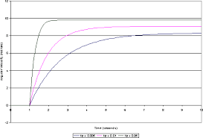
Proportional Control
Set motor power to some constant (Kp) * Error
Problems: Over/undershoot,
Steady-state error

Slide 12
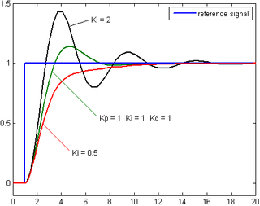
Proportional/Integral (PI) Control
Set motor power to some constant (Kp) * Error
Add some constant (Ki) * Σ Error
Problems: Overshoot

Slide 13
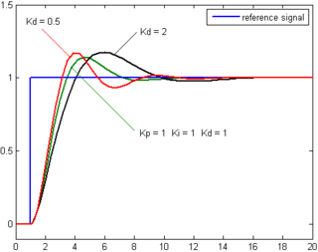
Proportional/Integral/Derivative (PID) Control
Set motor power to some constant (Kp) * Error
Add some constant (Ki) * ΣError
Add some constant (Kd) * ΔError
Problems: None!*

Slide 14
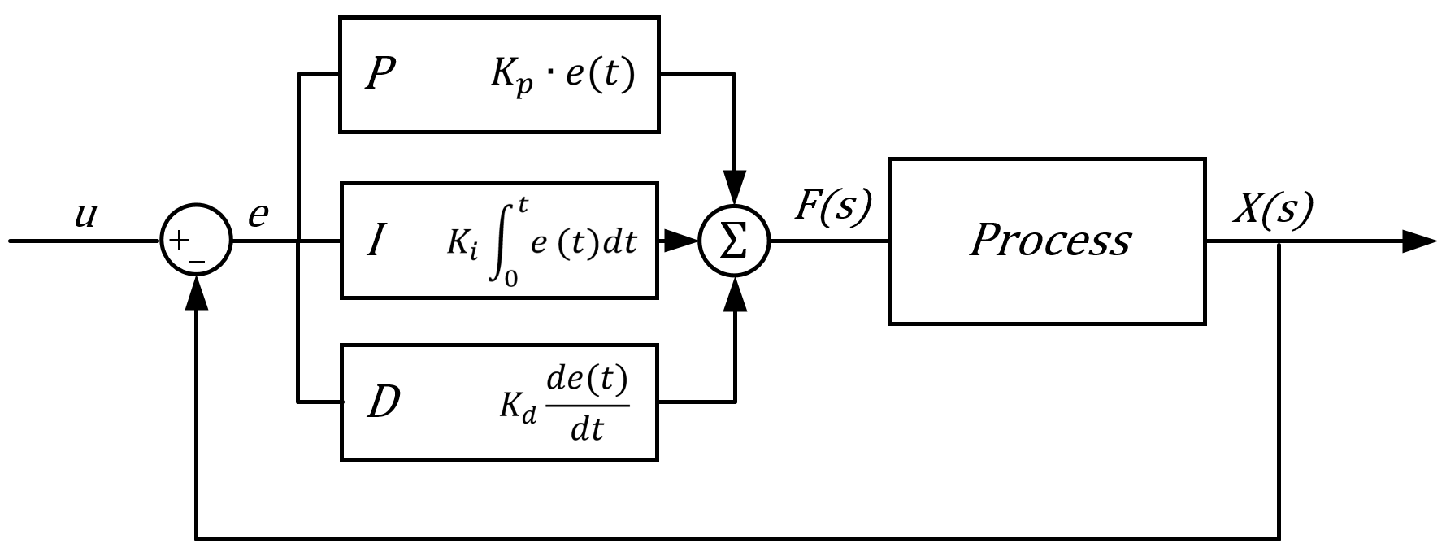
PID(F) Footnotes
You don’t always need to use all 4 terms
Tuning isn’t trivial

Slide 15
Tuning
In theory:
Tune F until system is close to desired state
Increase Kp until system oscillates around setpoint, then reduce to acceptable level
Increase Ki until an acceptable amount of steady-state error is reached
Increase Kd until the system rejects disturbances and doesn’t overshoot
In FRC:
You probably don’t need much more than Kp

Slide 16
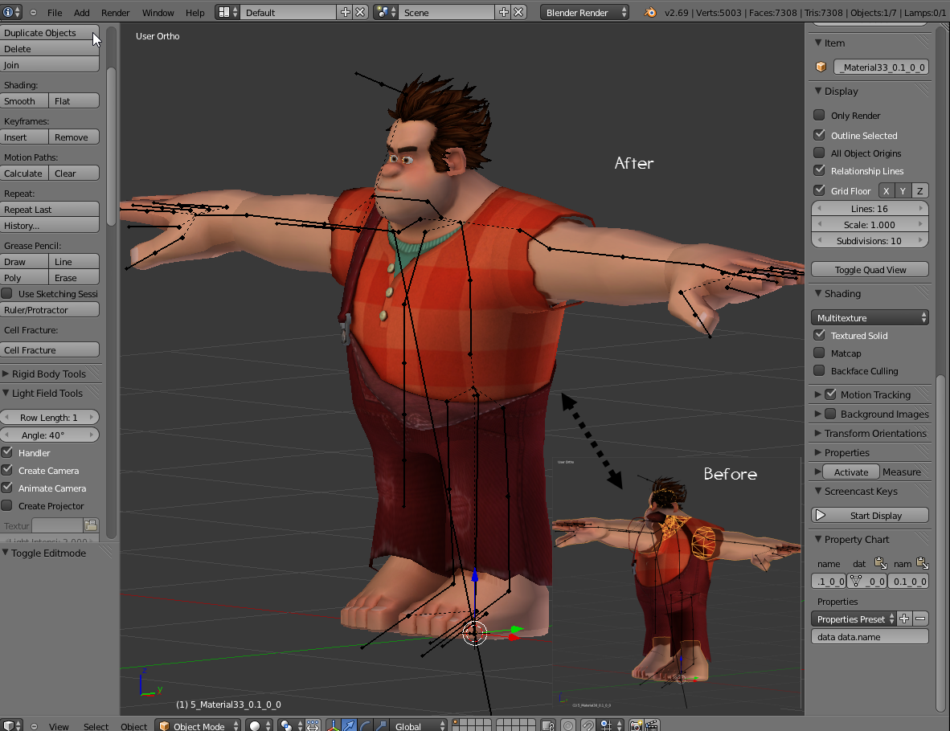
Modeling your System
To improve your control loop, model how the system works in theory
Feed-forward accounts for this model
Feedback (PID) accounts for things that you can’t predict
Model (esp. for position) holds your system at a steady-state

Slide 17
Feedforward in Velocity and Position loops
In a velocity loop, FF should do 95% of the legwork
In theory, P won’t eliminate all your steady-state error
Solutions: Make P into I (WPILib’s solution), OR just realize that it’s close enough
In a position loop, FF just keeps the system at a (mostly) steady state
Feedback must do most of the legwork to drive to setpoint
P can drive to setpoint fairly quickly

Slide 18
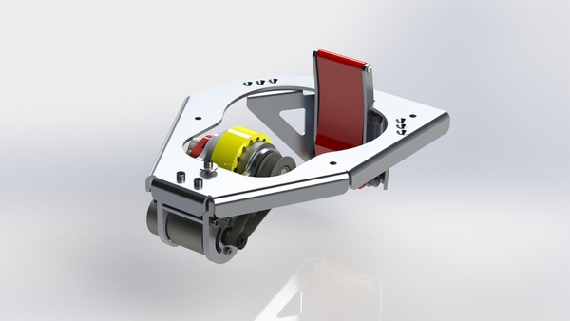
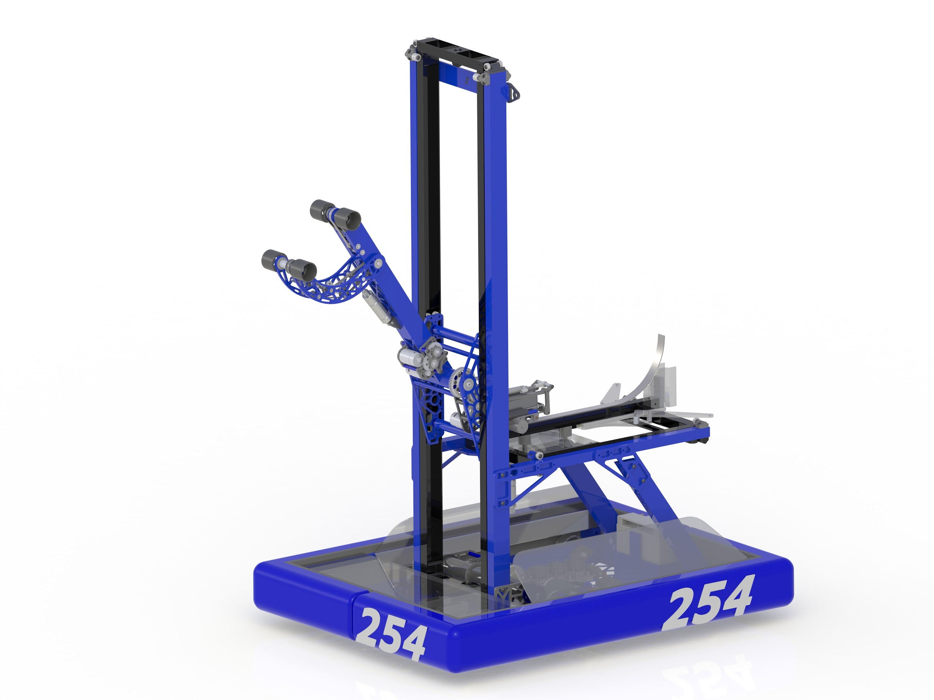
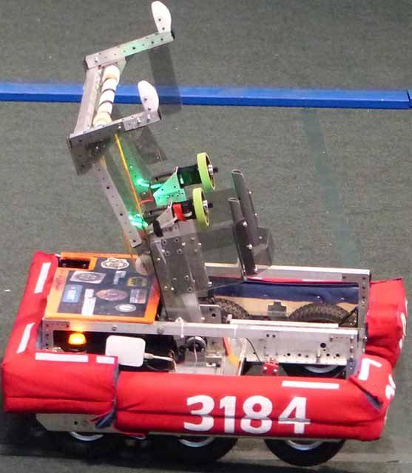
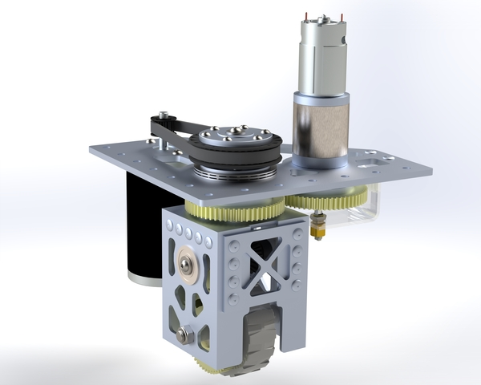

Applications

Slide 19
Why not PID?
Things that don’t require precise control
Complex motion (more than one dimension)
PID is SISO (Single Input Single Output)

Slide 20
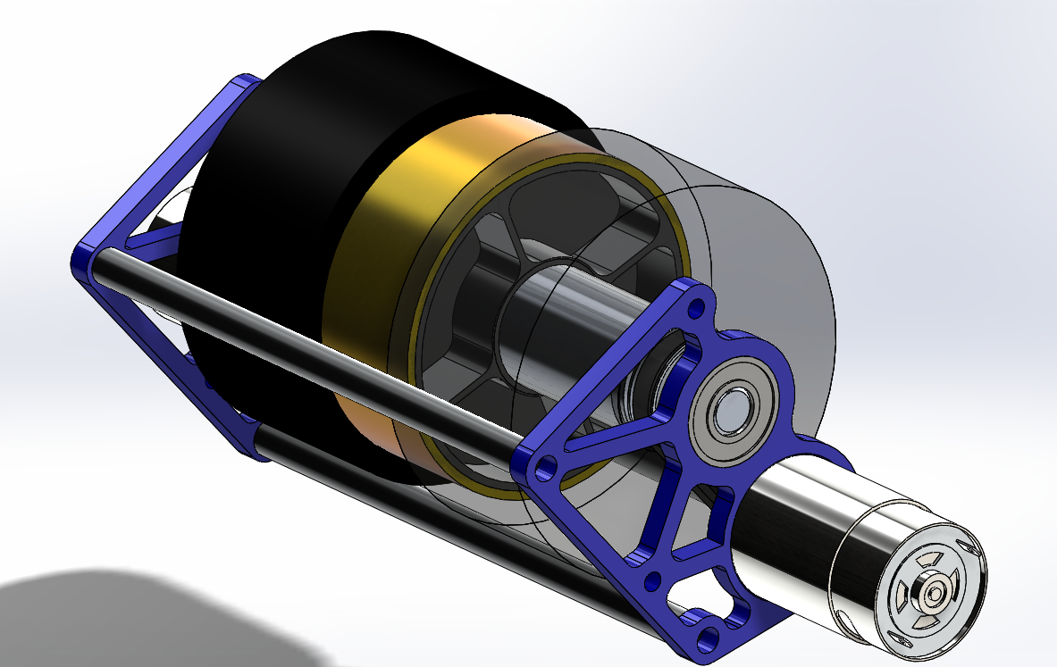
Flywheel
Set Feed-forward to be close to desired speed
Let 100% be the maximum speed
Choose FF so that velocity is close to desired RPM
Ex: 12V is 6000 RPM, set FF to 83% for desired speed of 5000 RPM
Tune Kp until the system returns to desired speed quickly

Slide 21
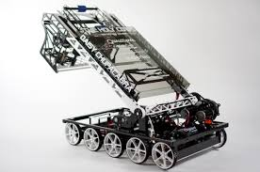
Big Arm
Use encoder on axis of rotation
Feed-forward accounts for gravity
Some constant times cosine of the arm angle
Tune Kp until system responds quickly

Slide 22
Turn to Angle (or keep driving straight)
Use gyroscope as input
Put output as your turn
arcadeDrive(0, turn) or tankDrive(turn, -turn)
Feedforward is minimum power required to start robot moving
Usually only requires kP

Slide 23
Closed-Loop Driving
Speed control on drivetrain
Tune each side of drive individually (should be similar)
Feed-forward is desired speed + friction intercept
Paper from 449

Slide 24
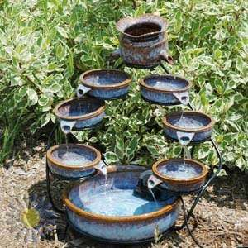
Cascading PID Loops
Approximates MIMO control
Example: Use output of turn-to-angle loop as input for drive loop
Provides much better control (functions more linearly at low speeds)
Allows for doing fancy stuff like...

Slide 25
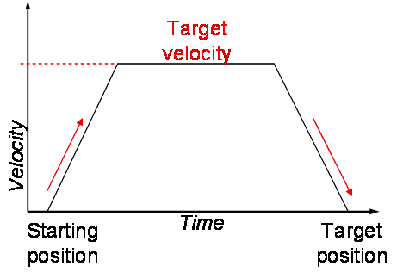
Motion Profiling
Generate many points (time, position, velocity) that follow a “motion profile”
Use velocity control loop to move between these points
Enables precise movement
Reliable, repeatable autonomous
Desmos demonstration

Slide 26
Implementation
Should be run at high speed, ≥50 Hz
Consistent timing (multithreading)
Not really Integral and Derivative, but Sum and Slope
WPILib’s PIDController
TalonSRX built-in PID control - unit issues
Write your own!

Slide 27
Learning More
FRC PDR - PID Control
PID for Dummies
Talon SRX Software Reference Guide
WPILib documentation
Chief Delphi
FRC Discord
“PID control system analysis and design” paper

Slide 28
Questions?
Suggestions:
Nick I don’t understand this
This is great, but driving at 50% power for 4 seconds is just as good
Является ли майонез инструментом?
How do I model systems?
How is this actually useful?
Is this what those cool robots from Boston Dynamics use?

Slide 29
Modern Control Theory
Controls multiple inputs/outputs and orders (position and velocity)
Control Bootcamp
FRC 971’s control writeups
Linear algebra!

