Slide 1
Body 2
Body 1
cur_offset
min size
overlap = min size - cur_offset
[overlap] = [cur_offset] * (min_size / cur_offset) * (overlap / min_size)
[overlap] = [cur_offset] * (overlap / cur_offset)
[overlap] = [cur_offset] * (min size / cur_offset – 1.0)

Slide 2


Slide 3
AVIDA

Slide 4
AVIDA
5.0

Slide 5
AVIDA

Slide 6
AVIDA
5.0

Slide 7
A
VIDA
5.0

Slide 8
A
VIDA
5.0

Slide 9
A
VIDA

Slide 10
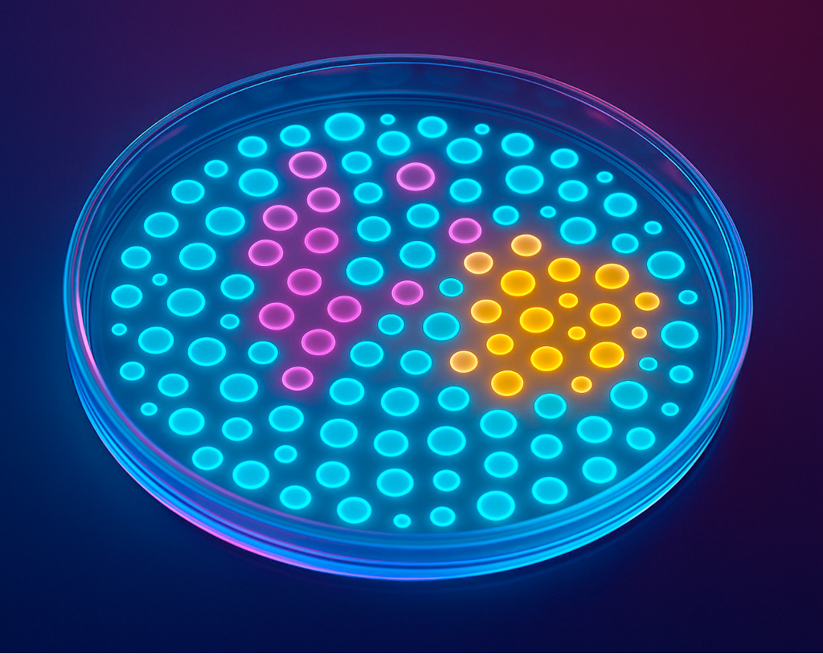
A
V
IDA
5.0

