Slide 1
Communication Perturbation-Resilient Vehicle Coordination at Smart Intersections
Li Jin

Slide 2
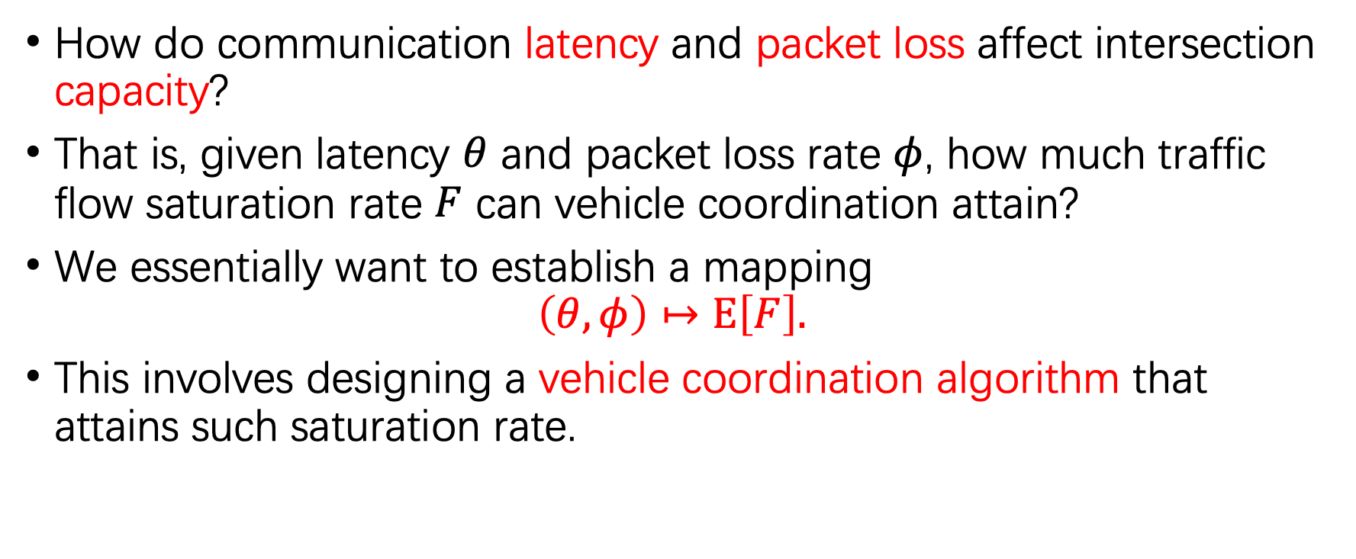
Main questions
How do communication latency and packet loss affect intersection capacity?
That is, given latency $θ$ and packet loss rate $φ$, how much traffic flow saturation rate $F$ can vehicle coordination attain?
We essentially want to establish a mapping
$$\left(θ,φ\right)↦E\left[F\right].$$
This involves designing a vehicle coordination algorithm that attains such saturation rate.

Slide 3
Sub-questions
How to relate communication latency to saturation rate?
Key 1: establish a latency-resilient vehicle coordination algorithm
Key 2: relate invariant set under the algorithm to saturation rate
Partially addressed in ACC21 paper; to be addressed more systematically
Expected result: algorithm -> invariant set -> safe headway
How to relate packet loss rate to expected saturation rate?
Key 1: establish a reconfigurable controller responsive to lost data
Key 2: relate packet loss rate under the controller traffic queue stability
Expected result: controller -> stability criterion -> saturation rate

Slide 4
Two-layer decision making
Planning layer: generates reference trajectories
Task 1: determines sequence, time windows, and nominal trajectories
Task 2: respond to packet losses
Tracking layer: tracks reference trajectories
Task 1: compensates observation & actuation errors
Task 2: ensures resiliency against latency

Slide 5
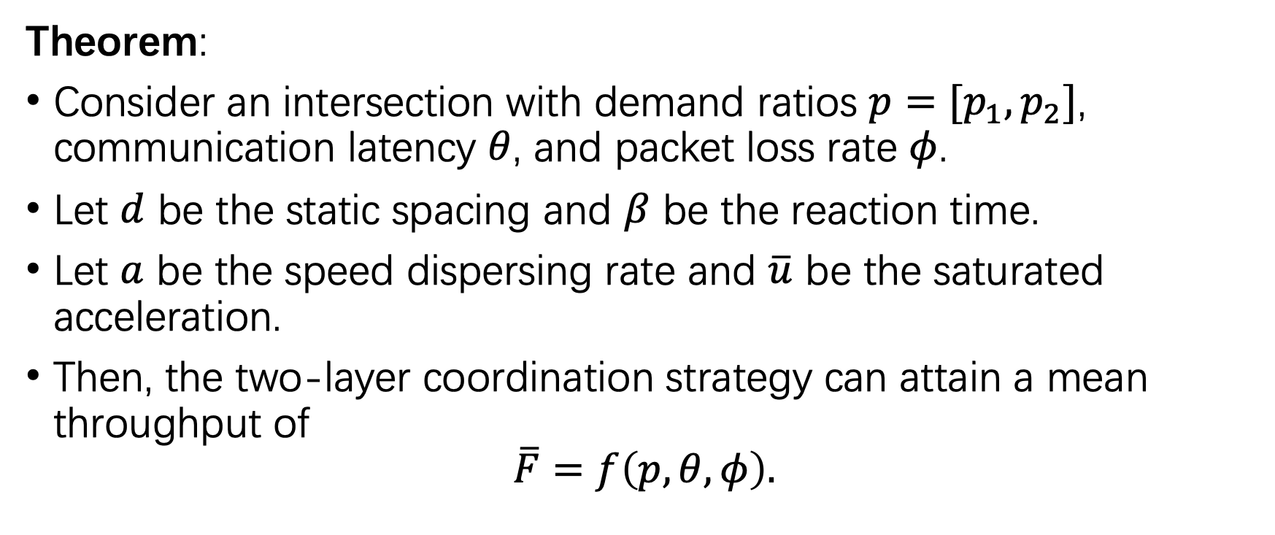
Main result
Theorem:
Consider an intersection with demand ratios $p=[p_{1},p_{2}]$, communication latency $θ$, and packet loss rate $φ$.
Let $d$ be the static spacing and $β$ be the reaction time.
Let $a$ be the speed dispersing rate and $\overline{u}$ be the saturated acceleration.
Then, the two-layer coordination strategy can attain a mean throughput of
$$\overline{F}=f\left(p,θ,φ\right).$$

Slide 6
Latency-resilient tracking
In this part, we assume the number of vehicles in the control zone is fixed.

Slide 7
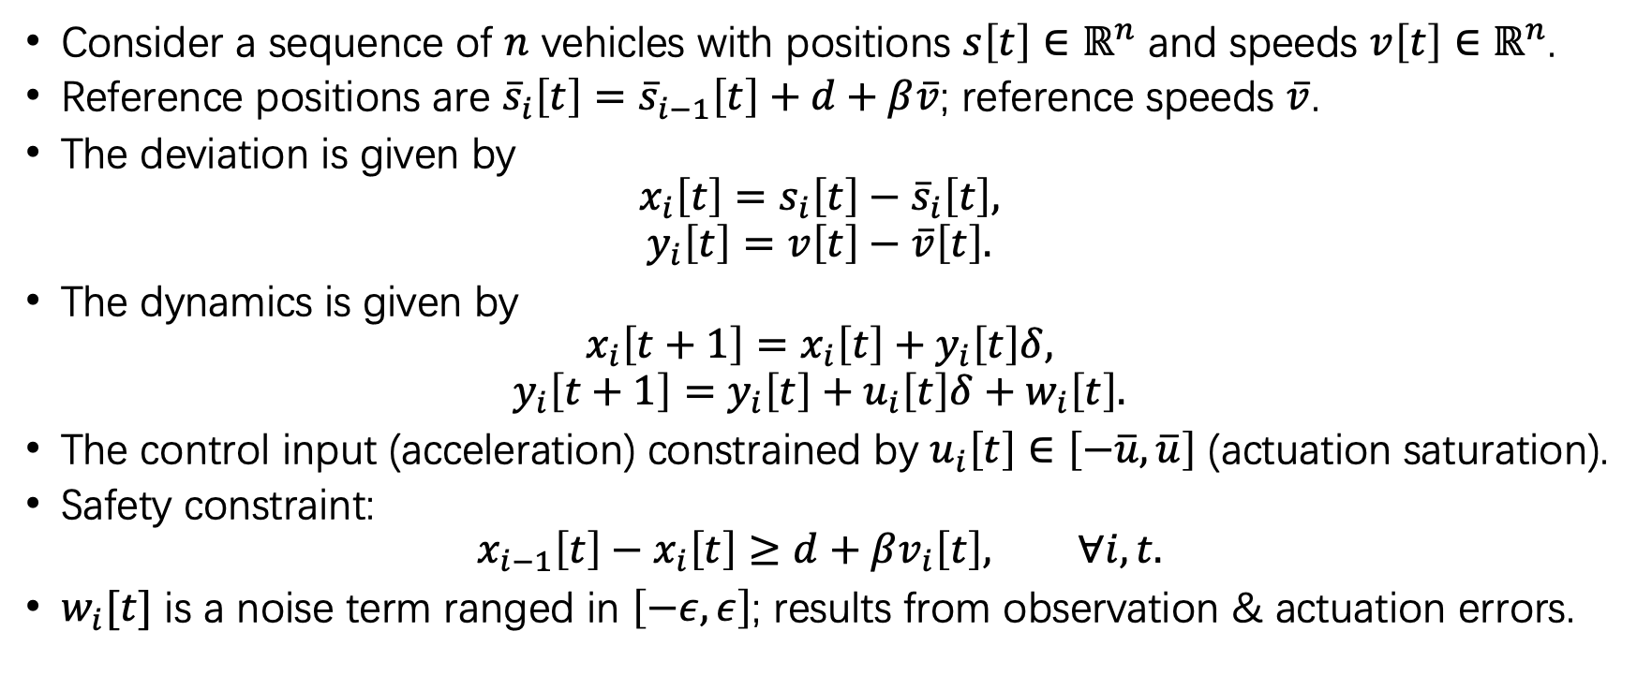
Task 1: nominal tracking
Consider a sequence of $n$ vehicles with positions $s\left[t\right]∈ℝ^{n}$ and speeds $v\left[t\right]∈ℝ^{n}$.
Reference positions are ${\overline{s}}_{i}\left[t\right]={\overline{s}}_{i−1}\left[t\right]+d+β\overline{v}$; reference speeds $\overline{v}$.
The deviation is given by
$$x_{i}\left[t\right]=s_{i}\left[t\right]−{\overline{s}}_{i}\left[t\right],$$
$$y_{i}\left[t\right]=v\left[t\right]−\overline{v}\left[t\right].$$
The dynamics is given by
$$x_{i}\left[t+1\right]=x_{i}\left[t\right]+y_{i}\left[t\right]δ,$$
$$y_{i}\left[t+1\right]=y_{i}\left[t\right]+u_{i}\left[t\right]δ+w_{i}\left[t\right].$$
The control input (acceleration) constrained by $u_{i}\left[t\right]∈\left[−\overline{u},\overline{u}\right]$ (actuation saturation).
Safety constraint:
$$x_{i−1}\left[t\right]−x_{i}\left[t\right]≥d+βv_{i}\left[t\right], ∀i,t.$$
$w_{i}[t]$ is a noise term ranged in $\left[−ε,ε\right]$; results from observation & actuation errors.

Slide 8







Nominal tracking
Control objective: ensures an invariant set (i) satisfying the safety constraint and (ii) attaining the minimal headway
Two decisions: (i) nominal trajectory, (ii) tracking algorithm
$${\overline{s}}_{1}[t]$$
$${\overline{s}}_{2}[t]$$
$${\overline{s}}_{3}[t]$$
position
$$s_{i}[t]$$
$$h^{∗}$$
$$Δ^{∗}$$
entrance
time $t$

Slide 9
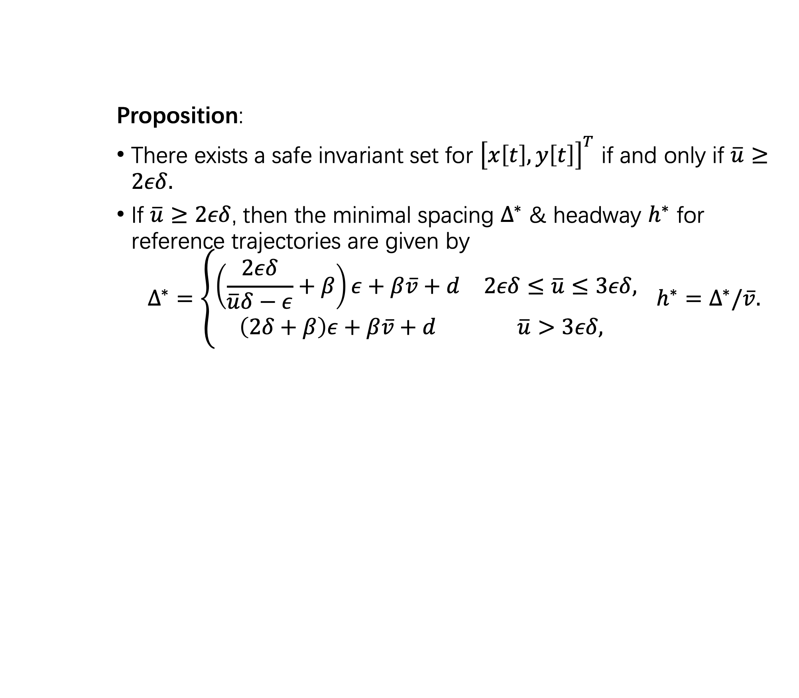
Nominal tracking: uniform ref. speed
Proposition:
There exists a safe invariant set for ${\left[x\left[t\right],y\left[t\right]\right]}^{T}$ if and only if $\overline{u}≥2εδ.$
If $\overline{u}≥2εδ$, then the minimal spacing $Δ^{∗}$ & headway $h^{∗}$ for reference trajectories are given by
$$Δ^{∗}=\left\{\begin{matrix}\left(\frac{2εδ}{\overline{u}δ−ε}+β\right)ε+β\overline{v}+d & 2εδ≤\overline{u}≤3εδ, \\ \left(2δ+β\right)ε+β\overline{v}+d & \overline{u}>3εδ,\end{matrix}\right. h^{∗}=Δ^{∗}/\overline{v}.$$

Slide 10
Nominal tracking: time-varying ref. speed
Proposition:
There exists a safe invariant set for ${\left[x\left[t\right],y\left[t\right]\right]}^{T}$ if and only if $\overline{u}≥2εδ.$
If $\overline{u}≥2εδ$, then the minimal spacing $Δ^{∗}$ & headway $h^{∗}$ for reference trajectories are given by
$$Δ^{∗}=\left\{\begin{matrix}\left(\frac{2εδ}{\overline{u}δ−ε}+β\right)ε+β\overline{v}+d & 2εδ≤\overline{u}≤3εδ, \\ \left(2δ+β\right)ε+β\overline{v}+d & \overline{u}>3εδ,\end{matrix}\right. h^{∗}=Δ^{∗}/\overline{v}.$$

Slide 11
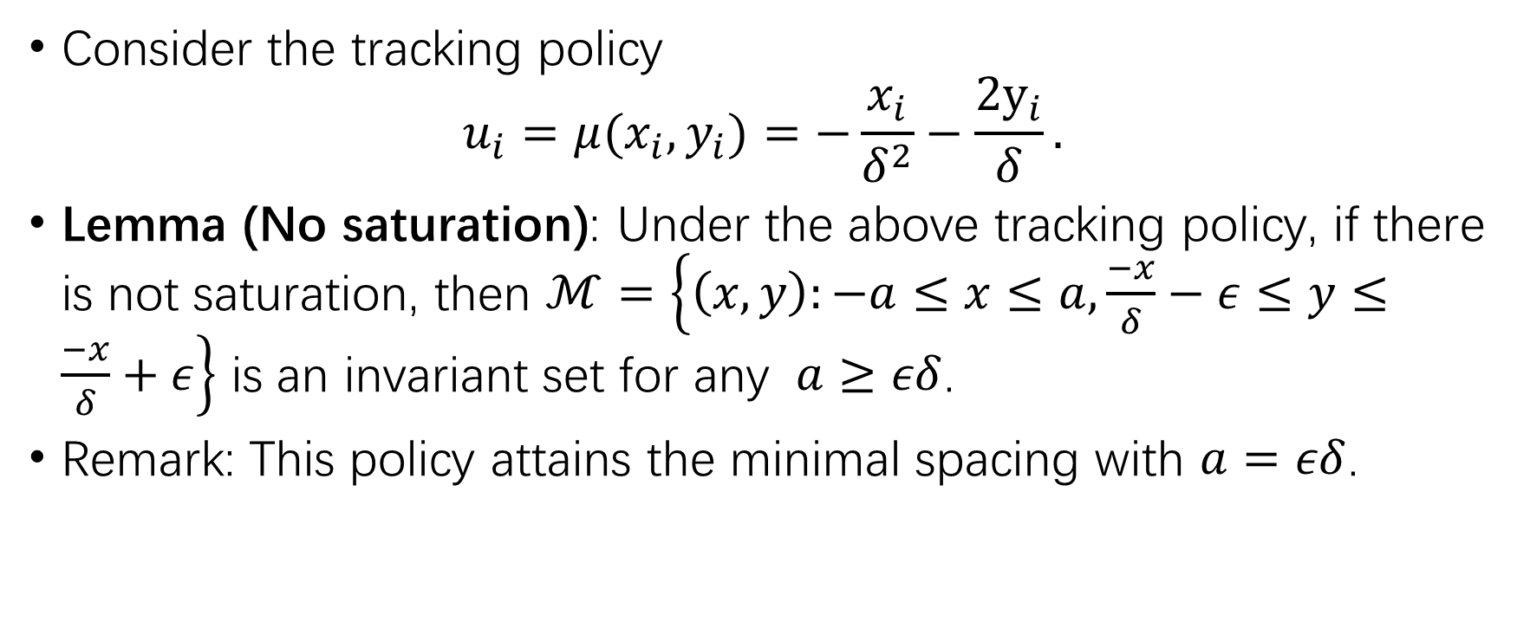
Non-saturated, uniform speed
Consider the tracking policy
$$u_{i}=μ(x_{i},y_{i})=−\frac{x_{i}}{δ^{2}}−\frac{2y_{i}}{δ}.$$
Lemma (No saturation): Under the above tracking policy, if there is not saturation, then $ℳ=\left\{\left(x,y\right):−a≤x≤a,\frac{−x}{δ}−ε≤y≤\frac{−x}{δ}+ε\right\}$ is an invariant set for any $a≥εδ$.
Remark: This policy attains the minimal spacing with $a=εδ$.

Slide 12




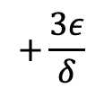
Non-saturated, uniform speed
$$u_{i}=μ(x_{i},y_{i})=−\frac{x_{i}}{δ^{2}}−\frac{2y_{i}}{δ}.$$
$$(−εδ,ε)$$
$$+\frac{3ε}{δ}$$
$$2ε$$
$$(εδ,−2ε)$$

Slide 13

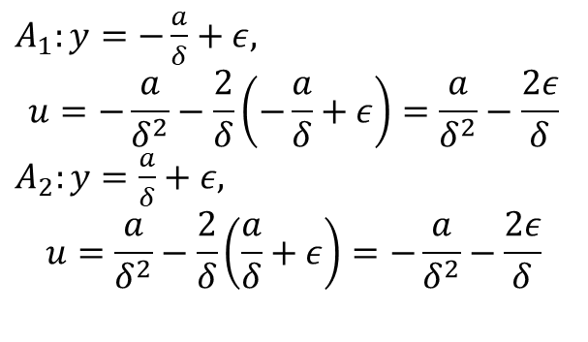
Non-saturated, uniform speed
$A_{1}:y=−\frac{a}{δ}+ε,$
$$u=−\frac{a}{δ^{2}}−\frac{2}{δ}\left(−\frac{a}{δ}+ε\right)=\frac{a}{δ^{2}}−\frac{2ε}{δ}$$
$A_{2}:y=\frac{a}{δ}+ε,$
$$u=\frac{a}{δ^{2}}−\frac{2}{δ}\left(\frac{a}{δ}+ε\right)=−\frac{a}{δ^{2}}−\frac{2ε}{δ}$$
$$y$$
$$A_{2}$$
$$\frac{ε}{δ}$$
$$ε$$
$$a$$
$$−a$$
$$A_{1}$$
$$x$$
$$−ε$$
$$v=−\frac{x}{δ}$$

Slide 14


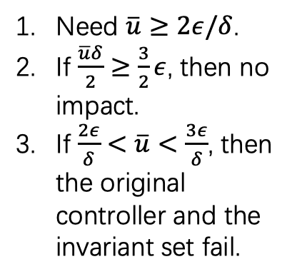
Saturated, uniform speed
$$y$$
Need $\overline{u}≥2ε/δ$.
If $\frac{\overline{u}δ}{2}≥\frac{3}{2}ε$, then no impact.
If $\frac{2ε}{δ}<\overline{u}<\frac{3ε}{δ}$, then the original controller and the invariant set fail.
$$\frac{\overline{u}δ}{2}$$
$$\overline{u}=−\frac{x}{δ^{2}}−\frac{2v}{δ}$$
$$y=−\frac{x}{2δ}−\frac{\overline{u}δ}{2}$$
$$ε$$
$$a$$
$$−a$$
$$x$$
$$−ε$$
$$−\frac{\overline{u}δ}{2}$$
$$A_{1}=(a,−\frac{a}{δ}−ε)$$
$$y=−\frac{x}{δ}$$

Slide 15

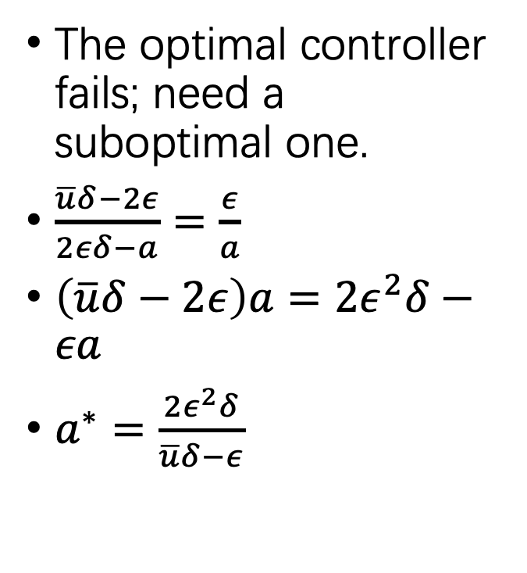



Saturated, uniform speed
The optimal controller fails; need a suboptimal one.
$\frac{\overline{u}δ−2ε}{2εδ−a}=\frac{ε}{a}$
$\left(\overline{u}δ−2ε\right)a=2ε^{2}δ−εa$
$a^{∗}=\frac{2ε^{2}δ}{\overline{u}δ−ε}$
$$(a−2εδ,\overline{u}δ−2ε)$$
$$a$$
$$\overline{u}$$
$$−2ε$$

Slide 16



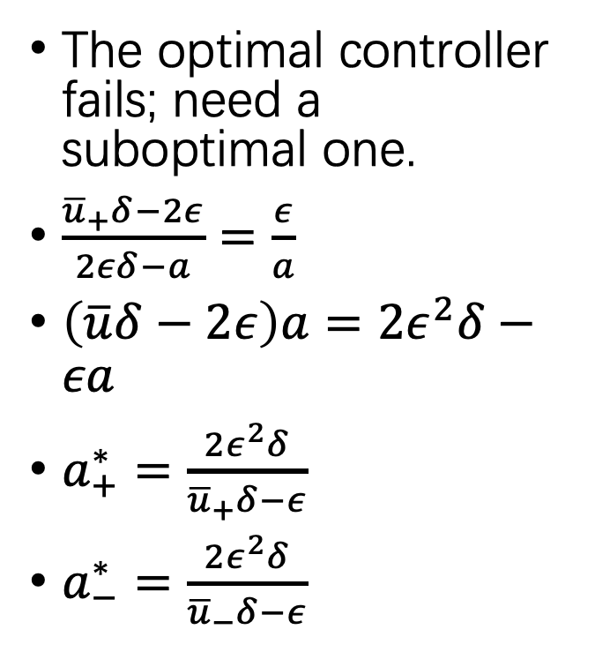


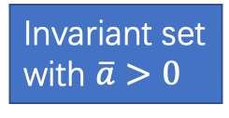
Saturated, non-uniform speed
$$−2ε$$
The optimal controller fails; need a suboptimal one.
$\frac{{\overline{u}}_{+}δ−2ε}{2εδ−a}=\frac{ε}{a}$
$\left(\overline{u}δ−2ε\right)a=2ε^{2}δ−εa$
$a_{+}^{∗}=\frac{2ε^{2}δ}{{\overline{u}}_{+}δ−ε}$
$a_{−}^{∗}=\frac{2ε^{2}δ}{{\overline{u}}_{−}δ−ε}$
$$−\overline{u}−\overline{a}$$
$$(a−2εδ,{\overline{u}}_{+}δ−2ε)$$
$$a_{+}$$
Invariant set
with $\overline{a}>0$
$$\overline{u}−\overline{a}$$
$$−2ε$$

Slide 17
Packet loss-resilient planning

Slide 18
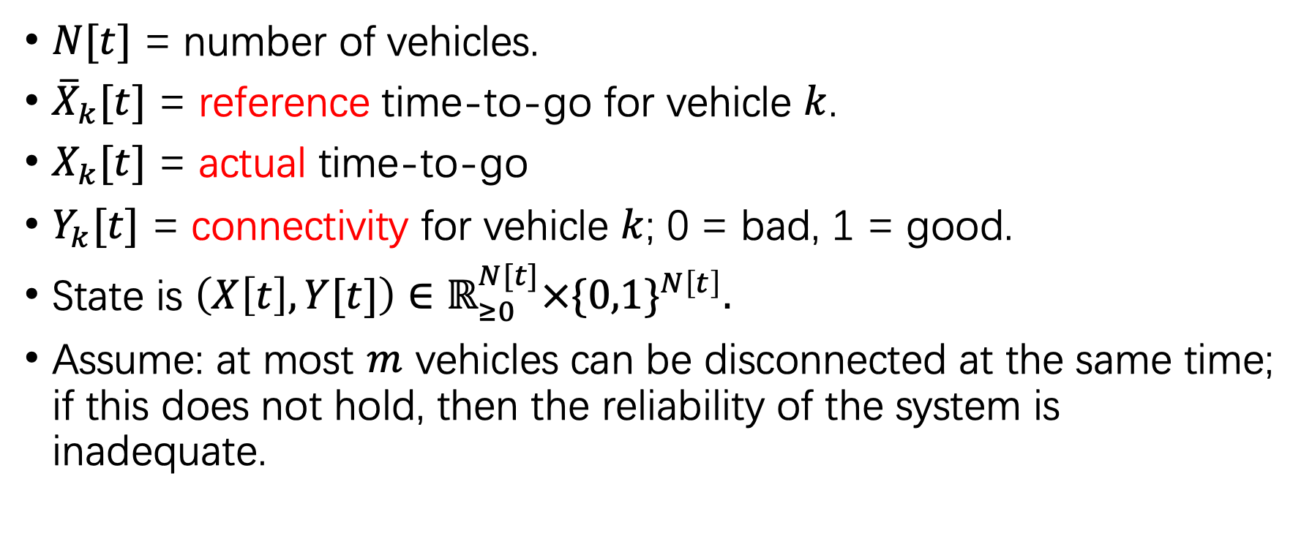
State
$N[t]$ = number of vehicles.
${\overline{X}}_{k}[t]$ = reference time-to-go for vehicle $k$.
$X_{k}[t]$ = actual time-to-go
$Y_{k}[t]$ = connectivity for vehicle $k$; 0 = bad, 1 = good.
State is $\left(X\left[t\right],Y[t]\right)∈ℝ_{≥0}^{N[t]}×{\{0,1\}}^{N\left[t\right]}.$
Assume: at most $m$ vehicles can be disconnected at the same time; if this does not hold, then the reliability of the system is inadequate.

Slide 19
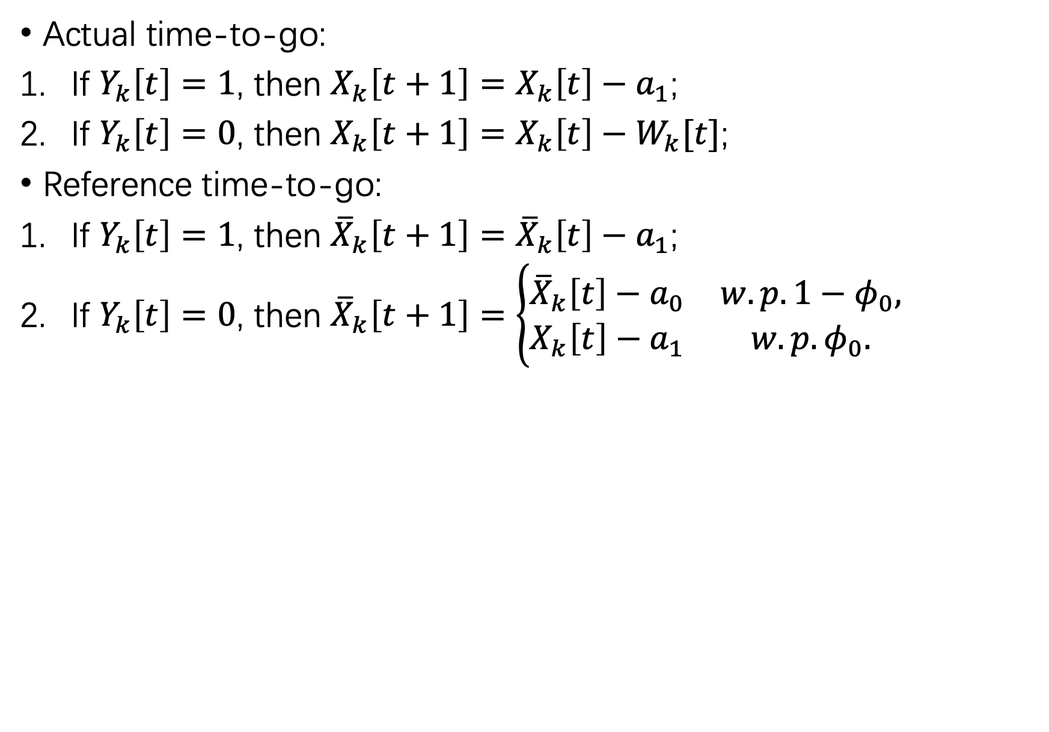
Dynamics
Actual time-to-go:
If $Y_{k}\left[t\right]=1$, then $X_{k}\left[t+1\right]=X_{k}\left[t\right]−a_{1}$;
If $Y_{k}\left[t\right]=0$, then $X_{k}\left[t+1\right]=X_{k}\left[t\right]−W_{k}[t]$;
Reference time-to-go:
If $Y_{k}\left[t\right]=1$, then ${\overline{X}}_{k}\left[t+1\right]={\overline{X}}_{k}\left[t\right]−a_{1}$;
If $Y_{k}\left[t\right]=0$, then ${\overline{X}}_{k}\left[t+1\right]=\left\{\begin{matrix}{\overline{X}}_{k}\left[t\right]−a_{0} & w.p. 1−φ_{0}, \\ X_{k}\left[t\right]−a_{1} & w.p. φ_{0}.\end{matrix}\right.$

Slide 20

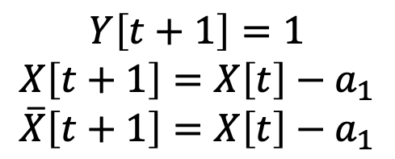
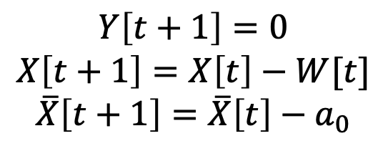
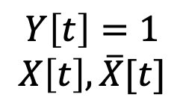
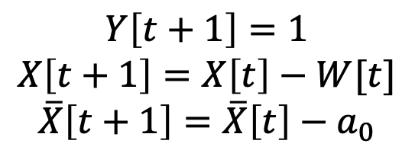

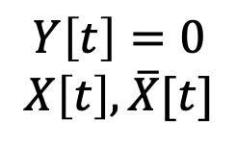

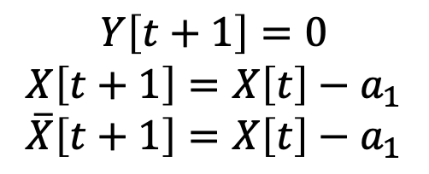

State transition
$$Y\left[t+1\right]=1$$
$$X\left[t+1\right]=X\left[t\right]−a_{1}$$
$$\overline{X}\left[t+1\right]=X\left[t\right]−a_{1}$$
$${1−q}_{1}$$
$$Y\left[t\right]=1$$
$$X\left[t\right],\overline{X}[t]$$
$$q_{1}$$
$$Y\left[t+1\right]=0$$
$$X\left[t+1\right]=X\left[t\right]−a_{1}$$
$$\overline{X}\left[t+1\right]=X\left[t\right]−a_{1}$$
$$Y\left[t+1\right]=1$$
$$X\left[t+1\right]=X\left[t\right]−W[t]$$
$$\overline{X}\left[t+1\right]=\overline{X}\left[t\right]−a_{0}$$
$${1−q}_{0}$$
$$Y\left[t\right]=0$$
$$X\left[t\right],\overline{X}[t]$$
$$q_{0}$$
$$Y\left[t+1\right]=0$$
$$X\left[t+1\right]=X\left[t\right]−W[t]$$
$$\overline{X}\left[t+1\right]=\overline{X}\left[t\right]−a_{0}$$

Slide 21
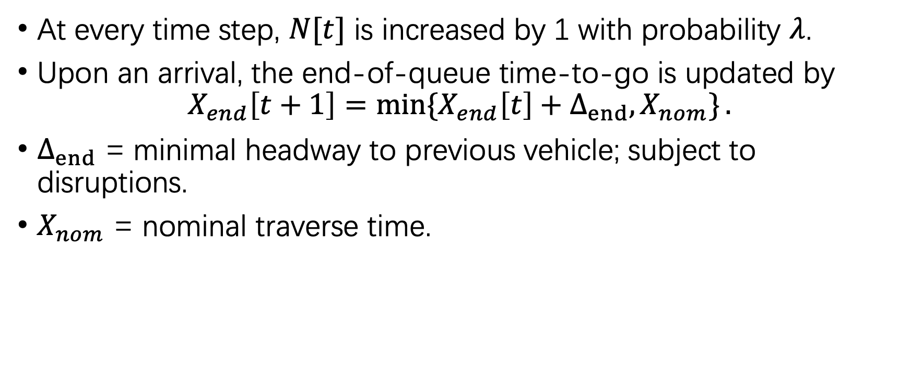
Arrival
At every time step, $N[t]$ is increased by 1 with probability $λ$.
Upon an arrival, the end-of-queue time-to-go is updated by
$$X_{end}\left[t+1\right]=\min{\{X_{end}\left[t\right]+Δ_{end},X_{nom}\}}.$$
$Δ_{end}$ = minimal headway to previous vehicle; subject to disruptions.
$X_{nom}$ = nominal traverse time.

Slide 22
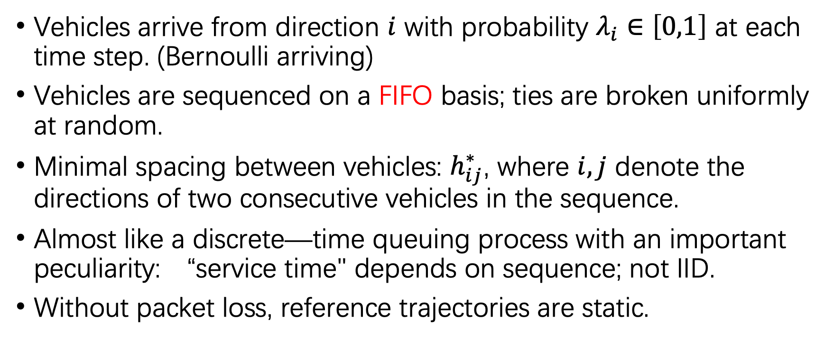
Nominal planning
Vehicles arrive from direction $i$ with probability $λ_{i}∈\left[0,1\right]$ at each time step. (Bernoulli arriving)
Vehicles are sequenced on a FIFO basis; ties are broken uniformly at random.
Minimal spacing between vehicles: $h_{ij}^{∗}$, where $i,j$ denote the directions of two consecutive vehicles in the sequence.
Almost like a discrete—time queuing process with an important peculiarity: “service time" depends on sequence; not IID.
Without packet loss, reference trajectories are static.

Slide 23
Response to lost packet
If a vehicle does not receive the instruction from the RSU, it will switch temporarily to onboard driving mode, with a more conservative spacing to the leading vehicle.
If the RSU does not receive the position of a vehicle, it will assume the worst-case perturbation and decelerate the reference trajectories of all the following vehicles.

