Slide 1
Automated Toxicity in Brazilian Online Political Discourse
Kai Barber-Harris

Slide 2
Contents
Introduction and Motivation
Aims
Data
What can we calculate?
Algorithm design: Collocations
Completed network graph
Data filtering
Algorithm design: Toxicity and sentiment
Investigating botscore and toxicity: Network
Investigating botscore and toxicity: Left-wing and right-wing
Investigating botscore and toxicity: Right-wing toxicity
Anomalous groups
Frequency analysis
Limitations
Conclusions
Further work
Links

Slide 3
Introduction & Motivation
Rising importance of social media
Increased polarisation in politics
Potential payout for successful manipulations, especially in politics

Slide 4
Aims
Are bots performing in a coordinated manner attempting to influence political discussions to be more incendiary?
Do coordinated activities or bot accounts admit a notable difference in average toxicity in different communities when compared to the generic real user base?

Slide 5
Data
437 million X posts
Data collected from August 2018 to March 2023
  Collection terms changed once, in July 2022
PKL files containing botscores, JSON files containing raw text

Slide 6
What can we calculate?
Toxicity (by ToLD-Br)
Sentiment (custom process)
Stance (custom process)
Botscore (calculation of the mean)
Community (Louvain analysis)
Any of these things for any given hashtag

Slide 7
Algorithm design: Collocations
Collect all posts with at least 2 hashtags
Sort hashtags to prevent backwards combinations
Record each hashtag’s individual appearances
  This is a node table
Generate combinations and record each pairing
  This is our edge table
Load results into Gephi!

Slide 8
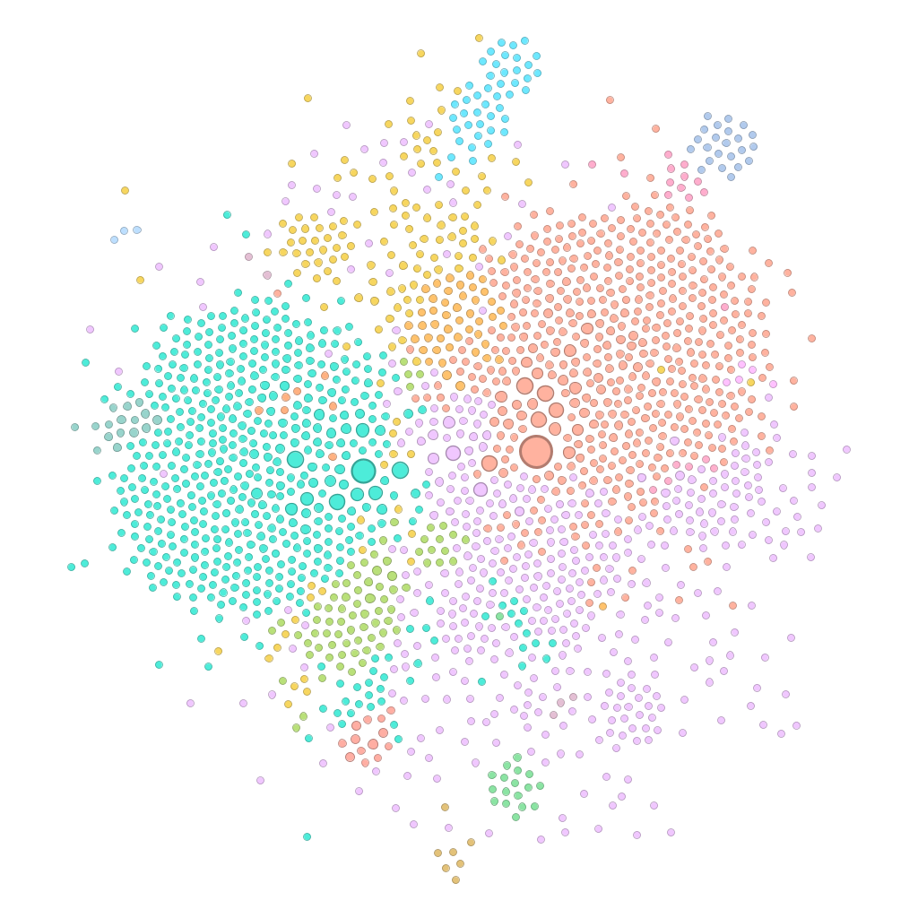
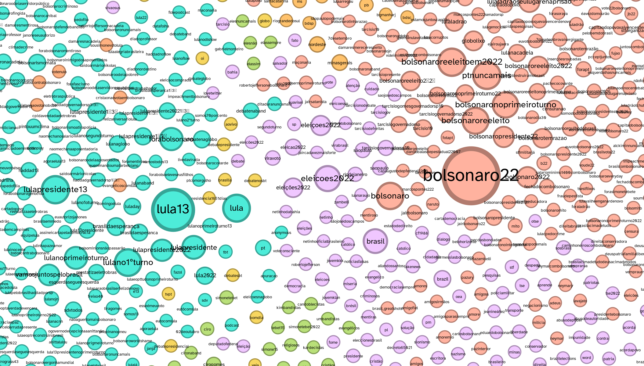
Completed network graph

Slide 9
Data filtering
Toxicity model takes a long time to run (approx. 0.2s per post)
Need to cut down on data
Full set: 437,000,000~
Post adjustment: 80,688,513
Hashtags only: 7,806,357
No reposts: 3,523,010
Only left-wing or right-wing hashtags with >1000 appearances, or those directly connected to one: 968,627*

Slide 10
Algorithm design: Toxicity and sentiment
Preprocess text through a standard NLP pipeline
Feed preprocessed text to classification function
Collect all posts containing each hashtag and calculate the normalised mean toxicity or sentiment of the hashtag.
This final value represents either:
  the probability of a post containing the hashtag to be toxic
  the variance of the hashtag from a neutral sentiment, + or -
Stance analysis abandoned due to uninteresting sentiment results

Slide 11
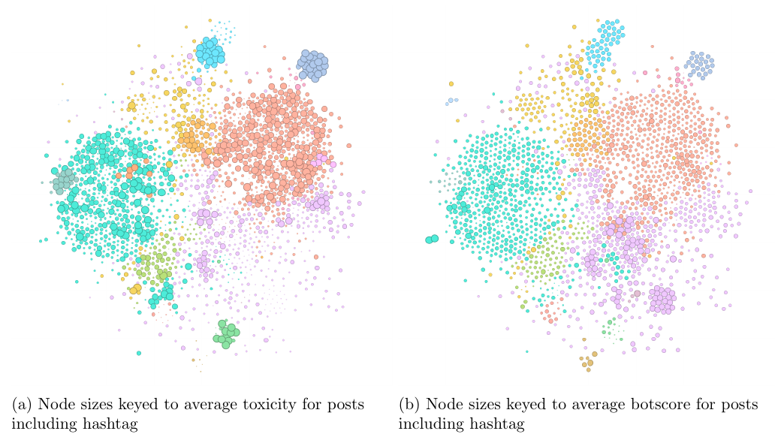
Investigating botscore and toxicity

Slide 12
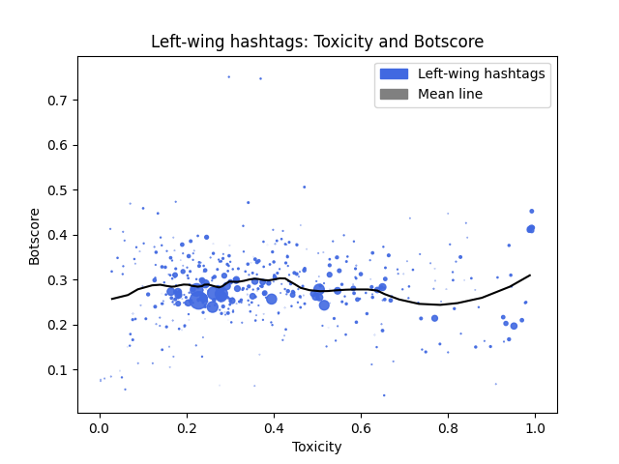
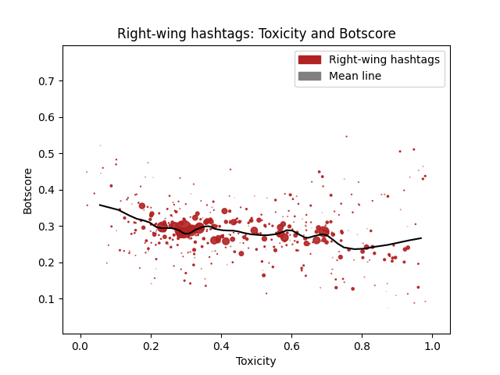
Investigating botscore and toxicity

Slide 13
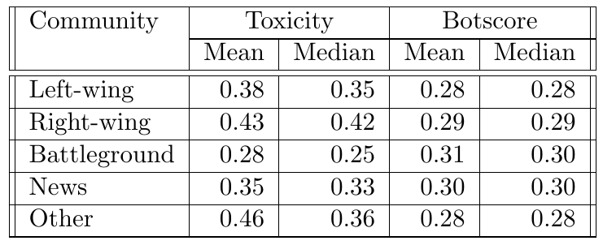
Investigating botscore and toxicity
Right-wing discussions notably more toxic than other discrete communities in both mean and median
All communities have roughly equivalent botscore means and medians

Slide 14
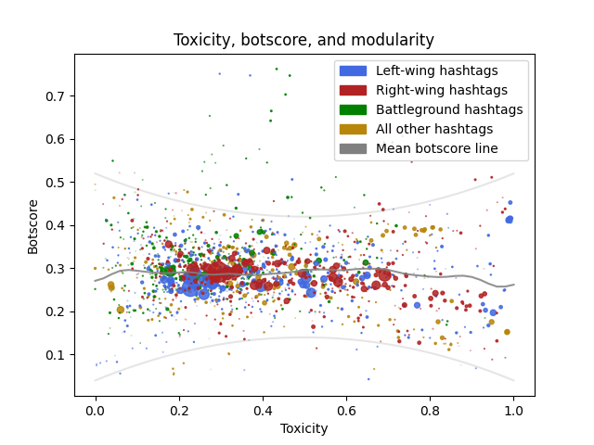
Anomalous groups
Anomalies show increased bot activity
Appear to be pushing high-toxicity ideas and conversations

Slide 15
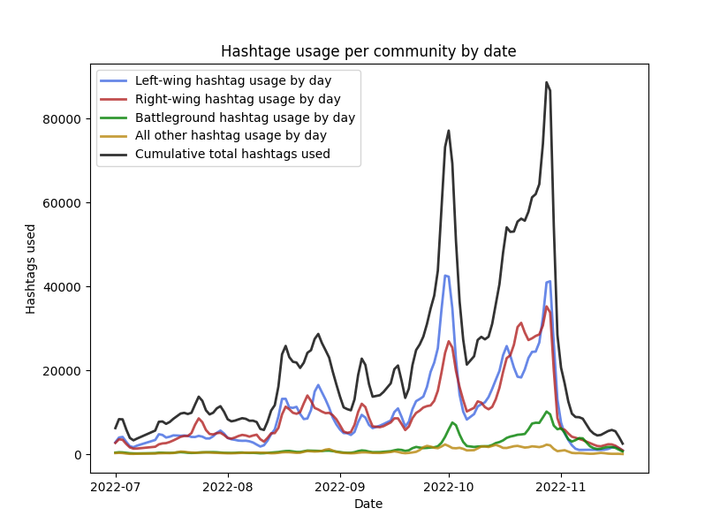
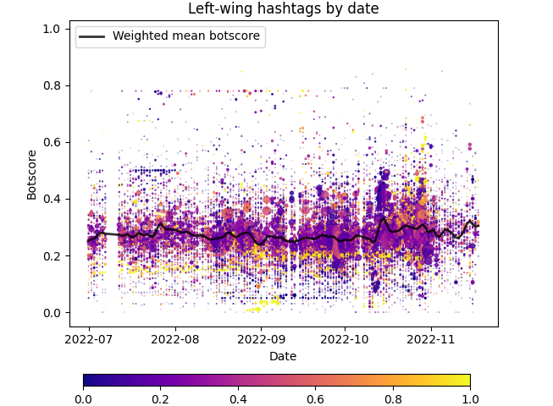
Frequency analysis

Slide 16
Limitations
Computation time
Lack of sentiment/stance analysis
Self-selection bias

Slide 17
Conclusions
Multiple instances of bots attempting to increase the toxicity of political discussion
Bots appear to favour left-wing spaces for targeting
Bots participate notably less in right-wing spaces the more toxic the conversation becomes
Overall project success: we answer our first question:
  Are bots performing in a coordinated manner attempting to influence political discussions to be more incendiary?

Slide 18
Further work
Advise to perform a more granular analysis
Stance analysis recommended
Deeper investigation into how bots act differently in different communities
What topics do bots prefer?

Slide 19
Links
Presentation video: [PLACEHOLDER]
Code: [PLACEHOLDER]

