Slide 1

Mini-Project on Global Positioning using Image Pr o cessing
Team Members:-
Abhishek Singh (RIT2012079)
Diwas Sharma (RIT2012001)
Harshit Gupta (RIT2012048)
Man Mohan Mishra (RIT2012002)
Rizwan Ahmad (RIT2012054)
Siddhant Jain (RIT2012077)
Under Supervision of: -
Dr. Pavan Chakraborty

Slide 2
Contents
Overview
Objective
Brief Look on GPS and Image Processing
Proposed Methodology
Limitations

Slide 3
Overview
In this modern era of technology people use online maps and GPS Services to get their way to desired location. In past few decades, researchers have embedded such software in smart phones and cars.
GPS has become a very useful technology in travelling and tourism but due to many limitations like quality of receiver device , sky blockages and atmospheric pressures it is seldom not possible to use GPS efficiently. Our project aims on reducing the dependency on the GPS satellites to know the position of a person.

Slide 4
Objective
To create a application software to find the location of a given image and its precise GPS
co-ordinates.

Slide 5
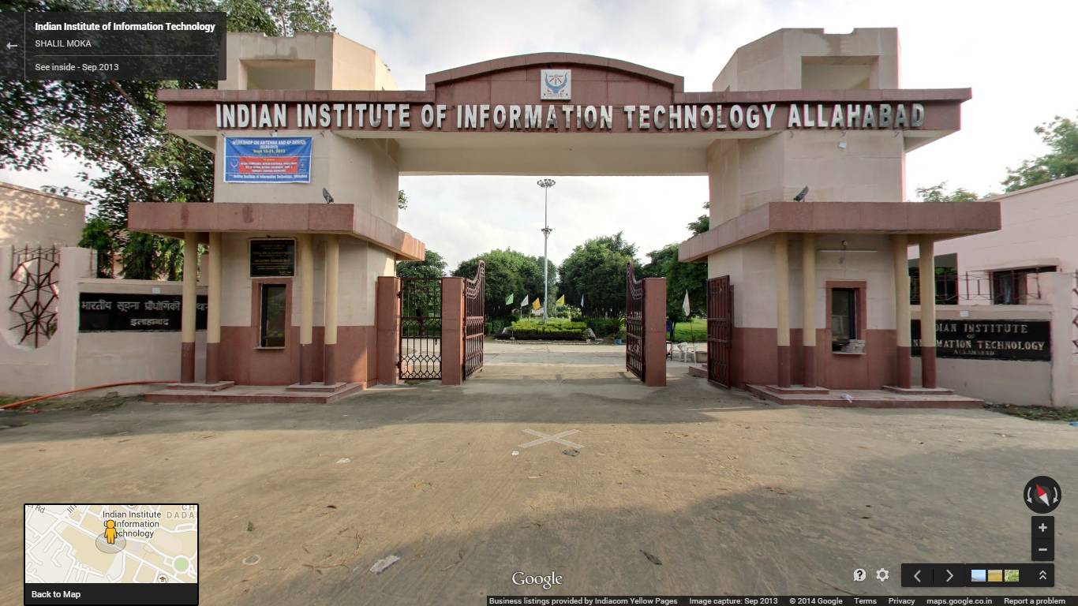
Objective (cont ….)
Input
GPS Coordinates:-
Latitude : 25.429323
Longitude : 81.770095
Location :- IIITA Main Gate

Slide 6
GPS
The Global Positioning System (GPS) is a space-based satellite navigation system that provides location and time information in all weather conditions, anywhere on or near the Earth where there is an unobstructed line of sight to four or more GPS satellites.

Slide 7
Image Processing
Image processing is any form of signal processing for which the input is an image, such as a photograph or video frame. The output of image processing may be either an image or a set of characteristics or parameters related to the image.

Slide 8
Methodology
Image Matching Algorithm (S.V.M.)
Creating Image Database
Converting Image
in Pixel
Scaling Image to
resolution 50x50
Embed Image in
Knowledge Store File
Matching the Given Image
Match Image pixel
by pixel with all
images in
Knowledge Store
Scaling given
image to
resolution 50x50
Select Image with
maximum match

Slide 9
Methodology (cont…)
Set Precision and Control Over Input Image….
Rejection of Input Image
If Maximum
Matching is less
than 30%
Input Image is
not appropriate
for matching
Checking ambiguity
Input Image
Has ambiguity and can be of more than 1 location
If 2 different set of images
have more than
80% of matching

Slide 10
Methodology (cont…)
Finding GPS Value….
Assuming that
GPS Value varies
Linearly,
GPS Value of current location is found.
GPS Values of 2 nearby locations are taken
Image with maximum
Match was selected
Printing GPS Value and Location Name

Slide 11
Methodology (cont…)
Making High Precision….

Slide 12
Limitations
We have used specific collection of images to match the user’s image with our collection, in our case images of IIIT-Allahabad are used, so images outside the scope won’t yield any result.
Images have been scaled to 50x50 resolution so, the accuracy is not 100% .
The actual GPS device gives coordinates accuracy of 15 meters, although we will try to improve this accuracy to 5 meters but images below this difference won’t get accurate result.
Multiple images may yield different coordinates but same name for the place depending on camera direction for same place.
The images are available only for day time. So, images taken at night may cause a problem

Slide 13
References
[1] S.V.N. Vishwanathan, M. Narsimha Murty, “ A Simple SVM Algorithm”, “Dept. of Computer Science and Automation, Indian Institute of Science” , Bangalore.
[2] Durgesh Kumar Shrivastava, “Data Classification using Support Vector Machine”, Journal of theoretical and applied Information Technology, 2005.
[3] John.C.Platt. ,”Positioning and Navigation Systems using GPS”, “International Archives of Photometry, Remote Sensing and Spatial Information Science”, Tokyo Japan, 2006.
[4] Elvis N. Ngah, “GPS Technology Optimizing Car Navigation”,”vrije Universiteit Amsterdam”,15 August 2006.

Slide 14
Suggestions and Questions(if any)
???

Slide 15
Thank You

