Slide 1

DBMS Project on Hospital Billing Software
Team α+ presents
Project Contributors:-
Diwas Sharma (RIT2012001)
Man Mohan Mishra (RIT2012002)
Harshit Gupta (RIT2012048)

Slide 2
Objectives
To design a Hospital Billing Software for patients with following objectives :-
Login to system and change password of system
Enter/edit Organization Code, Name and Address
Make Entry for New Patient and edit for Existing Patient.
Keep Track of All Wards, Beds, Patients.
Generate Bill, set them to pending or paid.
Update any value for patient or his bill amount.

Slide 3
List of Entities
User
Organization
Patient
Track
Charges
Bed
General_Ward
ICU
Log

Slide 4
Key Attributes
Key Attribute | Belongs to Entity
Org_Code | Organization
User_ID | User
Reg_No | Patient
Reg_No | Track
Reg_No | Charges
Log_ID | Log
Ward_Number | General_Ward
ICU_Number | ICU

Slide 5
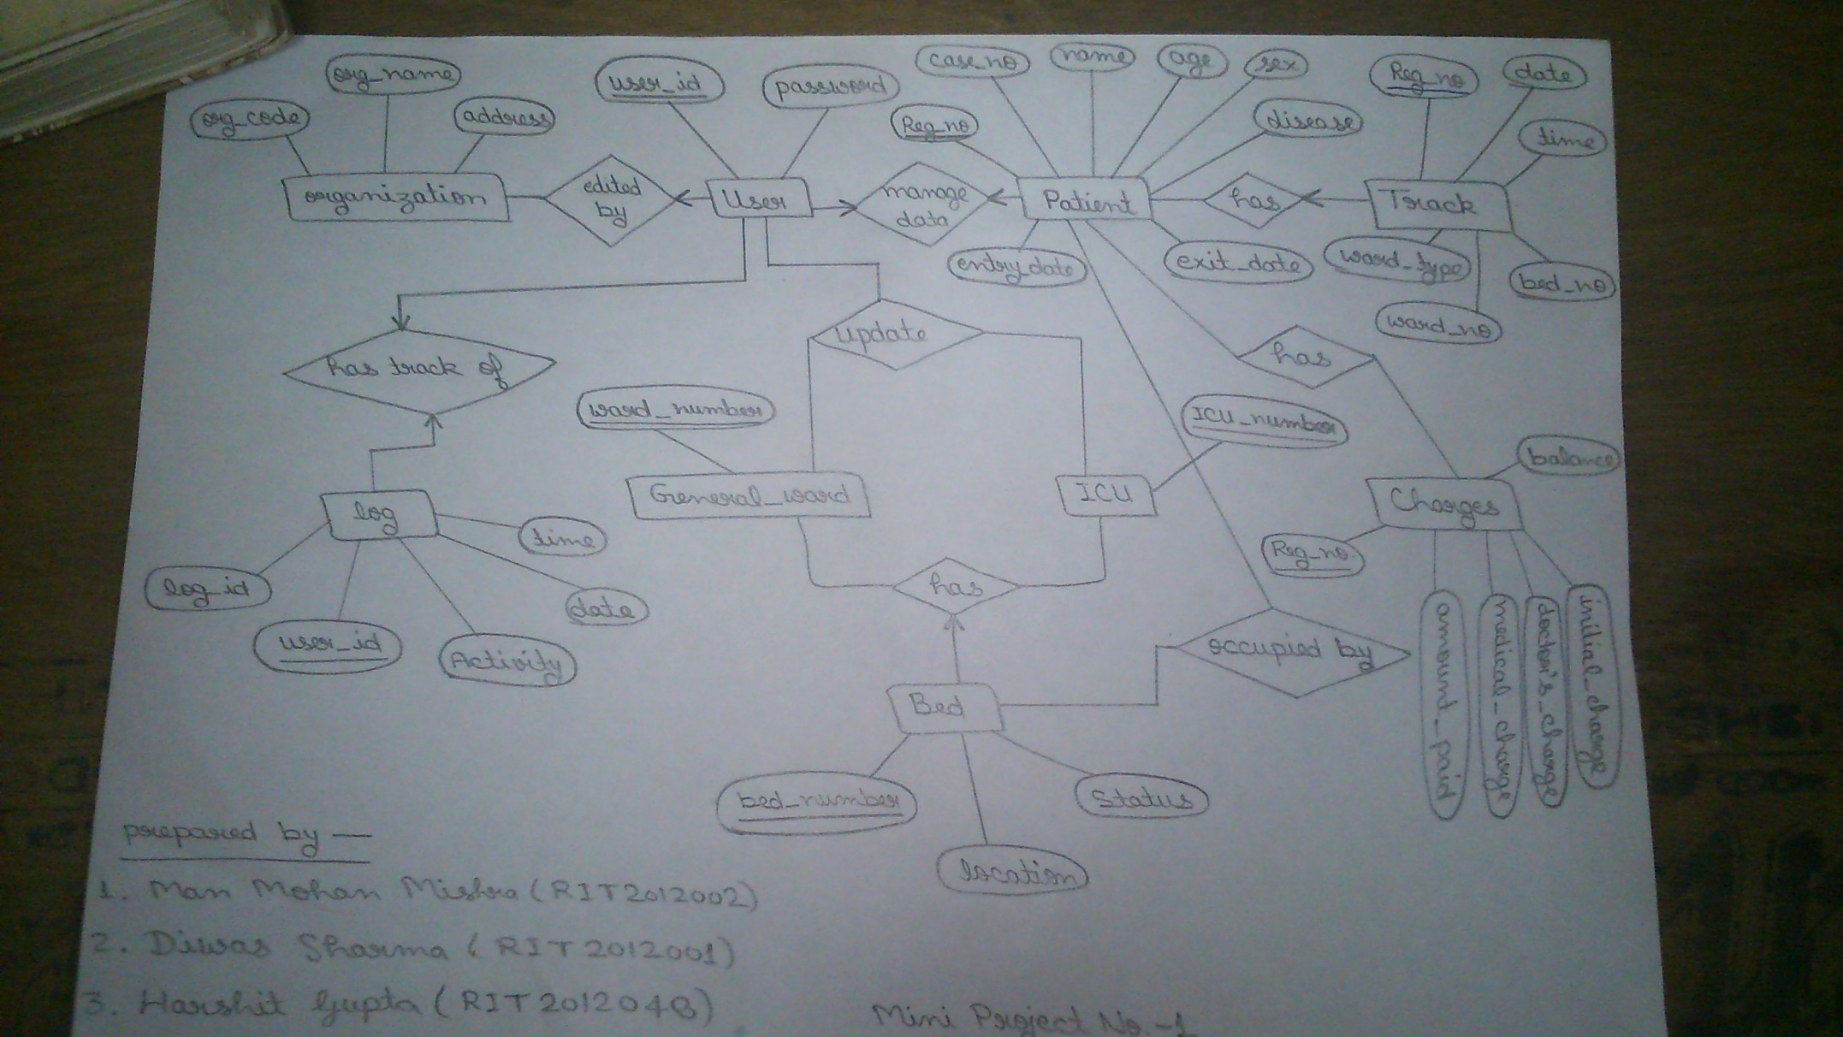
E.R. Diagram

Slide 6
Normalized Tables
Organization
User
Org_Code | Org_Name | Address
User_ID | Password
Patient
Reg_No. | Case_No | Name | Age | Sex | Disease | Entry_Date | Exit_Date
Track
Reg_No | Date | Time | Bed_No | Ward_No | Ward_Type
General_Ward
ICU
Ward_No
ICU_No

Slide 7
Normalized Tables (Cont.)
Charges
Reg_No | Initial_Charge | Doctor_Charge | Medical_Charge | Amount_Paid | Balance
Bed
Bed_No | Location | Status
Log
Log_ID | User_ID | Activity | Date | Time

Slide 8
Reasons for above Tables
In this current Situation, every entity has Primary Key and there is no redundancy of Data. So Design is in 1st Normal Form
There is no partial dependency in attributes, so Design comes in 2nd Normal Form.
There is no transitive dependency among attributes, so Design comes in 3rd Normalized Form.

Slide 9


