Slide 1
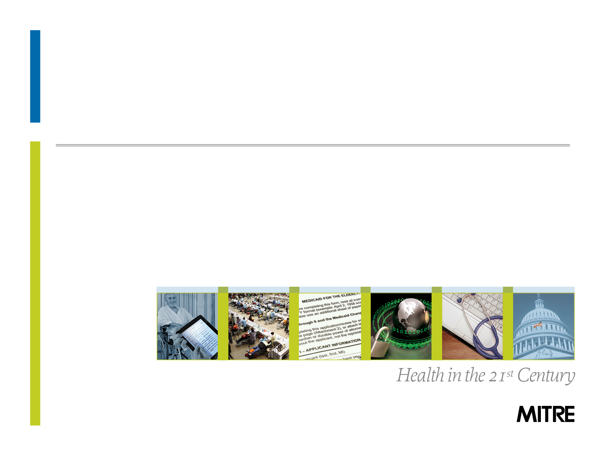

An Open Source Clinical Quality Modeling Framework

Slide 2

Background
“Quality is everyone's responsibility.”
- W. Edwards Deming
Notes:
“The Value of Ambulatory Care Measures: A Review of Clinical and Financial Impact from an Employer/Payer Perspective” (June, 2008) www.ajmc.com .

Slide 3
Background - Clinical Quality Measures
CMS defines Clinical Quality Measures as “tools that help us measure or quantify healthcare processes, outcomes, patient perceptions, and organizational structures”
Each CQM has goals related to one or more of the Institute of Medicine domains of health care quality: effective, safe, efficient, patient-centered, equitable, and timely care
Clinical Quality Measures are key critical components to the Meaningful Use program as part of the HITECH Act
It is assumed that, over time, addressing CQMs will result in:
Healthier outcomes for patients
Lower overall cost of care for the healthcare system
Notes:
“The Value of Ambulatory Care Measures: A Review of Clinical and Financial Impact from an Employer/Payer Perspective” (June, 2008) www.ajmc.com .

Slide 4
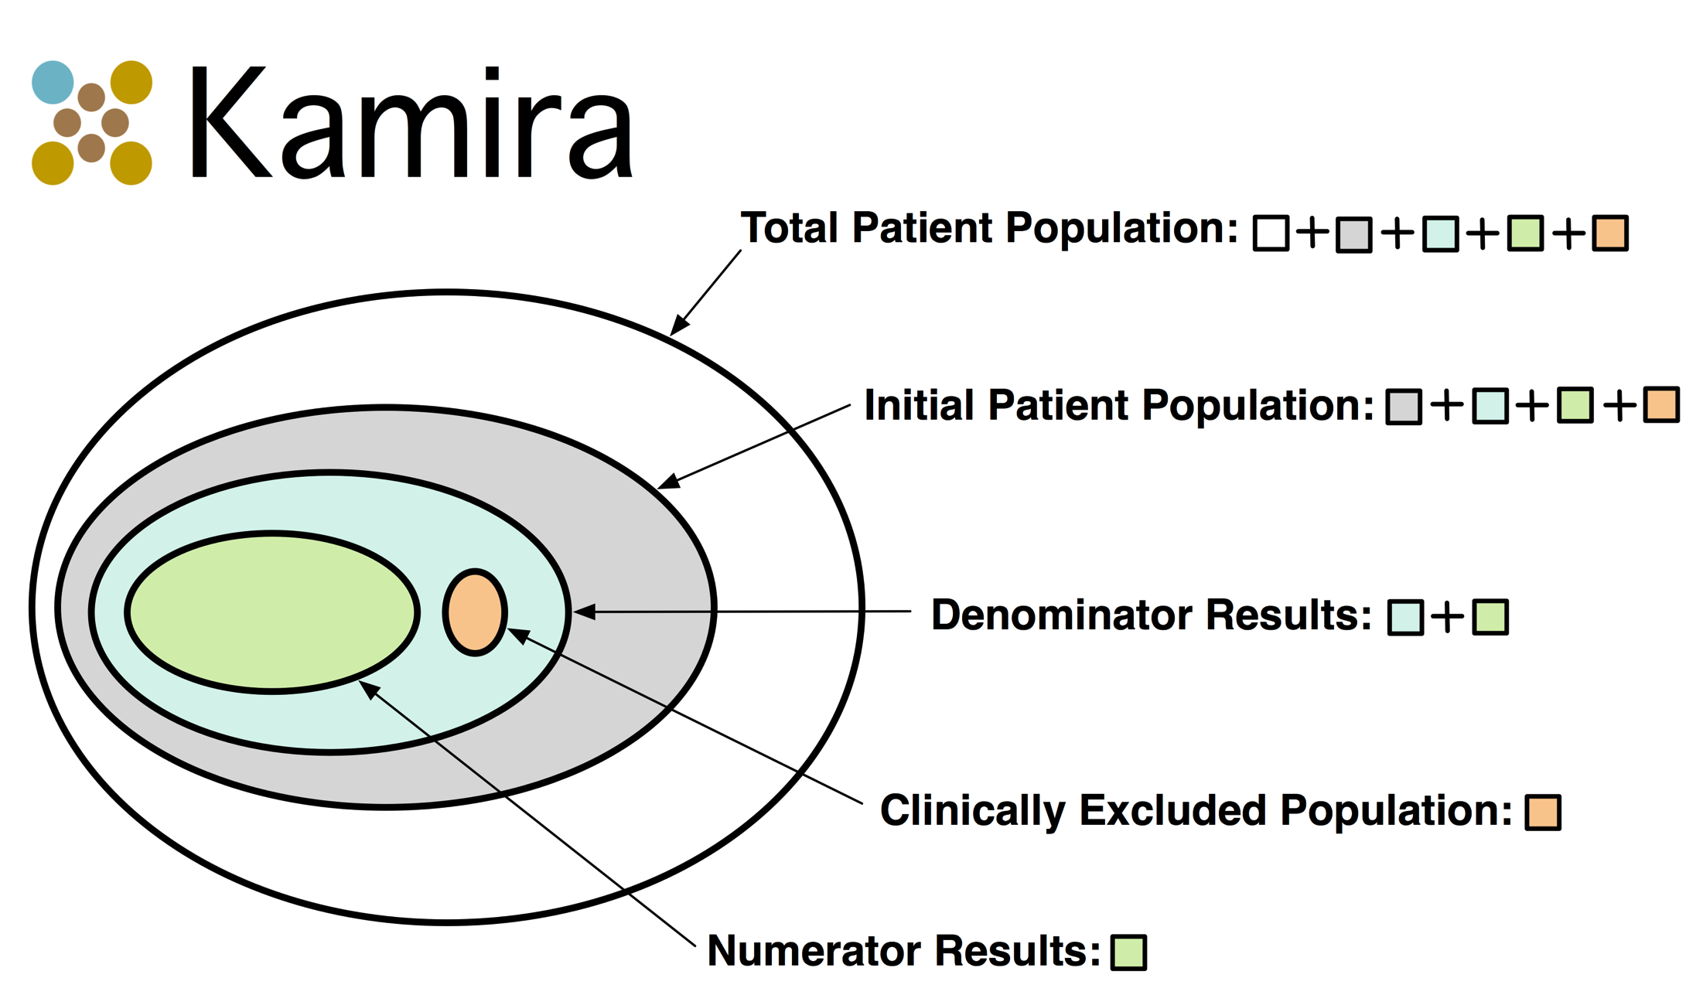
Clinical Quality Measures

Slide 5
Background – Pay for Performance
Pay For Performance (P4P) programs have been largely based on claims and administrative data.
CQMs are positioned to support P4P programs with a more complete clinical consideration vs. a focus on only claims data
The Clinical Quality Measure space is relatively new and complex environment spanning:
Government Policy Leaders
Standards Organizations
Technologists
Statisticians
Clinicians
Patients
Notes:
“The Value of Ambulatory Care Measures: A Review of Clinical and Financial Impact from an Employer/Payer Perspective” (June, 2008) www.ajmc.com .

Slide 6

Problem
If CQMs are used to gate Pay
for Performance… “What is
the quality of the
Meaningful Use Clinical
Quality Measures?”*
10 April 2012
*Posed to MITRE during an ONC project review
Dr. Doug Fridsma Director Standards and Interoperability Office of the National Coordinator of Health Information Technology (ONC)

Slide 7
Research Questions
What are the best methods to assess the overall value of a Clinical Quality Measure?
If the performance of a Clinical Quality Measure improves, how does it affect the overall health outcomes? What about the total cost to the healthcare system?
What are the best Clinical Quality Measures that improve the performance of other sibling Clinical Quality Measures?
Notes:
“The Value of Ambulatory Care Measures: A Review of Clinical and Financial Impact from an Employer/Payer Perspective” (June, 2008) www.ajmc.com .

Slide 8
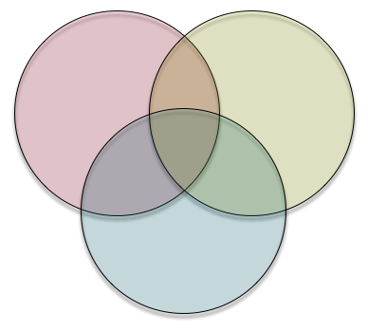
Idea
Availability of Clinical Patient Data
Clinical Quality Measures
Healthcare
Financial Models
The most value to the healthcare system

Slide 9
Plan
Develop the Kamira software framework to assess the quality of Clinical Quality Measures, considering 3 dimensions:
Availability of Clinical Patient Data required to drive Clinical Quality Measures
Complexity of Clinical Quality Measures
Model short-term costs and predict long-term savings associated with each Clinical Quality Measures
Enhance the Kamira software with external feedback on all 3 dimensions
Use open source to grow collaborators, and transition from a MIP-supported activity to a customer-championed project
Notes:
“The Value of Ambulatory Care Measures: A Review of Clinical and Financial Impact from an Employer/Payer Perspective” (June, 2008) www.ajmc.com .

Slide 10
Plan
Develop the Kamira software framework to assess the quality of Clinical Quality Measures, considering 3 dimensions:
Availability of Clinical Patient Data required to drive Clinical Quality Measures
Complexity of Clinical Quality Measures
Model short-term costs and predict long-term savings associated with each Clinical Quality Measures
Enhance the Kamira software with external feedback on all 3 dimensions
Use open source to grow collaborators, and transition from a MIP-supported activity to a customer-championed project
Notes:
“The Value of Ambulatory Care Measures: A Review of Clinical and Financial Impact from an Employer/Payer Perspective” (June, 2008) www.ajmc.com .

Slide 11
Availability of Clinical Patient Data
Current requirements for clinical attributes in Electronic Health Records for certification do not match required attributes for Clinical Quality Measures
Clinical Quality Measures are a super-set of the clinical attributes required for EHR certification
Standards currently available for expressing patient clinical data is currently limited to the C32 and CCDA
Current shortcomings of clinical data that are not required for certification are nearly all optional attributes which could be provided by EHR systems
Medications
Immunizations
Allergies
Tobacco Use
Etc.

Slide 12




Availability of Clinical Patient Data
Rigorous analysis on the use of optional clinical attributes, from real-world operational clinical facilities, is not readily available
Kamira can address this analysis in collaboration with several partners working with live clinical data

Slide 13
Availability of Clinical Patient Data
Encode automated analysis in the Kamira software to assess required/optional clinical attributes
Consider current and forecasted certification requirements
Stratify reporting on current and forecasted requirements for
Meaningful Use Stage 1
Meaningful Use Stage 2
Meaningful Use Stage 3
PQRS
Pioneer ACO Program
… etc.

Slide 14
Plan
Develop the Kamira software framework to assess the quality of Clinical Quality Measures, considering 3 dimensions:
Availability of Clinical Patient Data required to drive Clinical Quality Measures
Complexity of Clinical Quality Measures
Model short-term costs and predict long-term savings associated with each Clinical Quality Measures
Enhance the Kamira software with external feedback on all 3 dimensions
Use open source to grow collaborators, and transition from a MIP-supported activity to a customer-championed project
Notes:
“The Value of Ambulatory Care Measures: A Review of Clinical and Financial Impact from an Employer/Payer Perspective” (June, 2008) www.ajmc.com .

Slide 15
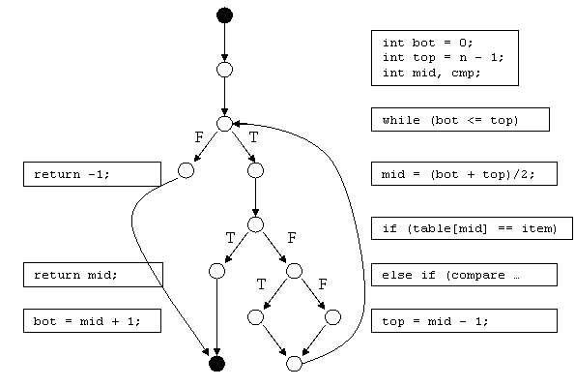
Complexity of Clinical Quality Measures
Cyclomatic Complexity is a software metric used to gauge the complexity of source code
Measures the number of linearly independent paths through the source code of a function
Simple example function where “CC” = 4
http://www.whiteboxtest.com/cyclomatic-complexity.php

Slide 16
Complexity of Clinical Quality Measures
Cyclomatic Complexity metrics for Meaningful Use Clinical Quality Measures can be automated through work being led on the open source popHealth project
Cyclomatic Complexity is a good low-hanging metric, but isn’t a desirable as single grade for a Clinical Quality Measure complexity
Cyclomatic Complexity measures the popHealth implementation of the Clinical Quality Measures
Cyclomatic Complexity does not assess complexity of logic with 1 single execution path
Total Cholesterol - HDL - (triglycerides / 5) < 100 mg/dL
Cyclomatic Complexity = 1

Slide 17
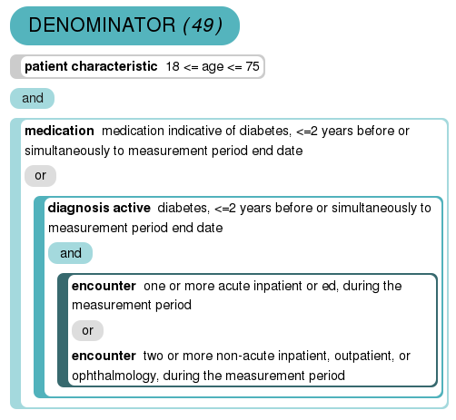
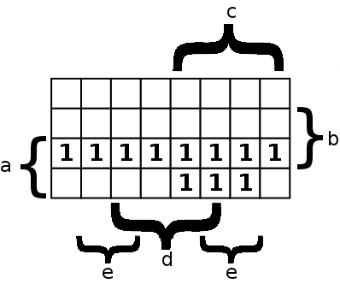
Complexity of Clinical Quality Measures
Figure shows a representation of the denominator criteria for this measure
Label each unique term with a letter: a-e with each term is either true (1) or false (0)
Express denominator as a logical equation: f(d)= a (b + (c (d + e)))
An expression in 5 variables has 25 = 32 possible outcomes
32 patient records would be required to fully test this logic block
Current Truth Table analysis work is manually-intensive and time consuming
Leveraging popHealth’s Quality Measure Engine for Meaningful Use, this process could be automated via the Kamira software
a
b
c
d
e
Tim Taylor’s work for the ONC/Cypress populating a truth table for denominator logic

Slide 18
Complexity of Clinical Quality Measures
Develop various automated approaches to measuring Clinical Quality Measure Complexity including:
Cyclomatic Complexity
Automated Truth Table Analysis supported via the popHealth Clinical Quality Measure Engine
Other complexity considerations, including Halstead Volume of the Clinical Quality Measure logic
Collect feedback from Vendors and Government on the approach
Conduct outreach with EHR vendors to vet the findings on Kamira’s Clinical Quality Measures complexity model
Conduct outreach with HHS sponsors to collect input on the importance and prioritization of complete rigorous testing of the Clinical Quality Measures

Slide 19
Plan
Develop the Kamira software framework to assess the quality of Clinical Quality Measures, considering 3 dimensions:
Availability of Clinical Patient Data required to drive Clinical Quality Measures
Complexity of Clinical Quality Measures
Model short-term costs and predict long-term savings associated with each Clinical Quality Measures
Enhance the Kamira software with external feedback on all 3 dimensions
Use open source to grow collaborators, and transition from a MIP-supported activity to a customer-championed project
Notes:
“The Value of Ambulatory Care Measures: A Review of Clinical and Financial Impact from an Employer/Payer Perspective” (June, 2008) www.ajmc.com .

Slide 20
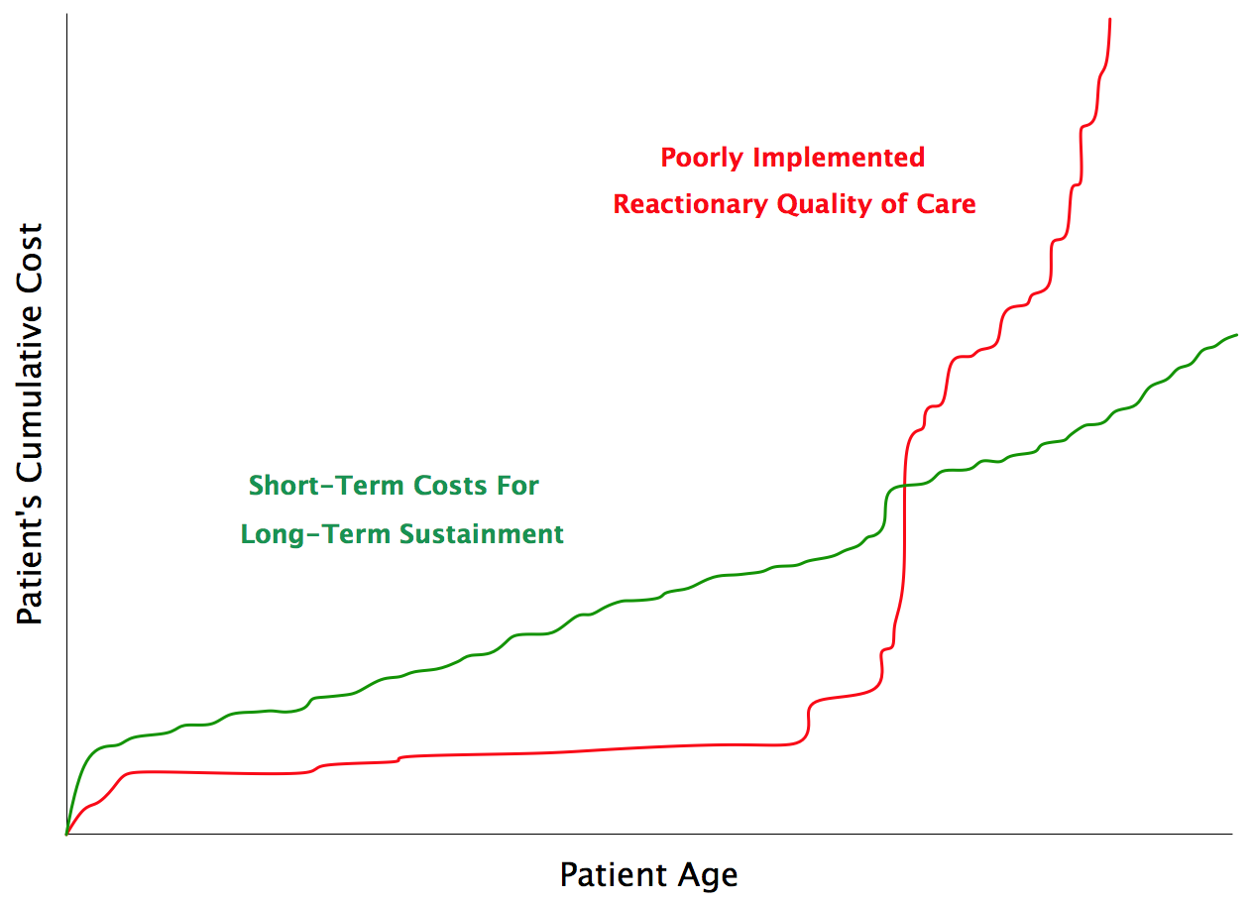
Using Clinical Quality Measures to Bend the Cost Curve
NOTIONAL
NOTIONAL

Slide 21
Model Financial Costs and Savings
Predicting short-term cost increases associated with improvements in Clinical Quality Measure performance
The majority of the Clinical Quality Measures provide opportunities for providers to take action
Laboratory Test
Procedures
Medications
Etc.
CMS claims data contains upper bounds on provider compensation to address CQMs
MITRE can identify a short-term cost associated with addressing gaps in care with the Clinical Quality Measures
Engage CMS FFRDC partner to lead financial analysis to forecast cost savings by addressing improvements in the Clinical Quality Measures

Slide 22
Example: Influenza Vaccination
Measure | Description | Short Term Cost (Influenza Vaccination) | Cost per Hospitalized Case, ages 50-64 | Cost per Hospitalized Case, ages ≥ 65
NQF 0041 | Influenza Immunization for Patients > 50 Years Old | ~$15 per person | $7,276 (± 25%) | $8,278 (± 25%)
 |  | In Scope | Out of Scope
In 2010, Influenza/Pneumonia ranked as the 9th cause of death (50,000 deaths)
One third of all Americans 50–64 years of age have one or more chronic medical condition that puts them at increased risk for serious flu complications.
Among the elderly, influenza vaccines can prevent 50 percent–60 percent of hospitalizations and 68 percent of deaths from flu-related complications.
Achieving 90 percent vaccination coverage would reduce deaths by over 15,000 annually in a year with an average flu season (i.e., not a major epidemic).
Notes:
References:
Maciosek, Michael, Leif Solberg, Ashley Coffield, Nichol Edwards, and Michael Goodman. “Influenza Vaccination: Health Impact and Cost Effectiveness Among Adults Aged 50 to 64 and 65 and Older.” American Journal of Preventive Medicine 31, no. 1 (2006): 72–79.
“National Vital Statistics Report” 60, no. 4. Deaths: Preliminary Data for 2010 (January 11, 2012). http://www.cdc.gov/nchs/data/nvsr/nvsr60/nvsr60_04.pdf.
“The State of Health Care Quality”. National Committee for Quality Assurance, 2010. http://www.ncqa.org/portals/0/state%20of%20health%20care/2010/sohc%202010%20-%20full2.pdf.

Slide 23
Idea
Availability of Clinical Patient Data
Clinical Quality Measures
Model Financial Costs and Savings with CQMs

Slide 24
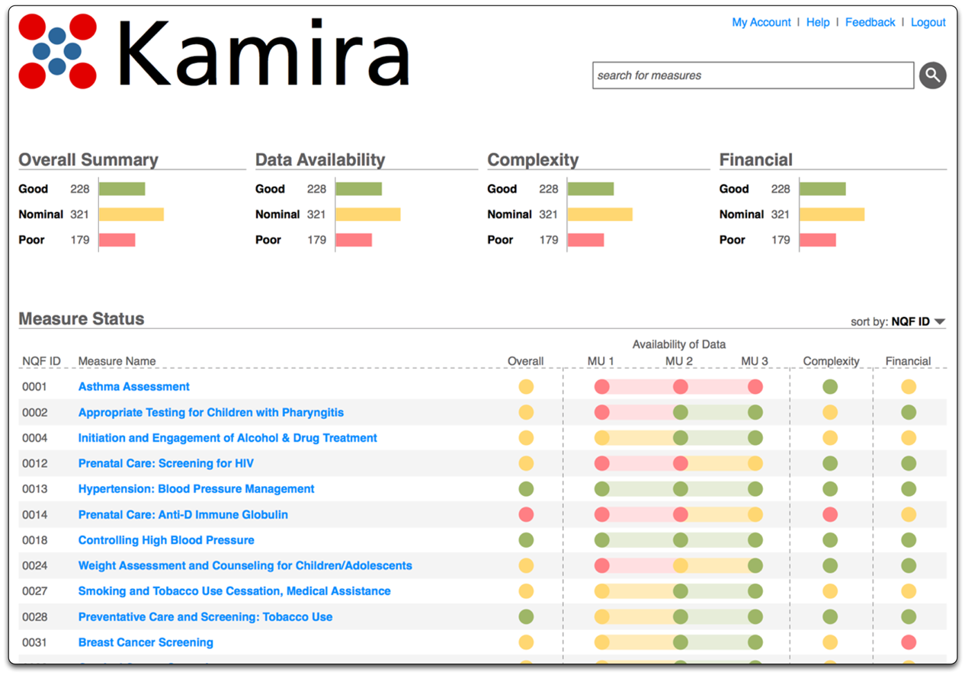
NOTIONAL
NOTIONAL

Slide 25
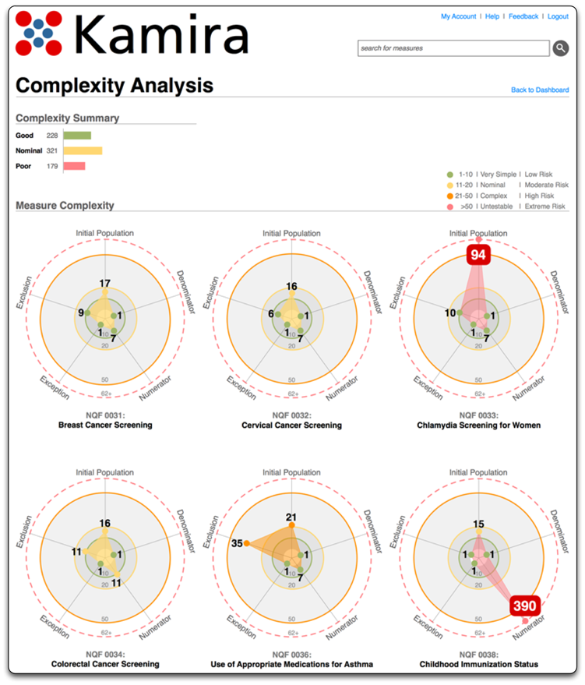
NOTIONAL
NOTIONAL

Slide 26
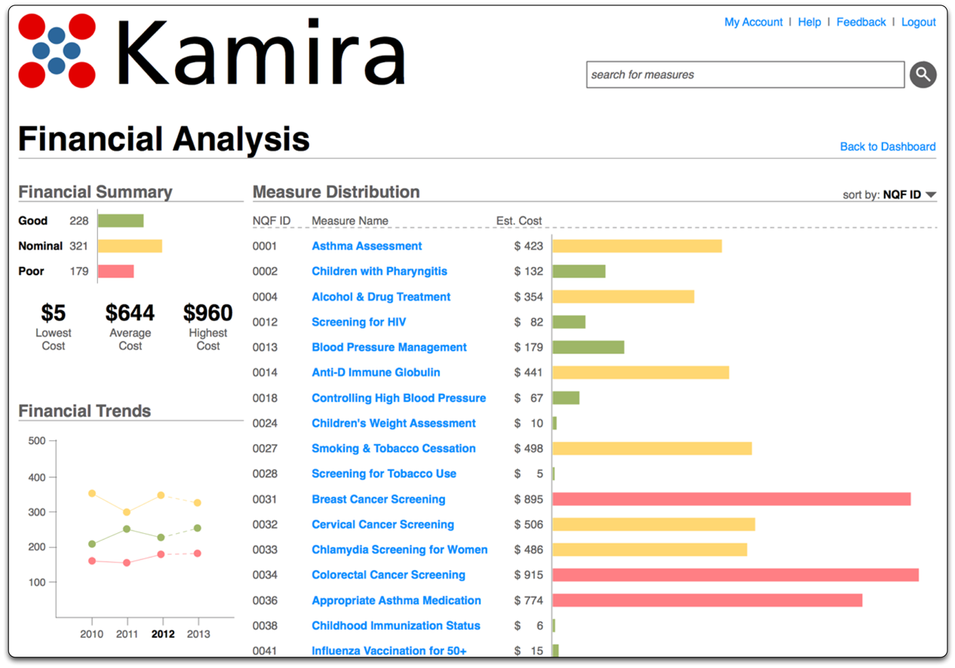
NOTIONAL
NOTIONAL

Slide 27
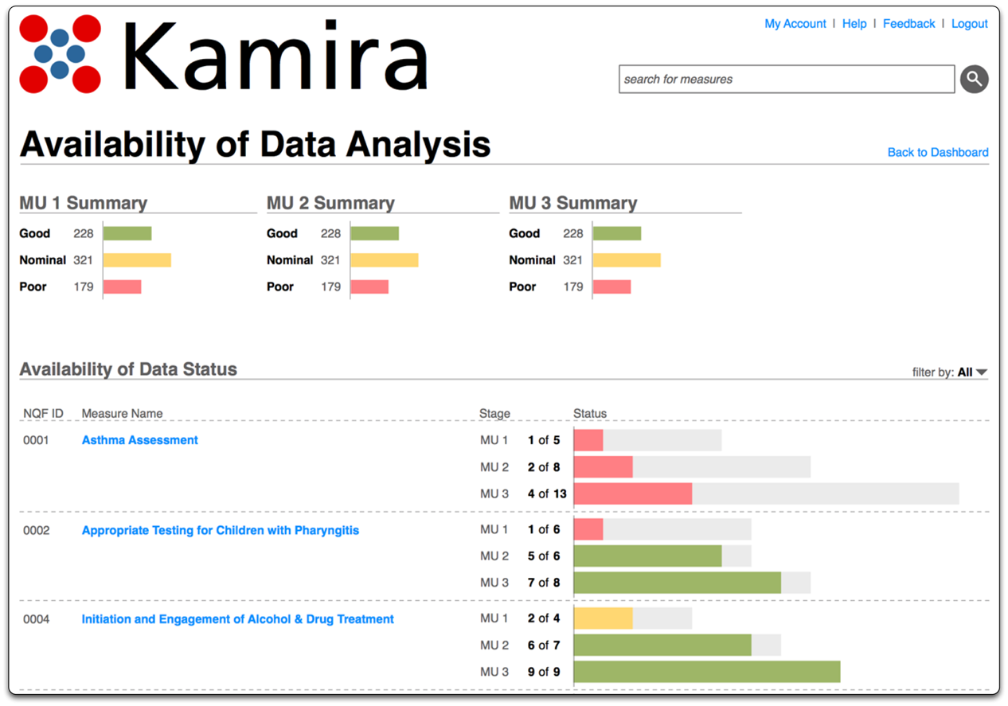
NOTIONAL
NOTIONAL

Slide 28
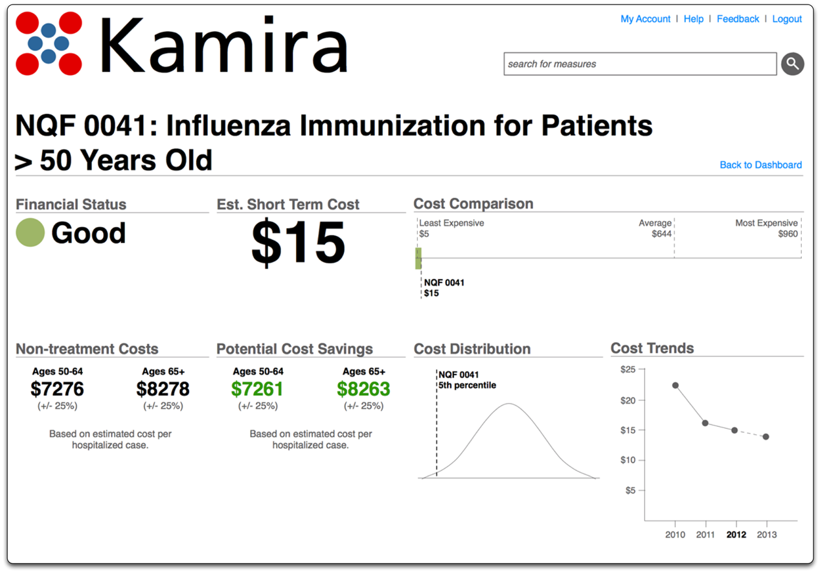
NOTIONAL
NOTIONAL

Slide 29
Target Users
Federal Policy Makers Considering Clinical Quality Measures
Office of the National Coordinator for Health Information Technology (ONC)
Center for Medicare and Medicaid Services (CMS)
Veterans Administration (VA)
Clinical Quality Measure Stakeholders and Experts
National Quality Forum (NQF)
MITRE
Quality Measure Stewards
American Medical Association (AMA)
National Committee for Quality Assurance (NCQA)
Healthcare Information Exchanges (HIEs)
Accountable Care Organizations (ACOs)
Electronic Health Record Vendors (EHRs)

Slide 30
Open Source
Kamira will be freely available via an Apache 2.0 Open Source distribution license
http://www.apache.org/licenses/LICENSE-2.0.html
Apache 2.0 is desired to leverage the existing MITRE-developed popHealth open source software, also using Apache 2.0
Apache 2.0 is very industry-friendly and permissive for integrators
Public released content to be hosted http://projectkamira.org/

Slide 31
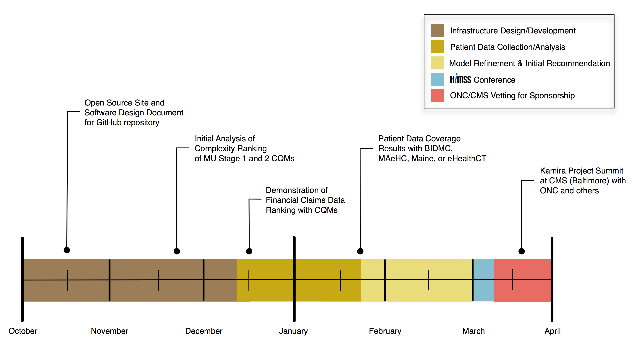
Proposed 6 Month Timeline

Slide 32
Questions?

