Slide 1
Aircraft Accident Data Analysis
By Mercy Ayub
Sep 09, 2024

Slide 2
Agenda
Introduction
About the Data
Process steps
Results & business application
Recommendation

Slide 3
Introduction
Our company is expanding to new industries to diversify its portfolio.
Specifically, they are interested in purchasing and operating airplanes for commercial and private enterprises.
Know more on potential risks of aircraft to pick the low-risk ones.
Considerations:
Factors for low-risk: injuries, level of damage, etc.
Make and model
Level of damage

Slide 4
About the Data
Data is for aviation accident data from 1962 to 2023 obtained from the National Transportation Safety Board.
Data on accidents and incidents from aviation used to determine low-risk aircraft
Coverage => United States, its territories and international waters

Slide 5
Process steps
Data understanding:
Overview – understand business requirements
Data understanding - Attributes and records
Selecting factors to be considered
Data preparation
Records editing for uniformity and easy manipulation
Handling missing records
Exploring data
Answering important questions: make, model, damage, injuries, etc
Recommendations
Selecting prospective suitable make and models

Slide 6
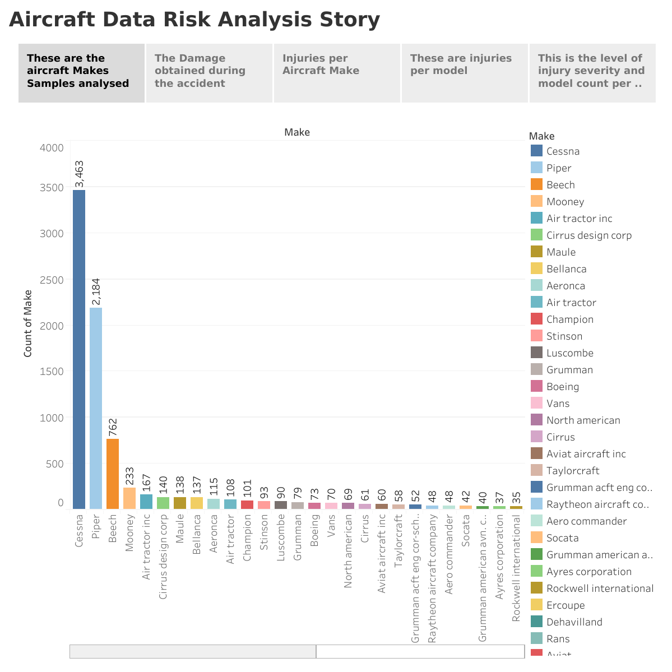

Slide 7
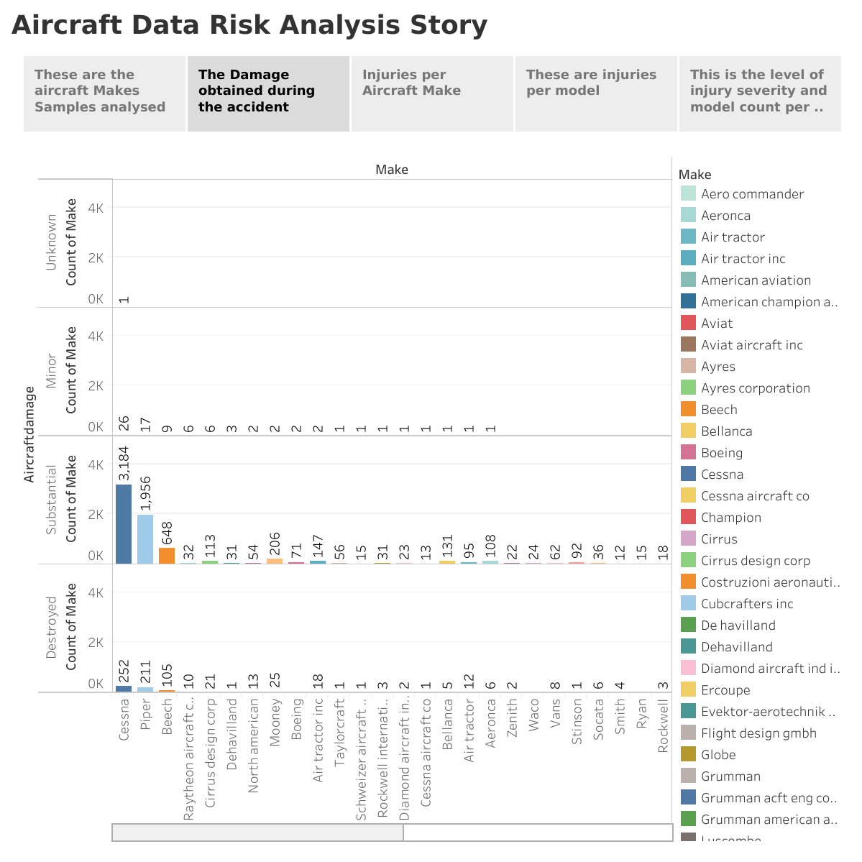

Slide 8
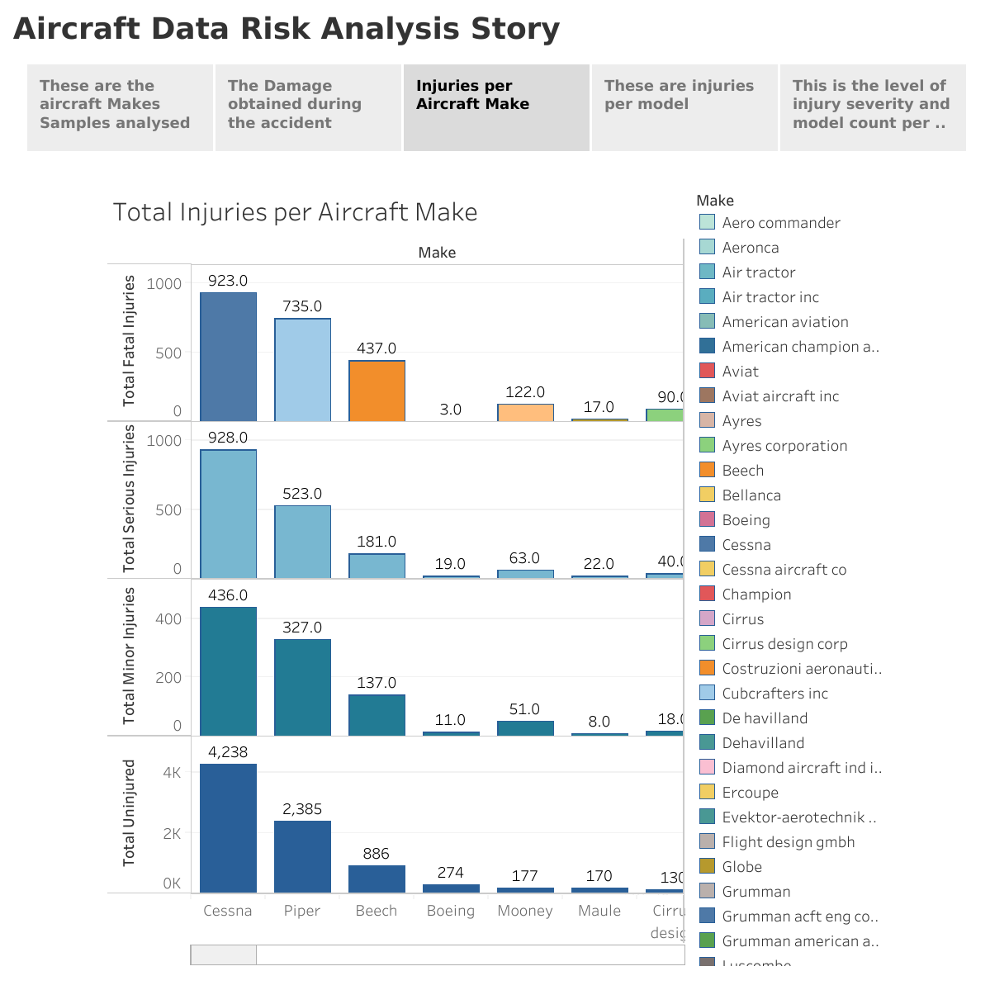

Slide 9
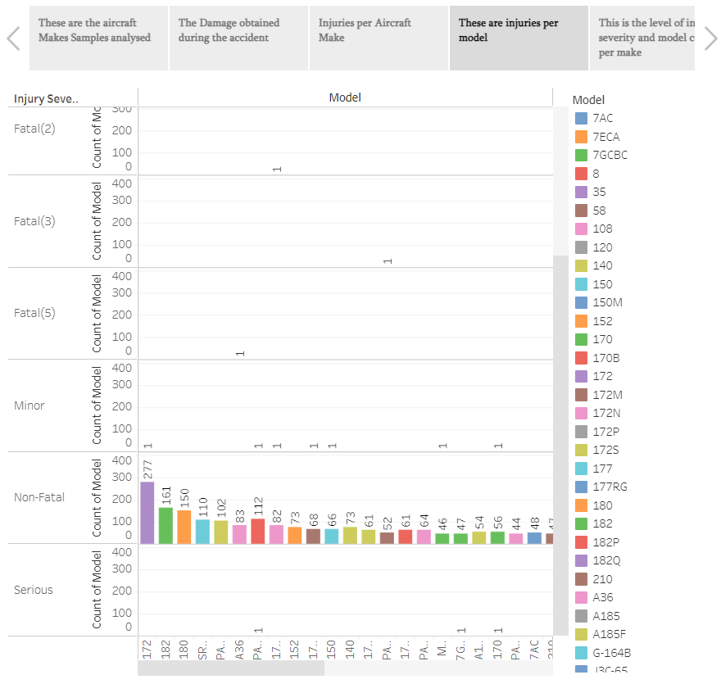

Slide 10
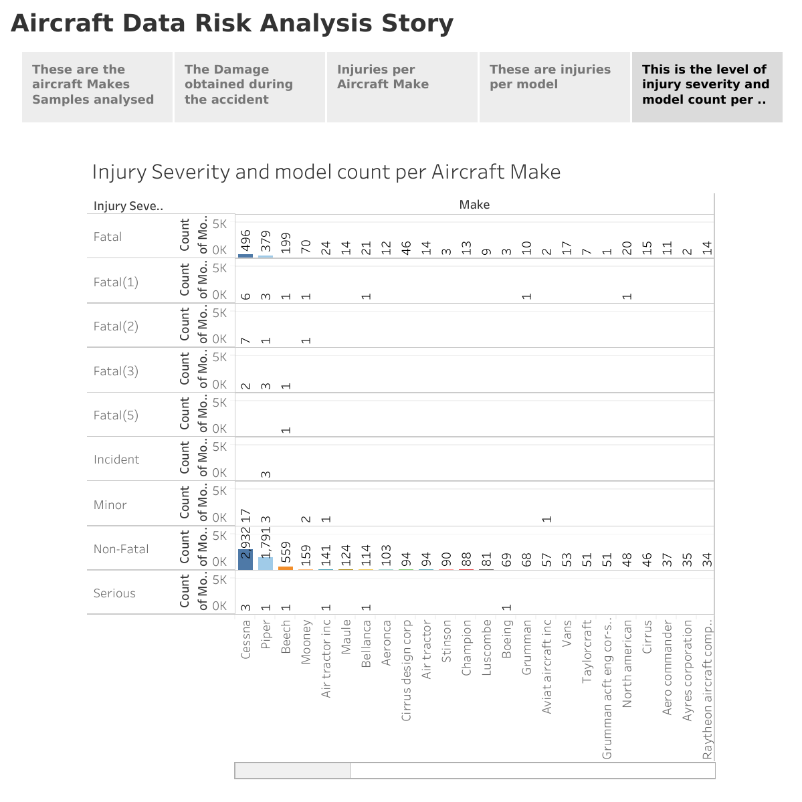

Slide 11
Recommendations
The top 3 showing more safety in terms of non-Fatal accidents and Level of Damage. i.e.: Cessna, Piper and Beech Make.
Model selection: The low-risk are the 172 models (of Cessna), with the most non-fatal injuries.
Others: Piper and Beech.
Cessna has the highest number of model count for non-fatal injuries, thus showing more safety.
Note: More research to be done based on other factors before making a decision on the chose of Airplane Make having more models that have Non-Fatal incidents/accidents.

Slide 12
Thank you ☺

