Slide 1
Develop a Search Tool to Analyze live Web Pages
Using Python 3.7

Slide 2
Introduction
Finding the count of a given word from a web page is of great importance in developing search engines like Google where the user inputs a set of words and a list of links is displayed in the order of maximum number of occurrences of the given words and considering other external factors.

Slide 3
Synopsis
Finds the count of a word present in a web page
The web page URL and the word is accepted as input from the user
The count is displayed as output
Also displays in tabular format the recent five searches made
Accepts Yes/No input from user and deletes the recent search history based on the user input
Stores a list of valid English words present in the web page and it’s count in an excel
Writes the HTML contents to a file

Slide 4
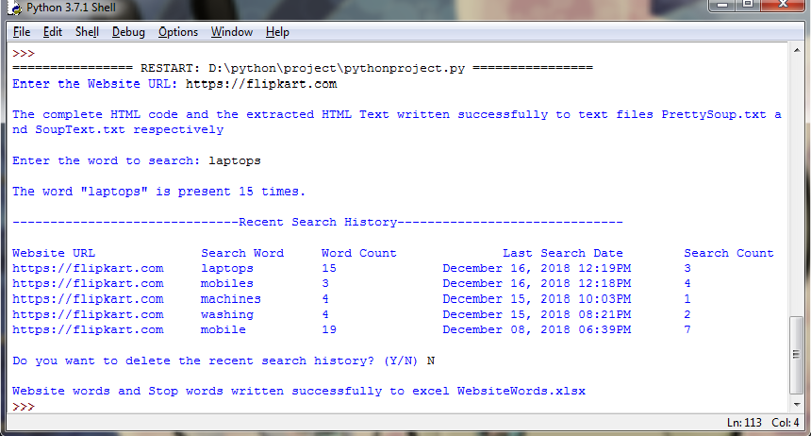
Output

Slide 5
Website Class
Attributes
Methods
Global Attributes:
stopWords
Instance Attributes:
websiteURL
pageText
soupText
soupFilteredText
inputWord
inpWordCount
wordsDict
Constructors: 1
Methods:
writeSoupToFile()
setWordsDict()
printInpWordCount()
printSearchHistory()
writeWordsToExcel()

Slide 6
Exception Handling
Validates the input URL by handling the following exceptions
InvalidSchema
MissingSchema
InvalidURL
ConnectionError
HTTPError
Handles the exception raised if the Excel is open when the program is running
PermissionError

Slide 7
Files & Databases
Files
Database
PrettySoup.txt
Stores the complete HTML code
SoupText.txt
Stores the text content of the HTML without tags
WebsiteWords.xlsx
Words Worksheet: Stores the list of valid English words present in the web page and it’s count
StopWords Worksheet: Stores the Stop Words retrieved from the nltk module
WordsDB : sqlite3
Table: search_history
Columns:
search_id : integer
website_url : text
search_word : text
word_count : integer
last_search_date : int
search_count : integer

