Slide 1
Ethiopian Smallholder Crop Yield Challenge
Weather-aware yield prediction, pricing context, and live demo

Slide 2
Data cleaning and integration
• Cleaned plot, weather, and market tables in code
• Standardized region and crop labels across all tables
• Joined weather by region + year + planting-season window
• Added weather-derived features and revenue metrics
• Validated model features on train-only statistics

Slide 3
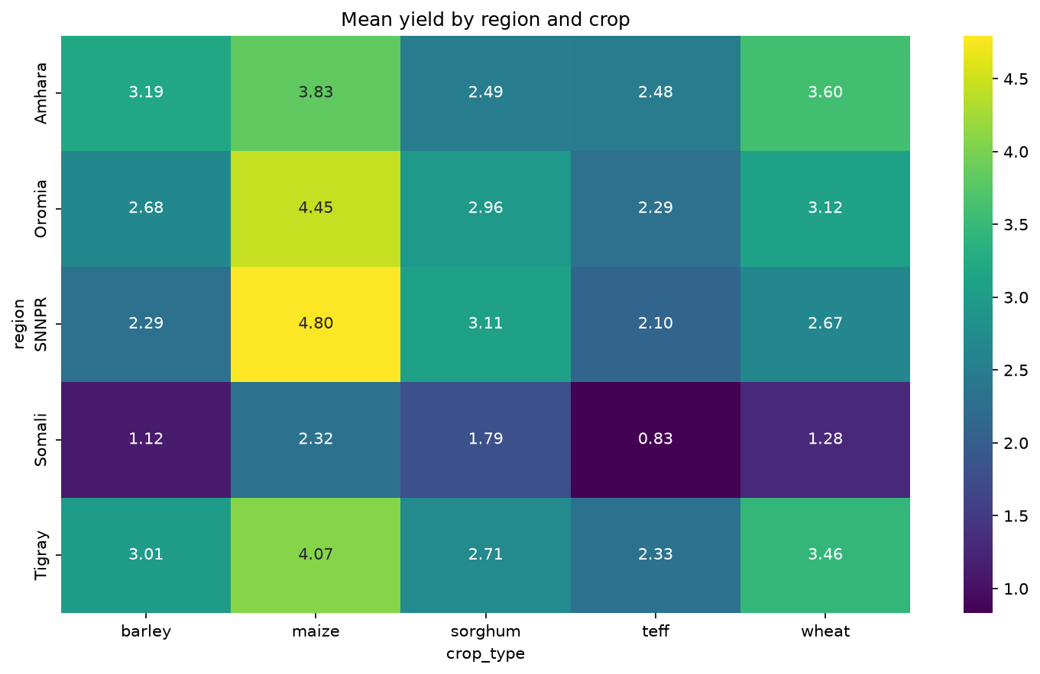
Key findings
• Yield differs materially by crop and region
• Weather features improve the model versus the no-weather baseline
• Price trends show material regional and crop differences
• Revenue per hectare is not the same as yield per hectare

Slide 4
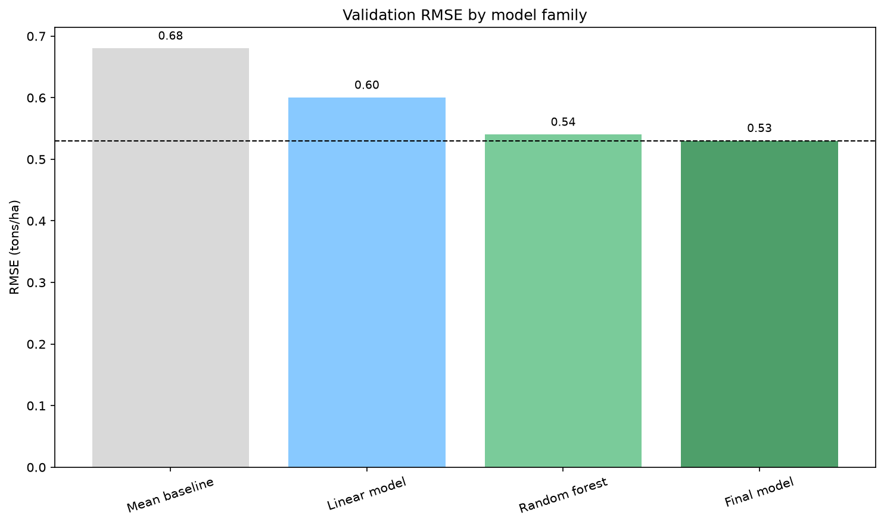
Modeling and evaluation
Weather-aware model: RMSE 0.5397, MAE 0.3908, R² 0.8518
No-weather ablation: RMSE 0.5933, MAE 0.4352, R² 0.8209
Final choice: RandomForestRegressor with weather features
Train/validation split: 80/20, random_state=42

Slide 5
Demo and next steps
• Live prediction app served on localhost:3000 and API on localhost:8000
• The app looks up seasonal weather and price automatically
• Estimated yield and revenue are returned in one step
• Next improvement: expand tuning and uncertainty estimates
• Link: local demo run from the project root and app directory

