Slide 1
MySQL

Slide 2
Introduction
Data:
Data refers to raw facts or information that can be processed or used for various purposes. It can be numbers, text, images, audio, video.
Database:
A database is a structured collection of data that is organized in a way that allows for efficient storage, retrieval, and manipulation.
It provides a mechanism for managing large volumes of data and ensuring data integrity.
Database Management System (DBMS):
A DBMS is software designed to manage databases. It provides an interface for users to interact with the database by performing tasks such as storing, retrieving, updating, and deleting data.

Slide 3
Introduction
Relational Database Management System (RDBMS):
An RDBMS is a specific type of DBMS that is based on the relational model of data. In an RDBMS, data is organized into tables, with each table consisting of rows and columns.
Relationships between tables are established through keys, such as primary keys and foreign keys. RDBMSs are widely used in various applications and industries due to their flexibility, scalability, and ease of use.
Table:
A table is a structured collection of data organized into rows and columns.
Each column in a table represents a specific attribute, while each row represents a single record or entry.

Slide 4
Different RDBMS
Oracle – Owned by Oracle – Licensed ORDBMS
SQL Server – Microsoft- Licensed RDBMS
NoSQL Databases- MongoDB etc.
Postgres- Enterprise DB- Opensource ORDBMS(Free)
MySQL – Oracle
Community Edition- Open Source(Free to use)
If mysql is embedded in some application and you are selling that application then you need to pay licensing to oracle for mysql
Enterprise Edition- Licensed by Oracle

Slide 5
MYSQL CLIENT
MySQL Workbench- it is Graphical User Interface to connect to MySQL Database
Mysql Command Line- it is a command line utility to connect to MysqL Database
Default Port for MySQL – 3306
Default Port for Oracle- 1521
Default Port for SQL Server- 1433
Default Port for Postgres- 5432

Slide 6
Basic Queries
Mysql –u root –p after this enter password # use to get into data base
Show databases; # use to list the databases present
Select database(); # shows the current data base in use
Create database databasename; # use to create the new database
Use databasename; # use to select the database of our choice
drop database databasename ; # use to delete the database .
Show tables; # will show the tables present in database
Desc table_name; # show the description of table

Slide 7
Creating tables
To create Table:
Create table table_name( col_name datatype constraints, ….);
Example:
Create table t1(c1 int ,c2 varchar(100),c3 date, c4 double);
Table formate:
Desc t1; -- gives description of table

Slide 8
Insert- is used to add the records to table
Insert into table_name (c1,c2,c3…) values(give values ……)
Example
Insert into t1(c1,c2,c3,c4) values(1,’a’,’2022-01-31’,23.567);
insert into t1 values(10,'arun','2022-01-01‘, 5.67);
Multi- row insert command
Insert into t1(c1,c2,c3,c4) values(1,’a’,’2022-01-31’, 2.3),
(2,’b’,’2022-01-31’, 3.56), (3,’c’,’2022-01-31’, 4.56),
(4,’d’,’2022-01-31’, 6.8);

Slide 9
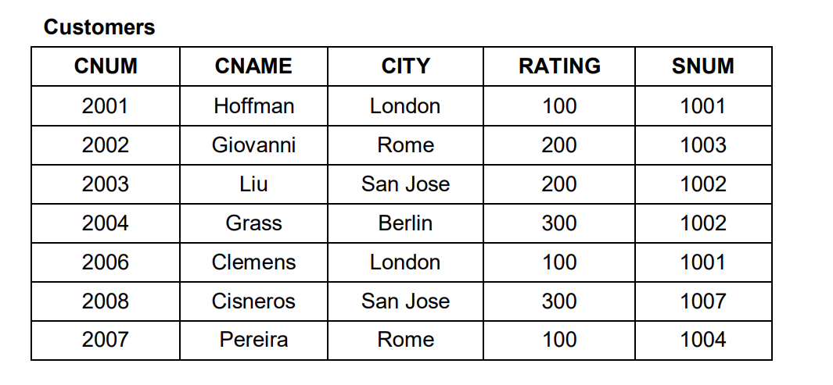
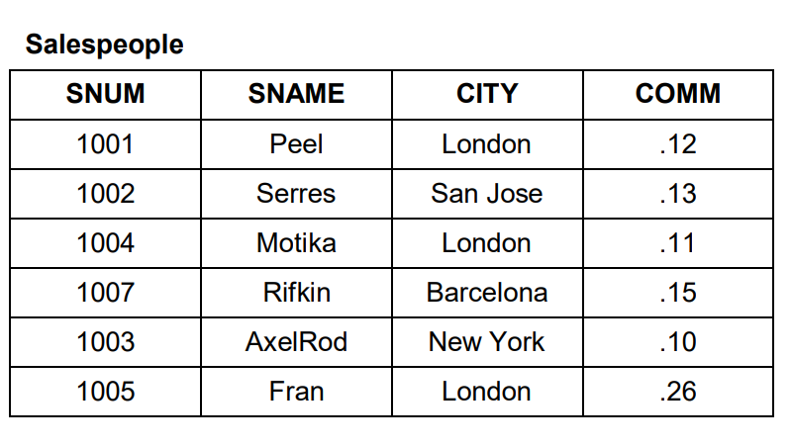
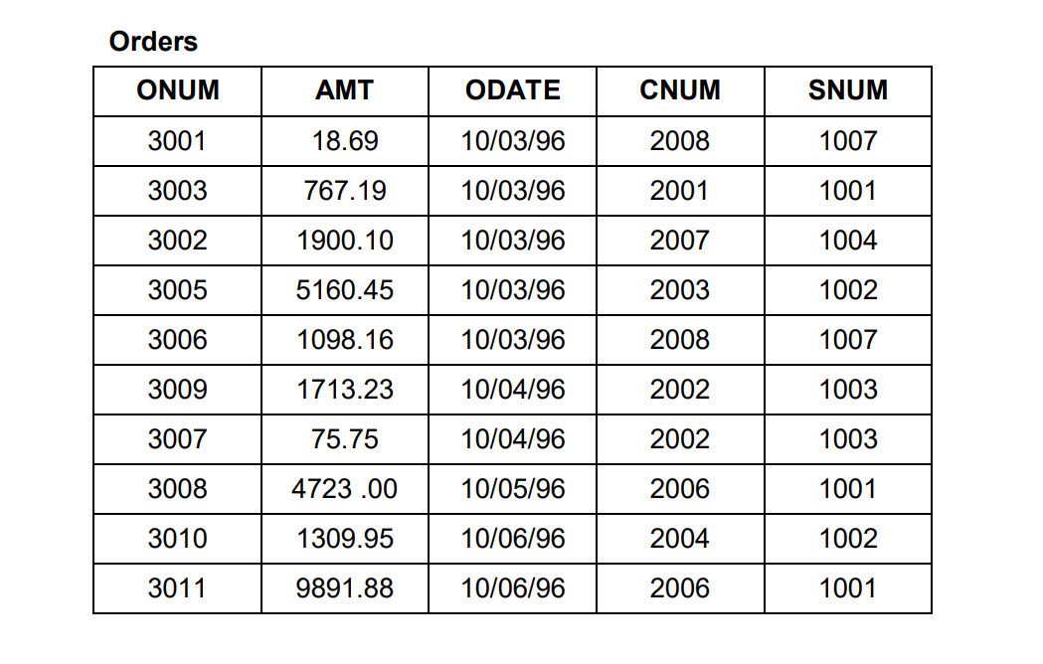

Slide 10
Update & Delete command
UPDATE:
UPDATE table_name SET column1 = value1, ... WHERE condition;
UPDATE customers SET city = “San Jose” WHERE cnum=2004;
DELETE:
DELETE FROM table_name WHERE condition;
DELETE FROM salespeople WHERE snum=“1003”;

Slide 11
Operators
=
!= or < >
>
<
>=
<=
In
Not in
Between
Not between
Is null
Is not null
>any or >all
< any or <all
<= any or < all
>=any or >= all
=any or =all
Like
Not Like

Slide 12
Alter Commands
Add Column: Add a new column to an existing table using ADD keyword.
ALTER TABLE table_name ADD Column column_name datatype;
Modify Column: Modify the data type or other properties of an existing column.
ALTER TABLE table_name MODIFY Column column_name datatype;
Drop Column: Remove an existing column from a table.
ALTER TABLE table_name DROP Column column_name;

Slide 13
Alter syntax
Add Constraint: Add a new constraint, such as a foreign key, check constraint, to an existing table.
ALTER TABLE table_name ADD CONSTRAINT constraint_name constraint_definition;
Rename Table: You can rename an existing table.
ALTER TABLE old_table_name RENAME TO new_table_name;
Rename Column: You can rename an existing column in a table.
ALTER TABLE table_name RENAME COLUMN
old_column_name TO new_column_name;

Slide 14
Constraints
some sort of restrictions - are used to enforce integrity of the data
Unique Key, Primary Key, Not Null …etc.
Check Constraint - define what range of values will be allowed/not allowed for a column
ALTER TABLE customers ADD CHECK (rating >= 100);
Default - defines what column value will take if explicit value for the column is not provided while inserting the data.
ALTER TABLE customers MODIFY City Varchar(10) DEFAULT ‘London';

Slide 15
What are different keys in sql?
Primary Key:
A primary key uniquely identifies each record in a table.
It must contain unique values and cannot contain NULL values.
Primary keys are often used as the basis for foreign key relationships with other tables. There can only be one primary key per table.
In many cases, a primary key is an auto-incremented integer column, but it can also be a composite key or a natural key.
Unique Key:
A unique key ensures that each value in a column is unique.
Unlike the primary key, it can contain NULL values, but only one NULL value per column. Multiple unique keys can exist in a table.

Slide 16
Foreign Key:
A foreign key establishes a relationship between two tables. It refers to the primary key or a unique key in another table, creating a parent-child relationship.
It ensures referential integrity by enforcing data consistency across related tables.
Candidate Key:
A candidate key is a column or a set of columns that could potentially serve as a primary key. It must be unique and non-null.
In a table, multiple candidate keys can exist, but only one is chosen as the primary key.

Slide 17
Natural Key:
A natural key is a key that is derived from the data itself, often based on real-world attributes. It can be a single column or a combination of columns.
Examples include social security numbers, email addresses, or unique identifiers inherent to the domain.
Surrogate Key:
A surrogate key is a system-generated key used as a substitute for a natural key. Surrogate keys are commonly auto-incremented integers.
It has no intrinsic meaning and is solely used for database operations.

Slide 18
Super Key:
A super key is a set of one or more columns that uniquely identifies each record in a table. It may contain more columns than necessary to uniquely identify each record.
A super key can include candidate keys, primary keys, or even non-key attributes.
It is a broader concept than candidate keys because it encompasses all possible keys, including keys that are not minimal.
Composite Key:
A composite key consists of two or more columns that together uniquely identify each record in a table. It allows for more precise data uniqueness constraints compared to single-column keys.

Slide 19
DDL- Data Definition Language
Data Definition Language is a subset of SQL used to define, modify, and manage the structure of database objects.
DDL statements are responsible for defining the organization of data in the database.
Common DDL statements include:
CREATE: create database demo;
ALTER: alter table t1 add column c5 int not null;
RENAME: alter table t1 rename to table1;
TRUNCATE: truncate table t1
DROP: drop table t1; | drop database demo;

Slide 20
Truncate vs. Delete
Truncate also delete data from the table but truncate doesn’t have any where clause which means truncate will remove all the records whereas delete can delete specific records using where clause
Truncate cannot be rollback but delete can be rollback
Truncate is faster in performance than delete
Truncate resets the auto increment value to initial value where as delete doesn’t reset the auto increment value
Delete can have a trigger but truncate cannot have a trigger
Delete can be executed on parent table having a foreign key but Truncate cannot.

Slide 21
DML- Data Manipulation Language
Data Manipulation Language is a subset of SQL used to manipulate data stored in the database.
Unlike DDL, which deals with the structure of the database objects, DML focuses on the actual data within those objects:
INSERT: Used to insert new rows of data into a table.
UPDATE: Used to modify existing data in a table.
DELETE: Used to remove one or more rows of data from a table.
DRL- Data Read Language:
SELECT: Used to retrieve data from one or more tables in the database.

Slide 22
DCL- Data Control Language
Data Control Language is a subset of SQL used to control access to data within the database.
DCL statements are primarily concerned with defining and managing permissions and privileges for database users.
GRANT: Used to give specific privileges or permissions to users.
Example: Giving permission to plummer to access the kitchen
REVOKE: Used to revoke previously granted privileges from users.
After the task complete removing permission.

Slide 23
TCL- Transaction Control Language
Transaction Control Language (TCL) is a subset of SQL used to manage transactions within a database.
TCL statements are responsible for controlling the transactional behavior of SQL operations, ensuring data integrity and consistency.
Start Transaction: Used to start the transaction without this command rollback will not work.
COMMIT: Used to permanently save the changes made during the current transaction to the database.
ROLLBACK: Used to undo all the changes made during the current transaction and restore the database to its previous state.

Slide 24
Joins

Slide 25
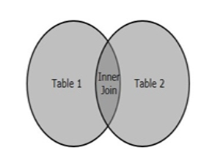
Inner Join
Returns only the rows where there is a match in both tables based on the specified condition.
It selects rows that have matching values in both tables' columns.
SQL Inner Join is a type of join that combines multiple tables by retrieving records that have matching values in both tables (in the common column).
Example:
SELECT column_name(s)
FROM table1 INNER JOIN table2
ON table1.col_name = table2.col_name;

Slide 26
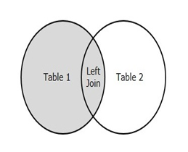
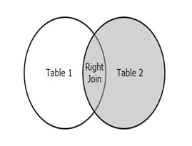
Left and Right Join
LEFT JOIN (or LEFT OUTER JOIN): Returns all rows from the left table and matching rows from the right table.
If there is no match, it returns NULL for the columns from the right table.
RIGHT JOIN (or RIGHT OUTER JOIN): Returns all rows from the right table and matching rows from the left table.
If there is no match, it returns NULL for the columns from the left table.
Example:
SELECT t1.c1, t2.c2 FROM t1 LEFT JOIN t2 ON t1.c1 = t2.c2;
SELECT t1.c1, t2.c2 FROM t1 RIGHT JOIN t2 ON t1.c1 = t2.c2;

Slide 27
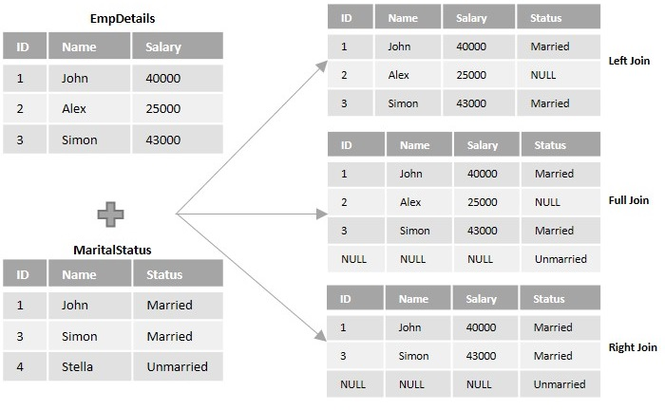
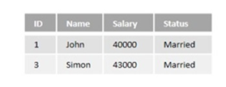
Inner Join

Slide 28
Column Alias:
A column alias is a name given to a column or an expression in the result set of a SQL query. It allows you to rename the output of a column or an expression to make it more meaningful or readable.
Column aliases are often used when the result set includes calculated fields, to provide a descriptive name for the calculated value. Column aliases are specified using the AS keyword followed by the desired name.
Example:
SELECT first_name AS "First Name", last_name AS "Last Name",
salary * 12 AS "Annual Salary“ FROM employees;

Slide 29
Table Alias:
A table alias is a shorthand notation used to reference a table within a SQL query.
It provides a shorter or more convenient way to reference a table, especially when the table name is long or when multiple tables are involved in a query.
Table aliases are specified after the table name in the FROM clause, using the AS keyword followed by the desired alias.
Example:
SELECT e.first_name, e.last_name, d.department_name
FROM employees AS e
JOIN departments AS d ON e.department_id = d.department_id;

Slide 30
Cross & Self Join
Cross Join is a basic type of inner join that is used to retrieve the Cartesian product (or cross product) of two individual tables.
Example:
SELECT ID, NAME, AMOUNT, DATE FROM CUSTOMERS CROSS JOIN ORDERS;
Self Join, is a type of join that combines the records of a table with itself.
Example:
SELECT a.ID, b.NAME as EARNS_HIGHER, a.NAME as EARNS_LESS,
a.SALARY as LOWER_SALARY FROM CUSTOMERS a, CUSTOMERS b
WHERE a.SALARY < b.SALARY;

Slide 31
Set Operators
Union
Union all
Intersect
Minus – Not Supported in MySQL instead Except Supported in MySQL
Pre-requisites for using Set Operators
Both the queries should have same number of columns
Corresponding data types of the columns in both the queries should be same/compatible

Slide 32
Two Sets A={1,2,3} and B={3,4,5}
A Union B= {1,2,3,4,5}– Need to perform sort to remove duplicates
B Union A= {3,4,5,1,2} – Need to perform sort to remove duplicates
A Union All B={1,2,3,3,4,5}- Doesn’t remove duplicates so no sort is required
B Union All A={3,4,5,1,2,3}-- Doesn’t remove duplicates so no sort is required
A Intersect B={3}– just the common elements
B Intersect A={3} – just the common elements
A minus B={1,2}– Elements of A which are not in B
B Minus A= {4,5}- Elements of B which are not in A

Slide 33
Aggregate Functions
Aggregate functions in SQL are functions that operate on a set of values and return a single value summarizing the data in that set. These functions are commonly used with the GROUP BY clause to perform calculations on groups of rows rather than individual rows.
Count- works on all data types
Count(*)/count(1) will count number of records in the table
Count(col_name) will count the number of not null values in the column of that table
Sum- Works only with numeric data types, Calculates the sum of values in a column.
Max- Finds the maximum value in a column.(recommended for Numeric)
Min- Finds the minimum value in a column.(recommended for Numeric)
Avg- only numeric fields, Calculates the average of values in a column.

Slide 34
Select Query Syntax
Select Column List(c1,c2…)
From
Table_List (t1,t2,t3) (join)
On
Where
6. Group by Clause
7. Having Clause
8. Order by
9. Limit
10. Offset

Slide 35
Group by Clause
When you use GROUP BY in a query, the result set is divided into groups of rows where the values of the specified column(s) are the same.
Once the rows are grouped, aggregate functions can be applied to each group to calculate summary statistics or perform calculations based on the grouped data.
After the aggregation, each group is represented by a single summary row in the result set of the aggregate function applied to the group.
Example:
SELECT product_name, SUM(amount) AS total_amt FROM sales
GROUP BY product_name;

Slide 36
Having clause
The HAVING clause in SQL is used to filter the results of a GROUP BY clause based on specified conditions.
While the WHERE clause filters individual rows before they are grouped, the HAVING clause filters groups of rows after they have been grouped by the GROUP BY clause and after the aggregate functions have been applied.
Example:
SELECT product_name, SUM(amount) AS total_amt FROM sales
GROUP BY product _name
HAVING SUM(amount) > 1000;

Slide 37
Where Clause Vs Having Clause
The WHERE clause is used to filter rows from the result set based on specified conditions.
It is applied before the rows are grouped (if using GROUP BY) and before any aggregate functions are calculated.
The WHERE clause is typically used to filter individual rows based on column values.
It cannot be used to filter based on aggregated results or calculated fields.
The HAVING clause is used to filter grouped rows from the result set based on specified conditions.
It is applied after the rows are grouped (if using GROUP BY) and after any aggregate functions are calculated.
The HAVING clause is typically used to filter groups of rows based on aggregated results or calculated fields.
It can only be used in conjunction with the GROUP BY clause.

Slide 38
ORDER BY Clause:
The ORDER BY clause in SQL is used to sort the result set of a query based on one or more columns.
It allows you to specify the order in which the rows should appear in the final result set. If no sort order is specified, the default is ascending order.
Each column specified in the ORDER BY clause can be followed by an optional ASC (ascending) or DESC (descending) keyword to specify the sort order.
Example:
SELECT * FROM sales ORDER BY salesperson_name DESC;
SELECT * FROM sales ORDER BY amount DESC, sp_name ASC;

Slide 39
DISTINCT
When you use DISTINCT in a SELECT statement, it instructs the database to remove duplicate rows from the result set before returning the data to the user.
It applies to all columns specified in the SELECT clause, not just one specific column. The DISTINCT keyword is often used when you want to retrieve unique values from a column or a combination of columns in a table.
Example:
SELECT DISTINCT category FROM products;
SELECT DISTINCT city, state FROM customers;
SELECT COUNT(DISTINCT order_id) AS unique_orders FROM orders;
SELECT DISTINCT customer_id FROM orders
WHERE region = 'North America' ORDER BY registration_date;

Slide 40
Limit and Offset
The LIMIT and OFFSET clauses in SQL are used to control the number of rows returned by a query and to specify a starting point for retrieving rows from the result set, respectively.
These clauses are commonly used together to implement pagination in applications where data needs to be displayed in smaller, manageable chunks.
Limit: ( How many rows to fetch )
SELECT * FROM employees LIMIT 10;
Offset: ( starting point )
SELECT * FROM employees LIMIT 10 OFFSET 20;

Slide 41
String functions in MySQL
1. ASCII: Returns the ASCII value for the specific character.
2. CHAR_LENGTH: Returns the length of a string (in characters).
3. CHARACTER_LENGTH: Returns the length of a string (in characters).
4. CONCAT: Adds two or more expressions together.
5. FORMAT: Formats a number to a format like "#,###,###.##", rounded to a specified number of decimal places.
6. INSERT: Inserts a string within a string at the specified position and for a certain number of characters.
7. LCASE: Converts a string to lower-case.
8. LEFT: Extracts a number of characters from a string (starting from left).

Slide 42
String functions in MySQL
9. LENGTH: Returns the length of a string (in bytes).
10. LOCATE: Returns the position of the first occurrence of a substring in a string.
11. LOWER: Converts a string to lower-case.
12. LPAD: Left-pads a string with another string, to a certain length.
13. LTRIM: Removes leading spaces from a string.
14. MID: Extracts a substring from a string (starting at any position).
15. POSITION: Returns the position of the first occurrence of a substring in a string.
16. REPEAT: Repeats a string as many times as specified.
17. UPPER: Converts a string to upper-case

Slide 43
String functions in MySQL
18. REVERSE: Reverses a string and returns the result.
19. RIGHT: Extracts a number of characters from a string (starting from right).
20. RTRIM: Removes trailing spaces from a string.
21. SPACE: Returns a string of the specified number of space characters.
22. SUBSTR: Extracts a substring from a string (starting at any position).
23. SUBSTRING: Extracts a substring from a string (starting at any position).
24. TRIM: Removes leading and trailing spaces from a string.
25. UCASE: Converts a string to upper-case.
26. REPLACE: Replaces all occurrences of a substring within a string, with a new substring.

Slide 44
Numeric Functions MySQL
MAX: Returns the maximum value in a set of values.
MIN: Returns the minimum value in a set of values.
MOD: Returns the remainder of a number divided by another number
PI: Returns the value of PI which is 3.14.
POW: Returns the value of a number raised to the power of another number.
ABS: Returns the absolute value of a number.
AVG: Returns the average value of an expression.
CEIL: Returns the smallest integer value that is >= to a number.

Slide 45
Numeric Functions MySQL
DIV: Used for integer division.
FLOOR: Returns the largest integer value that is <= to a number.
SIGN: Returns the sign of a number.
SQRT: Returns the square root of a number.
SUM: Calculates the sum of a set of values.
CEILING: Returns the smallest integer value that is >= to a number.
COUNT: Returns the number of records returned by a select query.
POWER: Returns the value of a number raised to the power of another number.
ROUND: Rounds a number to a specified number of decimal places.

Slide 46
Sub Queries
Sub queries, also known as nested queries or inner queries, are embedded within the context of another query.
Depending on the context and requirement, subqueries can return either a single value or multiple rows of data.
They allow you to use the result of one query as a part of another query.
Nested Structure: Sub queries are enclosed within parentheses () and are typically placed within the WHERE, FROM, or SELECT clauses of another query.
Execution Order: The sub query is executed first, and its result set is then used by the outer query.

Slide 47
Case statements
The CASE statement in SQL is a conditional expression that allows you to create more complex queries by applying different conditions and returning specific values based on those conditions.
It's similar to IF-THEN-ELSE logic in programming languages.
Syntax of CASE Statement:
CASE expression
WHEN value1 THEN result1
WHEN value2 THEN result2 ….
ELSE default_result
END

Slide 48
Window functions
ROW_NUMBER(): assigns a unique sequential integer to rows within a partition of a result set. Each row gets a unique number, starting from 1 for the first row in each partition.
RANK(): assigns a rank to rows within a partition of a result set. Rows with equal values receive the same rank. The next rank(s) will have a gap. For example, if two rows share rank 1, the next rank will be 3.
DENSE_RANK(): assigns ranks to rows within a partition of a result set. Rows with equal values receive the same rank. The next rank is the next consecutive number, without gaps.

Slide 49
EXISTS Operator in SQL
The EXISTS operator is used to check the existence of any record in a subquery.
It returns TRUE if the subquery returns one or more records, and FALSE if the subquery returns no records. It is typically used in the WHERE clause to filter records based on the results of another query.
Used for Optimizing queries to quickly determine the presence of rows without needing to count them. Avoiding joins when only a simple existence check is needed.
Example:
SELECT column1, column2, ... FROM table_name
WHERE EXISTS (subqueSry);

Slide 50
MySQL Programming
Stored Procedures: are reusable routines that encapsulate a series of SQL statements. They are used to perform operations like inserting, updating, deleting records, or even complex business logic. Procedures can take parameters and return result sets.
Functions: are similar to stored procedures but are designed to return a single value and can be used in SQL statements. Functions can also take parameters.
Triggers: are special types of stored procedures that automatically execute in response to certain events on a particular table, such as INSERT, UPDATE, or DELETE. Triggers are useful for enforcing business rules, maintaining audit trails, and synchronizing tables.

Slide 51
Functions
You can call functions inside queries.
There are 3 types of function:
1. Deterministic- if the function is expected to return same output for the same input value each time.
2. Reads SQL Data- if the function is having select from table command
3. NO SQL – if the function doesn’t read data from SQL table.
Example:
DELIMITER //
CREATE FUNCTION CheckEvenOrOdd (num INT)
RETURNS VARCHAR(40)
DETERMINISTIC
BEGIN
RETURN IF(num%2 = 0, 'Even Number', 'Odd Number');
END; //
DELIMITER ;

Slide 52
Procedures
Set of code/program which can take input through some parameters and can also return values through out parameters. You cannot call procedures inside queries
Example:
DELIMITER $$
CREATE PROCEDURE sp_greeting(name VARCHAR(100))
BEGIN
SELECT CONCAT('hello ', name) AS greeting;
END;
$$
DELIMITER ;

Slide 53
Functions vs Procedure
Return Value:
A function must return a single value (scalar value).
The return value can be of any data type (e.g., INT, VARCHAR, DATE).
A stored procedure does not need to return a value, but it can return multiple values through output parameters or result sets.
It can return zero or more result sets (like a series of SELECT statements).
Flexibility:
Functions: Less flexible in terms of performing multiple operations.
Procedures: More flexible, allowing for complex logic and multiple operations

Slide 54
Functions vs Procedure
Usage:
Functions can be used in SQL statements like SELECT, WHERE, HAVING, etc.
They can be called from within other SQL expressions.
Functions are often used for computations and to return single values derived from input parameters.
Procedures are invoked using the CALL statement.
They are typically used for operations that require multiple steps or complex logic, such as data manipulation (INSERT, UPDATE, DELETE) or administrative tasks.
Procedures can contain both procedural logic (loops, conditionals) and SQL statements.

Slide 55
Triggers
A trigger in SQL is a set of actions that are automatically executed in response to certain events on a specified table. Triggers can be invoked before or after an INSERT, UPDATE, or DELETE operation.
They are used to enforce business rules, validate input data, maintain audit trails, and implement complex default values.
Syntax: CREATE TRIGGER trigger_name
{BEFORE | AFTER} {INSERT | UPDATE | DELETE}
ON table_name FOR EACH ROW
BEGIN
-- SQL statements
END;

Slide 56
Views
A view in SQL is a virtual table that provides a way to present data from one or more tables in a specific format without altering the underlying tables.
Views are used to simplify complex queries, enhance security by restricting access to certain data, and present data in a more convenient form for users.
Syntax:
CREATE VIEW view_name AS SELECT column1, column2, ... FROM table_name WHERE condition;

Slide 57
Normalization
This is the process which allows you to window out redundant data within your database.
This involves restructuring the tables to successively meeting higher forms of Normalization.
A properly normalized database should have the following characteristics
Scalar values in each fields
Absence of redundancy.
Minimal use of null values.
Minimal loss of information.

Slide 58
Levels of Normalization
Levels of normalization based on the amount of redundancy in the database.
Various levels of normalization are:
First Normal Form (1NF)
Second Normal Form (2NF)
Third Normal Form (3NF)
Boyce-Codd Normal Form (BCNF)
Fourth Normal Form (4NF)
Fifth Normal Form (5NF)
Domain Key Normal Form (DKNF)
Redundancy
Number of Tables
Complexity
1NF
2NF
3NF
4NF
5NF
DKNF
Most databases should be 3NF or BCNF in order to avoid the database anomalies.

Slide 59
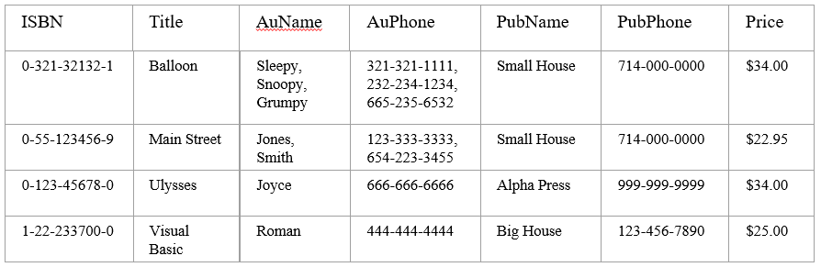
First Normal Form(1NF)
A table is considered to be in 1NF if all the fields contain
only scalar values (as opposed to list of values).
Example (Not 1NF)
Author and AuPhone columns are not scalar

Slide 60
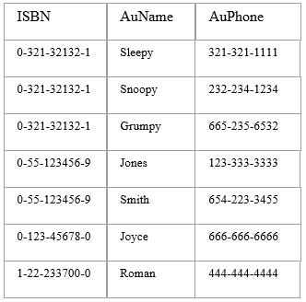
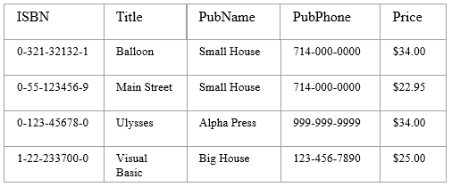
1NF - Decomposition
Place all items that appear in the repeating group in a new table
Designate a primary key for each new table produced.
Duplicate in the new table the primary key of the table from which the repeating group was extracted or vice versa.
Example (1NF)

Slide 61
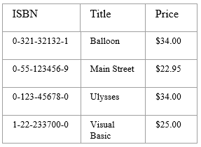
Functional Dependencies
If one set of attributes in a table determines another set of attributes in the table, then the second set of attributes is said to be functionally dependent on the first set of attributes.
Example 1
Table Scheme:
{ISBN, Title, Price}
Functional Dependencies:
{ISBN} → {Title}
{ISBN} → {Price}

Slide 62
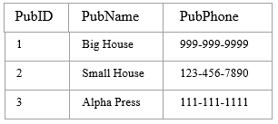
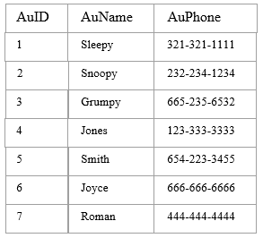
Functional Dependencies Examples
Table Scheme: {PubID, PubName, PubPhone}
Functional Dependencies:
{PubId} → {PubPhone}
{PubId} → {PubName}
{PubName, PubPhone} → {PubID}
Example 2
Table Scheme: {AuID, AuName, AuPhone}
Functional Dependencies:
{AuId} → {AuPhone}
{AuId} → {AuName}
{AuName, AuPhone} → {AuID}
Example 3

Slide 63
Second Normal Form (2NF)
The database is in first normal form and All non-key attributes in the table must be functionally dependent on the entire primary key
Example 1 (Not 2NF)
Scheme: {Title, PubId, AuId, Price, AuAddress}
Key → {Title, PubId, AuId}
{Title, PubId, AuID} → {Price}
{AuID} → {AuAddress}
AuAddress does not belong to a key
AuAddress functionally depends on AuId which is a subset of a key
Example 1 (Convert to 2NF)
Old Scheme:
{Title, PubId, AuId, Price, AuAddress}
New Schema:
{Title, PubId, AuId, Price}
{AuId, AuAddress}

Slide 64
Second Normal Form (2NF)
Example 2 (Not 2NF)
Scheme:
{City, Street, HouseNumber, HouseColor, CityPopulation}
key → {City, Street, HouseNumber}
{City, Street, HouseNumber} → {HouseColor}
{City} → {CityPopulation}
CityPopulation does not belong to any key.
CityPopulation is functionally dependent on the City which is a proper subset of the key
Example 2 (Convert to 2NF)
Old Scheme :
{City, Street, HouseNumber, HouseColor, CityPopulation}
New Scheme:
{city, Street, HouseNumber, HouseColor}
{city, cityPopulation}

Slide 65
Third Normal Form (3NF)
The table should be second normal form and No attribute is transitively dependent on the primary key.
Example (Not in 3NF)
Scheme → {Title, PubID, PageCount, Price }
Key → {Title, PubId}
{Title, PubId} → {PageCount}
{PageCount} → {Price}
Both Price and PageCount depend on a key hence 2NF
Transitively {Title, PubID} → {Price} hence not in 3NF
Transitively Dependent:
Table1:
A – Key Column
B, C, D – non-key Columns
D->C
C->A
D is transitively dependent on A

Slide 66
3NF - Decomposition
Move all items involved in transitive dependencies to a new entity.
Identify a primary key for the new entity.
Place the primary key for the new entity as a foreign key on the original entity.
Example 1 (Convert to 3NF)
Old Scheme → {Title, PubID, PageCount, Price }
New Scheme → {PubID, PageCount, Price}
New Scheme → {Title, PubID, PageCount}

Slide 67
Third Normal Form (3NF)
Example 2 (Not in 3NF)
Scheme → {Studio, StudioCity, CityTemp}
Primary Key → {Studio}
{Studio} → {StudioCity}
{StudioCity} → {CityTemp}
{Studio} → {CityTemp}
Both StudioCity and CityTemp depend on the entire key hence 2NF
CityTemp transitively depends on Studio hence violates 3NF
Example 2 (Convert to 3NF)
Old Scheme
{Studio, StudioCity, CityTemp}
New Scheme
{Studio, StudioCity}
{Studio, CityTemp}

Slide 68
Boyce-Codd Normal Form (BCNF)
BCNF does not allow dependencies between attributes that belong to candidate keys.
BCNF is a refinement of the third normal form in which it drops the restriction of a non-key attribute from the 3rd normal form.
Third normal form and BCNF are not same if the following conditions are true:
The table has two or more candidate keys
At least two of the candidate keys are composed of more than one attribute
The keys are not disjoint i.e. The composite candidate keys share some attributes

Slide 69
BCNF - Decomposition
Example 1 - Address (Not in BCNF)
Scheme → {City, Street, ZipCode }
Key1 → {City, Street }
Key2 → {ZipCode, Street}
No non-key attribute hence 3NF
{City, Street} → {ZipCode}
{ZipCode} → {City}
Dependency between attributes belonging to a key
Example 1 (Convert to BCNF)
Old Scheme
{City, Street, ZipCode }
New Scheme1
{ZipCode, Street}
{City, Street}
Loss of relation {ZipCode} → {City}
Alternate New Scheme1
{ZipCode, Street }
{ZipCode, City}

Slide 70
Decomposition – Loss of Information
If decomposition does not cause any loss of information it is called a lossless decomposition.
If a decomposition does not cause any dependencies to be lost it is called a dependency-preserving decomposition.
Any table scheme can be decomposed in a lossless way into a collection of smaller schemas that are in BCNF form. However the dependency preservation is not guaranteed.
Any table can be decomposed in a lossless way into 3NF that also preserves the dependencies. 3NF may be better than BCNF in some cases
Use your own judgment when decomposing schemas

Slide 71
Fourth Normal Form (4NF)
Fourth normal form eliminates independent many-to-one relationships between columns.
To be in Fourth Normal Form, a relation must first be in Boyce-Codd Normal Form. A given relation may not contain more than one multi-valued attribute.
Example (Not in 4NF)
Scheme → {MovieName, ScreeningCity, Genre)
Primary Key: {MovieName, ScreeningCity, Genre)
All columns are a part of the only candidate key, hence BCNF
Many Movies can have the same Genre
Many Cities can have the same movie, Violates 4NF
Movie
screeningCity
Genre
Hard Code
Los Angles
Comedy
Hard Code
New York
Comedy
Bill Durham
Santa Cruz
Drama
Bill Durham
Durham
Drama
The Code Warrier
New York
Horror

Slide 72
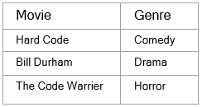
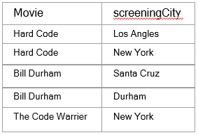
4NF - Decomposition
Move the two multi-valued relations to separate tables
Identify a primary key for each of the new entity.
Example 1 (Convert to 4NF)
Old Scheme:
{MovieName, ScreeningCity, Genre}
New Scheme:
{MovieName, ScreeningCity}
{MovieName, Genre}

Slide 73
Fourth Normal Form (4NF)
Example 2 (Not in 4NF)
Scheme → {Manager, Child, Employee}
Primary Key → {Manager, Child, Employee}
Each manager can have more than one child
Each manager can supervise more than one employee
4NF Violated
Example 2 (Convert to 4NF)
Old Scheme:
{Manager, Child, Employee}
New Scheme:
{Manager, Child}
{Manager, Employee}
Manager
Child
Employee
Manager
Employee
Manager
Child
Jim
Beth
Alice
Jim
Alice
Jim
Beth
Mary
Bob
Jane
Mary
Jane
Mary
NULL
Adam
Mary
Bob
Mary
Adam

Slide 74
Fifth Normal Form (5NF)
Fifth normal form is satisfied when all tables are broken into as many tables as possible in order to avoid redundancy.
Once it is in fifth normal form it cannot be broken into smaller relations without changing the facts or the meaning.
Domain Key Normal Form (DKNF)
The relation is in DKNF when there can be no insertion or deletion anomalies in the database.

Slide 75
Normalization Vs Denormalization
Normalization - Process of breaking big tables into multiple smaller tables to reduce data redundancy and eliminate DML anomalies.
Disadvantage is select queries become slow because you would need to perform multiple joins.
Denormalization- Process of combining multiple small tables into few big tables to increase data redundancy in order to increase the performance of select queries.
Disadvantage is redundancy of data

Slide 76
END

