Slide 1
Networking(N+)

Slide 2
Introduction
What is Network?
Network is a collection of multiple nodes (Network Devices).
A network is a collection of computers, servers, mainframes, network devices, peripherals, or other devices connected to allow data sharing.
An example of a network is the Internet, which connects millions of people all over the world.
What is networking?
Networking is a process of communication or transmission of data between devices is called Networking.

Slide 3
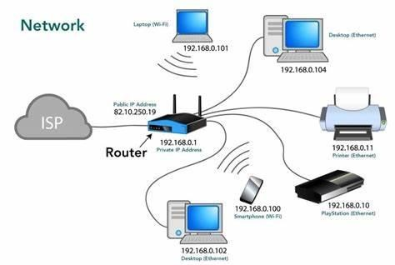
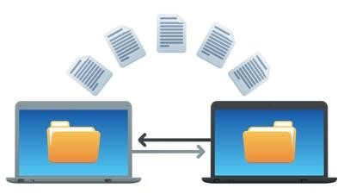
Network & Networking

Slide 4
Characteristics
Fault Tolerance:
If one node will go down remaining will work.
Quality Of Service:
Giving priority to the particular node(for transmission).
Scalability:
Even it grows(no. of user) it will give good performance.
Security:
When a non-user enters it will prevent by checking MAC & Authentications.

Slide 5
Data Communication
Sending Data from one end to another end (Receiver).
Types:
Simplex → Unidirectional. One way Communication.
Half-Duplex → Bi-directional but not in same time.
Duplex → Bi-directional In same time.
Sender
Receiver
Encode
Transmit
Decode

Slide 6
Types of computer network
A computer network is a group of computers linked to each other that enables the computer to communicate with another computer and share their resources, data, and applications.
A computer network is mainly of five types:
LAN (Local Area Network)
CAN (Campus Area Network)
MAN (Metropolitan Area Network)
WAN (Wide Area Network)
PAN (Personal Area Network)

Slide 7
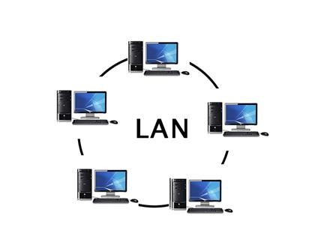
Local Area Network
Local Area Network is a group of computers connected to each other in a small area such as building, office.
LAN is used for connecting two or more personal computers through a communication medium such as twisted pair, coaxial cable, etc.

Slide 8
Advantages
It is less costly as it is built with inexpensive hardware such as hubs, network adapters, and Ethernet cables.
The data is transferred at an extremely faster rate and it also provides high security.
Disadvantages
Network performance degrades as the number of users exceeds.
A limited number of system can only be connected.

Slide 9
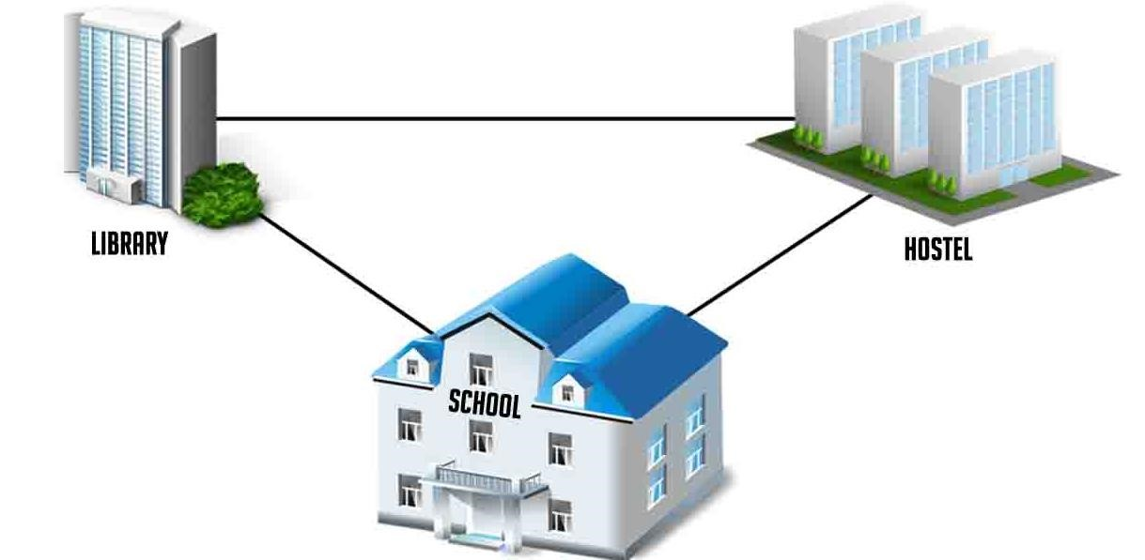
Campus Area Network ( CAN )
CAN is bigger than a LAN. This is a type of computer network which is usually used in places like a school or college.
This network covers a limited geographical area that is, it spreads across several buildings within the campus.

Slide 10
Advantages
To construct CAN networks we use hardware devices like hub, routers, switches, cables which are affordable.
We can easily access the data that are present in different departments with the help of CAN.
CAN networks have firewalls and proxy servers which are used for security purposes.
Disadvantages
It does not support a maximum number of nodes.
CAN maintenance is costly when compared to other networks like LAN, WAN etc.

Slide 11
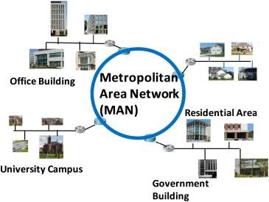
Metropolitan Area Network (MAN)
A MAN is larger than a LAN but smaller than a WAN.
This is the type of computer network that connects computers over a geographical distance through a shared communication path over a city, town or metropolitan area.

Slide 12
Advantages
It provides higher security compare to WAN and it is wider than LAN.
Increases the efficiency of handling data.
The speed of data can easily reach 1000 Mbps, as MAN uses fiber optics. Files and database transfer rates are fast.
Disadvantages
More cable require for a MAN connection from one place to another.
The large network difficult to manage.
The data rate is slow compared to LAN.
Cost is higher than LAN.

Slide 13
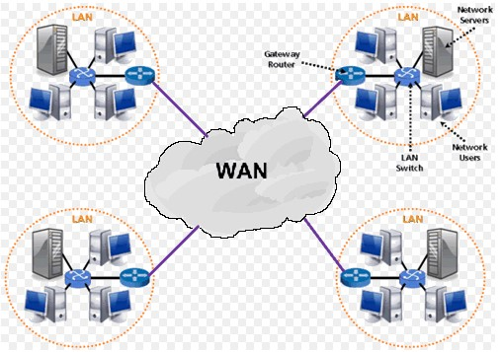
Wide Area Network (WAN)
A wide area network (WAN) is a computer network that covers a large geographical area comprising a region, a country, a continent or even the whole world.
WAN includes the technologies to transmit data, image, audio and video information over long distances and among different LANs and MANs.

Slide 14
Advantages
WAN covers larger geographical area. Hence business offices situated at longer distances can easily communicate.
Message can be sent very quickly to anyone else on the network
Disadvantages
It is difficult to maintain the network
WAN is not secure and means not reliable

Slide 15
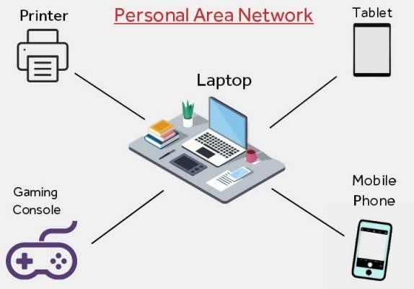
Personal Area Network
PAN is the interconnection between different devices like smartphones, tablets, computers and other digital devices.
PAN is used for personal purposes like data sharing among devices and it has a range of 10 meters.

Slide 16
Advantages
In PAN no extra space and extra cable requires.
It is reliable and secure.
It is easy to use and it is portable
Disadvantages
It is a slow data transfer.
PAN has a limited range.

Slide 17
Network topologies
A network topology is the physical and logical arrangement of nodes and connections in a network.
Types:
Bus topology
Ring topology
Mesh topology
Star topology
Hybrid topology

Slide 18
Bus Topology
Bus topology is a network type in which every computer and network device is connected to a single cable.
It transmits the data from one end to another in a single direction.
It is a multi-point connection and a non-robust topology because if the backbone fails the topology crashes.
Moderate data speeds:
Coaxial or twisted pair cables are mainly used in bus-based networks that support up to 10 Mbps.

Slide 19
Ring topology
In this topology, it forms a ring connecting devices with exactly two neighbouring devices.
The data flows in one direction, i.e., it is unidirectional and it flow in a clockwise direction.
The most common access method of the ring topology is token passing.
The sender modifies the token by putting the address along with the data and it will transfer from sender to receiver.

Slide 20
Mesh topology
Mesh topology is a type of networking in which all the computers are inter-connected to each other.
The connected nodes can be computers, switches, hubs, or any other devices.
In this topology setup, even if one of the connections goes down, it allows other nodes to be distributed.
The cost of cables is high as bulk wiring is required, hence suitable for less number of devices

Slide 21
Star topology
In this network arrangement, all devices linked to a central network device i.e. Hub, Switch..
In star topology, a device cannot provide communication directly between the devices.
The RJ-45 or coaxial cable is used in a star topology.
Examples of star topology in real life like Airports, Hospitals, Banks, and Educational Institutes.

Slide 22
Hybrid topology
Hybrid topology is a kind of network topology that is a combination of two or more network topologies, such as bus topology, mesh topology, ring topology, star topology.
Error detecting and troubleshooting are easy.
It is used to create large networks and It is expensive.
The speed of the topology becomes fast when two topologies are put together.
The design of a hybrid network is very complex.

Slide 23
Ip address
IP address is a unique address that is used to identify computers or nodes on the internet.
This address is assigned by Internet Assigned Numbers Authority (IANA) standard organization.
IPv4: [Internet Protocol version 4. (famous - 2006 )]
It consists of 4 numbers separated by the dots.
Each number can be from 0-255 in decimal numbers.
Example: 189.123.123.90

Slide 24
Classes of IP
There are around 4.3 billion IPv4 addresses and managing all those addresses without any scheme is next to impossible.
For easier management and assignment IP addresses are divided into the following 5 classes :
IP Class | Address Range | Maximum number of networks
Class A | 1-126 | 2097152
Class B | 127-191 | 65536
Class C | 192-223 | 256
Class D | 224-239 | Reserve for multitasking
Class E | 240-255 | Reserved for Research and development

Slide 25
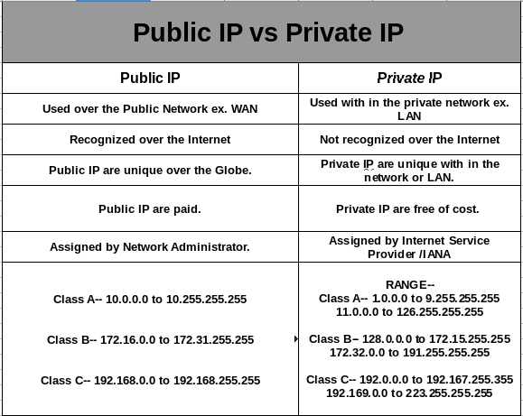
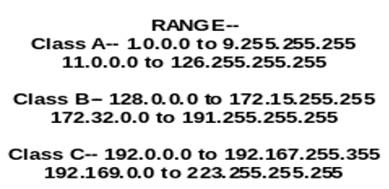
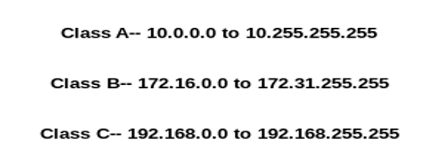

Slide 26
IPv6
With IPv4, we can connect only the above number of 4 billion devices uniquely, and apparently, there are much more devices in the world to be connected to the internet.
So, gradually we are making our way to IPv6 Address which is a 128-bit IP address.
In human-friendly form, IPv6 is written as a group of 8 hexadecimal numbers separated with colons(:).
Example:
2011:0bd9:75c5:0000:0000:6b3e:0170:8394

Slide 27
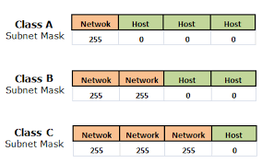
Subnetting
When a bigger network is divided into smaller networks, to maintain security, then that is known as Subnetting.
Subnetting helps in organizing the network in an efficient way which helps in expanding the technology for large firms and companies.
A → 10.0.0.0 / 8
Here, / 8 means no.of 1’s
B → 176.16.0.0 / 16
Here, / 16 means no.of 1’s
C → 192.168.0.0 / 24
Here, / 24 means no.of 1’s

Slide 28
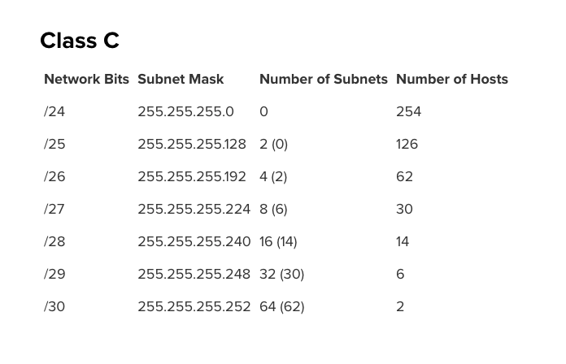
Subnet of Class C

Slide 29
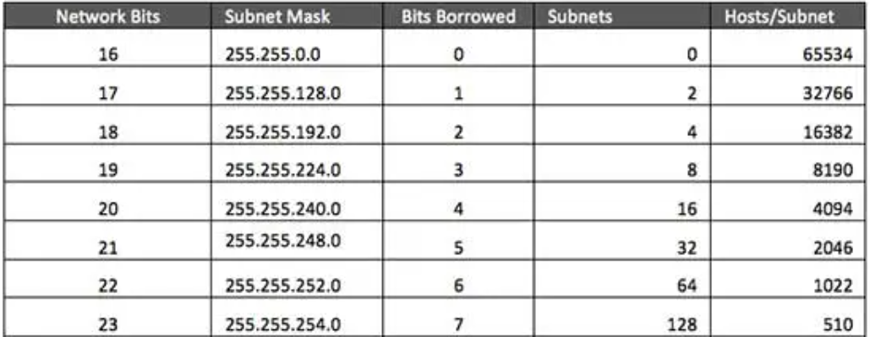
Subnet of class B

Slide 30
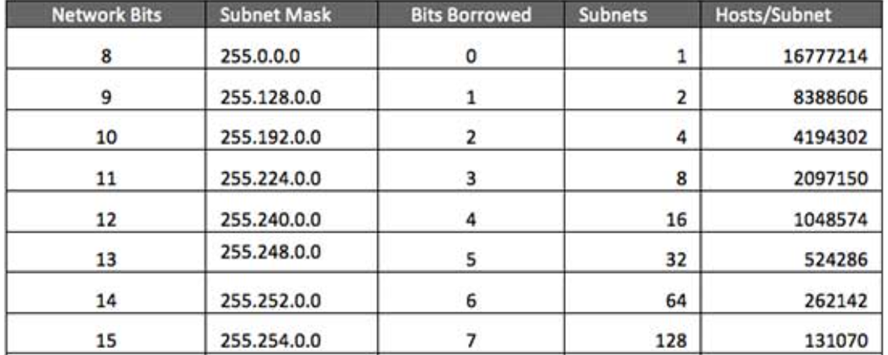
Subnet of class A

Slide 31
Network devices
Network devices, also known as networking hardware, are physical devices that allow hardware on a computer network to communicate and interact with one another.
Example
Repeater Hub
Bridge Switch
Routers NIC, etc.

Slide 32
Repeater:
A repeater operates at the physical layer.
Its job is to regenerate the signal over the same network before the signal becomes too weak or corrupted to extend the length to which the signal can be transmitted over the same network.
Hub:
A hub is a basically multi-port repeater.
A hub connects multiple wires coming from different branches.
Active Hub: These are the hubs that have their power supply and can clean, boost, and relay the signal along with the network.
Passive Hub: These are the hubs that collect wiring from nodes and power supply from the active hub.

Slide 33
Bridge:
A bridge operates at the data link layer.
A bridge is a repeater, with add on the functionality of filtering content by reading the MAC addresses of the source and destination.
It is used in Bus topology to overcome collision.
Switch:
A switch is a multiport bridge with a buffer and a design that can boost its efficiency and performance.
The switch can perform error checking before forwarding data, which makes it very efficient.
In other words, the switch divides the collision domain of hosts, but the broadcast domain remains the same.

Slide 34
Router:
A router is a device like a switch that routes data packets based on their IP addresses. The router is mainly a Network Layer device.
Routers normally connect LANs and WANs and have a dynamically updating routing table based on which they make decisions on routing the data packets.
Firewall:
It is a network security device, either hardware or software based, which monitors all incoming and outgoing traffic and based on a defined set of security rules accepts, rejects, or drops that specific traffic.
A firewall is essentially the wall that separates a private internal network from the open Internet at its very basic level.

Slide 35
network interface card[NIC]
It is a network adapter that is used to connect the computer to the network.
It is installed in the computer to establish a LAN.
It has a unique id that is written on the chip, and it has a connector to connect the cable to it.
NIC card is a layer 2 device which means that it works on both the physical and data link layers of the network model.

Slide 36
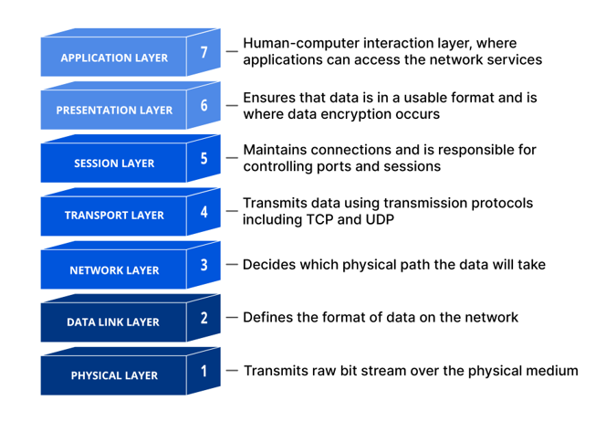
OSI model

Slide 37
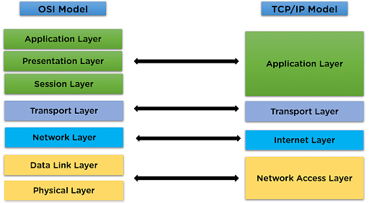
TCP / Ip

Slide 38
Network Protocol
It determines what is being communicated, how it is being communicated, and when it is being communicated.
It permits connected devices to communicate with each other, irrespective of internal and structural differences.
The protocols can be broadly classified into three major categories:
Network Communication
Network Management
Network Security

Slide 39
Network Communication
These protocols formally set out the rules and formats through which data is transferred.
These protocols handle syntax, semantics, error detection, synchronization, and authentication.
Hypertext Transfer Protocol(HTTP)
It is a layer 7 protocol that is designed for transferring a hypertext between two or more systems.
HTTP works on a client-server model, most of the data sharing over the web is done through using HTTP.

Slide 40
Transmission Control Protocol(TCP)
TCP layouts a reliable stream delivery by using sequenced acknowledgment.
It is a connection-oriented protocol i.e., it establishes a connection between applications before sending any data.
It has many applications such as emails, FTP, streaming media, etc.
User Datagram Protocol(UDP)
It is a connectionless protocol that lay-out a basic but unreliable message service.
It adds no flow control, reliability, or error-recovery functions.
It is used when we want faster transmission, for multicasting and broadcasting connections, etc.

Slide 41
Dynamic Host Configration Protocol(DHCP)
it’s a protocol for network management and it’s used for the method of automating the process of configuring devices on IP networks.
A DHCP server automatically assigns an IP address and various other configurational changes to devices on a network so they can communicate with other IP networks.
It also allows devices to use various services such as NTP, DNS, or any other protocol based on TCP or UDP.

Slide 42
Network Management
These protocols assist in describing the procedures and policies that are used in monitoring, maintaining, and managing the computer network.
Network management protocols can also be used for troubleshooting connections between a host and a client.
File Transfer Protocol(FTP)
FTP is a Client/server protocol that is used for moving files to or from a host computer, it allows users to download files, programs, web pages, and other things that are available on other services.

Slide 43
Network Security
These protocols make sure that no unauthorized devices, users, or services can access the network data.
Primarily, these protocols depend on encryption to secure data.
Hypertext Transfer Protocol(HTTPS)
It is the secured version of HTTP.
This protocol ensures secure communication between two computers where one sends the request through the browser and the other fetches the data from the web server.

Slide 44
VPN & SMTP
Virtual Private Network(VPN):
A service that helps you stay private online by encrypting the connection between your device and the internet.
This secure connection provides a private tunnel for your data and communications while you use public networks.
Simple Mail Transfer Protocol (SMTP):
It is a technical standard for transmitting electronic mail (email) over a network.
SMTP allows computers and servers to exchange data regardless of their underlying hardware or software.

Slide 45
NAT
Network Address Translation (NAT) is a service that enables private IP networks to use the internet and cloud.
NAT translates private IP addresses in an internal network to a public IP address before packets are sent to an external network.

Slide 47
INTERNET
Internet stands for Interconnected Network.
It is a network system that connects millions of web servers.
Internet is a vast network that connects computer all over the world.
Through the internet people can share information and communicate from anywhere.
Inventors of internet is John Kahn and Vint Cerf.
Features of Internet:
Internet is a global service and accessible to all.
Easy to use, Low cost, Security
Flexibility in communication.

Slide 48
Ethernet Cables
An ethernet cable allows the user to connect their devices such as computers, mobile phones, routers, etc.
Mainly there are three types of ethernet cables used in LANs.
Twisted Pair cables:
Twisted pair is a copper wire cable in which two insulated copper wires are twisted around each other to reduce interference or crosstalk.
It uses 10BASE-T, 100BASE-T, and some other newer ethernet variants.
Two Types: Unshield & Shielded Twisted Pair Cable

Slide 49
.
Coaxial cables:
A coaxial cable is used to carry high-frequency electrical signals with low losses.
It uses 10Base2 and 10Base5 Ethernet variants.
It is usually used in telephone systems, cable TV, etc.
Fiber optic cables.
Fiber optics can transmit signals over a very long distance as compared to twisted pairs or coaxial cables.
It uses 10BaseF, 100BaseFX, 100BaseBX, 100BaseSX, 1000BaseFx, 1000BaseSX, and 1000BaseBx ethernet variants.
Hence, it is capable of carrying information at a great speed.

Slide 50
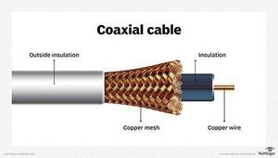

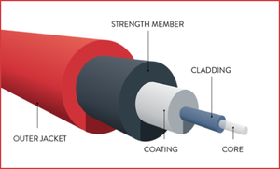
Twisted Pair Cable
Fiber Optic Cable

