Slide 1
SQL
Structured Query Language

Slide 2
Introduction:
SQL (Structured Query Language) is a programming language which is used to manage data stored in relational databases like MySQL, MS Access, SQL Server, Oracle, Sybase, Informix, Postgres etc.
SQL is a database computer language designed for the retrieval and management of data in a relational databases.
SQL was developed in the 1970s by IBM Computer Scientists and became a standard of the American National Standards Institute (ANSI) in 1986, and the International Organization for Standardization (ISO) in 1987.
SQL is the standard language to communicate with All the Relational Database Management Systems (RDMS)

Slide 3
RDBMS
RDBMS stands for Relational Database Management System.
RDBMS is the basis for SQL, and for all modern database systems like MS SQL Server, IBM DB2, Oracle, MySQL, and Microsoft Access.
A RDBMS is a DBMS that is based on the relational model as introduced by E. F. Codd in 1970.
The data in an RDBMS is stored in database objects known as tables.
This table is basically a collection of related data entries and it consists of numerous columns and rows.
Every table is broken up into smaller entities called fields.

Slide 4
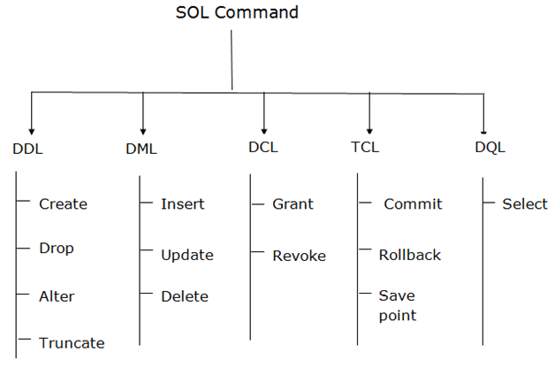
Types of SQL:

Slide 5
Database Normalization
Normalization is the process of organizing the data in the database.
It is also used to eliminate undesirable characteristics like Insertion, Update, and Deletion Anomalies.
Normalization divides the larger table into smaller and links them using relationships.
Failure to eliminate anomalies leads to data redundancy and can cause data integrity and other problems as the database grows.

Slide 6
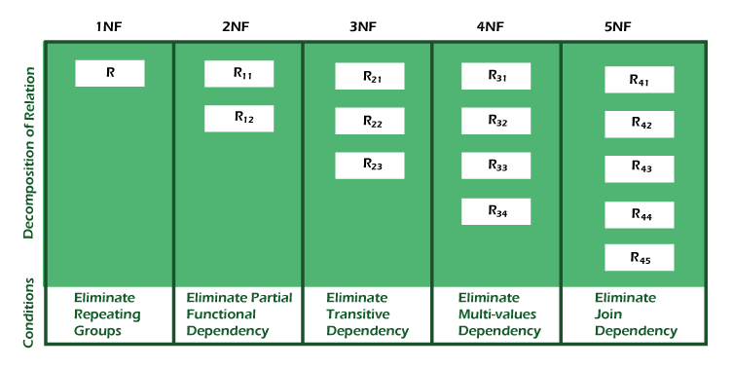
Types of Normal Forms:

Slide 7
Types of SQL Databases
There are many popular RDBMS available to work with.
MySQL
MySQL is an open source SQL database, which is developed by a Swedish company, MySQL AB.
1994 - Development of MySQL by Michael Widenius & David Axmark beginning in 1994.
1995 - First internal release on 23rd May 1995.
MS SQL Server
It is a Relational Database Management System developed by Microsoft Inc.
Its primary query languages are T-SQL & ANSI SQL

Slide 8
Oracle
It is a very large multi-user based database management system.
Oracle is a relational database management system developed by 'Oracle Corporation'.
Microsoft Access
It is one of the most popular Microsoft products. It is an entry-level database management software.
It is not only inexpensive but also a powerful database for small-scale projects.
PostgreSQL
It is object relational database management system (ORDBMS) that supports both relational (SQL) and non-relational (JSON) query.
It is a highly stable database that is developed based on the POSTGRES, version 4.2 released by the Computer Science Department in University of Berkeley, California.

Slide 9
SQL Constraints
SQL Constraints are the rules applied to a data columns or the complete table to limit the type of data that can go into a table.
When you try to perform any INSERT, UPDATE, or DELETE operation on the table, RDBMS will check whether that data violates any existing constraints and if there is any violation between the defined constraint and the data action, it aborts the operation and returns an error.
Example:
CREATE TABLE table_name (
column1 datatype constraint,
columnN datatype constraint
);

Slide 10
Constrains
NOT NULL constraint --> ensure that a column cannot have a NULL value.
UNIQUE constraint --> ensure that a column accepts only UNIQUE values.
DEFAULT constraint --> provides a default value for a column when none is specified.
PRIMARY constraint --> ensure that a column accepts only UNIQUE value.
FOREIGN constraint --> maps with a column in another table and uniquely identifies a row/record in that table.
CHECK constraint --> works like a validation and it is used to check the validity of the data entered into the particular column of the table.
INDEX constraints --> are created to speed up the data retrieval from the database.

Slide 11
SQL Syntax:
SQL syntax is a unique set of rules and guidelines to be followed while writing SQL statements.
All the SQL statements start with any of the keywords like SELECT, INSERT, UPDATE, DELETE, ALTER, DROP, CREATE, USE, SHOW and all the statements end with a semicolon (;).
The most important point to be noted here is that SQL is case insensitive, which means SELECT and Select have same meaning in SQL statements.
SQL CREATE DATABASE Statement
To store data within a database, you first need to create it.
Syntax :
CREATE DATABASE database_name;

Slide 12
SQL USE Statement
Once the database is created, it needs to be used in order to start storing the data accordingly.
Syntax :
USE database_name;
SQL DROP DATABASE Statement
If a database is no longer necessary, you can also delete it.
Synta :
DROP DATABASE database_name;

Slide 13
SQL DESC Statement
Every table in a database has a structure of its own. To display the structure of database tables, we use the DESC statements.
Syntax :
DESC table_name;
SQL INSERT INTO Statement
The SQL INSERT INTO Statement is used to insert data into database tables.
Syntax:
INSERT INTO table_name( column1, column2....columnN)
VALUES ( value1, value2....valueN);
SQL SELECT Statement
In order to retrieve the result-sets of the stored data from a database table, we use the SELECT statement.
Syntax:
SELECT column1, column2....columnN FROM table_name;

Slide 14
SQL UPDATE Statement
When the stored data in a database table is outdated and needs to be updated without having to delete the table, we use the UPDATE statement.
Syntax:
UPDATE table_name SET column1 = value1,.. columnN=valueN
[ WHERE CONDITION ];
SQL DELETE Statement
Without deleting the entire table from the database, you can also delete a certain part of the data by applying conditions.
Syntax:
DELETE FROM table_name WHERE {CONDITION};
SQL DROP TABLE Statement
To delete a table entirely from a database when it is no longer needed.
Syntax:
DROP TABLE table_name;

Slide 15
SQL TRUNCATE TABLE Statement
The TRUNCATE TABLE statement is implemented in SQL to delete the data of the table but not the table itself.
Syntax:
TRUNCATE TABLE table_name;
SQL ALTER TABLE Statement
The ALTER TABLE statement is used to alter the structure of a table. For instance, you can add, drop, and modify the data of a column using this statement.
Syntax:
ALTER TABLE table_name {ADD|DROP|MODIFY} column_name {data_type};
SQL ALTER TABLE Statement (Rename)
The ALTER TABLE statement is also used to change the name of a table as well.
Syntax:
ALTER TABLE table_name RENAME TO new_table_name;

Slide 16
SQL DISTINCT Clause
The DISTINCT clause in a database is used to identify the non-duplicate data from a column. Using the SELECT DISTINCT statement, you can retrieve distinct values from a column.
Syntax:
SELECT DISTINCT column1,.., columnN FROM table_name;
SELECT DISTINCT SALARY FROM CUSTOMERS;
SQL WHERE Clause
The WHERE clause is used to filter rows from a table by applying a condition.
Syntax:
SELECT column1, column2....columnN
FROM table_name
WHERE CONDITION;

Slide 17
SQL AND/OR Operators
The AND/OR Operators are used to apply multiple conditions in the WHERE clause.
Syntax:
SELECT column1, column2....columnN
FROM table_name
WHERE CONDITION-1 {AND|OR} CONDITION-2;
SELECT ID, NAME, SALARY FROM CUSTOMERS
WHERE SALARY > 2000 AND age < 25;
SQL IN Clause
The IN Operator is used to check whether the data is present in the column or not, using the WHERE clause.
Syntax:
SELECT column1, column2....columnN
FROM table_name
WHERE column_name IN (val-1, val-2,...val-N);
SELECT * FROM CUSTOMERS WHERE NAME IN ('Khilan', 'Hardik', 'Muffy');

Slide 18
SQL BETWEEN Clause
The BETWEEN Operator is used to retrieve the values from a table that fall in a certain range, using the WHERE clause.
Syntax:
SELECT column1, column2....columnN
FROM table_name
WHERE column_name BETWEEN val-1 AND val-2;
SELECT * FROM CUSTOMERS WHERE AGE BETWEEN 20 AND 25;
SQL LIKE Clause
The LIKE Operator is used to retrieve the values from a table that match a certain pattern, using the WHERE clause.
Syntax:
SELECT column1, column2....columnN
FROM table_name
WHERE column_name LIKE { PATTERN };
SELECT * FROM CUSTOMERS WHERE SALARY LIKE '200%';

Slide 19
SQL ORDER BY Clause / Sorting
The ORDER BY Clause is used to arrange the column values in a given/specified order.
Syntax:
SELECT column1, column2....columnN
FROM table_name WHERE CONDITION
ORDER BY column_name {ASC|DESC};
SELECT * FROM CUSTOMERS ORDER BY NAME ASC;
SQL GROUP BY Clause
The GROUP BY Clause is used to group the values of a column together.
Syntax:
SELECT column1… FROM table_name
WHERE CONDITION GROUP BY column_name;
SELECT ADDRESS, AGE FROM CUSTOMERS
GROUP BY ADDRESS, AGE;

Slide 20
SQL COUNT Function
The COUNT Function gives the number of non-null values present in the specified column.
Syntax:
SELECT COUNT(column_name) FROM table_name
WHERE CONDITION;
SELECT AGE, COUNT(Name) FROM CUSTOMERS GROUP BY AGE;
SQL HAVING Clause
The HAVING clause is also used to filter a group of rows by applying a condition.
Syntax:
SELECT SUM(column_name) FROM table_name
WHERE CONDITION GROUP BY column_name
HAVING (arithematic function condition);
SELECT ADDRESS, AGE, SUM(SALARY) AS
TOTAL_SALARY FROM CUSTOMERS GROUP BY
ADDRESS, AGE HAVING TOTAL_SALARY >=5000
ORDER BY TOTAL_SALARY DESC;

Slide 21
SQL CREATE INDEX Statement
To create an index on a database table, SQL provides the CREATE INDEX statement.
Syntax:
CREATE UNIQUE INDEX index_name
ON table_name ( column1, column2,...columnN);
CREATE INDEX sample_index on CUSTOMERS(NAME);
SQL DROP INDEX Statement
The DROP INDEX statement is used to drop an index from a table.
Syntax:
DROP INDEX index_name ON table_name;
DROP INDEX sample_index on CUSTOMERS;
SHOW INDEX FROM table_name;

Slide 22
SQL DataType
An SQL data type refers to the type of data which can be stored in a column of a database table.
SQL Data types are defined during the creation of a table in a database.
While creating a table, it is required to specify its respective data type and size along with the name of the column.
There are three main types of SQL data types available in any RDBMS. They are String, Numeric & Date and Time.
Example:
CREATE TABLE Customers (Name VARCHAR (25), Age INT);

Slide 23
SQL Operators
An SQL operator is a reserved word or a character used primarily in an SQL statement's WHERE clause to perform operation(s), such as comparisons and arithmetic operations.
These Operators are used to specify conditions in an SQL statement and to serve as conjunctions for multiple conditions in a statement.
Types of Operator in SQL:
Arithmetic operators
Comparison operators
Logical operators
Operators used to negate conditions
Example:
UPDATE CUSTOMERS SET AGE = AGE+5, SALARY = SALARY+3000;
DELETE FROM CUSTOMERS WHERE AGE > 25;

Slide 24
Arithmetic & Relational Operations:
Operator Description Example
+ Addition 10 + 20 = 30
- Subtraction 20 - 30 = -10
* Multiplication 10 * 20 = 200
/ Division 20 / 10 = 2
% Modulus 5 % 2 = 1
= Equal to 5 = 5 returns TRUE
!= Not equal 5 != 6 returns TRUE
<> Not equal 5 <> 4 returns TRUE
> Greater than 4 > 5 returns FALSE
< Less than 4 < 5 returns TRUE
>= Greater than or equal to 4 >= 5 returns FALSE
<= Less than or equal to 4 <= 5 returns TRUE
!< Not less than 4 !< 5 returns FALSE
!> Not greater than 4 !> 5 returns TRUE

Slide 25
Logical Operator:
Operator Description
ALL TRUE if all of a set of comparisons are TRUE.
AND TRUE if all the conditions separated by AND are TRUE.
ANY TRUE if any one of a set of comparisons are TRUE.
BETWEEN TRUE if the operand lies within the range of comparisons.
EXISTS TRUE if the subquery returns one or more records
IN TRUE if the operand is equal to one of a list of expressions.
LIKE TRUE if the operand matches a pattern specially with wildcard.
NOT Reverses the value of any other Boolean operator.
OR TRUE if any of the conditions separated by OR is TRUE
IS NULL TRUE if the expression value is NULL.
SOME TRUE if some of a set of comparisons are TRUE
UNIQUE The UNIQUE operator searches every row of a specified table for uniqueness (no duplicates).

Slide 26
SQL Expression
An SQL expression is a combination of one or more values, operators and SQL functions that are all evaluated to a value.
These SQL EXPRESSION(s) are like formulae and they are written in query language.
Expressions are used in WHERE clause of an SQL query specifies a condition that needs to be satisfied for the purpose of filtering records from a database table.
This condition is comprised of either single or multiple expressions.
Types:
Boolean Expressions
Numeric Expressions
Date and time Expressions

Slide 27
SQL Boolean Expressions
SQL Boolean Expressions are SQL expressions that return only Boolean Datatype as a result.
Example:
SELECT * FROM CUSTOMERS WHERE SALARY = 10000;
SQL Numeric Expressions
SQL Numeric expressions are comprised of two operands and an SQL Arithmetic Operator. These expressions are used to perform any mathematical operation in any query.
Example:
SELECT 15 + 6;
SELECT COUNT(*) FROM CUSTOMERS;
SQL Date Expressions
SQL Date Expressions are used to compare date related values with current system date and time values.
Example:
SELECT CURRENT_TIMESTAMP;

Slide 28
Creating a Table from an Existing Table
Instead of creating a new table every time, one can also copy an existing table and its contents including its structure, into a new table.
This can be done using a combination of the CREATE TABLE statement and the SELECT statement.
Syntax:
CREATE TABLE NEW_TABLE_NAME AS
SELECT [column1, column2...columnN]
FROM EXISTING_TABLE_NAME WHERE Condition;
1. CREATE TABLE SALARY AS SELECT ID, SALARY FROM CUSTOMERS;
2. INSERT INTO duplicate SELECT id, name, age FROM customers;
SQL CREATE TABLE IF NOT EXISTS
SQL command will create the table only when there is no table exists with the same name otherwise it will exit without any error.
Syntax: CREATE TABLE IF NOT EXISTS table_name

Slide 29
SQL Cloning:
SQL Cloning Operation allows to create the exact copy of an existing table along with its definition.
1. Simple Cloning:
Simple cloning operation creates a new replica table from the existing table and copies all the records in newly created table.
Syntax: CREATE TABLE new_table SELECT * FROM original_table;
2. Shallow Cloning:
Shallow cloning operation creates a new replica table from the existing table but does not copy any data records into newly created table, so only new but empty table is created.
Syntax: CREATE TABLE new_table LIKE original_table;
3. Deep Cloning:
Deep cloning operation is a combination of simple cloning and shallow cloning.
It not only copies the structure of the existing table but also its data into the newly created table.
Syntax:
CREATE TABLE new_table LIKE original_table;
INSERT INTO new_table SELECT * FROM original_table;

Slide 30
SQL View
A view in SQL is a virtual table that is stored in the database with an associated name.
A view can contain rows from an existing table (all or selected). A view can be created from one or many tables.
Unless indexed, a view does not exist in a database physically.
Syntax:
CREATE VIEW myview AS SELECT id, name FROM dummy;
WITH CHECK OPTION Clause
The purpose of the WITH CHECK OPTION is to ensure that all UPDATE and INSERT statements satisfy the condition(s) specified by the WHERE clause.
Syntax:
CREATE VIEW MY_VIEW AS SELECT name, age FROM CUSTOMERS
WHERE age >= 25 WITH CHECK OPTION;

Slide 31
SQL Joins
SQL Join clause is used to combine data from two or more tables in a database.
When the related data is stored across multiple tables, joins help you to retrieve records combining the fields from these tables using their foreign keys.
The part of the Join clause that specifies the columns on which records from two or more tables are joined is known as join-predicate.
This predicate is usually specified along with the ON clause and uses various comparison operators such as, <, >, <>, <=, >=, !=, BETWEEN, LIKE, and NOT etc.
There are two major types of joins: Inner Join and Outer Join.
Other joins like Left Join, Right Join, Full Join etc. Are just subtypes of these two major joins.
Syntax:
SELECT column_name(s) FROM table1 JOIN table2;
Example:
SELECT ID, NAME, AGE, AMOUNT FROM CUSTOMERS
JOIN ORDERS ON CUSTOMERS.ID = ORDERS.CUSTOMER_ID;

Slide 32
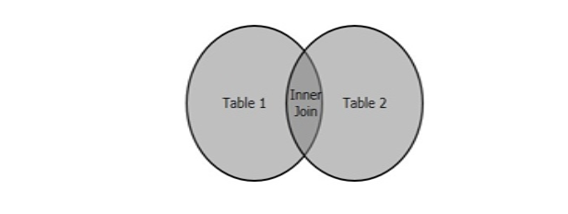
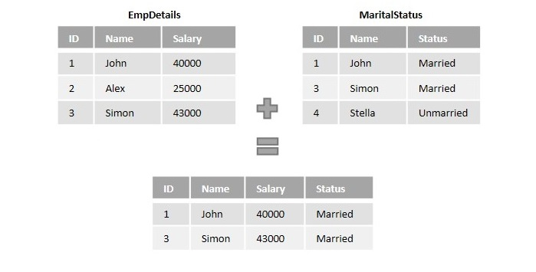
SQL Inner Join:
SQL Inner Join is a type of join that combines multiple tables by retrieving records that have matching values in both tables (in the common column).
It compares each row of the first table with each row of the second table, to find all pairs of rows that satisfy the join-predicate.
When the join-predicate is satisfied, the column values from both tables are combined into a new table.
Syntax:
SELECT column_name(s) FROM table1 INNER JOIN table2
ON table1.column_name = table2.column_name;

Slide 33
Outer Join
Outer Join is used to join multiple database tables into a combined result-set, that includes all the records, even if they don't satisfy the join condition.
NULL values are displayed against these records where the join condition is not met.
This scenario only occurs if the left table (or the first table) has more records than the right table (or the second table), or vice versa.
There are three types of outer joins:
Left (Outer) Join: Retrieves all the records from the first table, Matching records from the second table and NULL values in the unmatched rows.
Right (Outer) Join: Retrieves all the records from the second table, Matching records from the first table and NULL values in the unmatched rows.
Full (Outer) Join: Retrieves records from both the tables and fills the unmatched values with NULL.

Slide 34
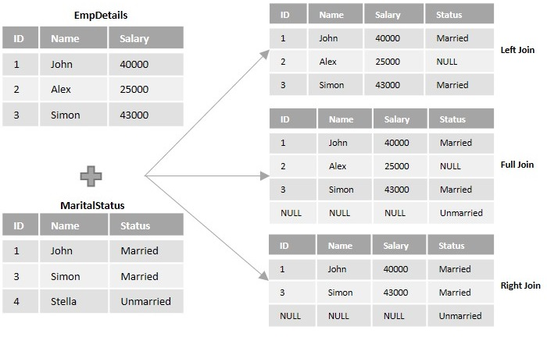
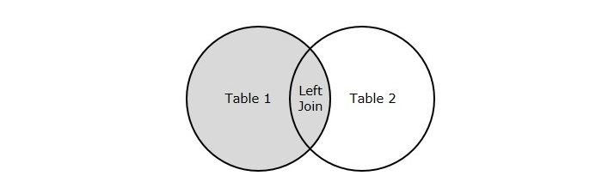
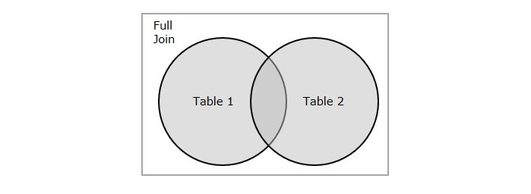
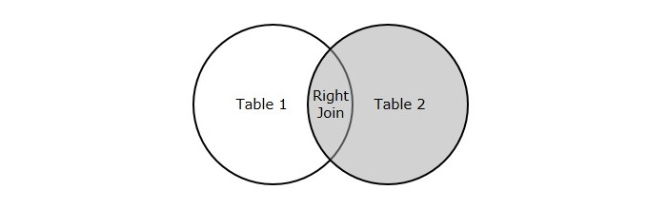
Example:

Slide 35
Cross & Self Join
SQL Cross Join is a basic type of inner join that is used to retrieve the Cartesian product (or cross product) of two individual tables.
That means, this join will combine each row of the first table with each row of second table .
Example:
SELECT ID, NAME, AMOUNT, DATE
FROM CUSTOMERS CROSS JOIN ORDERS;
Self Join, as its name suggests, is a type of join that combines the records of a table with itself.
Example:
SELECT column_name(s) FROM table1 a, table1 b
WHERE a.common_field = b.common_field;
SELECT a.ID, b.NAME as EARNS_HIGHER,
a.NAME as EARNS_LESS, a.SALARY as LOWER_SALARY
FROM CUSTOMERS a, CUSTOMERS b
WHERE a.SALARY < b.SALARY;

Slide 36
UNION:
UNION is a type of operator/clause in SQL, that works similar to the union operator in relational algebra.
It does nothing more than just combining information from multiple tables that are union compatible.
The tables to be combined must have same number of columns with the same datatype.
The number of rows need not be same.
Syntax:
SELECT * FROM table1 UNION SELECT * FROM table2;
Example:
SELECT * FROM COURSES_PICKED UNION
SELECT * FROM EXTRA_COURSES_PICKED;

Slide 40
Explanation
1NF → A relation is in 1NF if it contains an atomic value.
2NF → A relation will be in 2NF if it is in 1NF and all non-key attributes are fully functional dependent on the primary key.
3NF → A relation will be in 3NF if it is in 2NF and no transition dependency exists.
4NF → A relation will be in 4NF if it is in Boyce Codd's normal form and has no multi-valued dependency.
5NF → A relation is in 5NF If it is in 4NF and does not contain any join dependency, joining should be lossless.

