Slide 1
Spring

Slide 2
Introduction :
Spring framework was initially written by Rod Johnson and was first released under the Apache 2.0 license in June 2003.
Spring framework is an open source Java platform that provides comprehensive infrastructure support for developing robust Java applications very easily and very rapidly.
It can be thought of as a framework of frameworks because it provides support to various frameworks such as Hibernate, Tapestry, EJB, JSF, etc.
The framework, in broader sense, can be defined as a structure where we find solution of the various technical problems.

Slide 3
Advantages of Spring Framework
Predefined Templates
Loose Coupling because of dependency injection
Easy to test
Fast Development
Works on POJOs (Plain Old Java Object) which makes your application lightweight.
Inversion Of Control ( IoC ) Containers.
In that sense Spring also has an impact on frontend.
Note: it is not a "frontend framework" as such, it is a java framework for backend.

Slide 4
Features Of Spring Framework
Container:
Spring Framework creates and manages the life cycle and configuration of application objects.
MVC Framework:
Spring Framework is an MVC web application framework.
This framework is configurable via interfaces and accommodates multiple view technologies.
JDBC Exception Handling:
The JDBC abstraction layer of the Spring Framework offers an exception hierarchy, which simplifies the error handling strategy.

Slide 5
IoC Containers
The Spring container is at the core of the Spring Framework.
The container will create the objects, wire them together, configure them, and manage their complete life cycle from creation till destruction.
The Spring container uses DI to manage the components that make up an application. These objects are called Spring Beans.
The Spring IoC container makes use of Java POJO classes and configuration metadata to produce a fully configured and executable system or application.

Slide 6
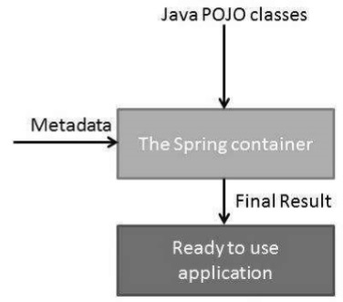
The following diagram represents a high-level view of how Spring works.

Slide 7
Spring BeanFactory Container :
This is the simplest container providing the basic support for DI and is defined by the org.springframework.beans.factory.BeanFactory interface.
The BeanFactory and related interfaces, such as BeanFactoryAware, InitializingBean, DisposableBean, are still present in Spring for the purpose of backward compatibility with a large number of third-party frameworks that integrate with Spring.
Spring ApplicationContext Container :
This container adds more enterprise-specific functionality such as the ability to resolve textual messages from a properties file and the ability to publish application events to interested event listeners.
This container is defined by the org.springframework.context.ApplicationContext interface.

Slide 8
BEAN Definition
The objects that form the backbone of your application and that are managed by the Spring IoC container are called beans.
These beans are created with the configuration metadata that you supply to the container. For example, in the form of XML <bean/>.
Bean definition contains the information called configuration metadata, which is needed for the container to know the following...
How to create a bean
Bean's lifecycle details
Bean's dependencies

Slide 9
Spring Configuration Metadata
Spring IoC container is totally decoupled from the format in which this configuration metadata is actually written.
Following are the three important methods to provide configuration metadata to the Spring Container −
XML based configuration file.
Annotation-based configuration
Java-based configuration

Slide 10
BEAN Scopes
When defining a <bean> you have the option of declaring a scope for that bean.
The Spring Framework supports the following five scopes, three of which are available only if you use a web-aware ApplicationContext.
singleton scopes, prototype scopes, request scopes, session scopes, global-session scopes.
Example:
<bean id = "..." class = "..." scope = "singleton"> </bean>

Slide 11
Types of Scope
Prototype → To force Spring to produce a new bean instance each time one is needed.
Singleton → If you want Spring to return the same bean instance each time one is needed.
Request → This scopes a bean definition to an HTTP request. Only valid in the context of a web-aware Spring ApplicationContext.
Session → This scopes a bean definition to an HTTP session.
Global-session → This scopes a bean definition to a global HTTP session.

Slide 12
Bean Life Cycle
When a bean is instantiated, it may be required to perform some initialization to get it into a usable state.
Similarly, when the bean is no longer required and is removed from the container, some (cleanup) Destruction may be required.
Bean Post Processor
The Bean Post Processor interface defines callback methods that you can implement to provide your own instantiation logic, dependency-resolution logic, etc.
It operate on bean (or object) instances, which means that the Spring IoC container instantiates a bean instance and then Bean Post Processor interfaces do their work.

Slide 13
Bean Definition Inheritance
Spring Bean definition inheritance has nothing to do with Java class inheritance but the inheritance concept is same.
You can define a parent bean definition as a template and other child beans can inherit the required configuration from the parent bean.
When you use XML-based configuration metadata, you indicate a child bean definition by using the parent attribute, specifying the parent bean as the value of this attribute.
Example:
<bean id ="helloIndia" class = "com.rose.HelloIndia" parent = "helloWorld">
<property name = "message1" value = "Hello India!"/>
</bean>

Slide 14
Dependency Injection
Dependency Injection (or sometime called wiring) helps in gluing the classes together and at the same time keeping them independent.
When writing a complex Java application, application classes should be as independent as possible of other Java classes to increase the possibility to reuse these classes and to test them independently of other classes while unit testing.

Slide 15
Constructor-based dependency injection
Constructor-based DI is accomplished when the container invokes a class constructor with a number of arguments, each representing a dependency on the other class.
Setter-based dependency injection
Setter-based DI is accomplished by the container calling setter methods on your beans after invoking a no-argument constructor or no-argument static factory method to instantiate your bean.

Slide 16
Injecting Inner Bean
Inner beans are beans that are defined within the scope of another bean.
Thus, a <bean/> element inside the <property/> or <constructor-arg/> elements is called inner bean
Example:
<bean id = "outerBean" class = "...">
<property name = "target">
<bean id = "innerBean" class = "..."/>
</property>
</bean>

Slide 17
Injecting Collection
what if you want to pass plural values like Java Collection types such as List, Set, Map, and Properties.
To handle the situation, Spring offers four types of collection configuration elements which are as follows...
<list> →This helps in wiring (injecting) a list of values, allowing duplicates.
<set> → This helps in wiring a set of values but without any duplicates.
<map> → This can be used to inject a collection of name-value pairs where name and value can be of any type.
<props> → This can be used to inject a collection of name-value pairs where the name and value are both Strings.

Slide 18
Beans AutoWiring
The Spring container can autowire relationships between collaborating beans without using <constructor-arg> and <property> elements, which helps cut down on the amount of XML configuration you write for a big Spring-based application.
Autowiring Modes
3. constructor
Similar to byType, but type applies to constructor arguments.
If there is not exactly one bean of the constructor argument type in the container, a fatal error is raised.

Slide 19
byName:
Autowiring by property name. Spring container looks at the properties of the beans on which autowire attribute is set to byName in the XML configuration file.
It then tries to match and wire its properties with the beans defined by the same names in the configuration file.
byType:
Autowiring by property datatype.
It then tries to match and wire a property if its type matches with exactly one of the beans name in configuration file.
If more than one such beans exists, a fatal exception is thrown.

Slide 20
Example:
Instead of using ref = "spellChecker" we can use autowire=“byName” or autowire = "constructor"
<bean id = "textEditor" class = "com.dependencyInject.TextEditor">
<property name = "spellChecker" ref = "spellChecker"/>
</bean> (OR)
<bean id = "textEditor" class = "com.dependencyInject.TextEditor"
autowire = "byType”> </bean>

Slide 21
Limitation of Autowiring
Overriding possibility
You can still specify dependencies using <constructor-arg> and <property> settings which will always override autowiring.
Primitive data types
You cannot autowire so-called simple properties such as primitives, Strings, and Classes.
Confusing nature
Autowiring is less exact than explicit wiring, so if possible prefer using explict wiring.

Slide 22
Anotation Based Configure
Starting from Spring 2.5 it became possible to configure the dependency injection using annotations.
So instead of using XML to describe a bean wiring, you can move the bean configuration into the component class itself by using annotations on the relevant class, method, or field declaration.
Annotation wiring is not turned on in the Spring container by default.
So, before we can use annotation-based wiring, we will need to enable it in our Spring configuration file using <context:annotation-config/>

Slide 23
Few important annotations
@Required
The @Required annotation applies to bean property setter methods.
@Autowired
The @Autowired annotation can apply to bean property setter methods, non-setter methods, constructor and properties.
@Qualifier
The @Qualifier annotation along with @Autowired can be used to remove the confusion by specifiying which exact bean will be wired.
JSR-250 Annotations
Spring supports JSR-250 based annotations which include @Resource, @PostConstruct and @PreDestroy annotations.

Slide 24
Java-Based Configuration
Java-based configuration option enables you to write most of your Spring configuration without XML but with the help of few Java-based annotations.
@Configuration & @Bean Annotations
Annotating a class with the @Configuration indicates that the class can be used by the Spring IoC container as a source of bean definitions.
The @Bean annotation tells Spring that a method annotated with @Bean will return an object that should be registered as a bean in the Spring application context.
<bean> --> @Component --> @Bean

Slide 25
Injecting Bean Dependencies
When @Beans have dependencies on one another, expressing that the dependency is as simple as having one bean method calling another
The @Import Annotation
The @Import annotation allows for loading @Bean definitions from another configuration class.
@Import(JavaConfig.class)
Lifecycle Callbacks
The @Bean annotation supports specifying arbitrary initialization and destruction callback methods, much like Spring XML's init-method and destroy-method attributes on the bean element
@Bean(initMethod = "init", destroyMethod = "cleanup" )

Slide 26
Event Handling
We have seen in all the chapters that the core of Spring is the ApplicationContext, which manages the complete life cycle of the beans.
The ApplicationContext publishes certain types of events when loading the beans.
Event handling in the ApplicationContext is provided through the ApplicationEvent class and ApplicationListener interface.
Hence, if a bean implements the ApplicationListener, then every time an ApplicationEvent gets published to the ApplicationContext, that bean is notified.
Listening to Context Events
To listen to a context event, a bean should implement the ApplicationListener interface which has just one method onApplicationEvent().

Slide 27
JDBC Framework
Spring JDBC Framework takes care of all the low-level details starting from opening the connection, prepare and execute the SQL statement, process exceptions, handle transactions and finally close the connection.
Spring JDBC provides several approaches and correspondingly different classes to interface with the database.
The most popular approach which makes use of JdbcTemplate class of the framework.
This is the central framework class that manages all the database communication and exception handling.

Slide 28
JDBC Template Class
The JDBC Template class executes SQL queries, updates statements, stores procedure calls, performs iteration over ResultSets, and extracts returned parameter values.
So you can configure a single instance of a JdbcTemplate and then safely inject this shared reference into multiple DAOs.
Executing SQL statements
String SQL = "select count(*) from Student";
int rowCount = jdbcTemplateObject.queryForInt( SQL );

Slide 29
Data Access Object (DAO)
DAO is commonly used for database interaction.
DAOs exist to provide a means to read and write data to the database and they should expose this functionality through an interface by which the rest of the application will access them.
The DAO support in Spring makes it easy to work with data access technologies like JDBC, Hibernate, JPA, or JDO in a consistent way.

Slide 30
Configuring Data Source
You can configure the DataSource in the XML file
<bean id = "dataSource"
class = "org.springframework.jdbc.datasource.DriverManagerDataSource">
<property name = "driverClassName" value = "com.mysql.jdbc.Driver"/>
<property name = "url" value = "jdbc:mysql://localhost:3306/TEST"/>
<property name = "username" value = "root"/>
<property name = "password" value = "password"/>
</bean>

Slide 31
Spring MVC Framework
The Spring Web MVC framework provides Model-View-Controller (MVC) architecture and ready components that can be used to develop flexible and loosely coupled web applications.
It used to create web application with client server architecture.
The Model encapsulates the application data and in general they will consist of POJO.
The View is responsible for rendering the model data and in general it generates HTML output that the client's browser can interpret.
The Controller is responsible for processing user requests and building an appropriate model and passes it to the view for rendering.

Slide 32
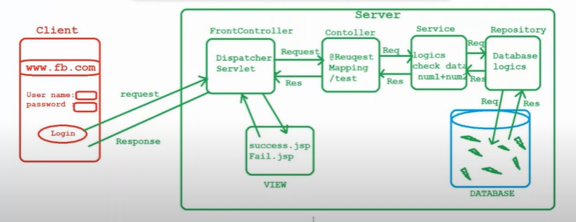
MVC Architecture

Slide 33
DispatcherServlet
The Spring Web model-view-controller (MVC) framework is designed around a DispatcherServlet that handles all the HTTP requests and responses.
Controller
The DispatcherServlet delegates the request to the controllers to execute the functionality specific to it.
The @Controller annotation indicates that a particular class serves the role of a controller.
The @RequestMapping annotation is used to map a URL to either an entire class or a particular handler method.

Slide 34
Creating JSP Views
Spring MVC supports many types of views for different presentation technologies.
These include - JSPs, HTML, PDF, Excel worksheets, XML, Velocity templates, XSLT, JSON, Atom and RSS feeds, JasperReports, etc.
But most commonly we use JSP templates written with JSTL.
Example :
<html>
<head> <title>Hello Spring MVC</title> </head>
<body> <h2>${message}</h2> </body>
</html>

Slide 38
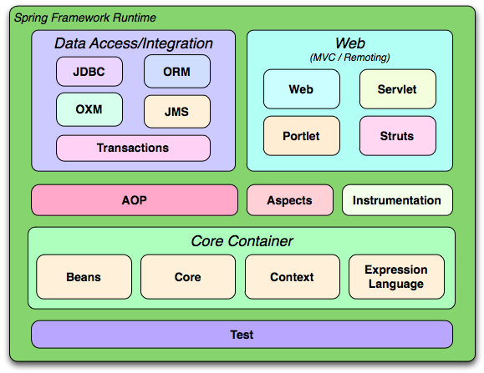
The Spring Framework consists of features organized into about 20 modules. These modules are grouped as shown in the following diagram.

Slide 39
Spring AOP- Framework
One of the key components of Spring Framework is the Aspect oriented programming (AOP) framework.
Aspect-Oriented Programming entails breaking down program logic into distinct parts called so-called concerns.
There are various common good examples of aspects like logging, auditing, declarative transactions, security, caching, etc.
The key unit of modularity in OOP is the class, whereas in AOP the unit of modularity is the aspect.
Spring AOP module provides interceptors to intercept an application(adding extra functionality while executing).

Slide 40
AOP Terminology
Aspect
This is a module which has a set of APIs providing cross-cutting requirements.
Join point
This represents a point in your application where you can plug-in the AOP aspect.
Advice
This is the actual action to be taken either before or after the method execution.
Target object
The object being advised by one or more aspects.

Slide 41
Pointcut
This is a set of one or more join points where an advice should be executed.
Introduction
An introduction allows you to add new methods or attributes to the existing classes.
Weaving
Weaving is the process of linking aspects with other application types or objects to create an advised object.
Note: aspectjrt.jar, aspectjweaver.jar, aspectj.jar, aopalliance.jar

Slide 42
Types of Advice
Before → Run advice before the a method execution.
After → Run advice after the method execution, regardless of its outcome.
Around → Run advice before and after the advised method is invoked.
After-returning
Run advice after the a method execution only if method completes successfully.
After-throwing
Run advice after the a method execution only if method exits by throwing an exception.

Slide 43
Custom Aspects Implementation
Spring supports the @AspectJ annotation style approach and the schema-based approach to implement custom aspects.
XML Schema based
Aspects are implemented using the regular classes along with XML based configuration.
@AspectJ based
@AspectJ refers to a style of declaring aspects as regular Java classes annotated with Java 5 annotations.

