Slide 1
Subnetting

Slide 2
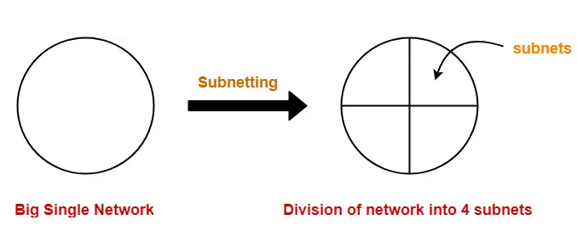
Subnetting Definition
Subnetting is a technique used in computer networking to divide a single, large network into smaller, more manageable sub-networks, or subnets. It's particularly useful for optimizing network performance, managing network traffic, and enhancing security.
Subnetting requires careful planning to ensure efficient use of IP addresses and to avoid network congestion or wastage. It's an essential skill for network administrators and engineers.
our class A, B and C networks?
Class A: 16777216 addresses in total.
Class B: 65536 addresses in total.
Class C: 256 addresses in total.
A subnet is a sub-network of a network that falls within the class A, B or C range.
Example-
Following diagram shows the sub netting of a big single network into 4 smaller subnets-

Slide 3
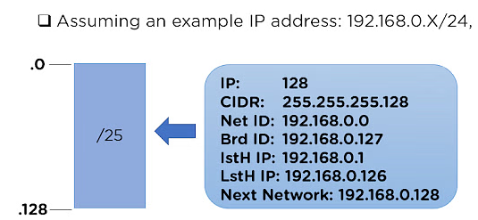
Characteristics of Subnetting
To design a subnetwork, some features are required to be understood properly which are:
Network ID: It is the first IP address in each Sub-Network in the main network ID.
Broadcast ID: This feature represents the last IP address in each Sub-Network in the network ID.
First Host ID: The next IP address after the Network ID is represented by the First Host ID.
Last Host ID: The IP address right before the Broadcast ID is represented as Last Host ID.
Next Network: This feature assigns the Network ID for the next sub-network.
# IP Addresses: This feature represents the total number of IP addresses in the sub-network.
To better understand the above characteristics,
you can refer to this example,

Slide 4
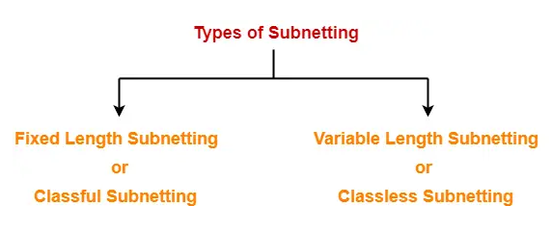
Types of Subnetting-
Subnetting of a network may be carried out in the following two ways-

Slide 5
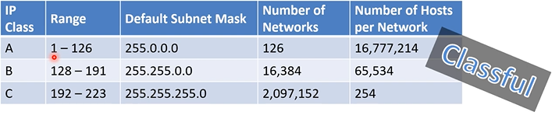
1. Fixed Length Subnetting-
Fixed length subnetting also called as classful subnetting divides the network into subnets where-
All the subnets are of same size.
All the subnets have equal number of hosts.
All the subnets have same subnet mask.

Slide 6
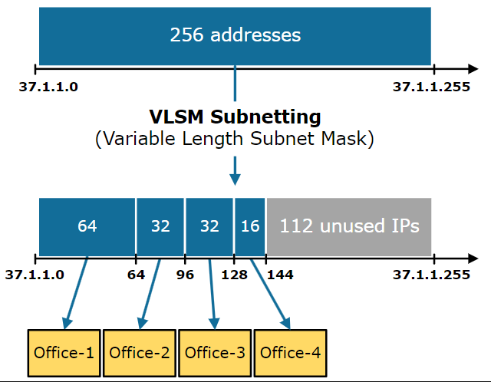
2. Variable Length Subnetting-
Variable length subnetting also called as classless subnetting divides the network into subnets where-
All the subnets are not of same size.
All the subnets do not have equal number of hosts.
All the subnets do not have same subnet mask.

Slide 7
Classful Networking:
In classful networking, IP addresses are divided into three main classes: Class A, Class B, and Class C.
The class of an IP address is determined by the first few bits of the address. Class A addresses have the first bit set to 0, Class B addresses have the first two bits set to 10, and Class C addresses have the first three bits set to 110.
Each class has a default subnet mask associated with it: Class A (/8), Class B (/16), and Class C (/24).
Classful networking does not allow for subnetting within these predefined classes. Each network must use the default subnet mask associated with its class, which can lead to inefficient use of IP addresses.
Classful networking was the original addressing scheme used in early versions of the Internet but has largely been replaced by classless networking.
Classless Networking:
Classless Inter-Domain Routing (CIDR) is the basis of classless networking. With CIDR, IP addresses are allocated in a more flexible and efficient manner.
CIDR allows for the allocation of IP addresses with variable-length subnet masks (VLSM). This means that networks can be subnetted more finely, allowing for better utilization of IP addresses and more efficient routing.
CIDR notation is used to represent IP addresses and their associated subnet masks. For example, instead of representing a network as a Class A, B, or C address with a default subnet mask, CIDR notation allows for more precise representation, such as 192.168.1.0/24.
Classless networking is the prevalent addressing scheme used in modern networking, offering greater flexibility, efficiency, and scalability compared to classful networking.

Slide 8

Class C Subnetting

Slide 9
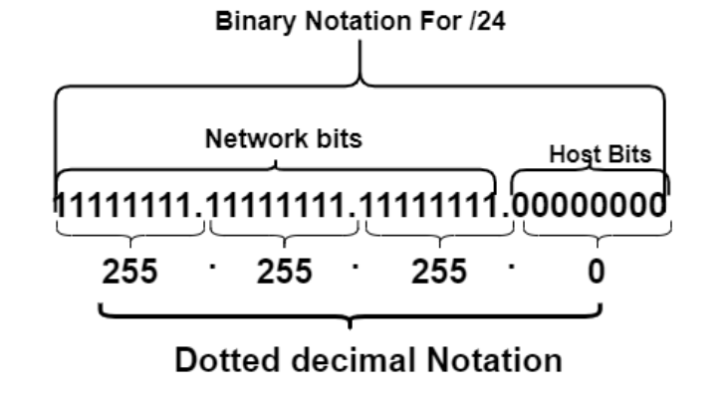
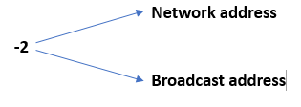
Class C
192 .168.0.0/24
n = no of n/w’s n = 1’s
m = no of hosts m = 0’s
FORMULA TO CALCULATE NO OF HOSTS/NETWORK
2^{m} -2
2⁸ -2
256 – 2
254 hosts/network
Total number of IP’s is 256 network
Total number of usable IP’s is 254/network
FORMULA TO CALCULATE NO OF N/W’S
2^{n}
2⁰ [ in last 8 bit there are no of n/w’s]
N=0

Slide 10
IP Address: | 192.168.0.0
Network Address: | 192.168.0.0
Usable Host IP Range: | 192.168.0.1 - 192.168.0.254
Broadcast Address: | 192.168.0.255
Total Number of Hosts: | 256
Number of Usable Hosts: | 254
Subnet Mask: | 255.255.255.0
Wildcard Mask: | 0.0.0.255
Binary Subnet Mask: | 11111111.11111111.11111111.00000000
IP Class: | C
CIDR Notation: | /24
IP Type: | Private
Network Address:192.168.0.0
Number of Usable Hosts:254
Broadcast Address:192.168.0.255

Slide 11
Class C
192 .168.0.0/25
n = no of n/w’s n = 1’s
m = no of hosts m = 0’s
11111111.11111111. 11111111.10000000 [Borrow 1 bit]
255. 255. 255. 128 [ Subnet mask]
FORMULA TO CALCULATE NO OF HOSTS/NETWORK
2^{m} -2
2⁷ -2
128– 2
126 hosts/network
Total number of IP’s is 128 network
Total number of usable IP’s is 126/network
FORMULA TO CALCULATE NO OF N/W’S
2^{n}
2¹
N=2

Slide 12
IP Address: | 192.168.0.0
Network Address: | 192.168.0.0
Usable Host IP Range: | 192.168.0.1 - 192.168.0.126
Broadcast Address: | 192.168.0.127
Total Number of Hosts: | 128
Number of Usable Hosts: | 126
Subnet Mask: | 255.255.255.128
Wildcard Mask: | 0.0.0.127
Binary Subnet Mask: | 11111111.11111111.11111111.10000000
IP Class: | C
CIDR Notation: | /25
IP Type: | Private
Network Address:192.168.0.0
Network Address:192.168.0.128
Usable Host IP Range:192.168.0.1 - 192.168.0.126
Usable Host IP Range:192.168.0.129 - 192.168.0.254
Broadcast Address:192.168.0.127
Broadcast Address:192.168.0.255
All 2 of the Possible /25 Networks for 192.168.0.*
Network Address | Usable Host Range | Broadcast Address:
192.168.0.0 | 192.168.0.1 - 192.168.0.126 | 192.168.0.127
192.168.0.128 | 192.168.0.129 - 192.168.0.254 | 192.168.0.255

Slide 13
Class C
192 .168.0.0/26
n = no of n/w’s n = 1’s
m = no of hosts m = 0’s
11111111.11111111. 11111111.11000000 [Borrow 2 bit]
255. 255. 255. 192 [ Subnet mask]
FORMULA TO CALCULATE NO OF HOSTS/NETWORK
2^{m} -2
2⁶ -2
64– 2
62 hosts/network
Total number of IP’s is 64 network
Total number of usable IP’s is 62/network
FORMULA TO CALCULATE NO OF N/W’S
2^{n}
2²
N=4

Slide 14
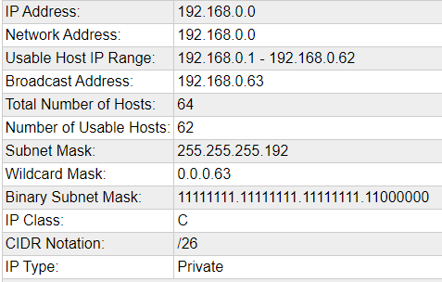
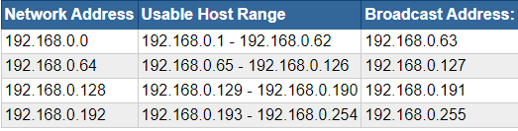

Slide 15


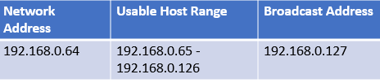

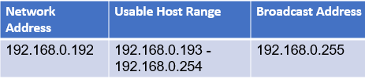
All 4 of the Possible /26 Networks for 192.168.0.*

Slide 16
Class C
192 .168.0.0/27 11111111.11111111. 11111111.11100000 [Borrow 3 bit]
n = no of n/w’s n = 1’s
m = no of hosts m = 0’s
255. 255. 255. 224 [ Subnet mask]
FORMULA TO CALCULATE NO OF HOSTS/NETWORK
2^{m} -2
2⁵ -2
32– 2
30 hosts/network
Total number of IP’s is 32 per network
Total number of usable IP’s is 30 per network
FORMULA TO CALCULATE NO OF N/W’S
2^{n}
2³
N=8

Slide 17
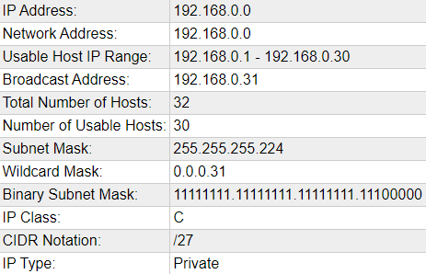
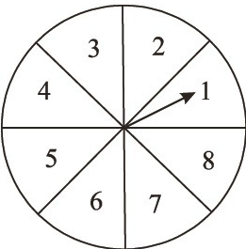
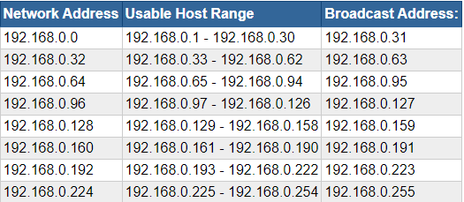
Total number of IP’s is 64 per network
Total number of usable IP’s is 62 per network
All 8 of the Possible /27 Networks for 192.168.0.*

Slide 18
Class C
192 .168.0.0/28 11111111.11111111. 11111111.11110000[Borrow 4 bit]
n = no of n/w’s n = 1’s
m = no of hosts m = 0’s
255. 255. 255. 240 [ Subnet mask]
FORMULA TO CALCULATE NO OF HOSTS/NETWORK
2^{m} -2
2⁴ -2
16– 2
14 hosts/network
Total number of IP’s is 16 per network
Total number of usable IP’s is 14 per network
FORMULA TO CALCULATE NO OF N/W’S
2^{n}
2⁴
N=16

Slide 19
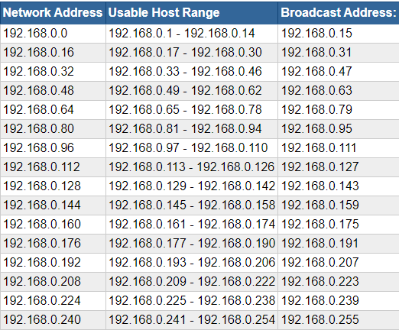
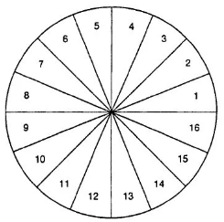
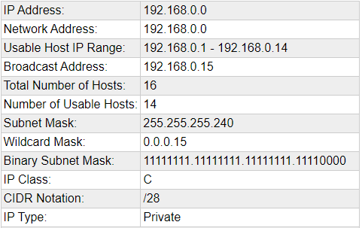
Total number of IP’s is 32 network
Total number of usable IP’s is 30/network
All 16 of the Possible /28 Networks for 192.168.0.*

Slide 20
Class C
192 .168.0.0/29 11111111.11111111. 11111111.11111000[Borrow 5 bit]
n = no of n/w’s n = 1’s
m = no of hosts m = 0’s
255. 255. 255. 248 [ Subnet mask]
FORMULA TO CALCULATE NO OF HOSTS/NETWORK
2^{m} -2
2³ -2
8– 2
6 hosts/network
Total number of IP’s is 8 per network
Total number of usable IP’s is 6 per network
FORMULA TO CALCULATE NO OF N/W’S
2^{n}
2⁵
N=32

Slide 21
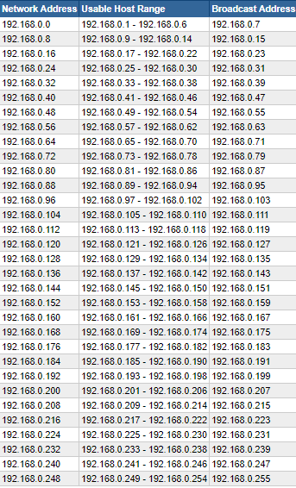

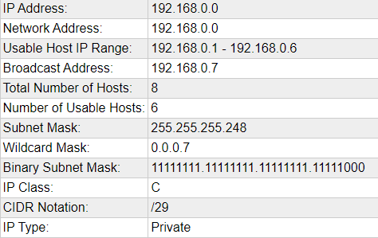
Total number of IP’s is 8 per network
Total number of usable IP’s is 6 per network
All 32 of the Possible /29 Networks for 192.168.0.*

Slide 22
Class C
192 .168.0.0/30 11111111.11111111. 11111111.11111100 [Borrow 6 bits]
n = no of n/w’s n = 1’s
m = no of hosts m = 0’s
255. 255. 255. 252 [ Subnet mask]
FORMULA TO CALCULATE NO OF HOSTS/NETWORK
2^{m} -2
2² -2
4– 2
2 hosts/network
Total number of IP’s is 4 per network
Total number of usable IP’s is 2 per network
FORMULA TO CALCULATE NO OF N/W’S
2^{n}
2⁶
N=64

Slide 23
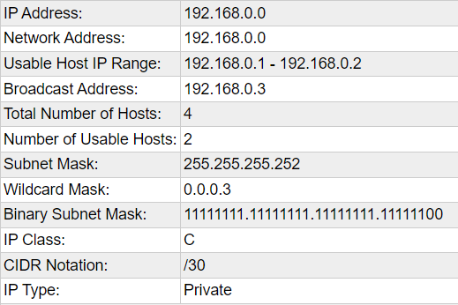

Slide 24
All 64 of the Possible /30 Networks for 192.168.0.*
Network Address Usable Host Range Broadcast Address:
192.168.0.0 192.168.0.1 - 192.168.0.2 192.168.0.3
192.168.0.4 192.168.0.5 - 192.168.0.6 192.168.0.7
192.168.0.8 192.168.0.9 - 192.168.0.10 192.168.0.11
192.168.0.12 192.168.0.13 - 192.168.0.14 192.168.0.15
192.168.0.16 192.168.0.17 - 192.168.0.18 192.168.0.19
192.168.0.20 192.168.0.21 - 192.168.0.22 192.168.0.23
192.168.0.24 192.168.0.25 - 192.168.0.26 192.168.0.27
192.168.0.28 192.168.0.29 - 192.168.0.30 192.168.0.31
192.168.0.32 192.168.0.33 - 192.168.0.34 192.168.0.35
192.168.0.36 192.168.0.37 - 192.168.0.38 192.168.0.39
192.168.0.40 192.168.0.41 - 192.168.0.42 192.168.0.43
192.168.0.44 192.168.0.45 - 192.168.0.46 192.168.0.47
192.168.0.48 192.168.0.49 - 192.168.0.50 192.168.0.51
192.168.0.52 192.168.0.53 - 192.168.0.54 192.168.0.55
192.168.0.56 192.168.0.57 - 192.168.0.58 192.168.0.59
192.168.0.60 192.168.0.61 - 192.168.0.62 192.168.0.63
192.168.0.64 192.168.0.65 - 192.168.0.66 192.168.0.67
192.168.0.68 192.168.0.69 - 192.168.0.70 192.168.0.71
192.168.0.72 192.168.0.73 - 192.168.0.74 192.168.0.75
192.168.0.76 192.168.0.77 - 192.168.0.78 192.168.0.79
192.168.0.80 192.168.0.81 - 192.168.0.82 192.168.0.83
192.168.0.84 192.168.0.85 - 192.168.0.86 192.168.0.87
192.168.0.88 192.168.0.89 - 192.168.0.90 192.168.0.91
192.168.0.92 192.168.0.93 - 192.168.0.94 192.168.0.95
192.168.0.96 192.168.0.97 - 192.168.0.98 192.168.0.99
192.168.0.100 192.168.0.101 - 192.168.0.102 192.168.0.103
192.168.0.104 192.168.0.105 - 192.168.0.106 192.168.0.107
192.168.0.108 192.168.0.109 - 192.168.0.110 192.168.0.111
192.168.0.112 192.168.0.113 - 192.168.0.114 192.168.0.115
192.168.0.116 192.168.0.117 - 192.168.0.118 192.168.0.119
192.168.0.120 192.168.0.121 - 192.168.0.122 192.168.0.123
192.168.0.124 192.168.0.125 - 192.168.0.126 192.168.0.127
192.168.0.128 192.168.0.129 - 192.168.0.130 192.168.0.131
192.168.0.132 192.168.0.133 - 192.168.0.134 192.168.0.135
192.168.0.136 192.168.0.137 - 192.168.0.138 192.168.0.139
192.168.0.140 192.168.0.141 - 192.168.0.142 192.168.0.143
192.168.0.144 192.168.0.145 - 192.168.0.146 192.168.0.147
192.168.0.148 192.168.0.149 - 192.168.0.150 192.168.0.151
192.168.0.152 192.168.0.153 - 192.168.0.154 192.168.0.155
192.168.0.156 192.168.0.157 - 192.168.0.158 192.168.0.159
192.168.0.160 192.168.0.161 - 192.168.0.162 192.168.0.163
192.168.0.164 192.168.0.165 - 192.168.0.166 192.168.0.167
192.168.0.168 192.168.0.169 - 192.168.0.170 192.168.0.171
192.168.0.172 192.168.0.173 - 192.168.0.174 192.168.0.175
192.168.0.176 192.168.0.177 - 192.168.0.178 192.168.0.179
192.168.0.180 192.168.0.181 - 192.168.0.182 192.168.0.183
192.168.0.184 192.168.0.185 - 192.168.0.186 192.168.0.187
192.168.0.188 192.168.0.189 - 192.168.0.190 192.168.0.191
192.168.0.192 192.168.0.193 - 192.168.0.194 192.168.0.195
192.168.0.196 192.168.0.197 - 192.168.0.198 192.168.0.199
192.168.0.200 192.168.0.201 - 192.168.0.202 192.168.0.203
192.168.0.204 192.168.0.205 - 192.168.0.206 192.168.0.207
192.168.0.208 192.168.0.209 - 192.168.0.210 192.168.0.211
192.168.0.212 192.168.0.213 - 192.168.0.214 192.168.0.215
192.168.0.216 192.168.0.217 - 192.168.0.218 192.168.0.219
192.168.0.220 192.168.0.221 - 192.168.0.222 192.168.0.223
192.168.0.224 192.168.0.225 - 192.168.0.226 192.168.0.227
192.168.0.228 192.168.0.229 - 192.168.0.230 192.168.0.231
192.168.0.232 192.168.0.233 - 192.168.0.234 192.168.0.235
192.168.0.236 192.168.0.237 - 192.168.0.238 192.168.0.239
192.168.0.240 192.168.0.241 - 192.168.0.242 192.168.0.243
192.168.0.244 192.168.0.245 - 192.168.0.246 192.168.0.247
192.168.0.248 192.168.0.249 - 192.168.0.250 192.168.0.251
192.168.0.252 192.168.0.253 - 192.168.0.254 192.168.0.255

Slide 25

Class B Sub netting

Slide 26
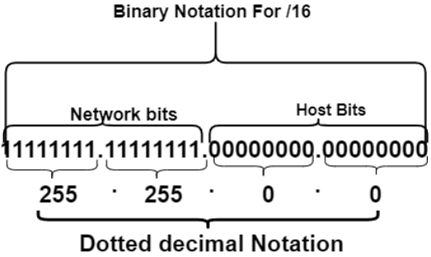
Class B
172 .16.0.0/16
n = no of n/w’s n = 1’s
m = no of hosts m = 0’s
FORMULA TO CALCULATE NO OF N/W’S
2^{n}
2⁰ [ in last 16 bit there are no of n/w’s ]
N=0
FORMULA TO CALCULATE NO OF HOSTS/NETWORK
2^{m} -2
2¹⁶ -2
65536– 2
65534 hosts/network
Total number of IP’s is 65536 per network
Total number of usable IP’s is 655364 per network

Slide 27
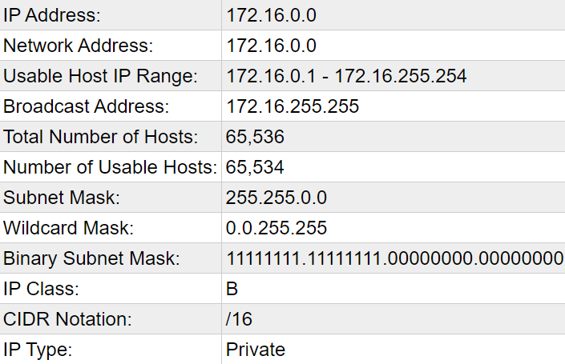
Network Address:172.16.0.0
Number of Usable Hosts:65534
172.16 0.1
to
172.16.255.254
Broadcast Address:172.16.255.255

Slide 28
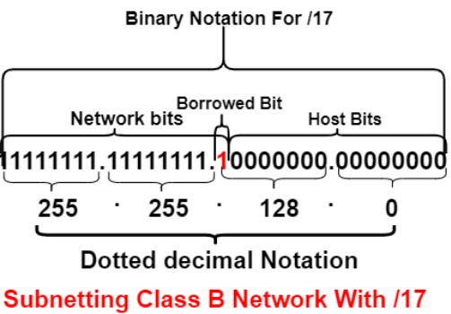
Class B
172 .16.0.0/17
n = no of n/w’s n = 1’s
m = no of hosts m = 0’s
FORMULA TO CALCULATE NO OF N/W’S
2^{n}
2¹ [ in last 8 bit there are no of n/w’s ]
N=2
Formula to Calculate Block size
FORMULA TO CALCULATE NO OF HOSTS/NETWORK
2^{m} -2
2¹⁵ -2
32768– 2
32766 hosts/network
Total number of IP’s is 32768 per network
Total number of usable IP’s is 32766 per network
Block size of each subnet = Total number of IP address
256
= 32758 = 128
256

Slide 29
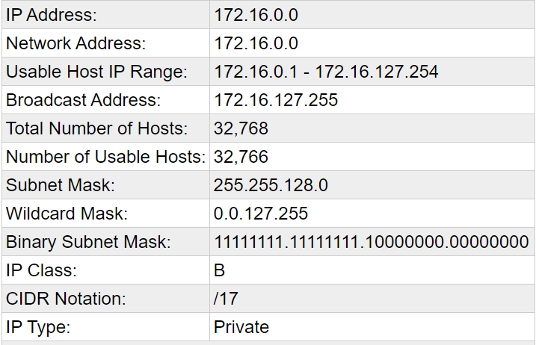
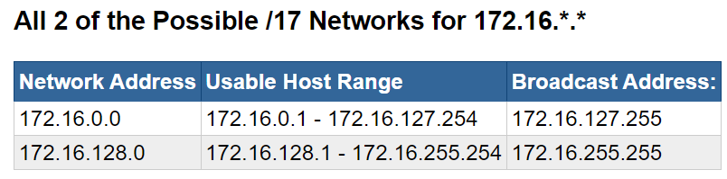

Slide 30
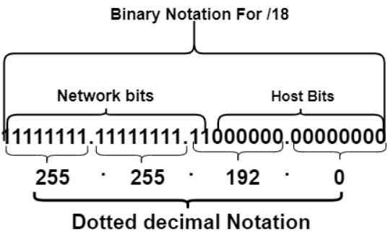
Class B
172 .16.0.0/18
n = no of n/w’s n = 1’s
m = no of hosts m = 0’s
FORMULA TO CALCULATE NO OF N/W’S
2^{n}
2² [ in last 8 bit there are no of n/w’s ]
N=4
Formula to Calculate Block size
FORMULA TO CALCULATE NO OF HOSTS/NETWORK
2^{m} -2
2¹⁴ -2
16384– 2
16382 hosts/network
Total number of IP’s is 16384 per network
Total number of usable IP’s is 16382 per network
Block size of each subnet = Total number of IP address
256
= 16384 = 64
256

Slide 31
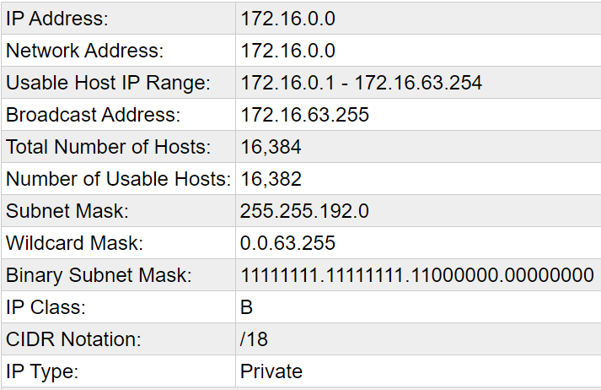
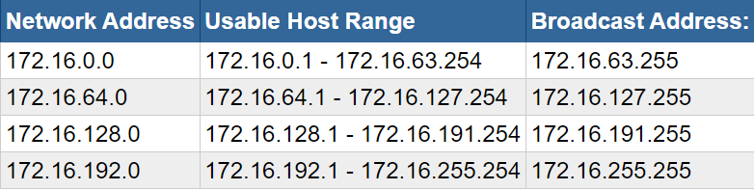
All 4 of the Possible /18 Networks for 172.16.*.*

Slide 32
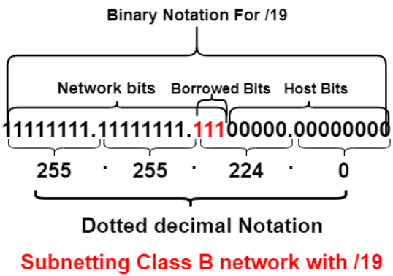
Class B
172 .16.0.0/19
n = no of n/w’s n = 1’s
m = no of hosts m = 0’s
FORMULA TO CALCULATE NO OF N/W’S
2^{n}
2³ [ in last 8 bit there are no of n/w’s ]
N=8
Formula to Calculate Block size
FORMULA TO CALCULATE NO OF HOSTS/NETWORK
2^{m} -2
2¹³ -2
8192– 2
8190 hosts/network
Total number of IP’s is 8192 per network
Total number of usable IP’s is 8190 per network
Block size of each subnet = Total number of IP address
256
= 8192 = 32
256

Slide 33
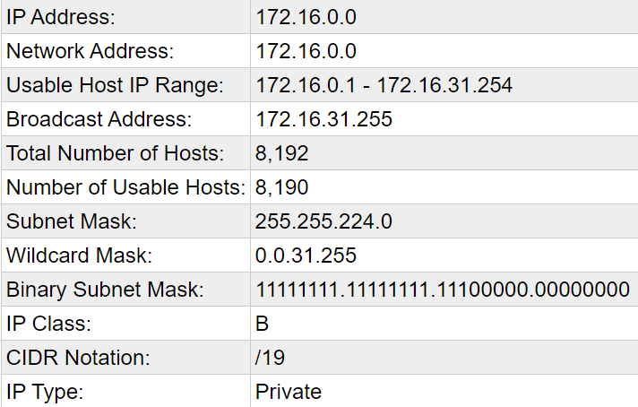
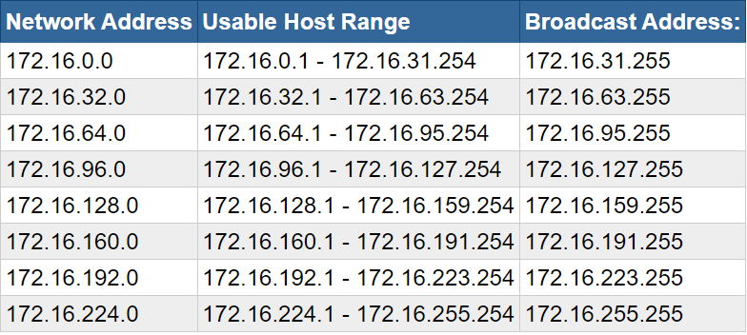
All 8 of the Possible /19 Networks for 172.16.*.*

Slide 34
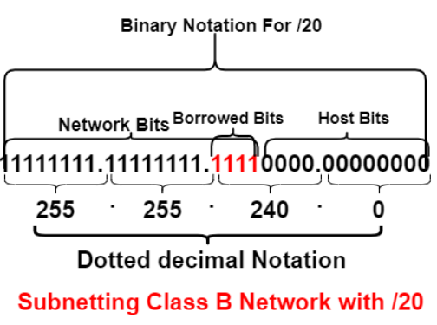
Class B
172 .16.0.0/20
n = no of n/w’s n = 1’s
m = no of hosts m = 0’s
FORMULA TO CALCULATE NO OF N/W’S
2^{n}
2⁴ [ in last 8 bit there are no of n/w’s ]
N=16
Formula to Calculate Block size
FORMULA TO CALCULATE NO OF HOSTS/NETWORK
2^{m} -2
2¹² -2
4096– 2
4094 hosts/network
Total number of IP’s is 4096 per network
Total number of usable IP’s is 4094 per network
Block size of each subnet = Total number of IP address
256
= 4096 = 16
256

Slide 35
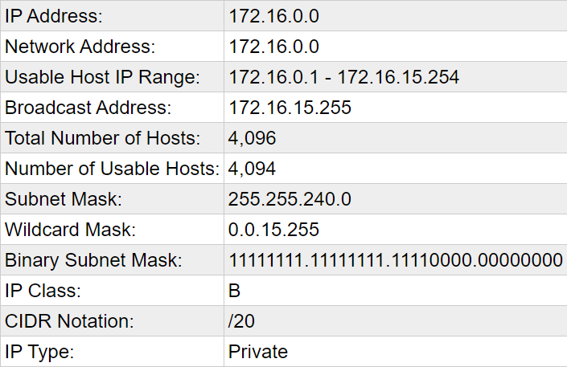
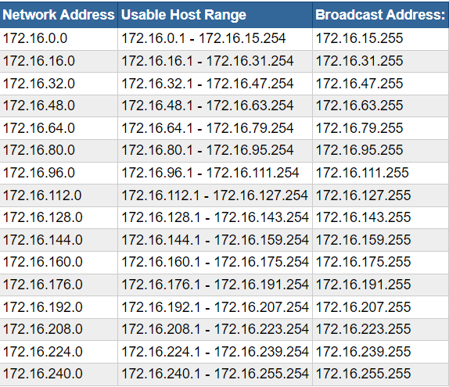
All 16 of the Possible /20 Networks for 172.16.*.*

Slide 36
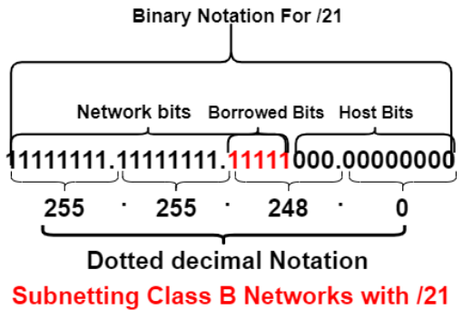
Class B
172 .16.0.0/21
n = no of n/w’s n = 1’s
m = no of hosts m = 0’s
FORMULA TO CALCULATE NO OF N/W’S
2^{n}
2⁵ [ in last 8 bit there are no of n/w’s ]
N=32
Formula to Calculate Block size
FORMULA TO CALCULATE NO OF HOSTS/NETWORK
2^{m} -2
2¹¹ -2
2048– 2
2046 hosts/network
Total number of IP’s is 2048 per network
Total number of usable IP’s is 2046 per network
Block size of each subnet = Total number of IP address
256
= 2048 = 8
256

Slide 37
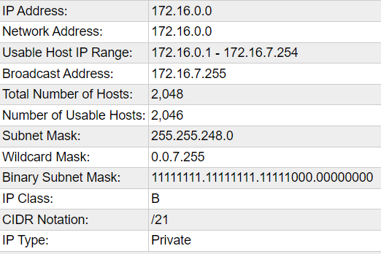

Slide 38
All 32 of the Possible /21 Networks for 172.16.*.*
Network Address Usable Host Range Broadcast Address
172.16.0.0 172.16.0.1 - 172.16.7.254 172.16.7.255
172.16.8.0 172.16.8.1 - 172.16.15.254 172.16.15.255
172.16.16.0 172.16.16.1 - 172.16.23.254 172.16.23.255
172.16.24.0 172.16.24.1 - 172.16.31.254 172.16.31.255
172.16.32.0 172.16.32.1 - 172.16.39.254 172.16.39.255
172.16.40.0 172.16.40.1 - 172.16.47.254 172.16.47.255
172.16.48.0 172.16.48.1 - 172.16.55.254 172.16.55.255
172.16.56.0 172.16.56.1 - 172.16.63.254 172.16.63.255
172.16.64.0 172.16.64.1 - 172.16.71.254 172.16.71.255
172.16.72.0 172.16.72.1 - 172.16.79.254 172.16.79.255
172.16.80.0 172.16.80.1 - 172.16.87.254 172.16.87.255
172.16.88.0 172.16.88.1 - 172.16.95.254 172.16.95.255
172.16.96.0 172.16.96.1 - 172.16.103.254 172.16.103.255
172.16.104.0 172.16.104.1 - 172.16.111.254 172.16.111.255
172.16.112.0 172.16.112.1 - 172.16.119.254 172.16.119.255
172.16.120.0 172.16.120.1 - 172.16.127.254 172.16.127.255
172.16.128.0 172.16.128.1 - 172.16.135.254 172.16.135.255
172.16.136.0 172.16.136.1 - 172.16.143.254 172.16.143.255
172.16.144.0 172.16.144.1 - 172.16.151.254 172.16.151.255
172.16.232.0 172.16.232.1 - 172.16.239.254 172.16.239.255
172.16.240.0 172.16.240.1 - 172.16.247.254 172.16.247.255
172.16.248.0 172.16.248.1 - 172.16.255.254 172.16.255.255
172.16.152.0 172.16.152.1 - 172.16.159.254 172.16.159.255
172.16.160.0 172.16.160.1 - 172.16.167.254 172.16.167.255
172.16.168.0 172.16.168.1 - 172.16.175.254 172.16.175.255
172.16.176.0 172.16.176.1 - 172.16.183.254 172.16.183.255
172.16.184.0 172.16.184.1 - 172.16.191.254 172.16.191.255
172.16.192.0 172.16.192.1 - 172.16.199.254 172.16.199.255
172.16.200.0 172.16.200.1 - 172.16.207.254 172.16.207.255
172.16.208.0 172.16.208.1 - 172.16.215.254 172.16.215.255
172.16.216.0 172.16.216.1 - 172.16.223.254 172.16.223.255
172.16.224.0 172.16.224.1 - 172.16.231.254 172.16.231.255

Slide 39
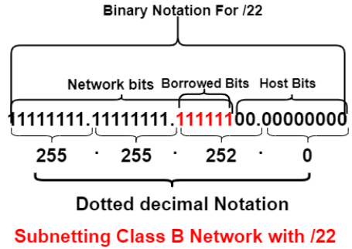
Class B
172 .16.0.0/22
n = no of n/w’s n = 1’s
m = no of hosts m = 0’s
FORMULA TO CALCULATE NO OF N/W’S
2^{n}
2⁶ [ in last 8 bit there are no of n/w’s ]
N=64
Formula to Calculate Block size
FORMULA TO CALCULATE NO OF HOSTS/NETWORK
2^{m} -2
2¹⁰ -2
1024– 2
1022 hosts/network
Total number of IP’s is 1024 per network
Total number of usable IP’s is 1022 per network
Block size of each subnet = Total number of IP address
256
= 1024 = 4
256

Slide 40
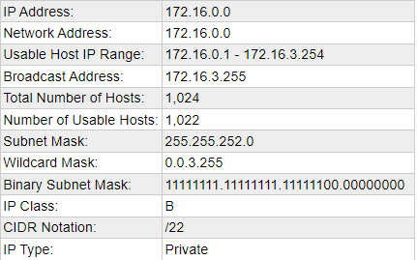

Slide 41
All 64 of the Possible /22 Networks for 172.16.*.*
172.16.116.0 172.16.116.1 - 172.16.119.254 172.16.119.255
172.16.120.0 172.16.120.1 - 172.16.123.254 172.16.123.255
172.16.124.0 172.16.124.1 - 172.16.127.254 172.16.127.255
172.16.128.0 172.16.128.1 - 172.16.131.254 172.16.131.255
172.16.132.0 172.16.132.1 - 172.16.135.254 172.16.135.255
172.16.136.0 172.16.136.1 - 172.16.139.254 172.16.139.255
172.16.140.0 172.16.140.1 - 172.16.143.254 172.16.143.255
172.16.144.0 172.16.144.1 - 172.16.147.254 172.16.147.255
172.16.148.0 172.16.148.1 - 172.16.151.254 172.16.151.255
172.16.152.0 172.16.152.1 - 172.16.155.254 172.16.155.255
172.16.156.0 172.16.156.1 - 172.16.159.254 172.16.159.255
172.16.160.0 172.16.160.1 - 172.16.163.254 172.16.163.255
172.16.164.0 172.16.164.1 - 172.16.167.254 172.16.167.255
172.16.168.0 172.16.168.1 - 172.16.171.254 172.16.171.255
172.16.172.0 172.16.172.1 - 172.16.175.254 172.16.175.255
172.16.176.0 172.16.176.1 - 172.16.179.254 172.16.179.255
172.16.180.0 172.16.180.1 - 172.16.183.254 172.16.183.255
172.16.184.0 172.16.184.1 - 172.16.187.254 172.16.187.255
172.16.188.0 172.16.188.1 - 172.16.191.254 172.16.191.255
172.16.192.0 172.16.192.1 - 172.16.195.254 172.16.195.255
172.16.196.0 172.16.196.1 - 172.16.199.254 172.16.199.255
172.16.200.0 172.16.200.1 - 172.16.203.254 172.16.203.255
172.16.204.0 172.16.204.1 - 172.16.207.254 172.16.207.255
172.16.208.0 172.16.208.1 - 172.16.211.254 172.16.211.255
172.16.212.0 172.16.212.1 - 172.16.215.254 172.16.215.255
172.16.216.0 172.16.216.1 - 172.16.219.254 172.16.219.255
172.16.220.0 172.16.220.1 - 172.16.223.254 172.16.223.255
172.16.224.0 172.16.224.1 - 172.16.227.254 172.16.227.255
172.16.228.0 172.16.228.1 - 172.16.231.254 172.16.231.255
172.16.232.0 172.16.232.1 - 172.16.235.254 172.16.235.255
172.16.236.0 172.16.236.1 - 172.16.239.254 172.16.239.255
172.16.240.0 172.16.240.1 - 172.16.243.254 172.16.243.255
172.16.244.0 172.16.244.1 - 172.16.247.254 172.16.247.255
172.16.248.0 172.16.248.1 - 172.16.251.254 172.16.251.255
172.16.252.0 172.16.252.1 - 172.16.255.254 172.16.255.255
Network Address Usable Host Range Broadcast Address:
172.16.0.0 172.16.0.1 - 172.16.3.254 172.16.3.255
172.16.4.0 172.16.4.1 - 172.16.7.254 172.16.7.255
172.16.8.0 172.16.8.1 - 172.16.11.254 172.16.11.255
172.16.12.0 172.16.12.1 - 172.16.15.254 172.16.15.255
172.16.16.0 172.16.16.1 - 172.16.19.254 172.16.19.255
172.16.20.0 172.16.20.1 - 172.16.23.254 172.16.23.255
172.16.24.0 172.16.24.1 - 172.16.27.254 172.16.27.255
172.16.28.0 172.16.28.1 - 172.16.31.254 172.16.31.255
172.16.32.0 172.16.32.1 - 172.16.35.254 172.16.35.255
172.16.36.0 172.16.36.1 - 172.16.39.254 172.16.39.255
172.16.40.0 172.16.40.1 - 172.16.43.254 172.16.43.255
172.16.44.0 172.16.44.1 - 172.16.47.254 172.16.47.255
172.16.48.0 172.16.48.1 - 172.16.51.254 172.16.51.255
172.16.52.0 172.16.52.1 - 172.16.55.254 172.16.55.255
172.16.56.0 172.16.56.1 - 172.16.59.254 172.16.59.255
172.16.60.0 172.16.60.1 - 172.16.63.254 172.16.63.255
172.16.64.0 172.16.64.1 - 172.16.67.254 172.16.67.255
172.16.68.0 172.16.68.1 - 172.16.71.254 172.16.71.255
172.16.72.0 172.16.72.1 - 172.16.75.254 172.16.75.255
172.16.76.0 172.16.76.1 - 172.16.79.254 172.16.79.255
172.16.80.0 172.16.80.1 - 172.16.83.254 172.16.83.255
172.16.84.0 172.16.84.1 - 172.16.87.254 172.16.87.255
172.16.88.0 172.16.88.1 - 172.16.91.254 172.16.91.255
172.16.92.0 172.16.92.1 - 172.16.95.254 172.16.95.255
172.16.96.0 172.16.96.1 - 172.16.99.254 172.16.99.255
172.16.100.0 172.16.100.1 - 172.16.103.254 172.16.103.255
172.16.104.0 172.16.104.1 - 172.16.107.254 172.16.107.255
172.16.108.0 172.16.108.1 - 172.16.111.254 172.16.111.255
172.16.112.0 172.16.112.1 - 172.16.115.254 172.16.115.255

Slide 42
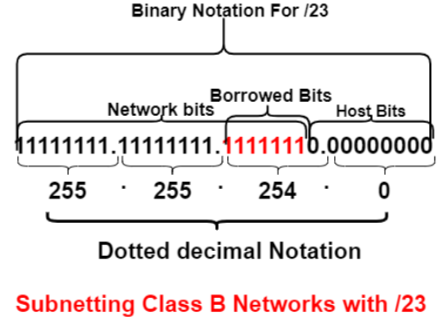
Class B
172 .16.0.0/23
n = no of n/w’s n = 1’s
m = no of hosts m = 0’s
FORMULA TO CALCULATE NO OF N/W’S
2^{n}
2⁷ [ in last 8 bit there are no of n/w’s ]
N=128
Formula to Calculate Block size
FORMULA TO CALCULATE NO OF HOSTS/NETWORK
2^{m} -2
2⁹ -2
512– 2
510 hosts/network
Total number of IP’s is 512 per network
Total number of usable IP’s is 510 per network
Block size of each subnet = Total number of IP address
256
= 512 = 2
256

Slide 43
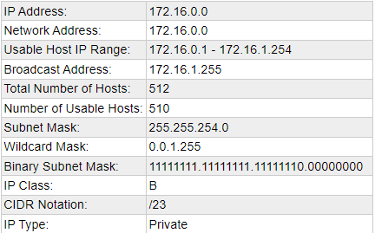

Slide 44
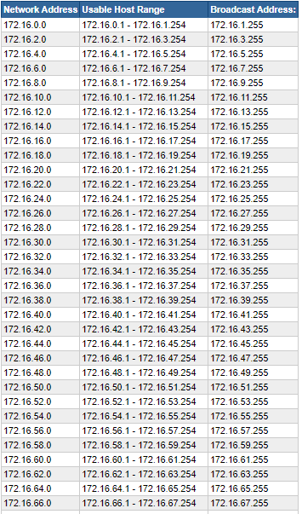
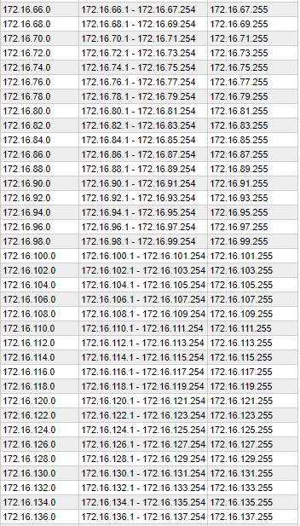
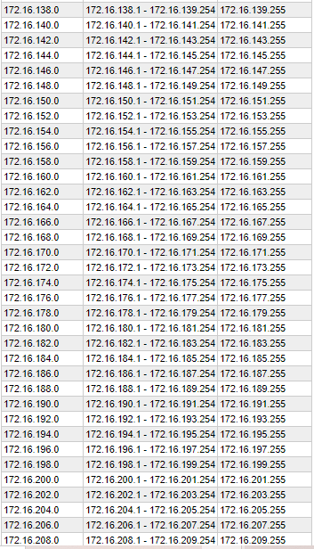
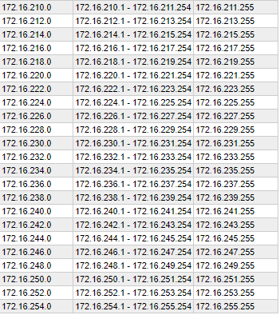
All 128 of the Possible /23 Networks for 172.16.*.*

Slide 45

Class A Sub netting

Slide 46
Class A
10.0.0.0/8
n = no of n/w’s n = 1’s
m = no of hosts m = 0’s
11111111.00000000. 00000000.00000000
255. 0. 0. 0 [ Subnet mask]
FORMULA TO CALCULATE NO OF N/W’S
2^{n}
2⁰
N=1
FORMULA TO CALCULATE NO OF HOSTS/NETWORK
2^{m} -2
2²⁴ -2
16777216– 2
16777214 hosts/network
Total number of IP’s is 16777216 per network
Total number of usable IP’s is 16777214 per network

Slide 47
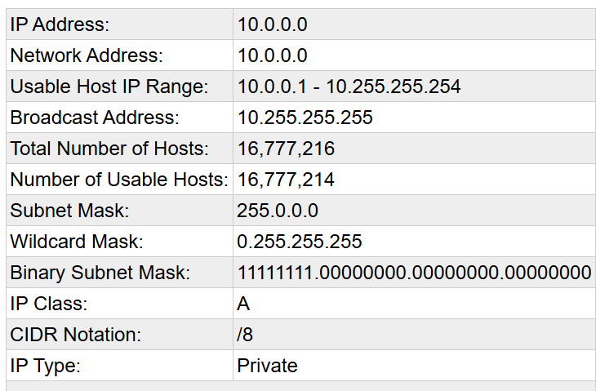
Network Address:10.0.0.0
Number of Usable Hosts:16777214
10.0.0.1
to
10.255.255.254
Broadcast Address:10.255.255.255

Slide 48
Class A
10.0.0.0/9
n = no of n/w’s n = 1’s
m = no of hosts m = 0’s
11111111.10000000. 00000000.00000000
255. 128. 0. 0 [ Subnet mask]
FORMULA TO CALCULATE NO OF N/W’S
2^{n}
2¹
N=2
Formula to Calculate Block size
Block size of each subnet = Total number of IP address
256
= 8388608 = 32768
256
Again we have to divide
= 32768 =128
256
FORMULA TO CALCULATE NO OF HOSTS/NETWORK
2^{m} -2
2²³ -2
8388608– 2
8388606 hosts/network
Total number of IP’s is 8388608 per network
Total number of usable IP’s is 8388606 per network

Slide 49
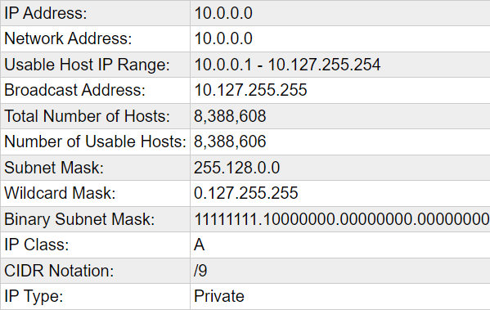
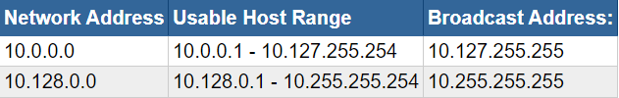
All 2 of the Possible /9 Networks for 10.*.*.*

Slide 50
Class A
10.0.0.0/10
n = no of n/w’s n = 1’s
m = no of hosts m = 0’s
11111111.11000000. 00000000.00000000
255. 192. 0. 0 [ Subnet mask]
FORMULA TO CALCULATE NO OF N/W’S
2^{n}
2²
N=4
Formula to Calculate Block size
Block size of each subnet = Total number of IP address
256
= 4194304 = 16384
256
Again we have to divide
= 16384 =64
256
FORMULA TO CALCULATE NO OF HOSTS/NETWORK
2^{m} -2
2²² -2
4194304– 2
4194302 hosts/network
Total number of IP’s is 4194304 per network
Total number of usable IP’s is 4194302 per network

Slide 51
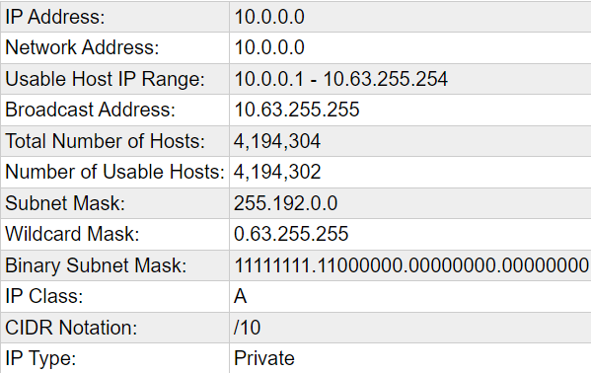
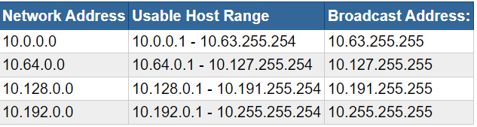
All 4 of the Possible /10 Networks for 10.*.*.*

Slide 52
Class A
10.0.0.0/11
n = no of n/w’s n = 1’s
m = no of hosts m = 0’s
11111111.11100000. 00000000.00000000
255. 224. 0. 0 [ Subnet mask]
FORMULA TO CALCULATE NO OF N/W’S
2^{n}
2³
N=8
Formula to Calculate Block size
Block size of each subnet = Total number of IP address
256
= 2097152 = 8192
256
Again we have to divide
= 8192 =32
256
FORMULA TO CALCULATE NO OF HOSTS/NETWORK
2^{m} -2
2²¹ -2
2097152– 2
2097150hosts/network
Total number of IP’s is 2097152 per network
Total number of usable IP’s is 2097150 per network

Slide 53
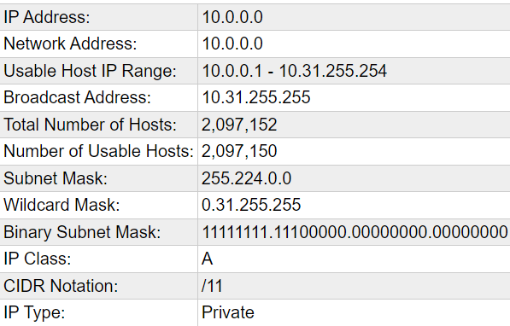

All 8 of the Possible /11 Networks for 10.*.*.*

Slide 54
Class A
10.0.0.0/12
n = no of n/w’s n = 1’s
m = no of hosts m = 0’s
11111111.11110000. 00000000.00000000
255. 240. 0. 0 [ Subnet mask]
FORMULA TO CALCULATE NO OF N/W’S
2^{n}
2⁴
N=16
Formula to Calculate Block size
Block size of each subnet = Total number of IP address
256
= 1048574 = 4096
256
Again we have to divide
= 4096 =16
256
FORMULA TO CALCULATE NO OF HOSTS/NETWORK
2^{m} -2
2²⁰ -2
1048576– 2
1048574 hosts/network
Total number of IP’s is 1048576 per network
Total number of usable IP’s is 1048574 per network

Slide 55


All 16 of the Possible /12 Networks for 10.*.*.*

Slide 56
Class A
10.0.0.0/13
n = no of n/w’s n = 1’s
m = no of hosts m = 0’s
11111111.11111000. 00000000.00000000
255. 248. 0. 0 [ Subnet mask]
FORMULA TO CALCULATE NO OF N/W’S
2^{n}
2⁵
N=32
Formula to Calculate Block size
Block size of each subnet = Total number of IP address
256
= 524288 = 2048
256
Again we have to divide
= 2048 = 8
256
FORMULA TO CALCULATE NO OF HOSTS/NETWORK
2^{m} -2
2¹⁹ -2
524288– 2
524286 hosts/network
Total number of IP’s is 524288 per network
Total number of usable IP’s is 524286 per network

Slide 57


All 32 of the Possible /13 Networks for 10.*.*.*

Slide 58
Class A
10.0.0.0/14
n = no of n/w’s n = 1’s
m = no of hosts m = 0’s
11111111.11111100. 00000000.00000000
255. 252. 0. 0 [ Subnet mask]
FORMULA TO CALCULATE NO OF N/W’S
2^{n}
2⁶
N=64
Formula to Calculate Block size
Block size of each subnet = Total number of IP address
256
= 262144 = 1024
256
Again we have to divide
= 1024 = 4
256
FORMULA TO CALCULATE NO OF HOSTS/NETWORK
2^{m} -2
2¹⁸ -2
262144– 2
262142 hosts/network
Total number of IP’s is 262144 per network
Total number of usable IP’s is 262142 per network

Slide 59


Slide 60


All 64 of the Possible /14 Networks for 10.*.*.*

Slide 61



Slide 62
Class A
10.0.0.0/15
n = no of n/w’s n = 1’s
m = no of hosts m = 0’s
11111111.11111110. 00000000.00000000
255. 254. 0. 0 [ Subnet mask]
FORMULA TO CALCULATE NO OF N/W’S
2^{n}
2⁷
N=128
Formula to Calculate Block size
Block size of each subnet = Total number of IP address
256
= 131072 = 512
256
Again we have to divide
= 512 = 2
256
FORMULA TO CALCULATE NO OF HOSTS/NETWORK
2^{m} -2
2¹⁷ -2
131072– 2
131070 hosts/network
Total number of IP’s is 131072 per network
Total number of usable IP’s is 131070 per network

Slide 63


Slide 64


All 128 of the Possible /15 Networks for 10.*.*.*

Slide 65



Slide 66



Slide 67


