Slide 1
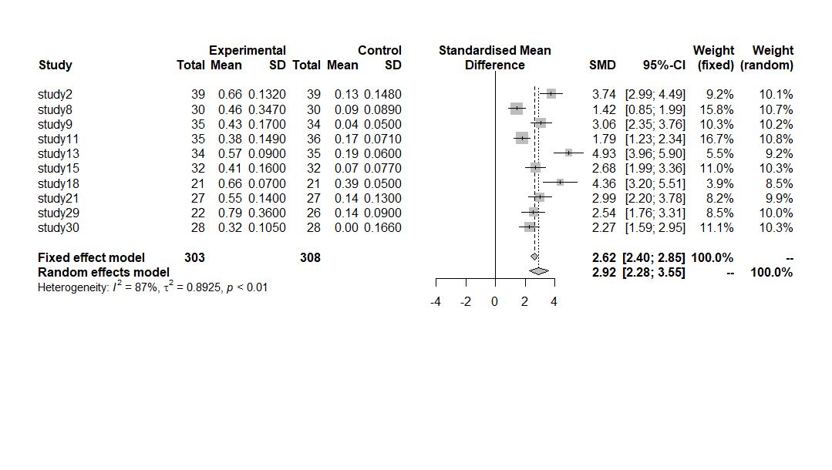
Meta meangoup1

Slide 2
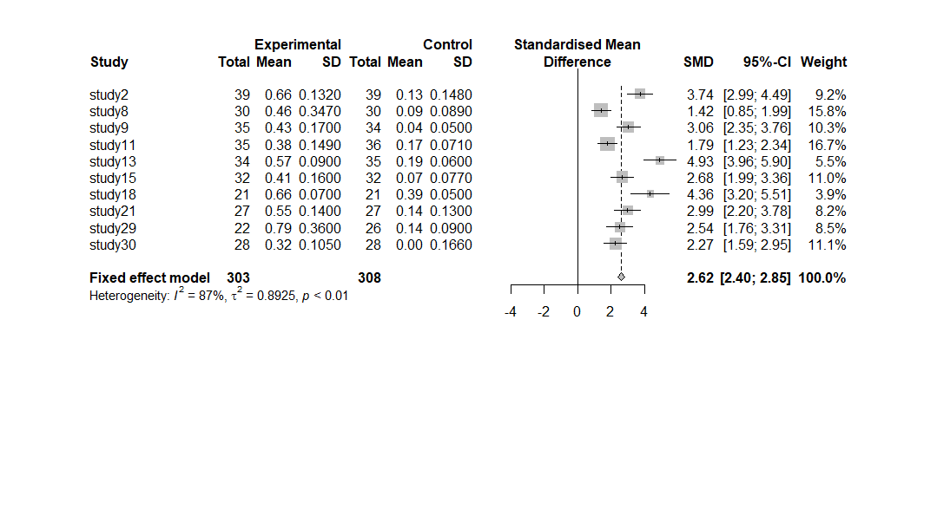
Random_Effect_Model

Slide 3
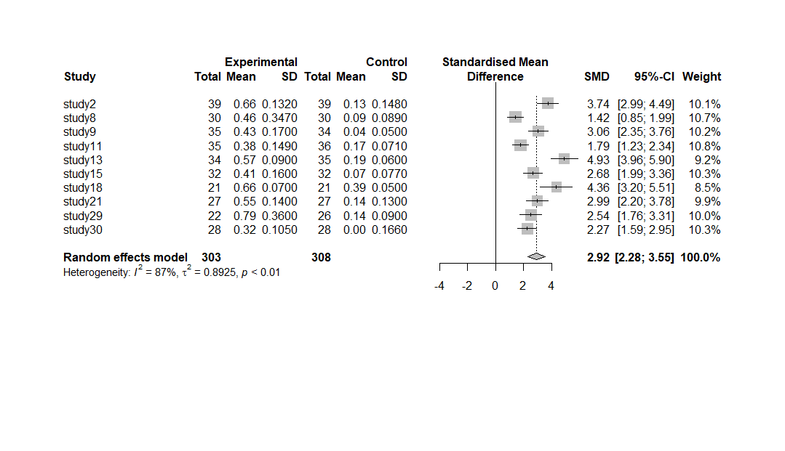
Fixed_Effect_Model

Slide 4
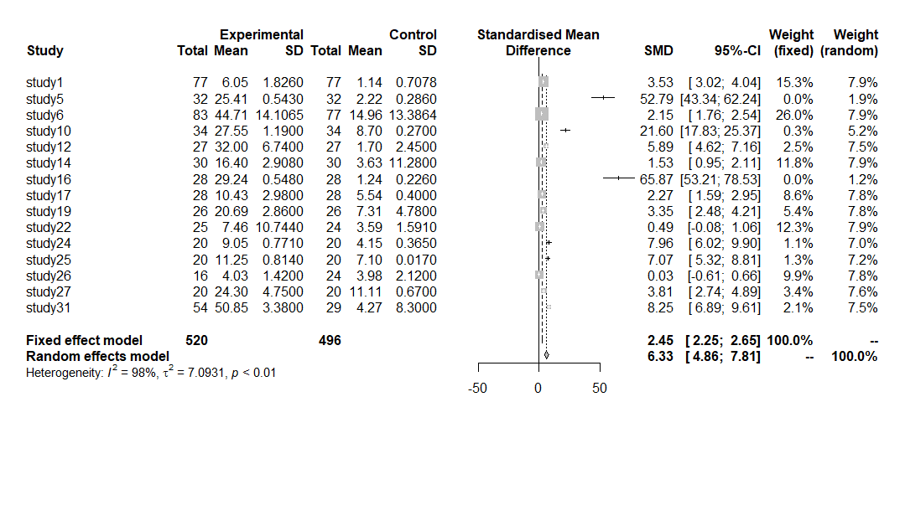
sumgorup

Slide 5
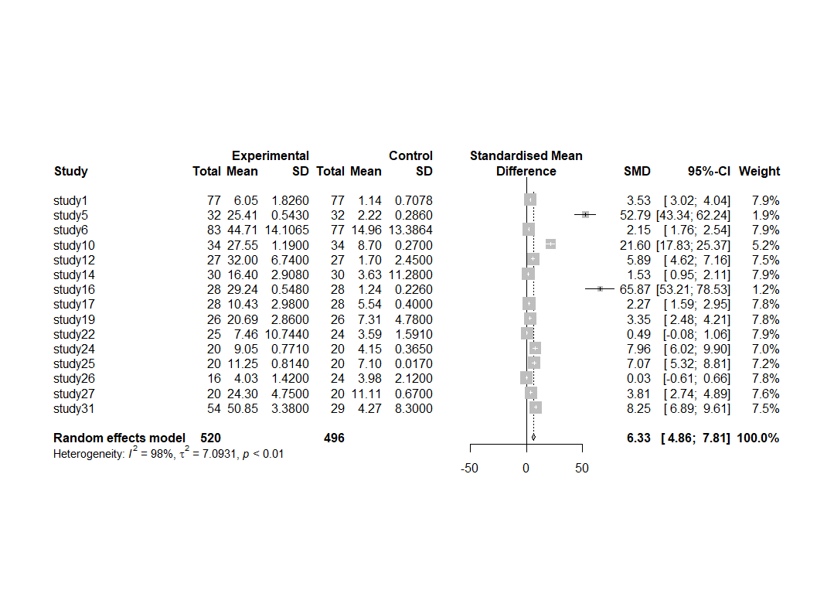

Slide 6
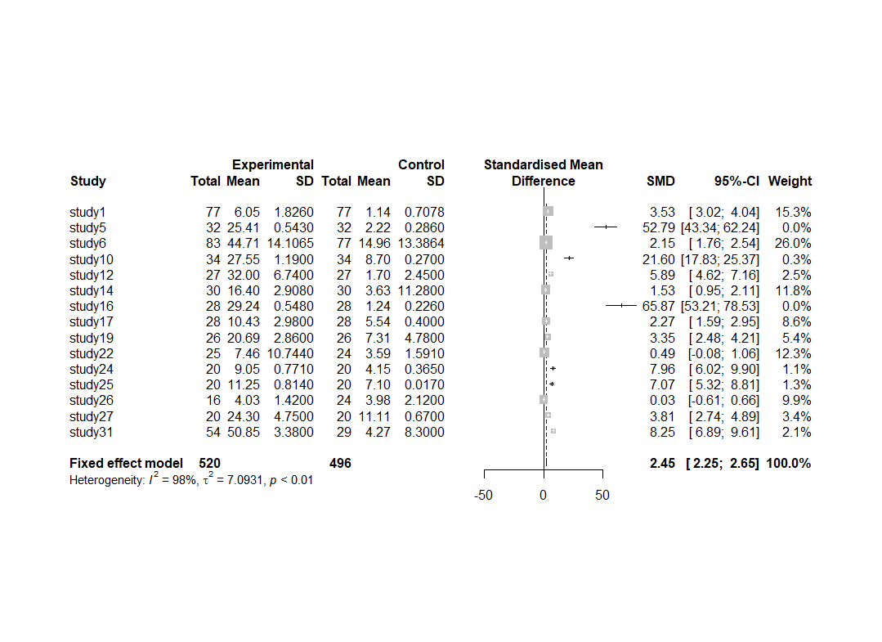

Slide 7
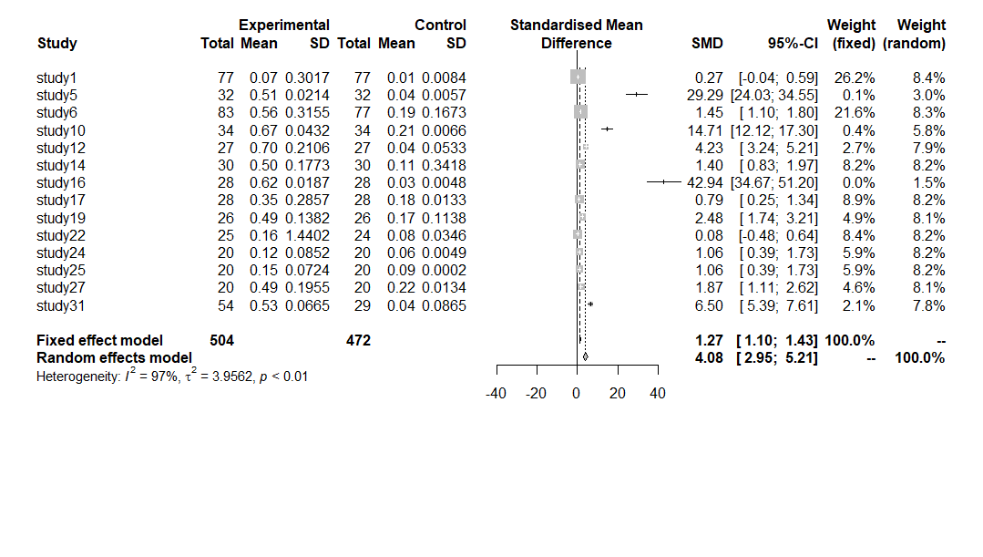
Total score

Slide 8
table 4. the mean effect size according to the sub-factor of environmental literacy
variable | k | ES(g) | 95% C.I. |  | T² | I² (%) | Q | df | p
 |  |  | Lower | Upper
affection | 18 | 2.4239 | 1.716 | 3.131 | 2.180 | 95.2 | 0.56 | 3 | 0.906
behavior | 16 | 2.2789 | 1.472 | 3.085 | 2.474 | 95.8
knowledge | 17 | 2.5764 | 1.817 | 3.334 | 2.311 | 95.7
function | 10 | 2.9599 | 1.053 | 4.866 | 9.033 | 98.3
table 5. the mean effect size according to the interventions
Variables |  | k | ES(g) | 95% C.I. |  | T² | I² (%) | Q | df | p
 |  |  |  | Lower | Upper
Grade | 1 | 4 | 0.7335 | -1.628 | 3.095 | 5.707 | 98.3 | 63.26 | 4 | 0.000***
 | 2 | 4 | 0.6961 | 0.364 | 1.027 | 0.042 | 37.4
 | 3 | 6 | 3.0172 | 2.310 | 3.723 | 0.629 | 81.4
 | 5 | 21 | 2.4967 | 1.838 | 3.154 | 2.139 | 94.6
 | 6 | 26 | 3.0033 | 2.209 | 3.796 | 3.926 | 97.2
Unit | Upper 13 times | 26 | 3.2647 | 2.466 | 4.062 | 3.940 | 97.0 | 6.50 | 1 | 0.010*
 | Under 13 times | 35 | 2.0236 | 1.500 | 2.546 | 2.331 | 95.7
N. Of Students | Upper 30 | 33 | 2.2722 | 1.705 | 2.838 | 2.567 | 96.5 | 1.19 | 1 | 0.275
 | Under 30 | 28 | 2.7877 | 2.053 | 3.521 | 3.621 | 96.1
Place | Outside | 25 | 2.6908 | 2.037 | 3.344 | 2.548 | 95.1 | 0.58 | 1 | 0.448
 | Inside | 36 | 2.3485 | 1.753 | 2.944 | 3.079 | 96.8

Slide 9
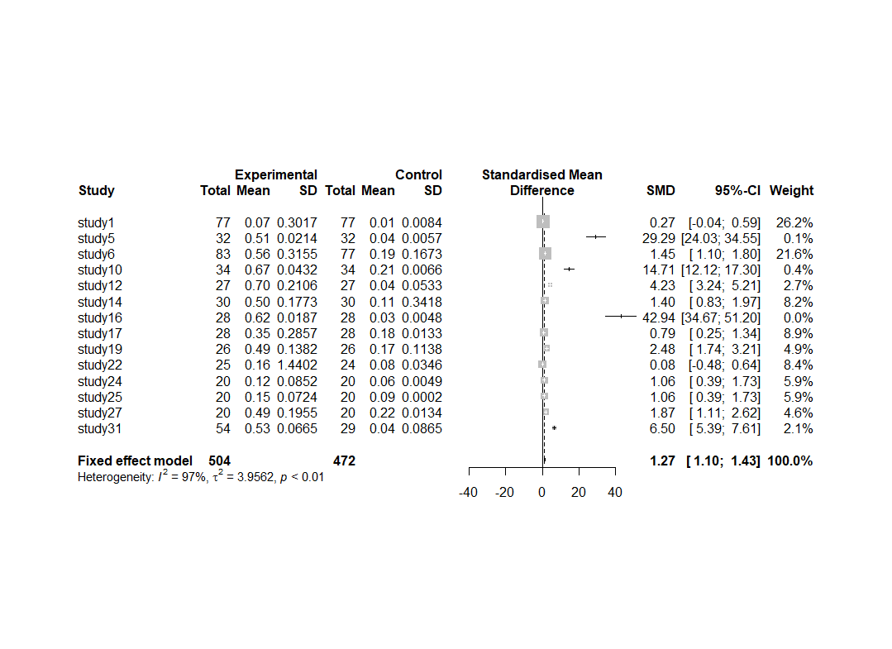

Slide 10
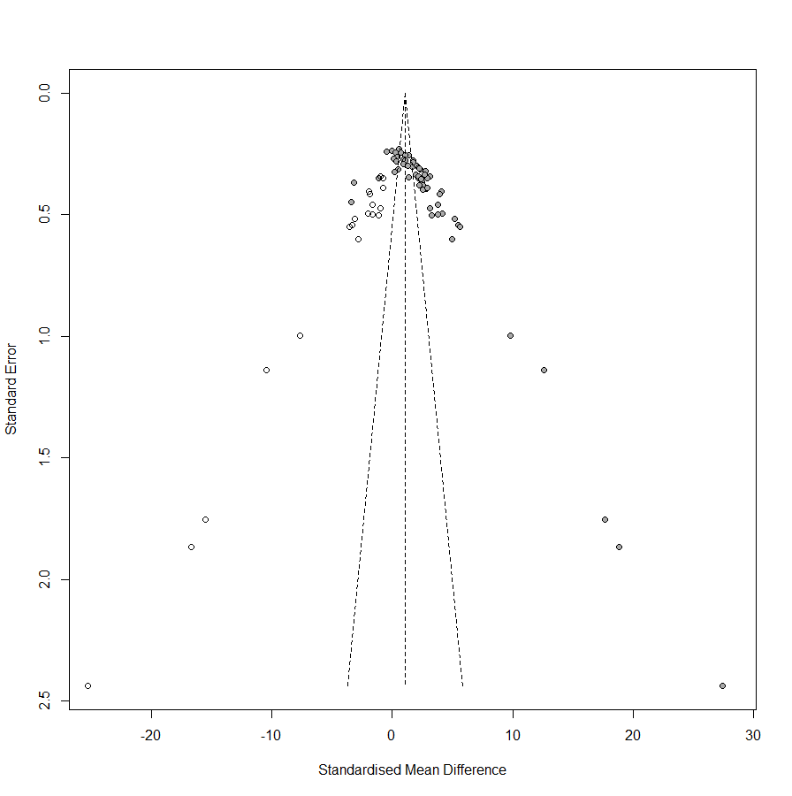

Slide 11
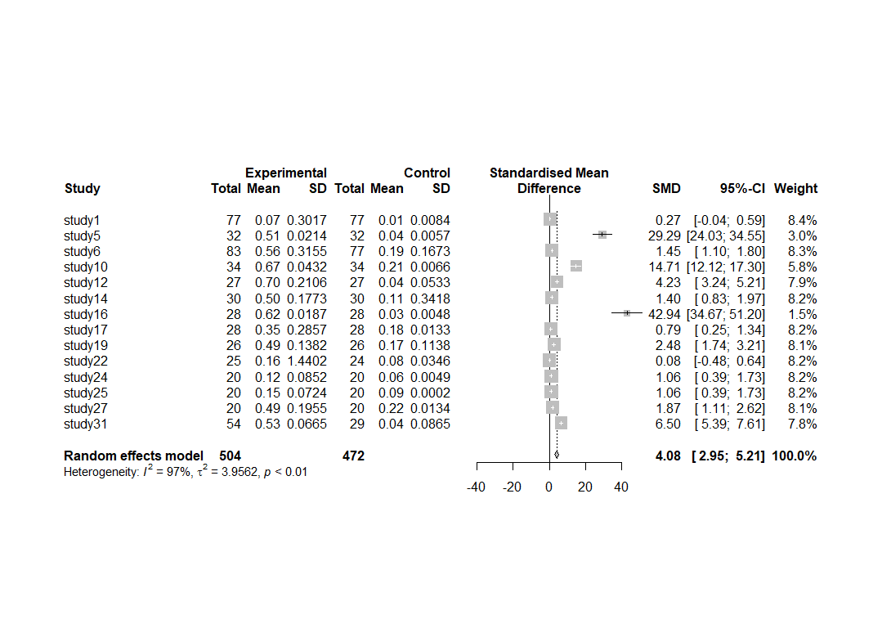

Slide 12
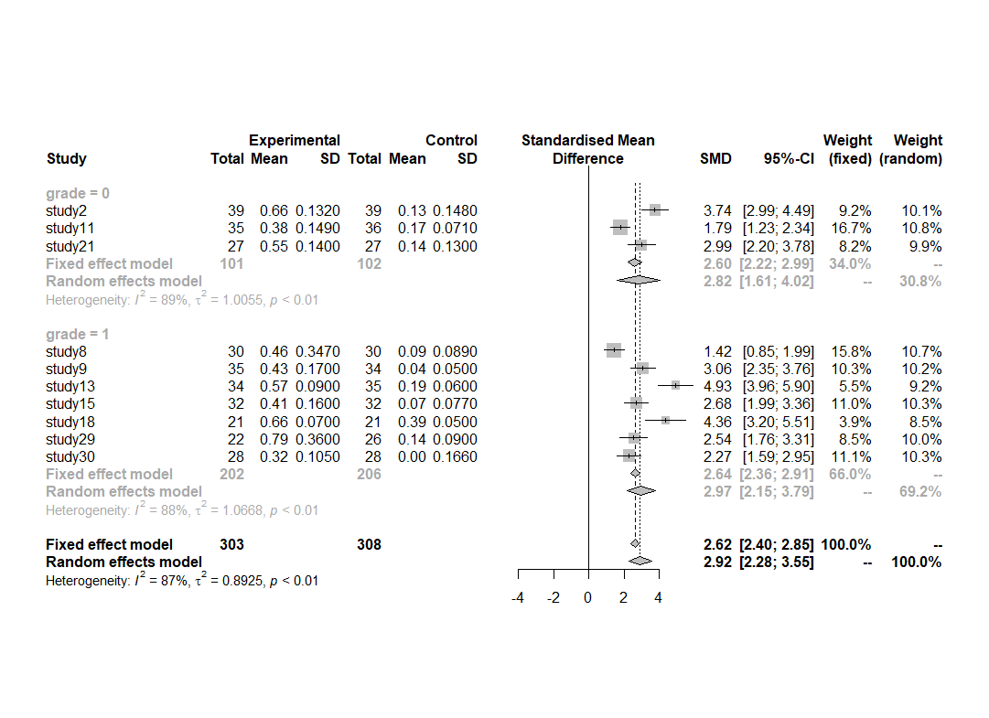
Metaanova(meangroup)_by grade

Slide 13
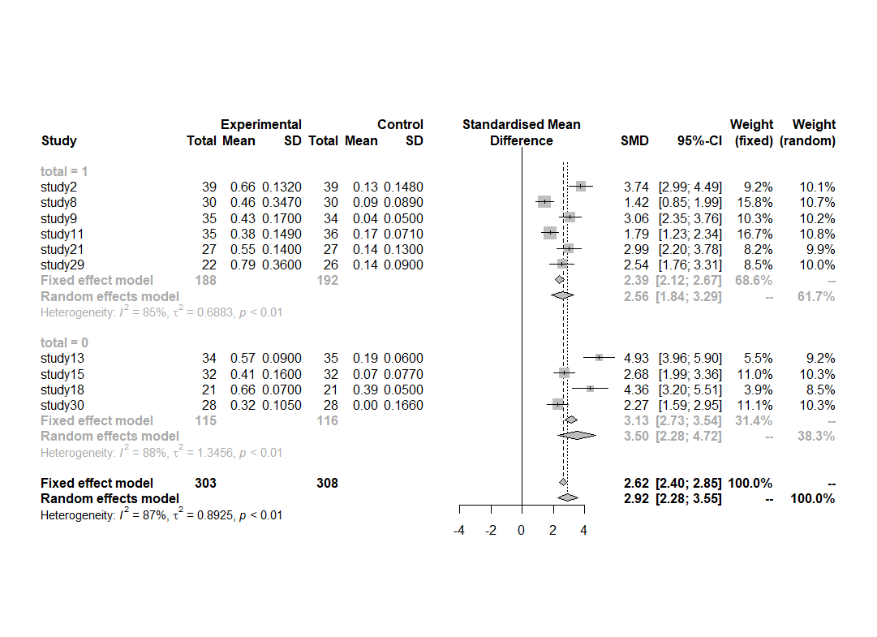
Metaanova(meangroup)_by total

Slide 14
Metaanova(meangroup)_number

Slide 15
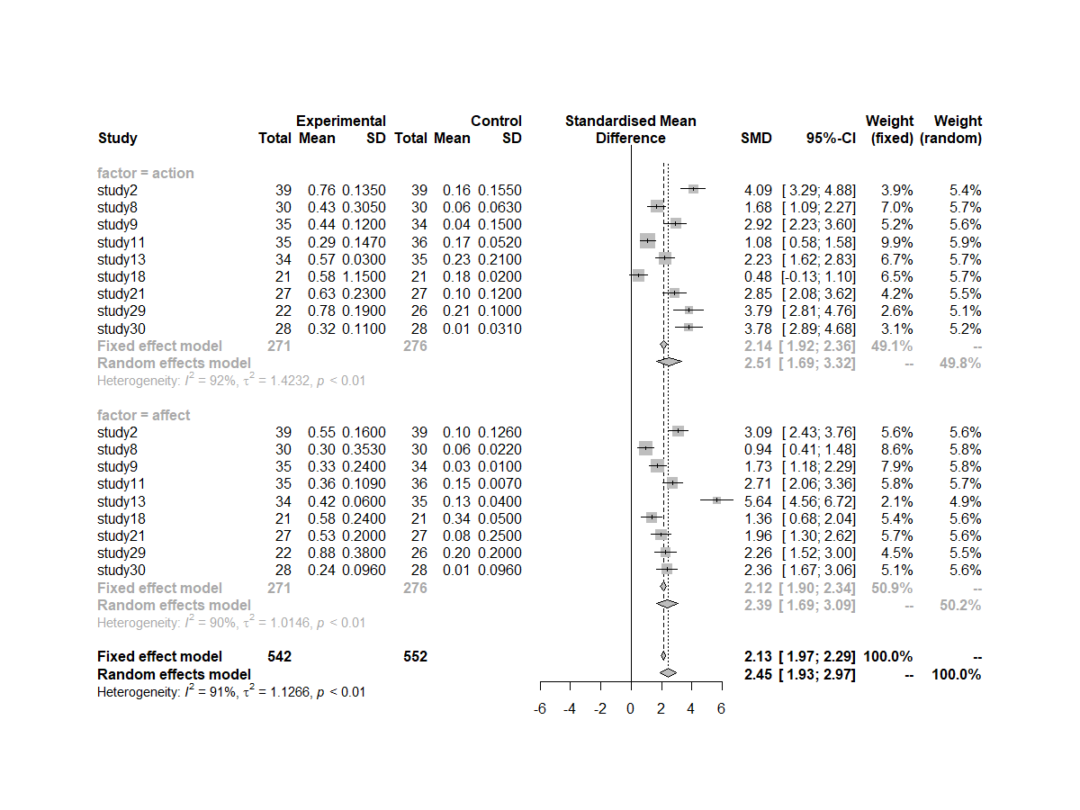
Meangroup_Factor anova

Slide 16
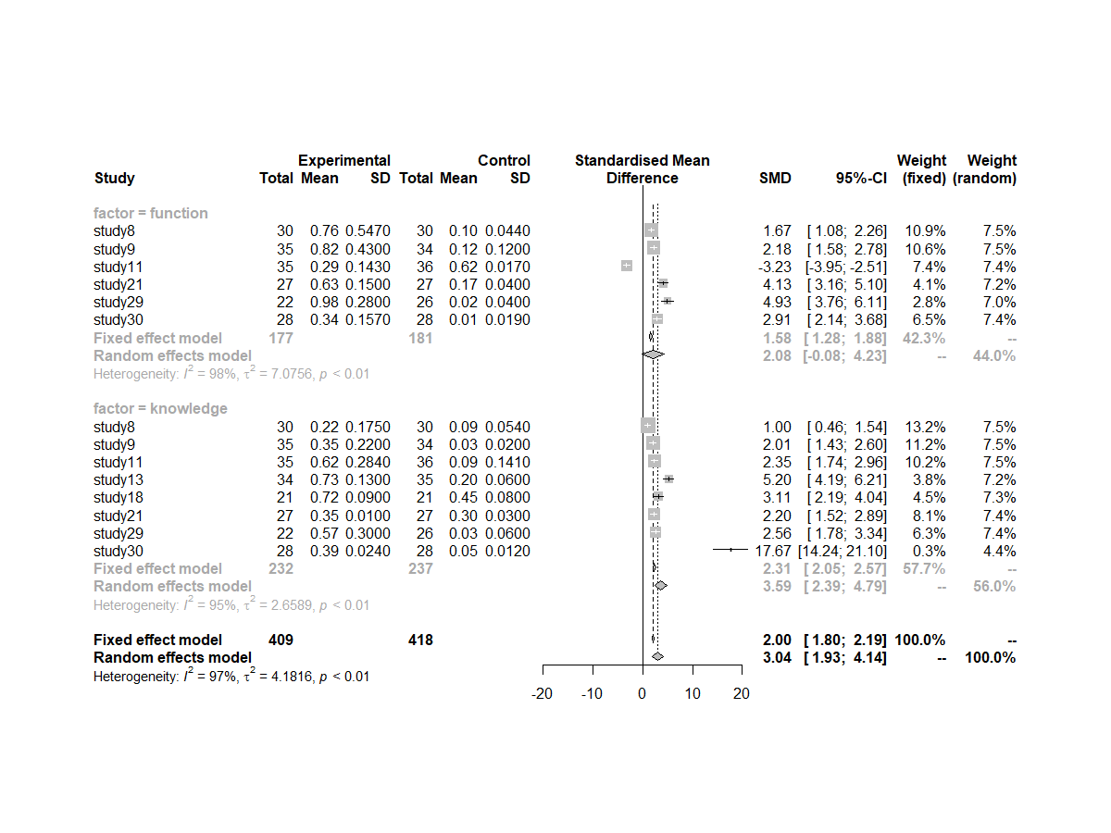
Meangroup_Factor anova

