Slide 1
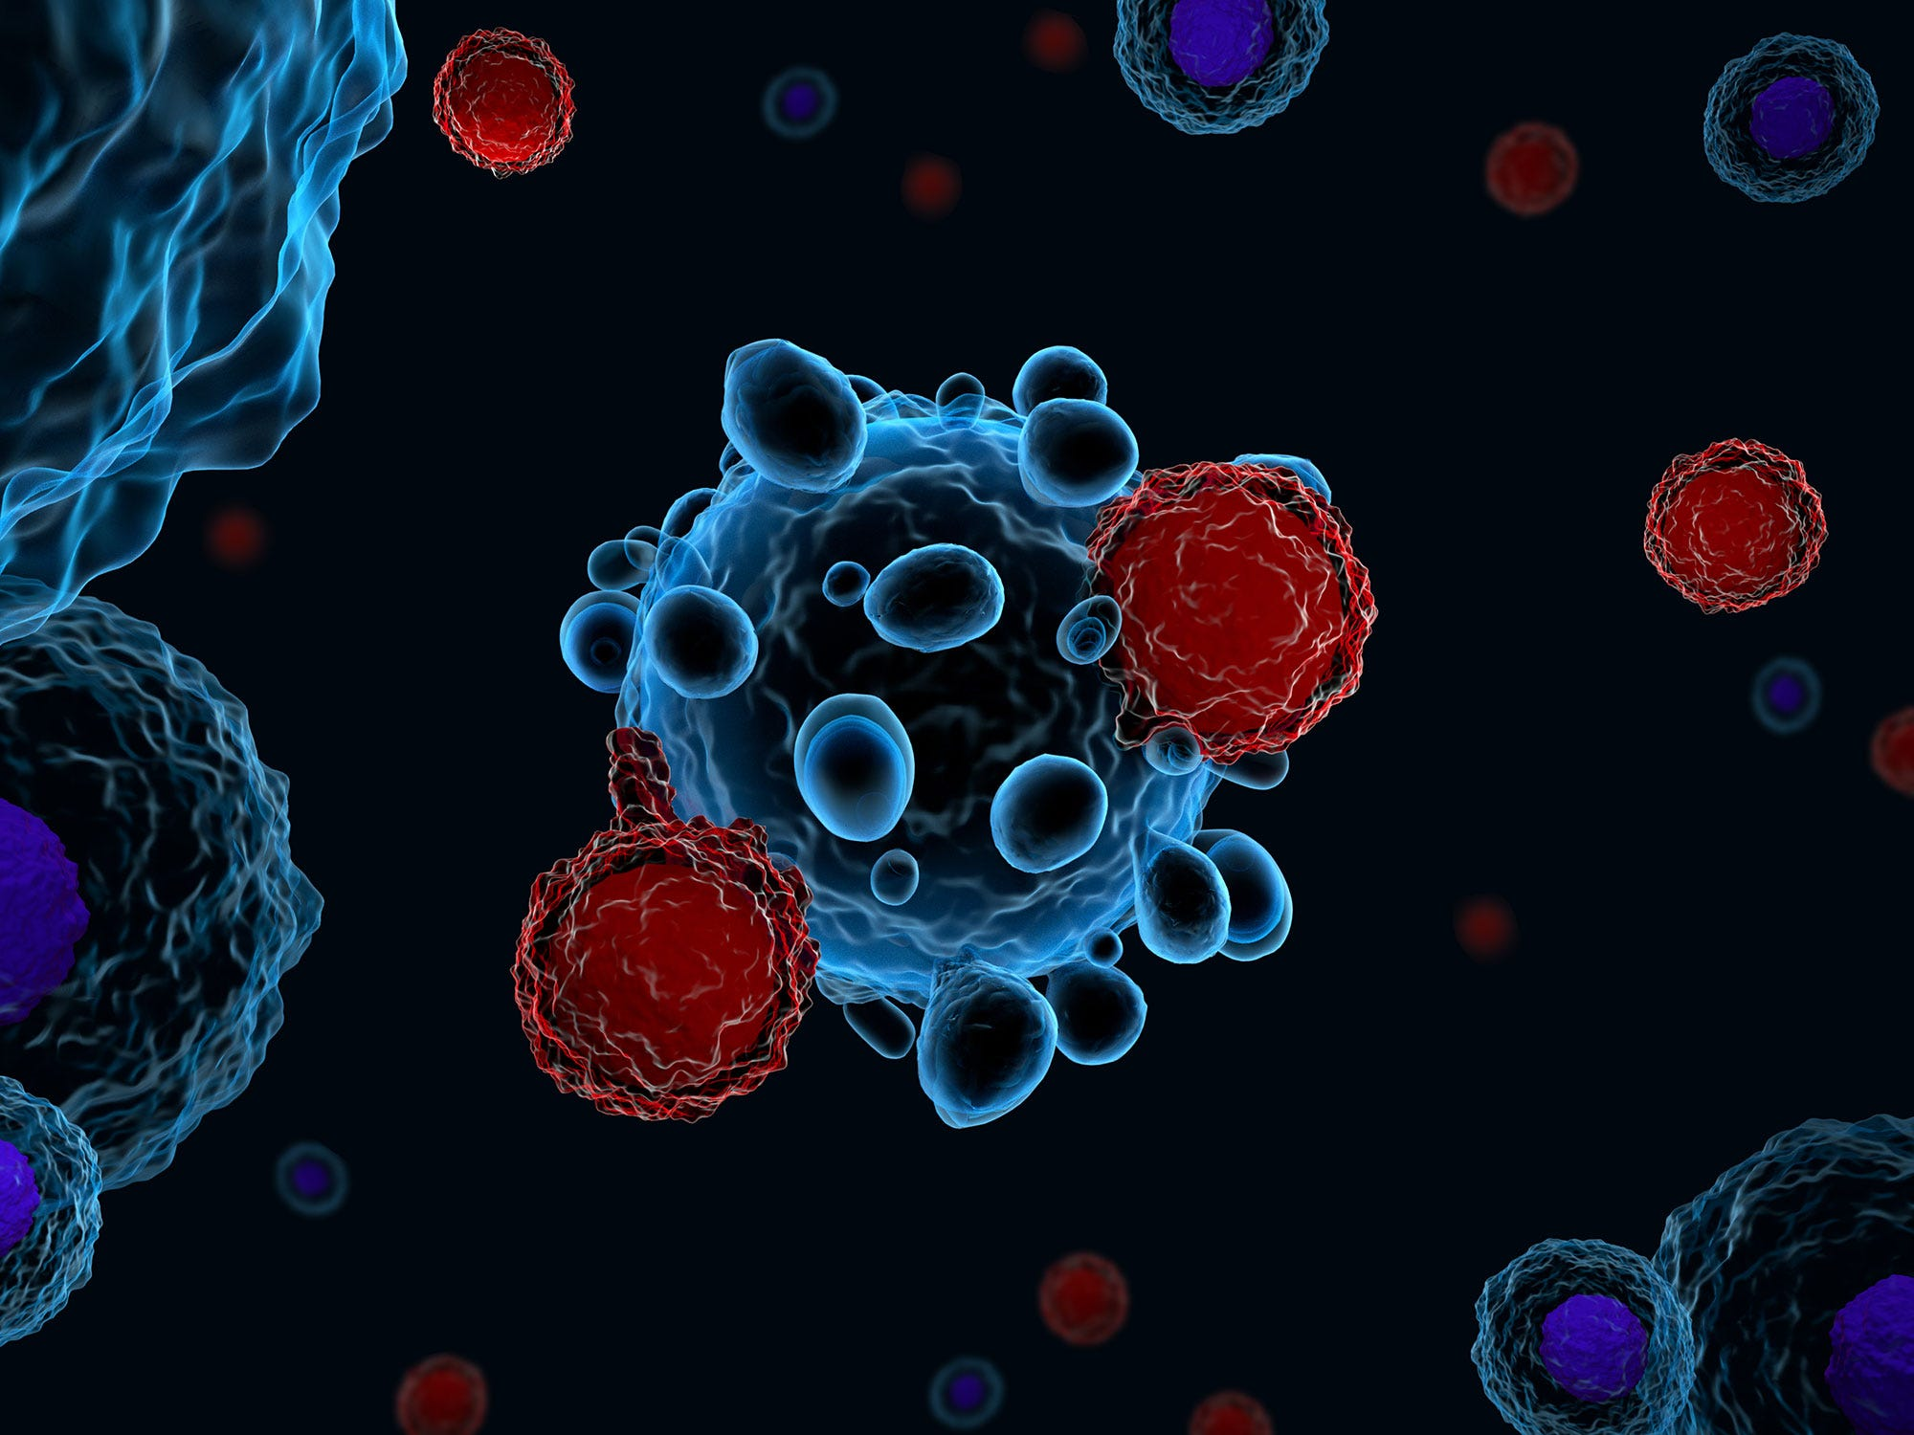
Multiclass skin lesion classification using
PAD-UFES-20 dataset​

Slide 2
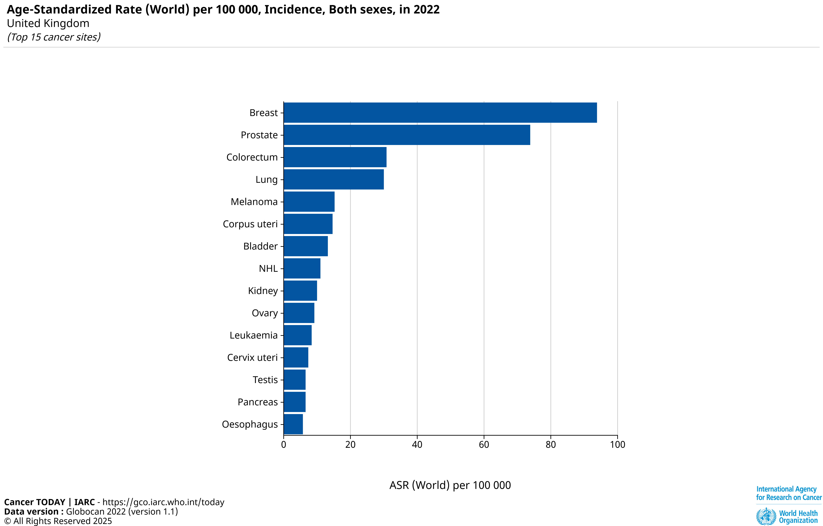
Introduction
Motivation:
Skin cancer is common; 1 in 3 cancers (WHO, 2017)
Low-resource settings, smartphones + AI can reduce delays
Downstream task
Develop models to classify skin lesions into 6 categories
Compare traditional ML vs. deep learning
Explore whether numerical + images improves accuracy vs. image-only

Slide 3
Background
Research Objectives:
Develop machine learning models for skin lesion classification using the PAD-UFES-20 dataset
Research Questions:
How does the performance change when comparing multiclass classification to binary classification (cancerous / non-cancerous)?
How does the performance of traditional models compare with deep learning approaches for skin lesion classification?
Hypotheses:
CNN models trained on smartphone images can achieve competitive performance in classifying skin lesions.
Literature Review:
SkinLesNet:Classification of Skin Lesions and Detection of Melanoma Cancer
The impact of patient clinical information on automated skin cancer detection
Multimodal deep learning
Hybrid Multi-Modal Approach

Slide 4
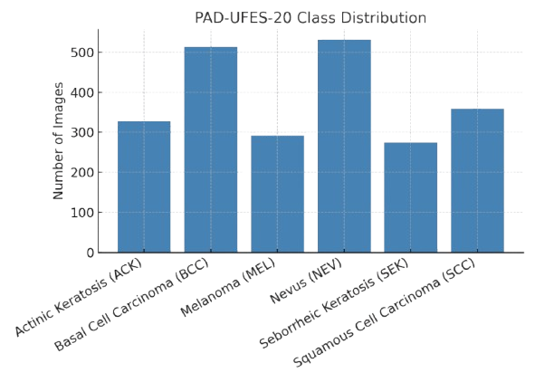
Dataset OVERVIEW
Why data set:
Multimodal (image & numerical) and realistic dataset
Prior research
Pacheco & Krohling (2020)
Dataset Description:
6 classes: ACK, BCC, MEL, NEV, SEK, SCC
2,298 dermoscopic images from 1,373 patients
Includes up to 26 clinical numerical features
(age, sex, skin type, lesion site, diameter)
Ethics & License:
Approved by UFES ethics committee & Plataforma Brasil
Patients consented; anonymised data
Publicly available on Mendeley Data under CC BY 4.0 license

Slide 5
Project plan & Work distribution
Gantt Chart

