Slide 1

Tastybites
App Development/ ApexPlanet
Date: July 5, 2025
Pothina Mercy

Slide 2
Problem and solution
The problem:
Finding specific recipe details quickly can be cumbersome.
Traditional cookbooks lack interactive features.
Our Solution:
A dynamic mobile application providing instant access to a curated collection of recipes.
Offers a seamless, visual way to explore ingredients and preparation steps.

Slide 3

App Introduction
Feature Name: Engaging splash Screen
Description:
Provides a visually appealing introduction to the app upon launch.
Displays the app's logo/branding briefly before transitioning to the main content.
Enhances the initial user experience and app professionalism.

Slide 4
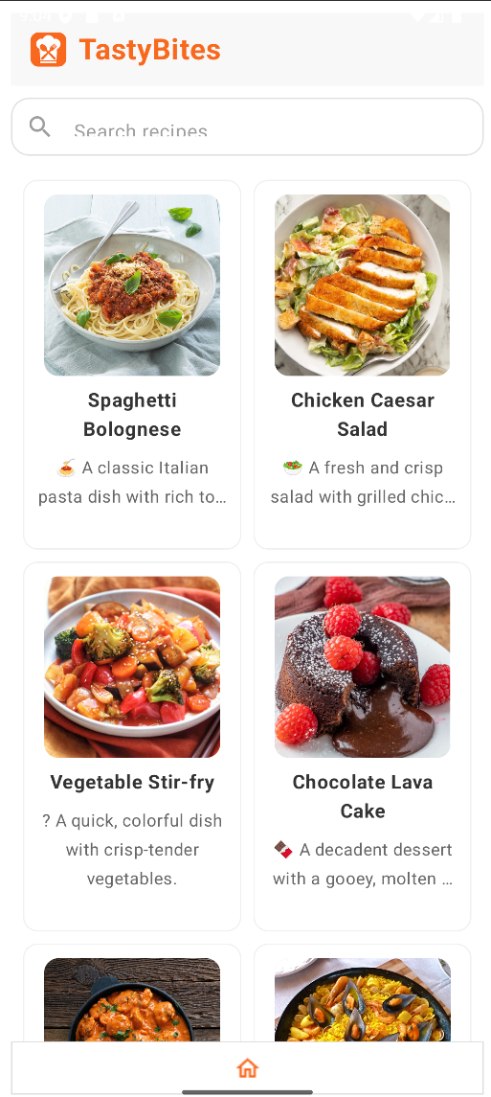
intuitive Recipe Catalog
Feature Name: Extensive recipe Catalog and Visual Browse
Description:
Showcases a collection of 26 diverse recipes.
Each Recipe is presented as visually appealing “card” with its corresponding image, making Browse easy and inviting.

Slide 5
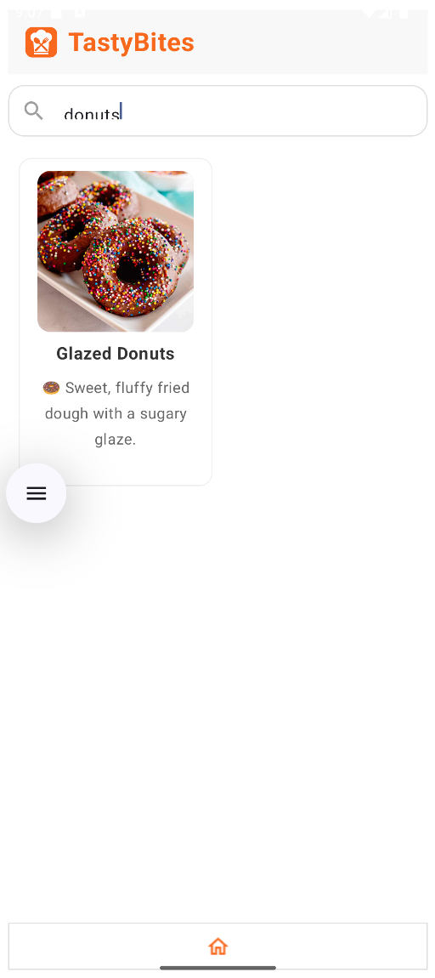
recipe search
Feature Name: Dynamic Recipe Search
Description:
Allows users to quickly find specific recipes using a search bar.
Users can search by recipe name or key ingredients.
Provides instant results as the user types, making discovery efficient.

Slide 6
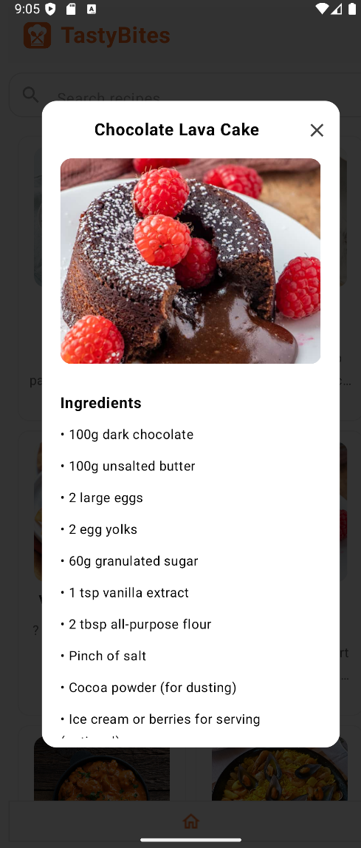
Detailed Recipe View
Feature Name: Interactive Recipe Details via Overlay
Description:
Clicking any recipe card opens an interactive overlay popup.
This popup immediately displays all ingredients and clear, step-by-step preparation instructions.
The popup also features the recipe's image for quick visual reference.

Slide 7
Thank you & Call to action
Thank you
Github Repository: https://github.com/mercypothina/Task5-Finalization_Deployment_and_Presentation.git

