Slide 1


NYSE: AEO
American Eagle Outfitters, Inc.
Final Investment
Proposal
▲ BUY
12-Mo Target: $35.11 | Upside: +110.2%
Mary Falatau · Tijane Paug · Meredith Villaluz
FIN360 – Corporate Financial Statement Analysis | BYU–Hawaii | April 2026

Slide 2
Why AEO? Why Now?
INTRODUCTION
+110%
14–41%
$0
Upside Potential
Valuation Discount
Long-Term Debt
12-Month Price Target $35.11 vs. Current $16.70
AEO trades below sector median on every metric
Cleanest balance sheet in specialty retail peer group
AEO is a fundamentally strong business trading at a significant market discount. With zero long-term debt, double-digit digital growth, and two high-momentum brands — American Eagle and Aerie — the company is positioned to grow revenue from $5.33B to $6.53B by FY2031. Our five-method weighted valuation, confirmed by the analyst consensus of $35.00, supports a compelling BUY at current levels.

Slide 3
Who Is AEO?
BUSINESS OVERVIEW
Company Profile
Brand Portfolio
Founded 1977 in Pittsburgh, PA ~44,000 employees worldwide 1,172 company-owned stores 371 licensed locations in 30+ countries $5.33B total net revenue (FY2024) +4% comparable sales growth
American Eagle
Denim, casual apparel — teens & young adults (15–25)
Aerie
Intimates, activewear, swimwear — body positivity (15–35)
Todd Snyder / Unsubscribed
Premium niche brands for diversification
Powering Profitable Growth Strategy
▸ Brand investments: Sydney Sweeney & Travis Kelce ambassador partnerships
▸ Digital-first: BOPIS + double-digit digital revenue growth
▸ Cost discipline: closing ~35 underperforming stores
▸ Aerie expansion into underserved U.S. markets

Slide 4
Three Structural Tailwinds
MARKET & INDUSTRY ANALYSIS
E-Commerce Acceleration
Athleisure Market Boom
Specialty Retail Growth
27% → 43%+
$306B → $492B
~3% p.a.
Apparel e-commerce penetration (2019→2024)
Global athleisure market (2021→2027, +61%)
U.S. specialty apparel market ($350B+)
AEO reported double-digit digital growth in FY2024. Physical stores now serve as BOPIS fulfillment centers, improving unit economics.
Directly benefits Aerie's OFFLINE activewear sub-brand. Higher-margin activewear drives gross margin expansion toward 45% by FY2031.
AEO's eVal revenue forecast of 2.75–3.30% growth is conservative. Simply growing at market pace meets all projected targets.
Porter's Five Forces Snapshot
New Entrants
Supplier Power
Buyer Power
Substitutes
Industry Rivalry
Moderate
Low–Mod
High
Mod–High
High

Slide 5
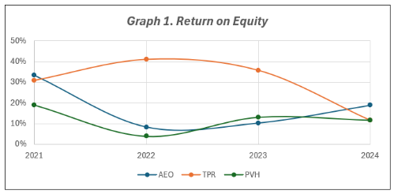
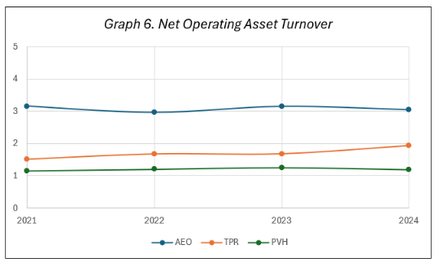
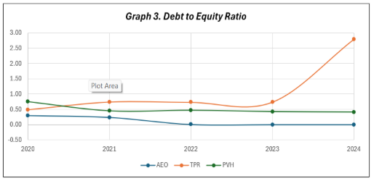
AEO Outperforms Peers
FINANCIAL ANALYSIS
Profitability & Returns
Capital Structure
Operational Efficiency
▸ ROE: 18.8% (FY2024) — highest among peers
▸ Debt-to-Equity dropped from 0.24 (FY2021) → ~0
▸ NOAT: 2.96x–3.15x (~$3 revenue per $1 assets)
▸ RNOA: 18.5% — achieved with ZERO leverage
▸ 100% equity-financed operations since FY2023
▸ Days Sales Receivables: 15.8–19.4 days (best-in-class)
⚠ Key Risks to Monitor:
Inventory holding period rising (58→72 days) · Tariff impact ~$25–$30M · Gen Z / millennial consumer sensitivity to macro downturns · Competitive pressure from Shein, Zara, ANF

Slide 6
Strong Growth Trajectory
FINANCIAL FORECAST FY2025–FY2031
Margin Expansion Highlights
Metric | FY2024 | FY2031
Gross Margin | 39.2% | 45.0%
Net Margin | 6.2% | 11.7%
Net Income | $329M | $763M
EBITDA | $640M | $1,247M
Revenue | $5.33B | $6.53B
Key Assumptions:
Sales Growth
3-4% / yr
COGS / Sales
59% → 55%
SG&A / Sales
27% → 25.9%
Tax Rate
25%
LT Debt
$0 through FY2031

Slide 7
Multi-Method Analysis
VALUATION
Method Weights
DCF (eVal)
45%
EV/EBITDA
25%
EV/EBIT
10%
P/E Multiples
10%
PEG Ratio
10%
12-Month Target
$35.11
Sector Median | +110.2% Upside
✔ Analyst Consensus: $35.00 independently validates our $35.11 target · Today's weighted target of $27.79 already implies +66.4% upside · AEO trades at 14–41% discount on every metric vs. sector median

Slide 8
CONCLUSION & RECOMMENDATION
Final Verdict: BUY American Eagle Outfitters
01
Revenue Growth Supported by Structural Tailwinds
$5.33B (FY2024) → $6.53B (FY2031). Powered by e-commerce acceleration (27%→43%+), athleisure boom ($306B→$492B), and stable ~3% specialty retail market growth — all structural, not cyclical.
02
Compelling Margin Expansion Trajectory
Gross margin: 39.2% → 45.0%. Net margin: 6.2% → 11.7%. EBITDA nearly doubles. Driven by better sourcing, SG&A leverage, and Aerie's higher-margin activewear mix.
03
Valuation Discount + Pristine Balance Sheet
14–41% discount to sector median on every metric. Zero long-term debt. ROE of 18.8% — highest among peers with no financial leverage. $190M+ returned via buybacks in FY2024.
FINAL RECOMMENDATION: BUY | 12-Month Target: $35.11 (Sector Median) | Upside: +110.2% | WACC: 13.90%

