Slide 1
Laboratory Work 3
DML Operations in PostgreSQL
Mukhametkali Merey
KBTU

Slide 2
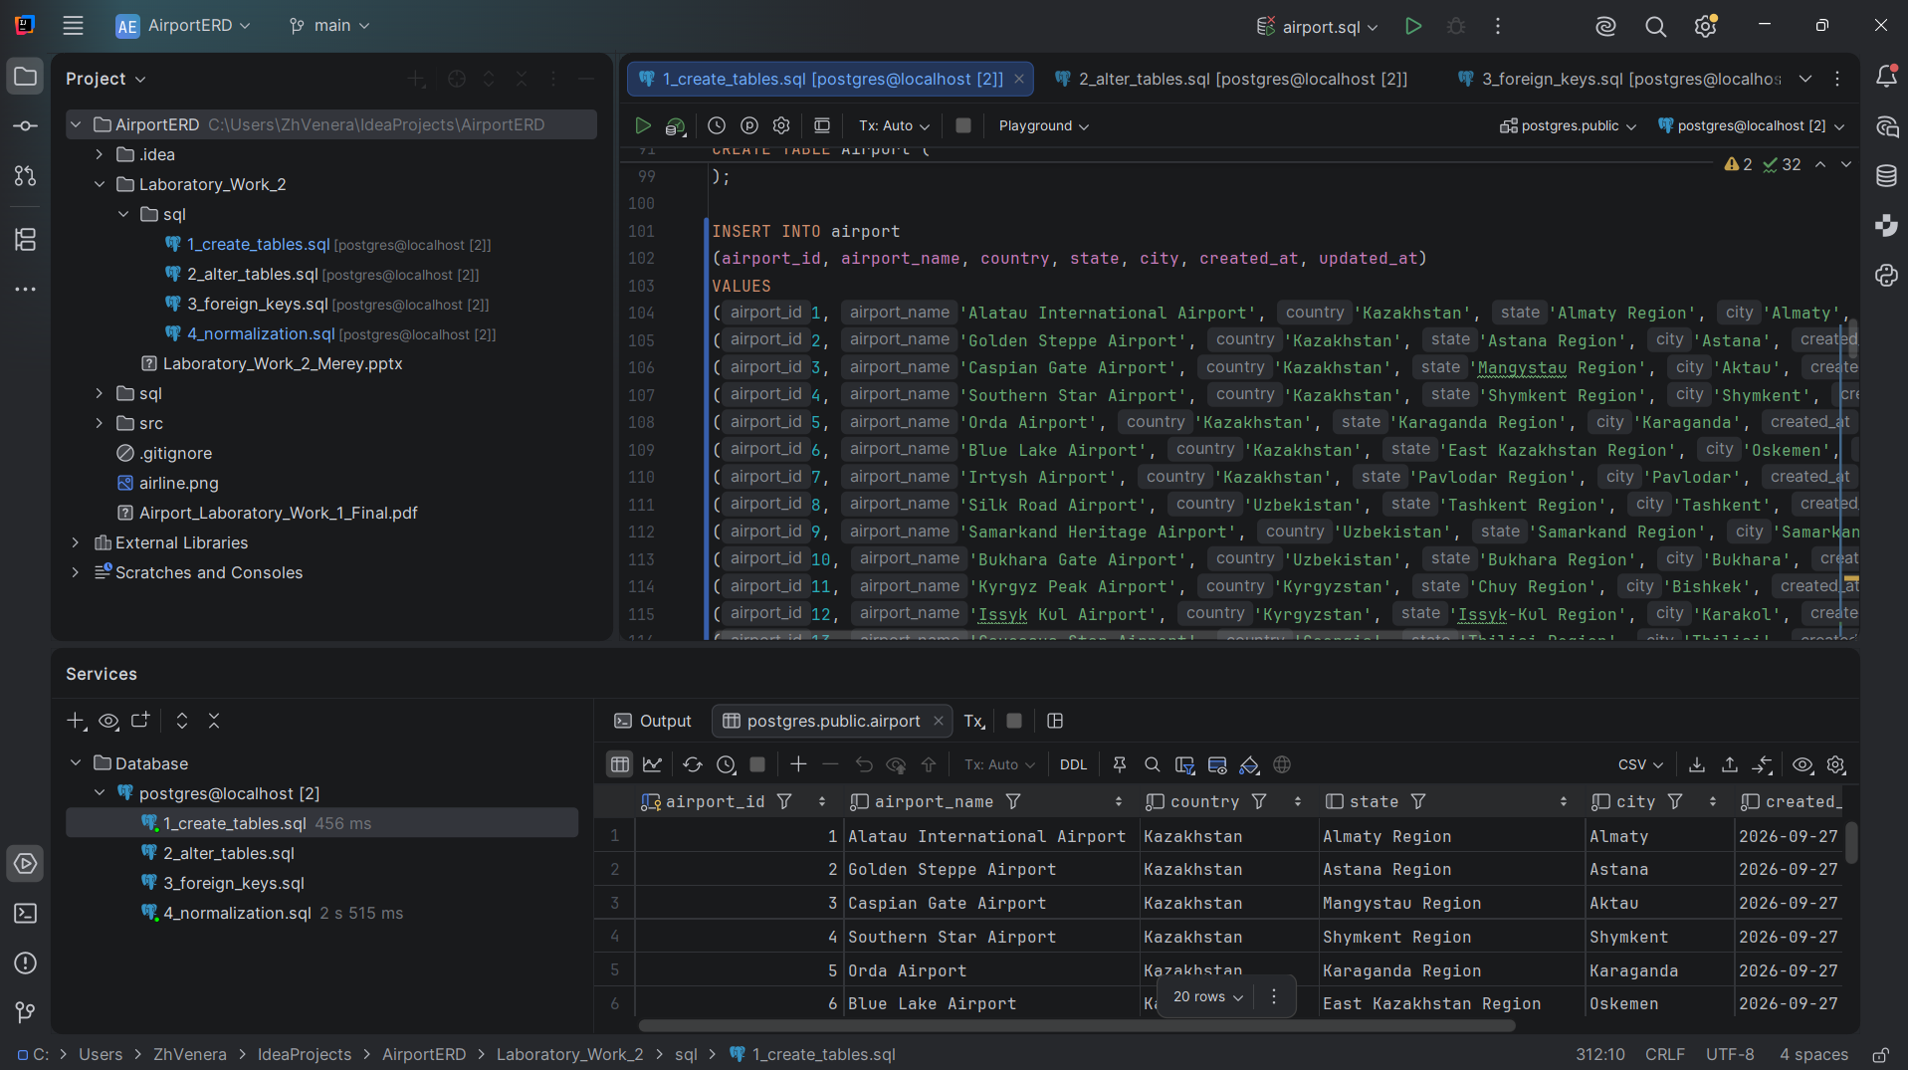
Task 1 — Insert 200 records
Inserted generated airport and related database records using SQL INSERT statements.

Slide 3
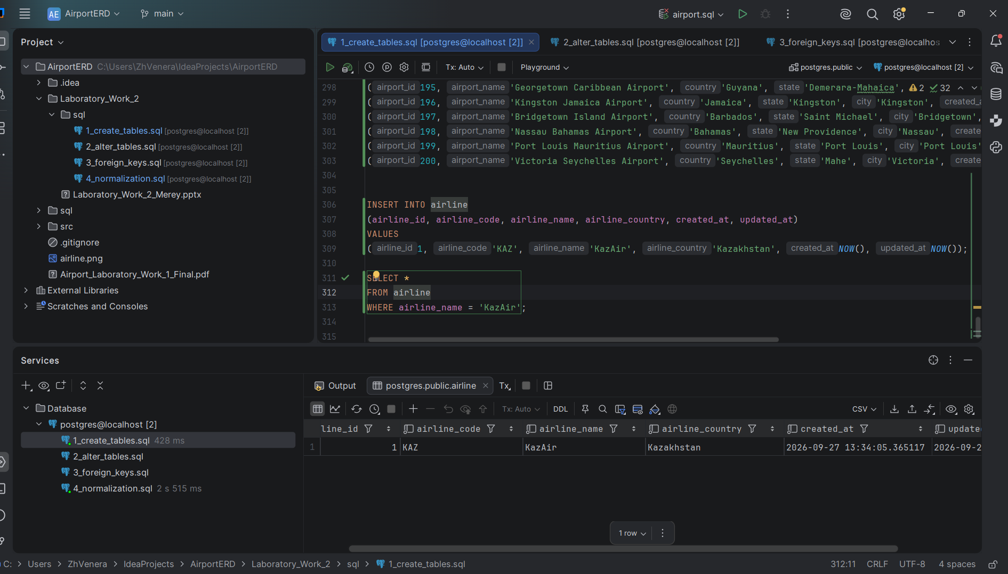
Task 2 — Add KazAir
Added KazAir with airline code KAZ and country Kazakhstan.

Slide 4
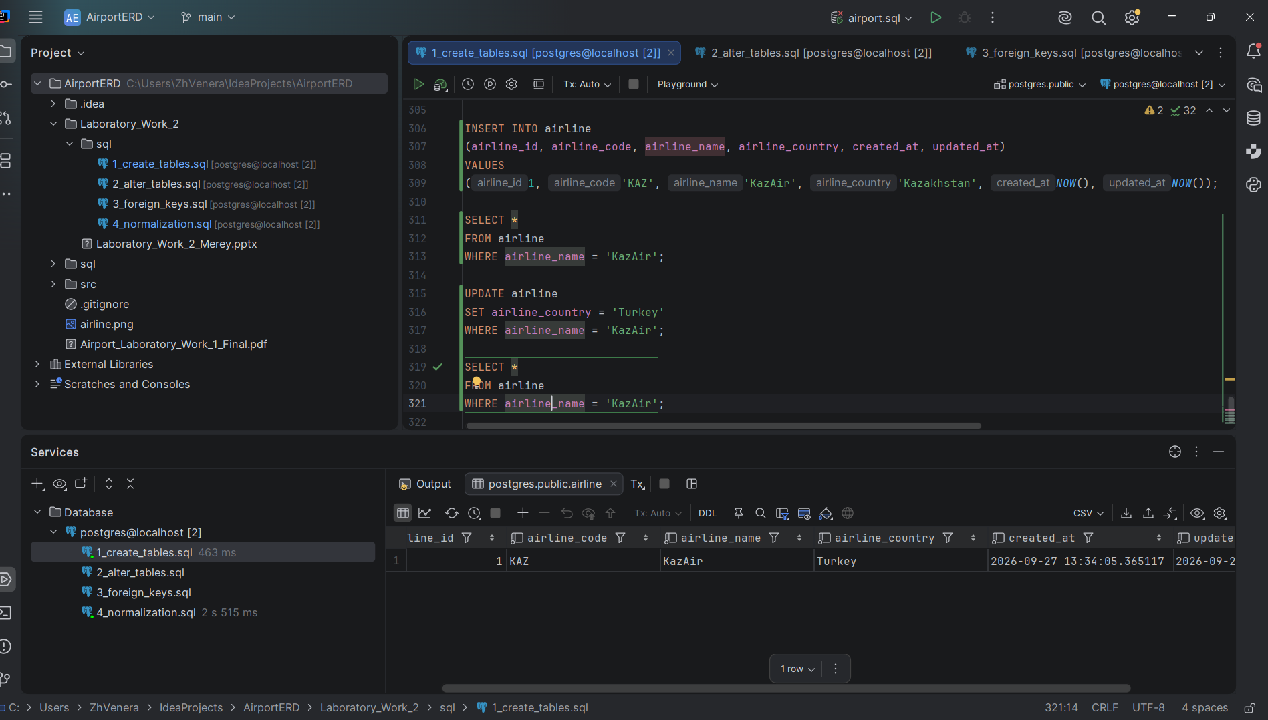
Task 3 — Update KazAir country
Changed the country of KazAir to Turkey.

Slide 5
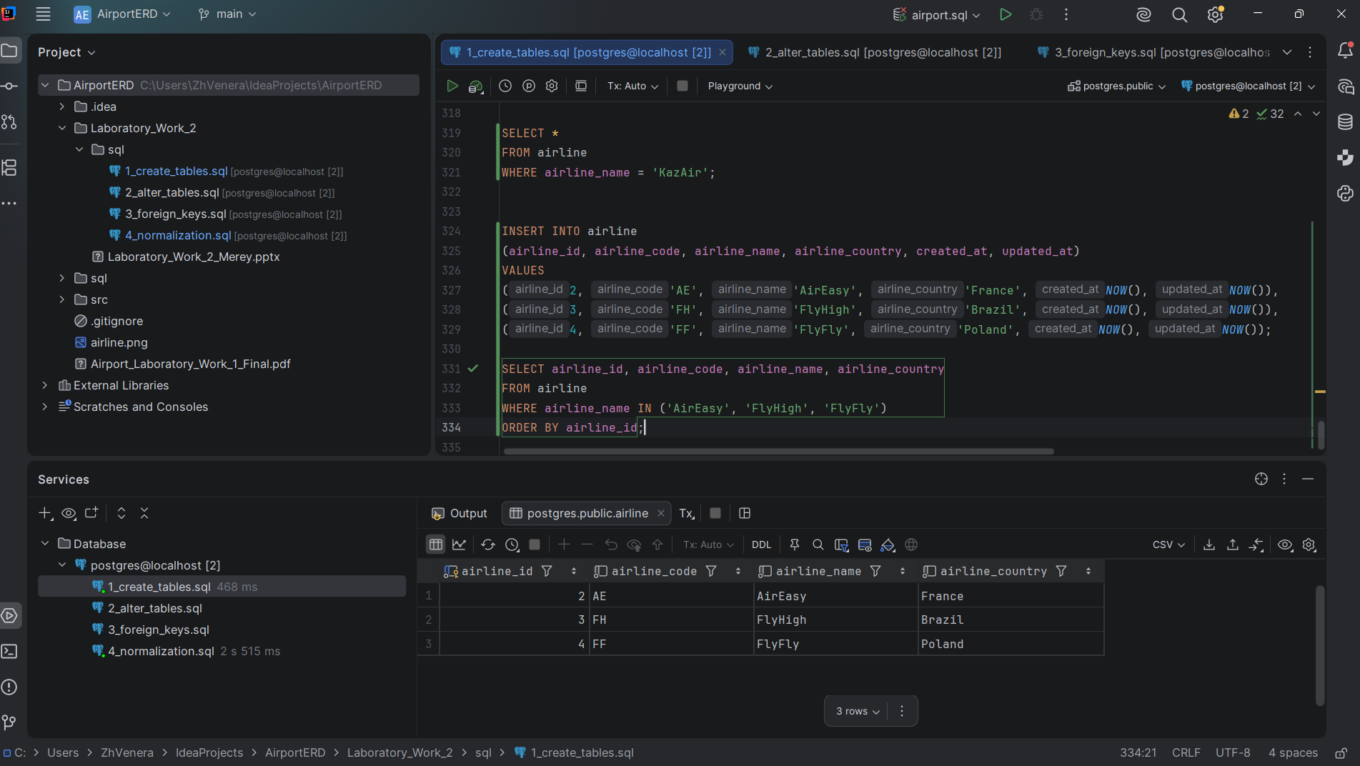
Task 4 — Add three airlines
Added AirEasy, FlyHigh and FlyFly with their countries and codes.

Slide 6
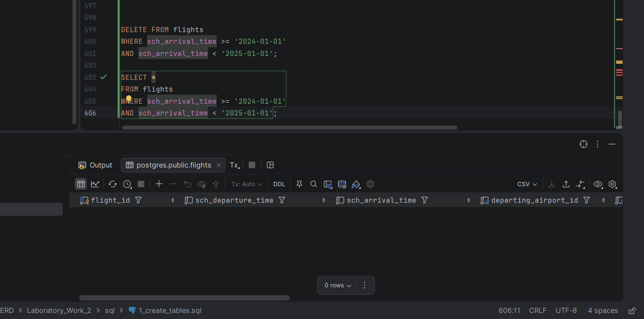
Task 5 — Delete 2024 flights
Deleted flights whose scheduled arrival time was in 2024; the final check shows 0 matching rows.

Slide 7
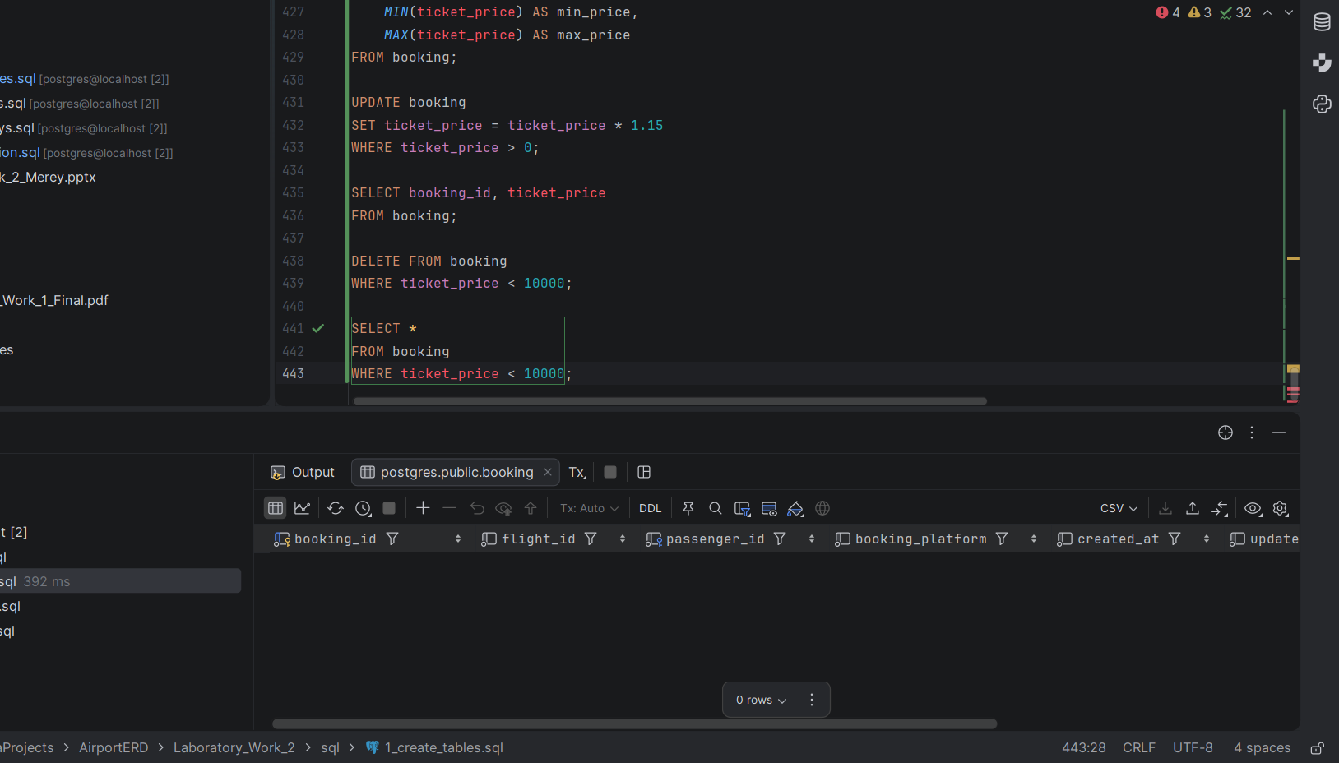
Task 6 — Increase ticket prices
Increased booking ticket prices by 15 percent using UPDATE.

Slide 8
Task 7 — Delete cheap tickets
Deleted bookings with ticket prices below 10,000.

Slide 9
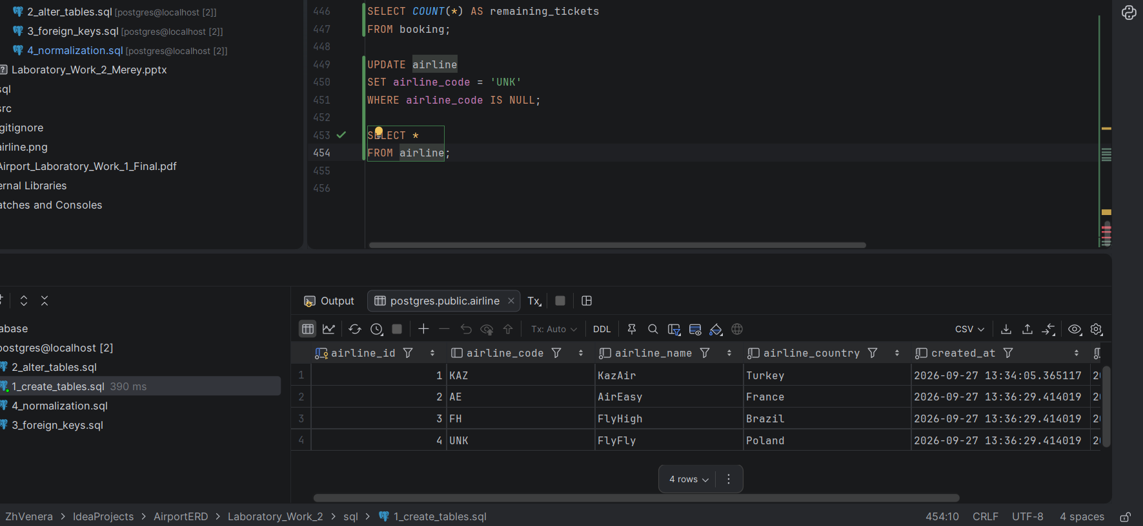
Task 8 — Replace NULL airline codes
Replaced NULL airline codes with UNK.

Slide 10
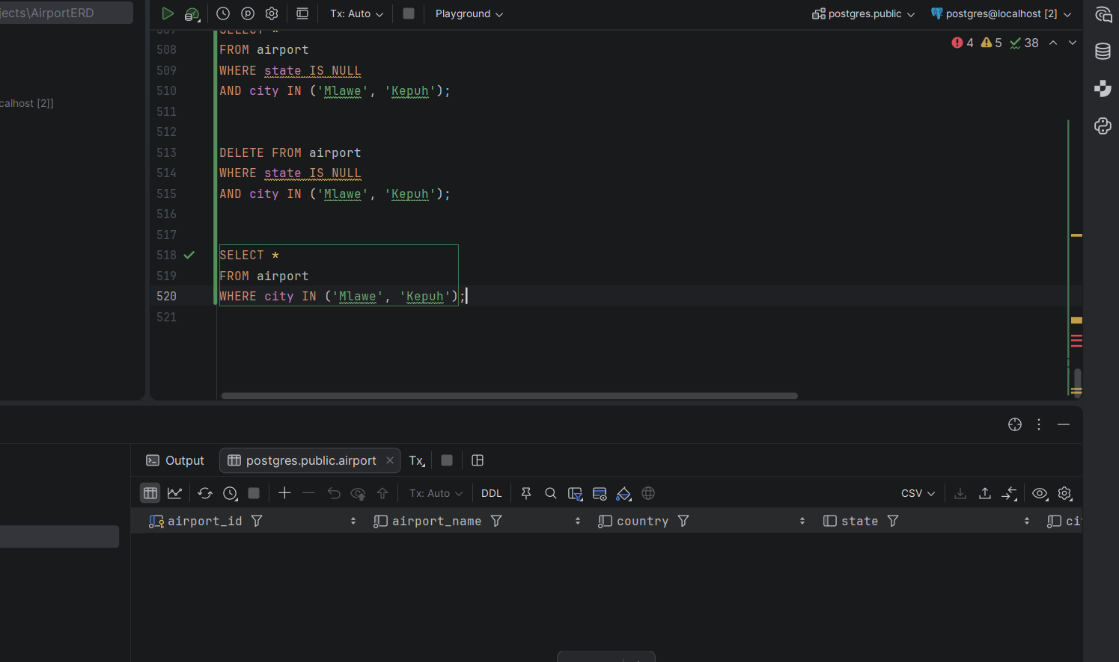
Task 10 — Delete Mlawe and Kepuh airports
Deleted airports with NULL state for the cities Mlawe and Kepuh.

Slide 11
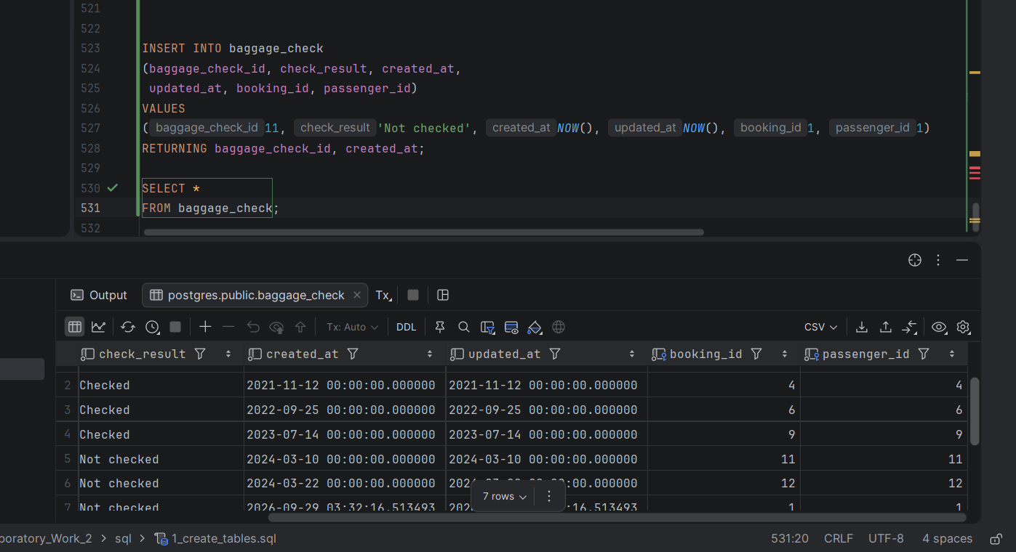
Task 11 — Insert baggage check
Inserted a baggage check record and used RETURNING to show its ID and created_at.

Slide 12
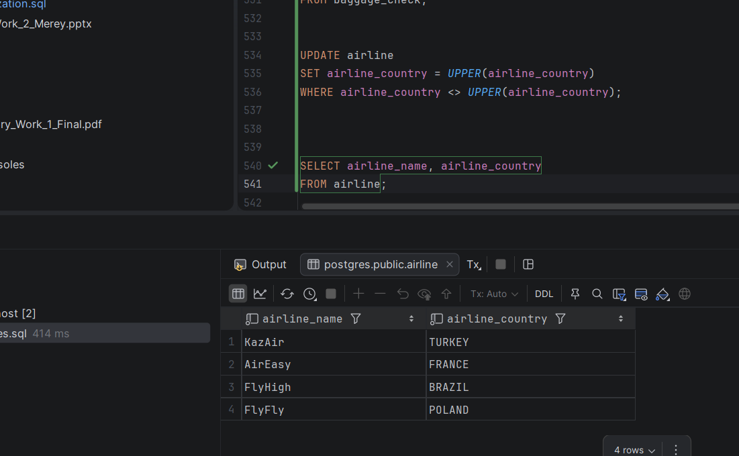
Task 12 — Uppercase airline countries
Converted airline country names to uppercase with UPPER().

Slide 13
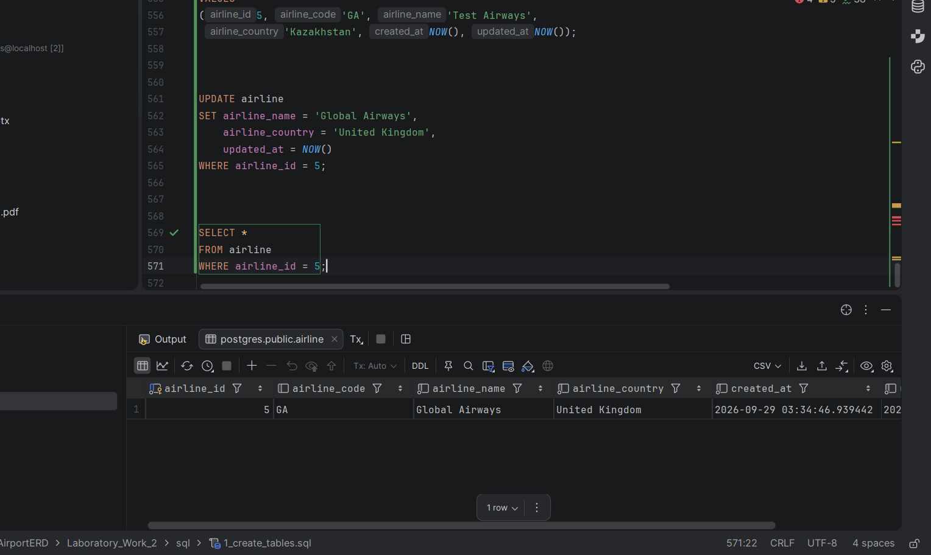
Task 13 — Update airline ID 5
Changed airline ID 5 to Global Airways, United Kingdom, and updated the timestamp.

Slide 14
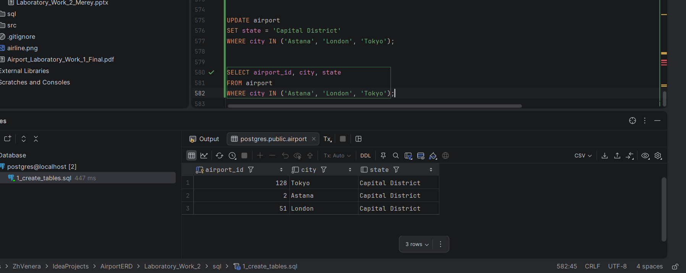
Task 14 — Update airport states
Set state to Capital District for Astana, London and Tokyo.

Slide 15
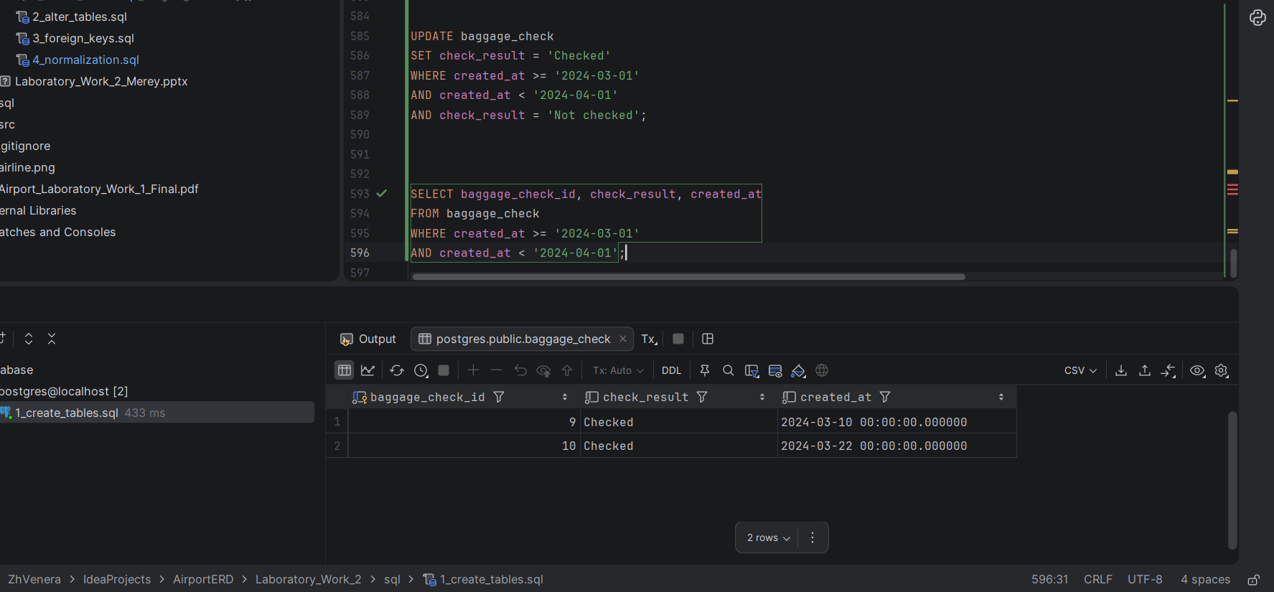
Task 15 — Check March 2024 baggage
Changed March 2024 baggage checks from Not checked to Checked.

Slide 16
Conclusion
DML operations used: INSERT, UPDATE, DELETE, SELECT and RETURNING.
Database: PostgreSQL
Tool: DataGrip

