Slide 1
Laboratory Work 2
Normalization and DDL
Course: Databases
Student: Merey Mukhametkali
Date: September 2026

Slide 2
Task 1. Initial Normal Form Violation Analysis
Original relation:
Booking_receipt(booking_id, passenger_full_name, passenger_passport_number,
flight_number, departure_airport_name, departure_city,
arrival_airport_name, arrival_city, airline_name, seat_numbers, ticket_price).
The relation violates First Normal Form (1NF) because seat_numbers can contain
several values in one cell, for example "12A, 12B".
A 1NF attribute must contain one atomic value.
Since the relation is not in 1NF, it cannot be in 2NF or 3NF either.
Problematic column: seat_numbers.

Slide 3
Tasks 2 and 3. Normalization and Functional Dependencies
Functional dependencies:
booking_id -> flight_number, ticket_price
flight_number -> departure_airport_name, arrival_airport_name, airline_name
departure_airport_name -> departure_city
arrival_airport_name -> arrival_city
passenger_passport_number -> passenger_full_name
(booking_id, passenger_passport_number) -> seat_number
1NF:
Booking_receipt_1NF
Primary key: (booking_id, passenger_passport_number)
2NF:
Booking_2NF
Passenger_2NF
Booking_passenger_2NF
3NF:
Passenger
Airport
Airline
Flight
Booking
Booking_passenger

Slide 4
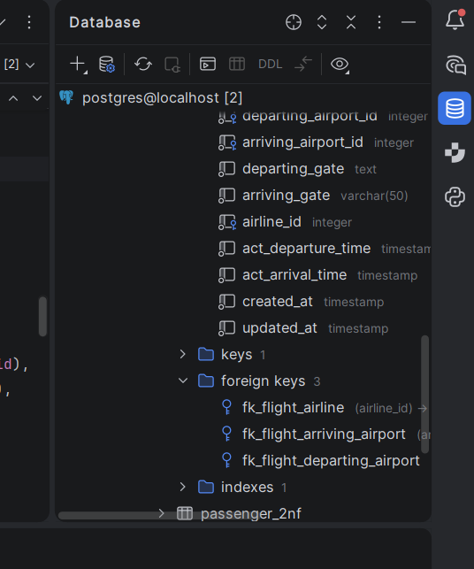
Task 4. 3NF Verification for Flights
Current primary key: flight_id.
Functional dependency:
flight_id -> sch_departure_time, sch_arrival_time,
departing_airport_id, arriving_airport_id, departing_gate,
arriving_gate, airline_id, act_departure_time,
act_arrival_time, created_at, updated_at.
The Flights table is in 3NF. Its primary key has one attribute,
so partial dependencies are impossible.
departing_airport_id, arriving_airport_id and airline_id are
foreign keys. Airport and Airline details are stored in separate tables,
so there is no transitive dependency between non-key attributes inside Flights.

Slide 5
Task 5. CREATE TABLE
CREATE TABLE lab2_passenger (
passport_number VARCHAR(20) PRIMARY KEY,
full_name VARCHAR(100) NOT NULL
);
CREATE TABLE lab2_airline (
airline_id INT PRIMARY KEY,
airline_name VARCHAR(50) NOT NULL
);
CREATE TABLE lab2_airport (
airport_id INT PRIMARY KEY,
airport_name VARCHAR(100) NOT NULL,
city VARCHAR(50) NOT NULL
);
CREATE TABLE lab2_flight (
flight_number VARCHAR(20) PRIMARY KEY,
departure_airport_id INT NOT NULL,
arrival_airport_id INT NOT NULL,
airline_id INT NOT NULL,
FOREIGN KEY (departure_airport_id) REFERENCES lab2_airport(airport_id),
FOREIGN KEY (arrival_airport_id) REFERENCES lab2_airport(airport_id),
FOREIGN KEY (airline_id) REFERENCES lab2_airline(airline_id)
);
CREATE TABLE lab2_booking (
booking_id INT PRIMARY KEY,
flight_number VARCHAR(20) NOT NULL,
ticket_price DECIMAL(10,2) NOT NULL,
FOREIGN KEY (flight_number) REFERENCES lab2_flight(flight_number)
);
CREATE TABLE lab2_booking_passenger (
booking_id INT NOT NULL,
passport_number VARCHAR(20) NOT NULL,
seat_number VARCHAR(10) NOT NULL,
PRIMARY KEY (booking_id, passport_number),
FOREIGN KEY (booking_id) REFERENCES lab2_booking(booking_id),
FOREIGN KEY (passport_number) REFERENCES lab2_passenger(passport_number)
);

Slide 6
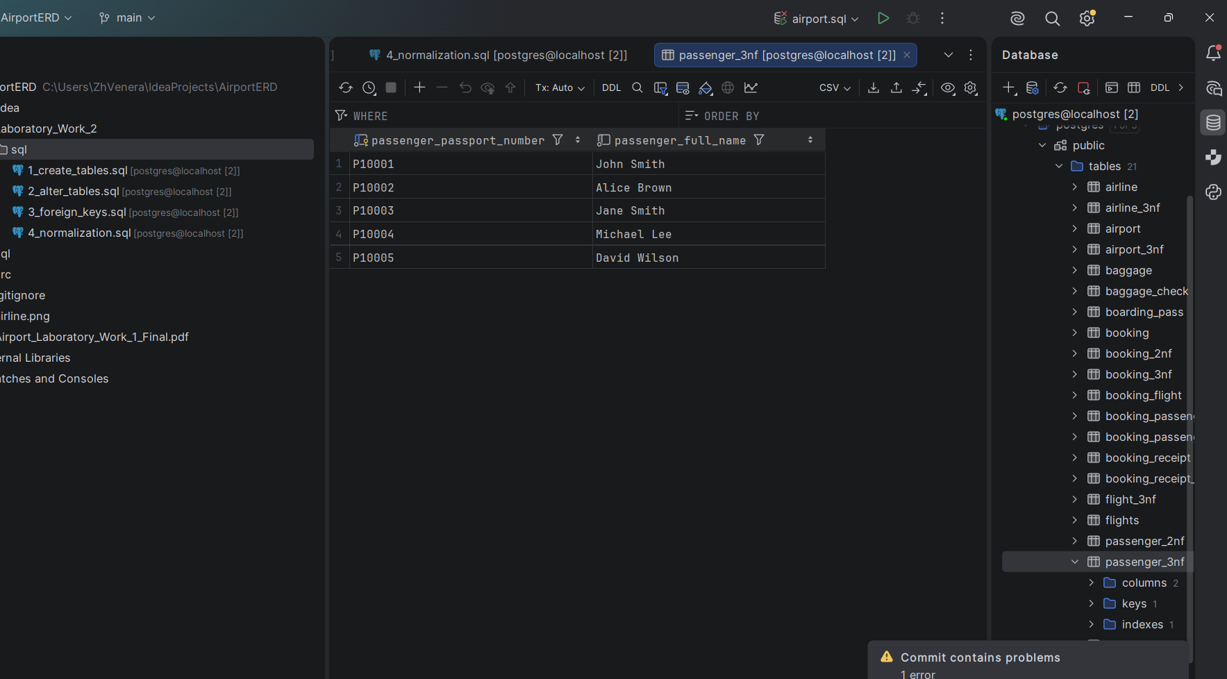
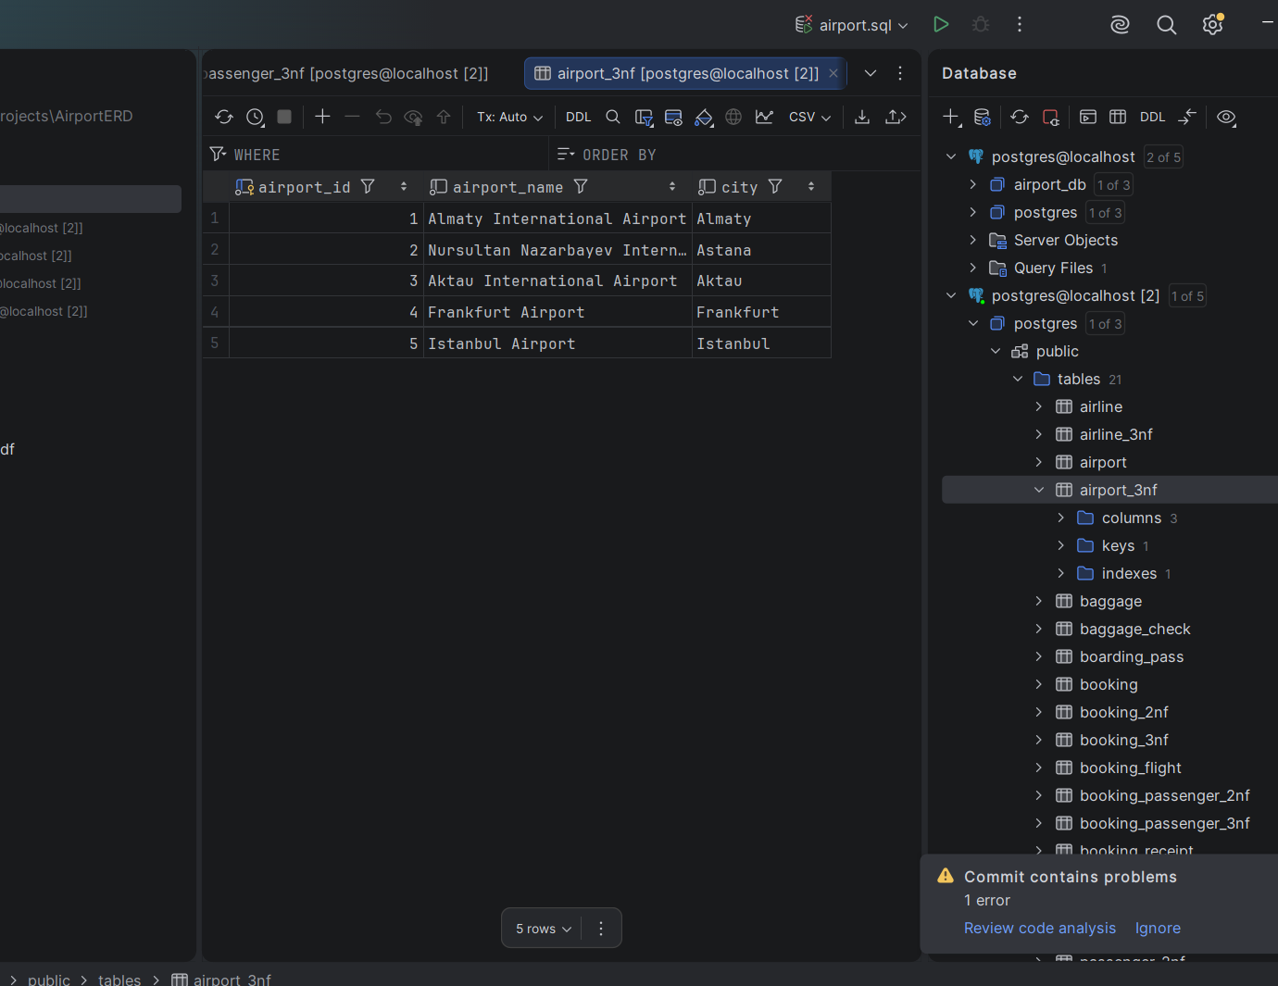
Task 5. Normalized Tables

Slide 7
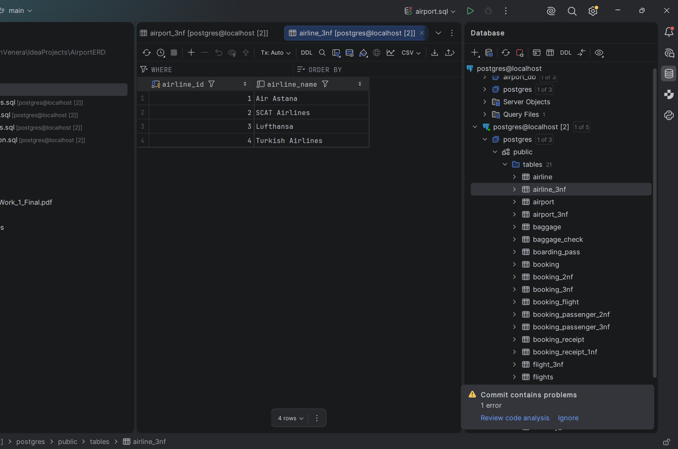
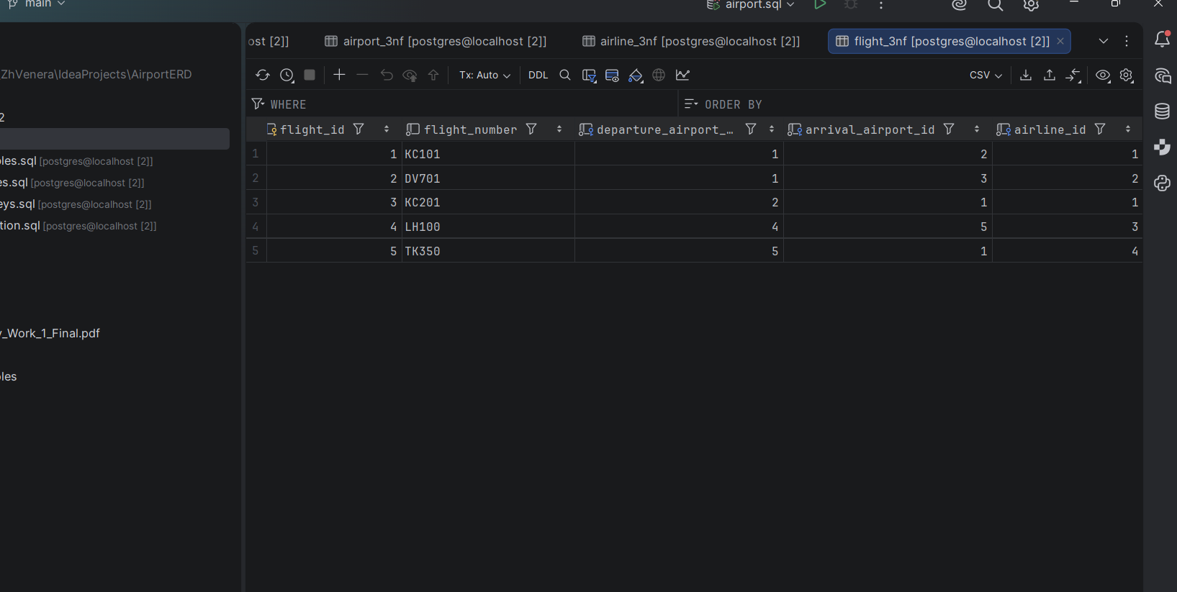
Task 5. Normalized Tables

Slide 8
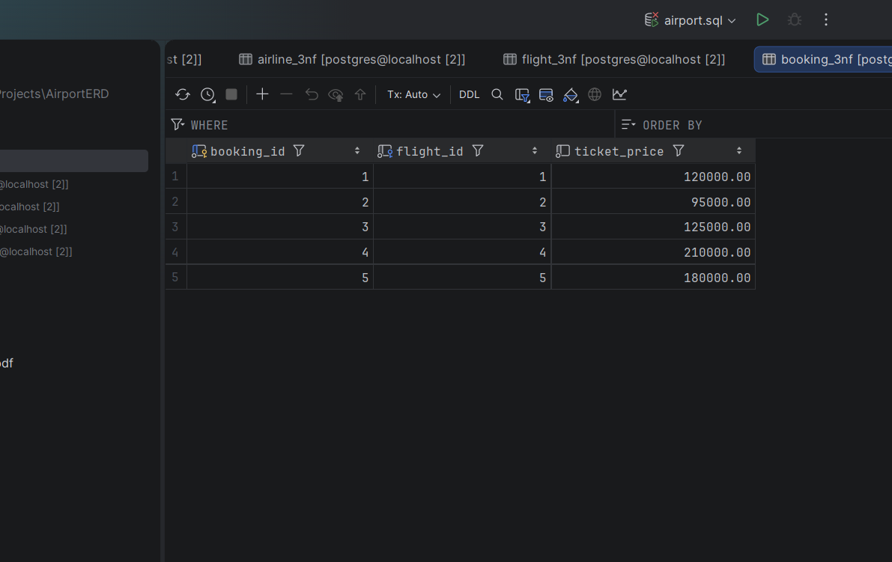
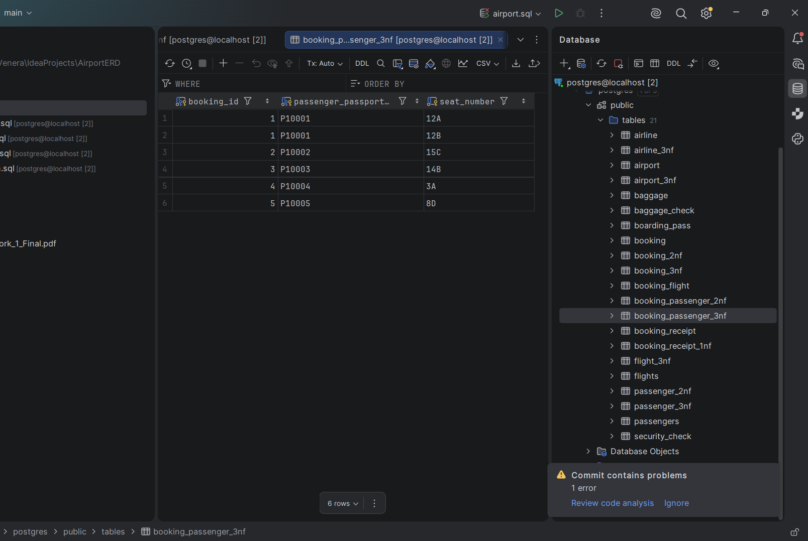
Task 5. Normalized Tables

Slide 9
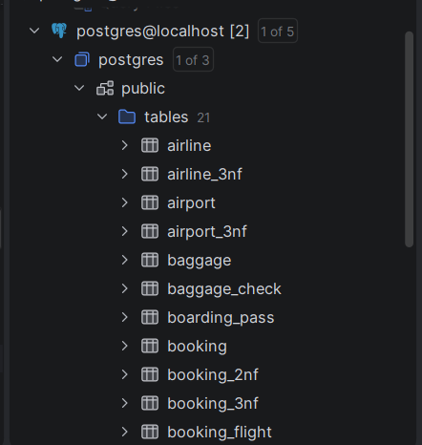
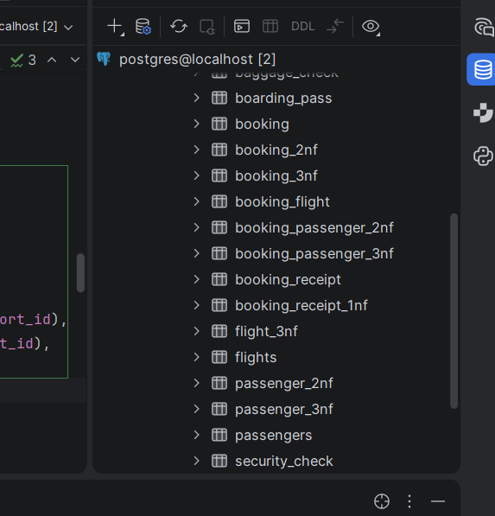
DDL
The required DDL tables were created in PostgreSQL.
ALTER TABLE operations:
airline_info -> airline
price -> ticket_price
departing_gate VARCHAR(50) -> TEXT
drop info from airline

Slide 10
Foreign Key Relationships
Passengers:
Security_check, Booking, Baggage_check
Booking:
Baggage_check, Baggage, Boarding_pass, Booking_flight
Flights:
Booking_flight
Airport:
Flights (departing_airport_id, arriving_airport_id)
Airline:
Flights (airline_id)

