Slide 1

GWU Data Analytics & Visualization Bootcamp, Spring/Summer 2021
OpenWeather Air Quality Index (AQI) Analysis
By Michelle Reilly & Elodie Slawinski
Notes:
Presenter: Michelle
Presentation notes:
Greetings
API from OpenWeather (background on API?, background on OpenWeather)
Feel free to ask questions as we go through the slides

Slide 2
What to expect?
1
2
3
4
✓ Selected topic and the reason why we selected this topic
✓ Source of data and the questions we hope to answer with the data
✓ Description of the data exploration phase of the project
✓ Description of the analysis phase of the project
Notes:
Presenter: Michelle
Presentation notes:
Structure of our briefing
What to expect
Feel free to ask questions throughout the briefing
We will highlight some of our challenges as well as how this analysis could be updated for future needs

Slide 3
AQI Analysis Overview
Notes:
Presenter: Michelle
Presentation notes:
N/A

Slide 4
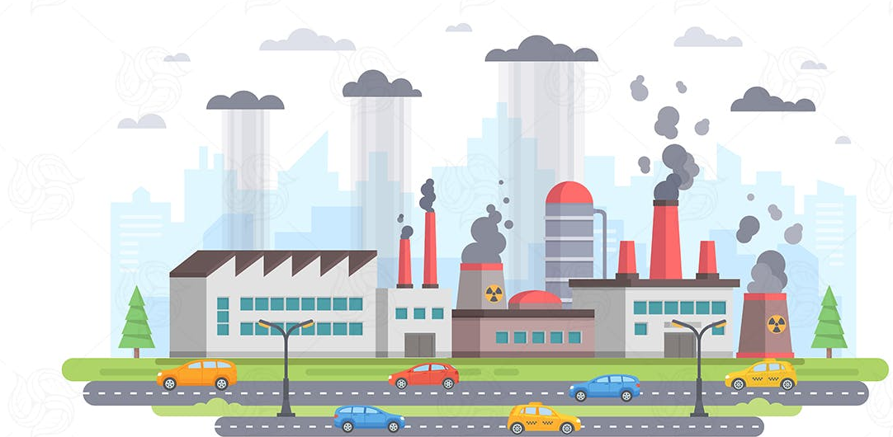
Selected Topic
Air Quality Index (AQI) Analysis
The U.S. Environmental Protection Agency (EPA) establishes an AQI for several major air pollutants regulated by the Clean Air Act.
As the world is battling global warming, our team decided to review and analyze AQIs for four different states.
We captured historical data on the following pollutants:
Carbon monoxide (CO)
Nitrogen monoxide (NO)
Nitrogen dioxide (NO2)
Ozone (O3)
Sulphur dioxide (SO2)
Ammonia (NH3)
Particle pollution (also known as particulate matter, specifically PM2.5 and PM10)
https://www.epa.gov/sites/default/files/2015-10/documents/ace3_criteria_air_pollutants.pdf
Notes:
Presenter: Michelle
Presentation notes:
We were curious to see how AQI has evolved over the last ~ 12 months, throughout COVID with the reduction of traffic
What is the Air Quality Index?
It is measured from 1 to 5, with 5 being the worst air quality
Beyond AQI, OpenWeather also captures historical information about 8 pollutants listed on this slide
Each of these pollutants has a national air quality standard set by EPA to protect public health

Slide 5

Sources of Data
OpenWeather API
The OpenWeather Air Pollution API provides current, forecast and historical air pollution data for any coordinates on the globe
OpenWeather classifies Air Quality per the scale below:
1 = Good
2 = Fair
3 = Moderate
4 = Poor
5 = Very Poor
OpenWeather's API considers elements beyond the basic Air Quality Index (AQI). It also captures metrics on 8 different pollutants
Historical data is accessible from 27th November 2020
We pulled latitudes and longitudes from all US states in a separate CSV and used this data to capture the lat/long coordinates of the center of our 4 selected states:
Alaska
California
Washington, DC
Massachusetts
We then created 4 different API requests for the 4 states and captured the AQI data into a separate CSV, which we then loaded into Tableau for visualization purposes
Notes:
Presenter: Michelle
Presentation notes:
Challenges we encountered in finding historical AQI data
Decided to use OpenWeather’s AQI through an API
However, OpenWeather’s only allows to track AQI since 11/20/20
Decided to set up an API for 4 different states, for comparison purposes (incl. DC since most of us live in DC)
Used lats and longs from a Google database listing lats and logs of centers of all 50 states and DC
Future researches could make this API more dynamic to include data of 50 states and DC
(From README)
✓ Description of the data exploration phase of the project:
After settling on a topic we found interesting and relevant, we tried to google and research data that aligned with our interests.
We found lots of sources and projects done for India, and then more specific cities elsewhere, but not what we wanted in terms of measurements from our area. We found what we thought was perfect source from the EPA, but ran into technical issues working with it’s API when trying to collect information past one day’s worth of data.
Then we found OpenWeather AQI API, looked into the documentation, the data samples, the lat/long way to tailor data outputs. After pairing it with a google data set of 51 lat/longs across the US, we were able to explore different options for pairing down our sample.

Slide 6
Which of the below air pollutants have the most impact of the overall AQI?
Carbon monoxide (CO)
Nitrogen monoxide (NO)
Nitrogen dioxide (NO2)
Ozone (O3)
Sulphur dioxide (SO2)
Ammonia (NH3)
Particle pollution 1 (PM2.5)
Particle pollution 2 (PM10)
Notes:
Presenter: Elodie
Presentation notes:
8 other pollutants in the atmosphere
Our goal to evaluate which of the pollutants had the most prevents overtraining/error in the data

Slide 7

Hypothesis Testing
By running various machine learning models (RandomForest), we are trying to assess whether specific pollutants have more or less impact of the AQI.
Moreover, we want to compare various states’ pollutants to see if there are any trends at the state level.
Air Quality Index (AQI) Analysis
Notes:
Presenter: Elodie
Presentation notes:
Used the historical data and uploaded the whole data into tableau to develop visualizations to create story in Tableau (a very popular tool to summarize data in visual formats)

Slide 8
AQI Analysis Summary
Notes:
Presenter: Elodie
Presentation notes:

Slide 9
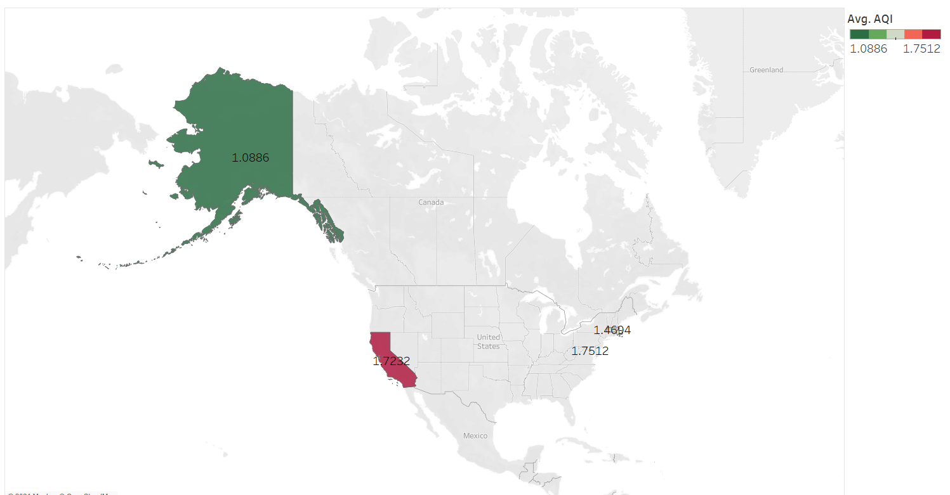
Selected States for our AQI Analysis
USING TABLEAU
Our team selected four states for comparison purposes:
Alaska
California
Washington, DC
Massachusetts
This visualization summarizes the Air Quality Index (AQI) score by month and by state since November 2020.
Tableau Story Link: https://public.tableau.com/app/profile/elo.sla/viz/Final_Project_AQI_Story/AQIStory?publish=yes
Notes:
Presenter: Elodie
Presentation notes:
Created an average AQI for the 4 locations
You see red that shows the higher level (CA vs AK)
Hard to see but DC had worse as an average than MA

Slide 10
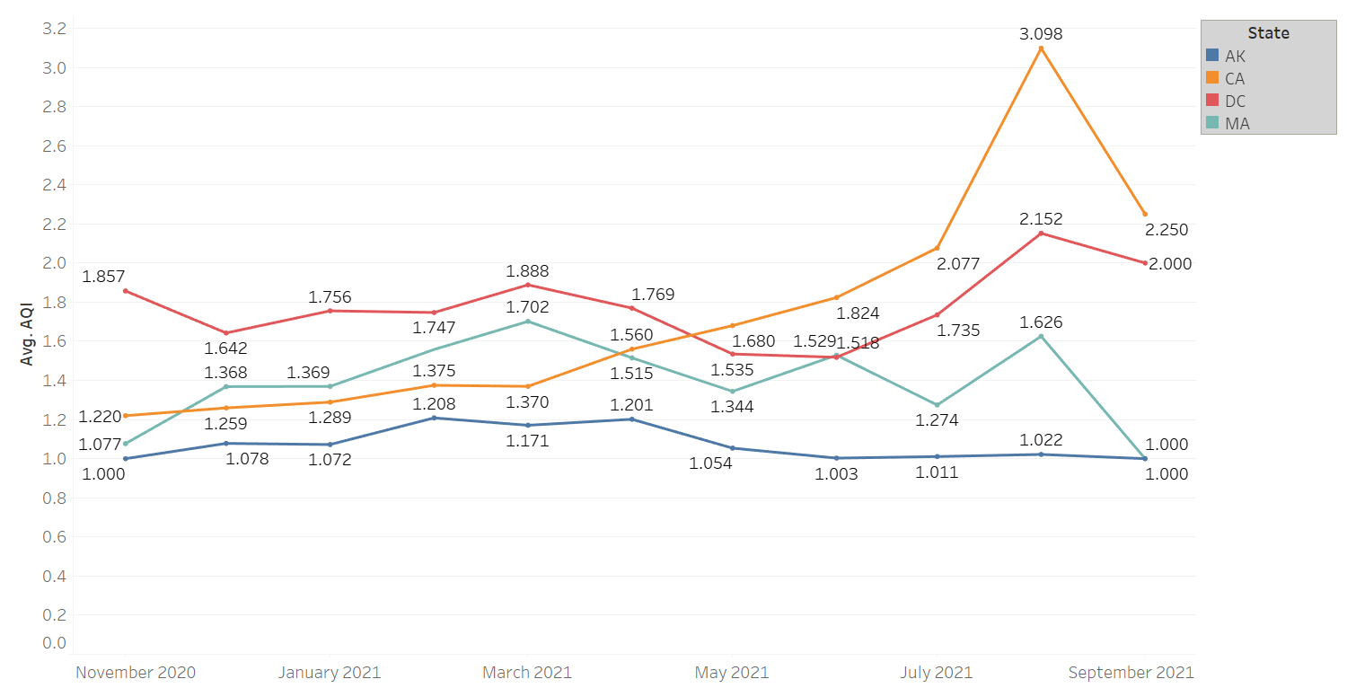
Historical AQI By State
USING TABLEAU
This visualization summarizes the Air Quality Index (AQI) score by month and by state since November 2020.
Average AQIs have been steady between November 2020 and July 2021, with a significant increase in August 2021, particularly in California (that is likely due to the fire activity across the state in the summer of 2021).
Tableau Story Link: https://public.tableau.com/app/profile/elo.sla/viz/Final_Project_AQI_Story/AQIStory?publish=yes
Notes:
Presenter: Elodie
Presentation notes:
ADD

Slide 11
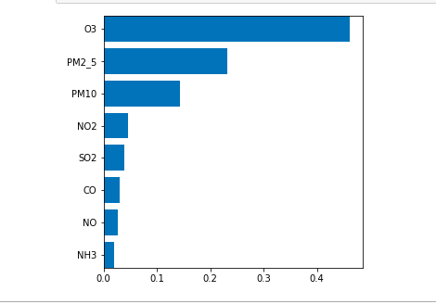
Impact Analysis Across the Four Locations
USING OUR MACHINE LEARNING MODEL
After they were scaled, we can see O3 has the most impact of our X feature values on the AQI output in our sample size of the four locations.
Notes:
Presenter: Michelle
Presentation notes:
- Impact Scoring
- Decision tree, many little samples and taking a winner take allapproach
-

Slide 12
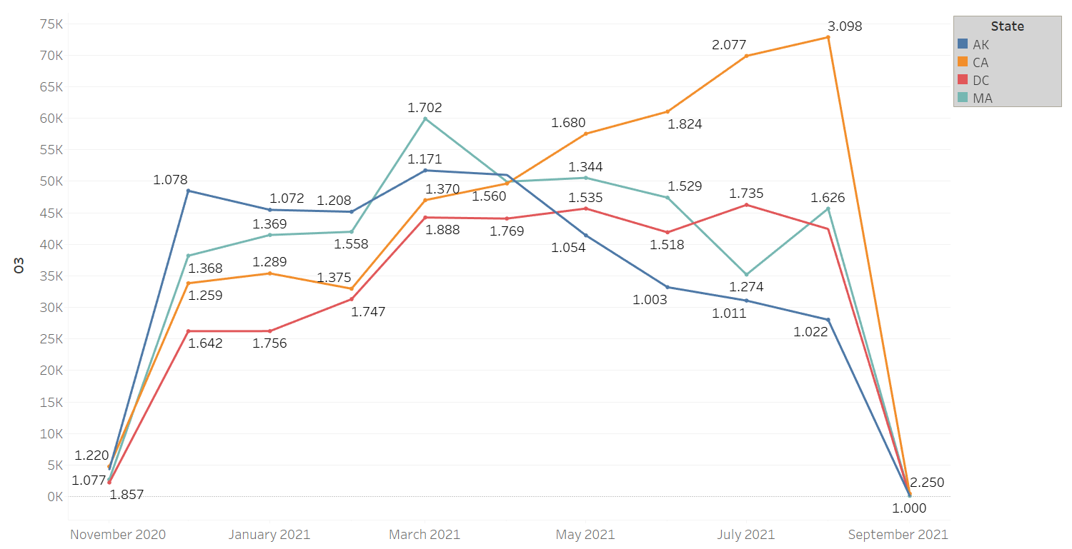
Historical Ozone (O3) Levels by State
USING TABLEAU
This visualization summarizes the ozone level by state and by month.
California’s ozone levels have steadily increased since April 2021.
Tableau Story Link: https://public.tableau.com/app/profile/elo.sla/viz/Final_Project_AQI_Story/AQIStory?publish=yes
Notes:
Presenter: Elodie
Presentation notes:
ADD

Slide 13
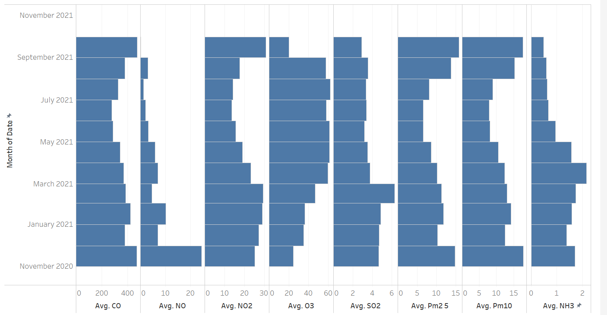
Historical Pollutants by Month in DC
USING TABLEAU
This visualization summarizes the 8 pollutants tracked by OpenWeather in Washington, DC since November 2020.
While the scales of each pollutant vary, this visualization helps understand how each pollutant increase or decrease over time.
Tableau Story Link: https://public.tableau.com/app/profile/elo.sla/viz/Final_Project_AQI_Story/AQIStory?publish=yes
Notes:
Presenter: Elodie
Presentation notes:
ADD

Slide 14
Closer Scaled Look
USING OUR MACHINE LEARNING MODEL
Using a scaler to ,,,,
Notes:
Presenter: Michelle
Presentation notes:
We believe that it would be worth making this more dynamic for future research using the full advantage of the links

Slide 15



Any questions for the team?
Elodie Slawinski
Michelle Reilly
elodiecslawinski@gmail.com
+1-240-481-2175
michelleeileenreilly@gmail.com
+1-305-965-0030
Notes:
Presenter: Michelle + Elodie

