Slide 1
EnhancIng Image-Based FashIon AssIstants wIth CondItIoned DIffusIon Models
Video Presentation

Slide 2
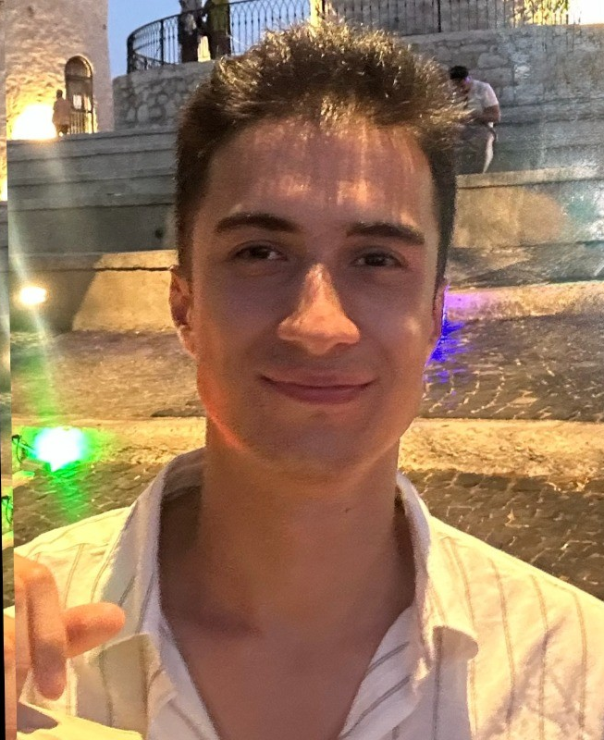
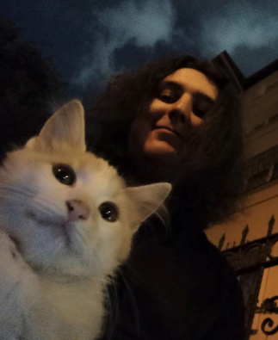
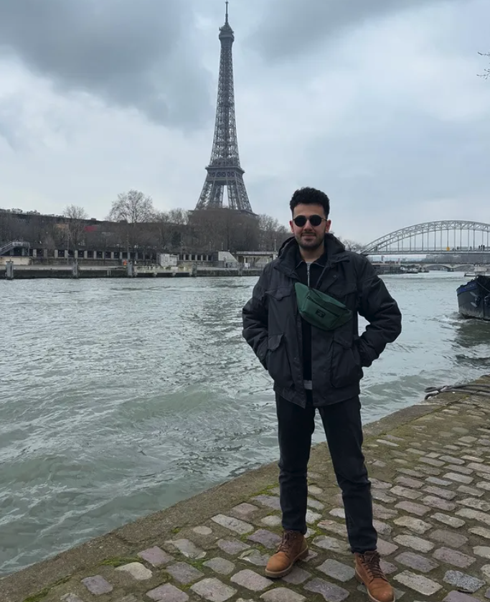
Team Introduction
Eyüp Menevşe
2210356031
Ahmet Uman
2210356129
Mehmet Eren Soykök
2200765016

Slide 3
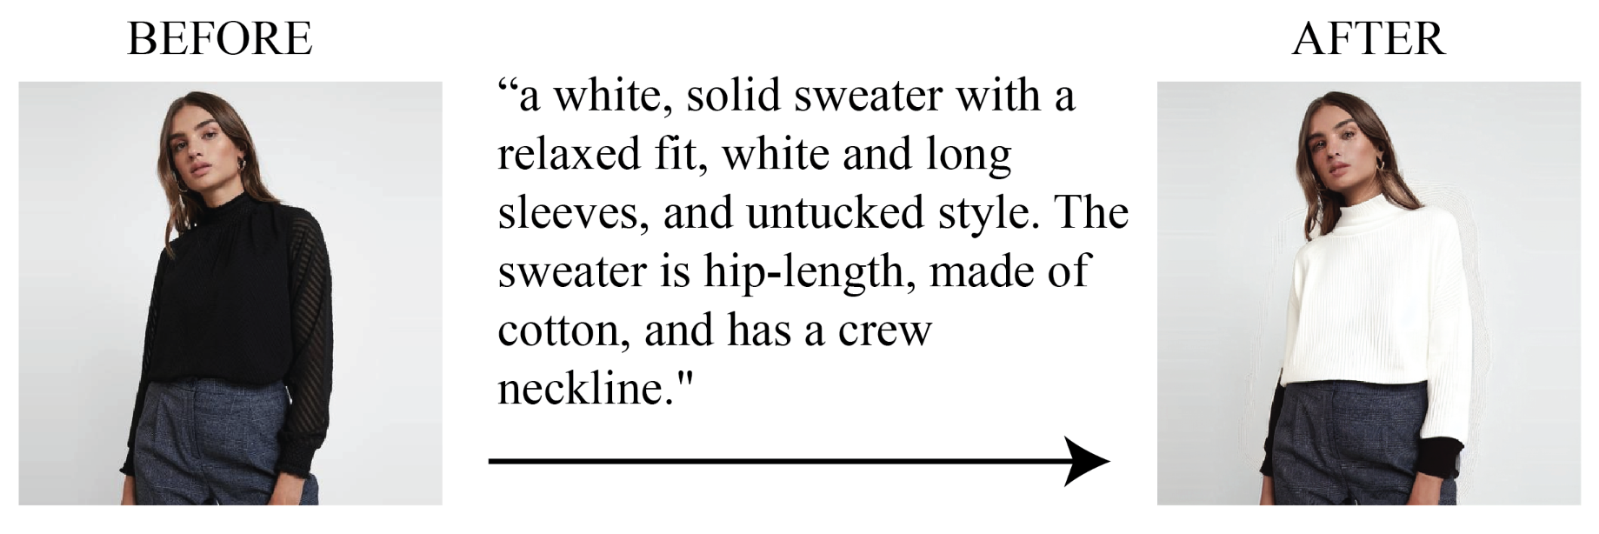
Problem Introduction
Our project focuses on enabling people to describe a clothing piece they want to wear and see it on their body. We have created a workflow where a person can upload a photo of themselves along with a text input where they describe the clothing they want to wear and get an output image with the desired piece on them.

Slide 4
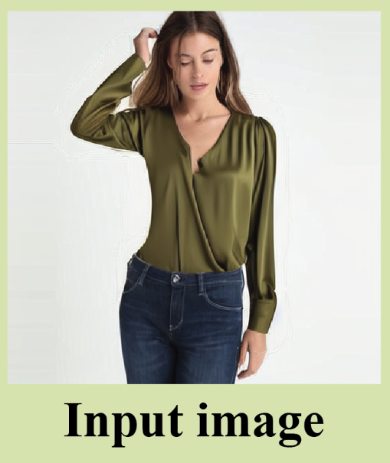


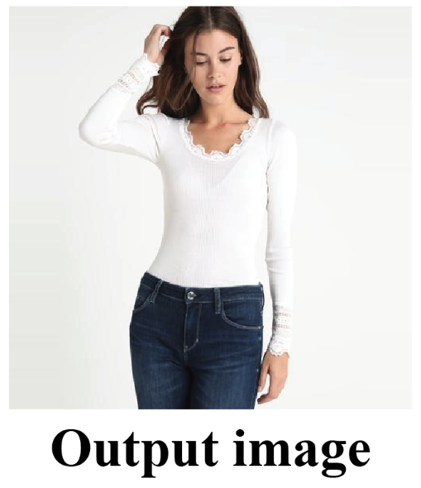
Solution Methodology
We are using a conditioned Stable Diffusion Inpainting text-to-image model as base model where you describe a text with a mask image and get a output image with the masked part filled with your text description. On top of this base model, we are attaching a ControlNet conditioning model where we use a segmentation map of the input image and use this to provide extra information to our workflow.
+
+
+ Text Input =
Segmentation Image

Slide 5
Quick Demo
Now I will show a live demonstration of our model.

Slide 6
Thank you for listening.

