Slide 1


Erdös Institute Fall 2023
December 1, 2023
Predicting Groundwater Levels
Marcos Ortiz, Meredith Sargent, Riti Bahl, Chelsea Gary, and Anireju Emmanuel Dudun

Slide 2
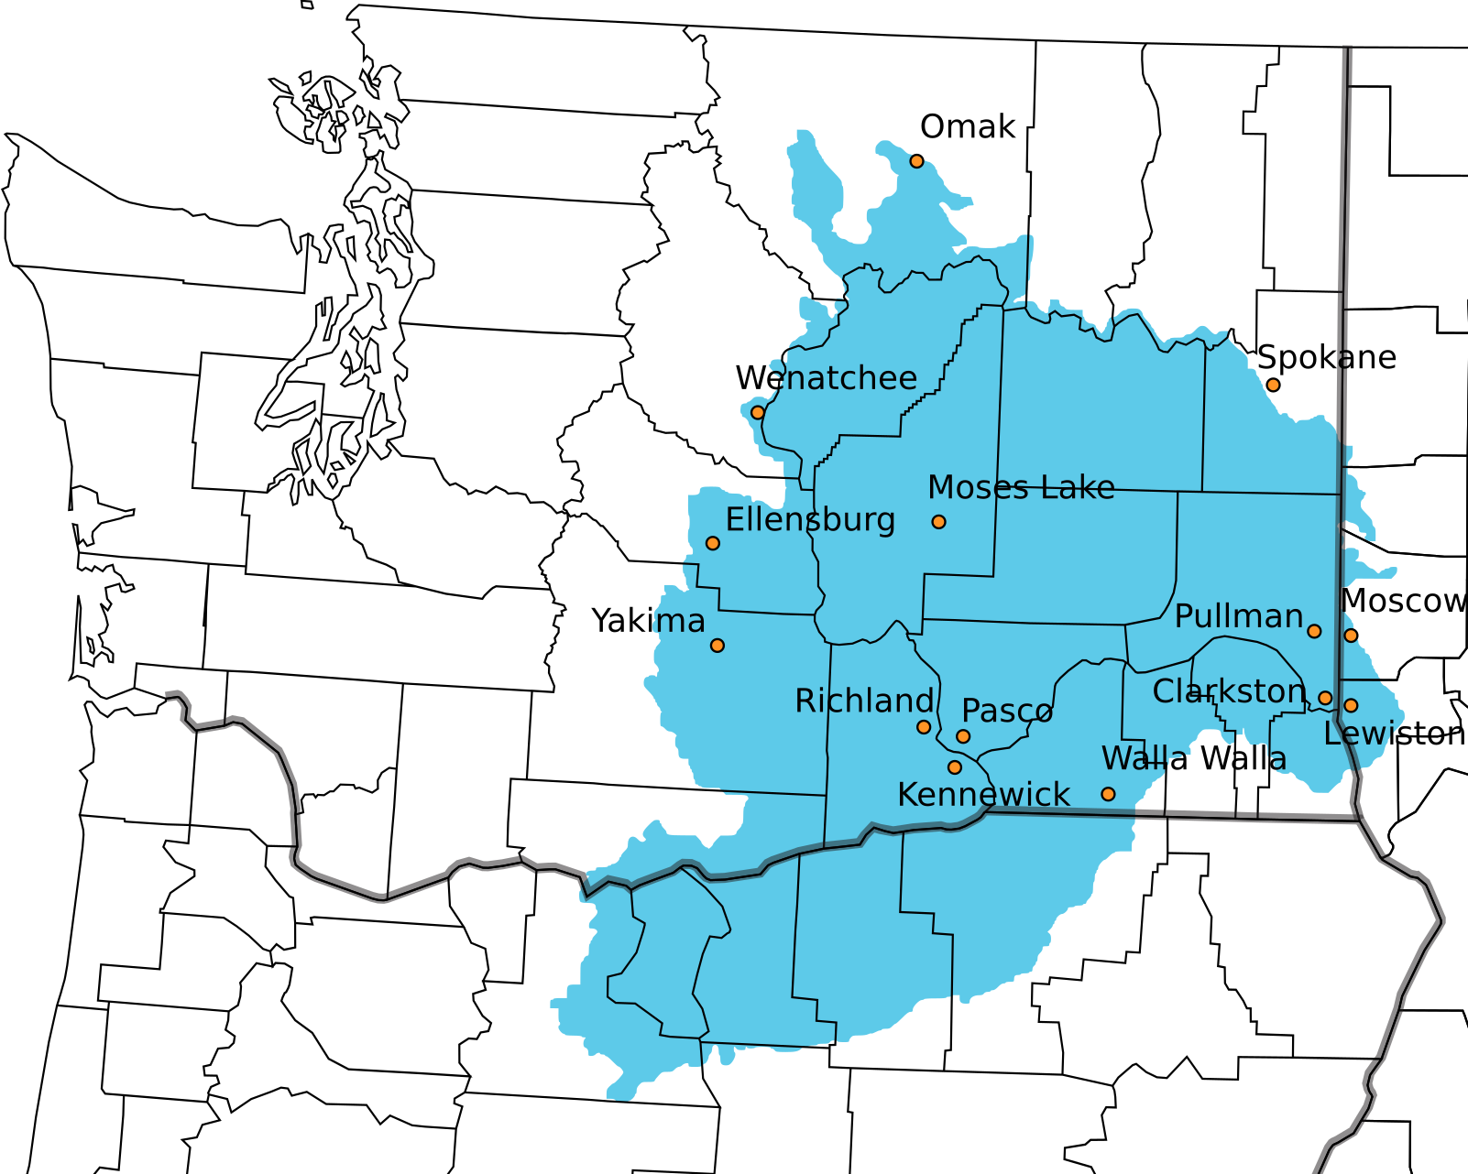
Overview
1
Over the last 100 years, water abstraction volume has increased from 500 to ~4000 km /yr due to population growth, economic development, and rapid urbanization around the world.
3
2
More specifically, the Columbia Basin lies in an arid lowland area, making groundwater level prediction crucial to assist with water supply monitoring.

Slide 3




Why Spokane?
Spokane county boasts the second-largest number of farms in Washington state, with a total of 2,425 in 2017. Additionally, the availability of consistent data over several years from a cluster of wells makes Spokane an ideal location for modeling purposes. The area's excellent weather and river data further contribute to its appeal.
Stakeholders
1
Spokane residents.
2
Spokane businesses.
3
Local government agencies.

Slide 4


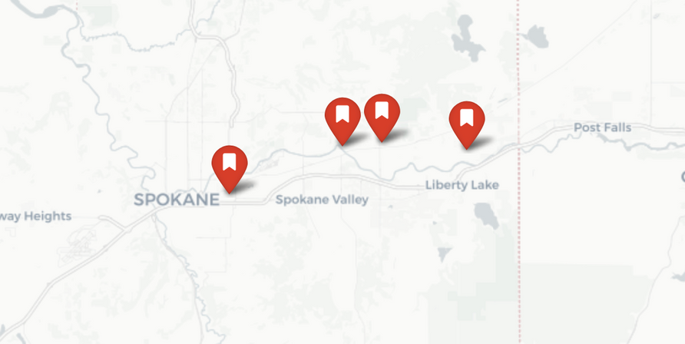


Datasets
Well Data
1
Date
We selected four groundwater monitoring wells in the Spokane area with differing lithographies.
Data was gathered from various government and commercial sources.
2
Water Level (feet below surface)
Weather Data I
3
Temperature
4
Pressure
5
Humidity
6
Wind Speed
7
Wind Gust
Weather Data ||
APK309
APK310
AFL259
8
Precipitation
AEK201
Surface Data
9
Gage Height
10
Discharge Rate

Slide 5
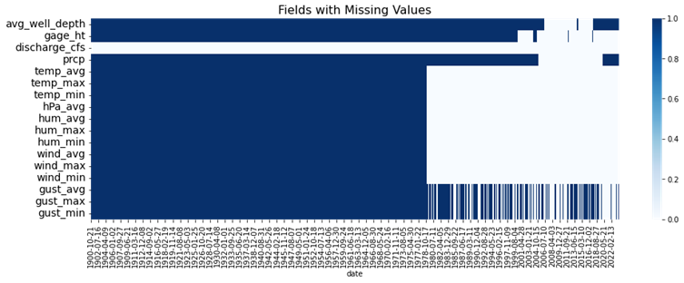

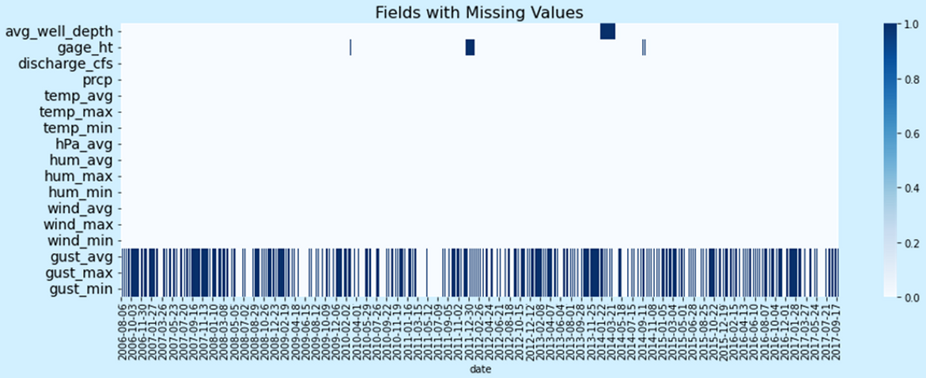
Dataset Processing
1900-2022
APK309
1
Data prior to 2006 was dropped due to missing values.
2
Wind Gust & Gage Height missing data between 2006 - 2017 were replaced with zero and last non-missing values respectively.
Key Features includes: date, gage_ht, discharge_cfs, prcp, temp_avg, hum_avg, wind_avg and gust_avg
2006-2017
3
APK309
4
Engineered Precipitation data with 45 days lag for better correlation with target feature: Water level

Slide 6
1
Baseline
Models
2
Linear Regression
3
Convolutional Neural Network
4
Recurrent Neural Network
(Long Short Term Memory)
Wrapped in custom Scikit-Learn estimators/transformers

Slide 7
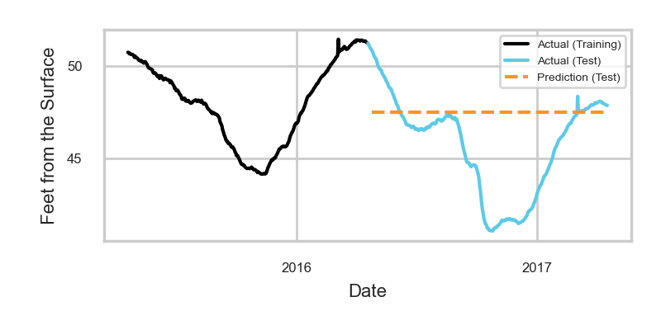
Baseline
APK309 | APK309

Slide 8
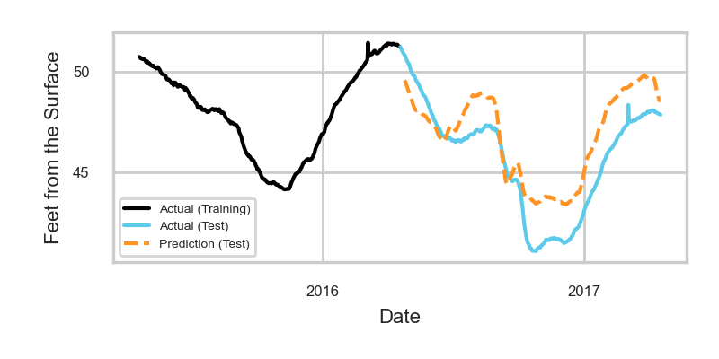
Linear Regression
APK309 | APK309

Slide 9
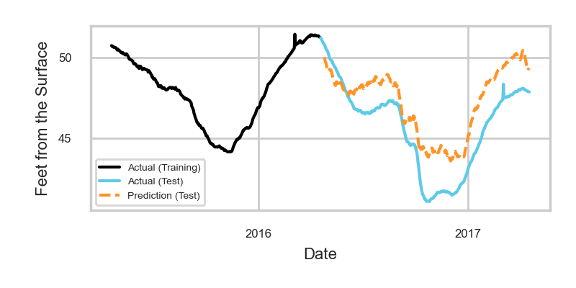
CNN
Hyperparameters were tuned using grid search to enhance performance.
Number of convolutional layers.
Kernel and filter sizes.
Number of dense layers.
Units in each dense layer.
Batch size
Learning rate
Early stopping threshold.
APK309 | APK309
Model Structure
Input
Convolutional
Flattening
Dense
Output

Slide 10
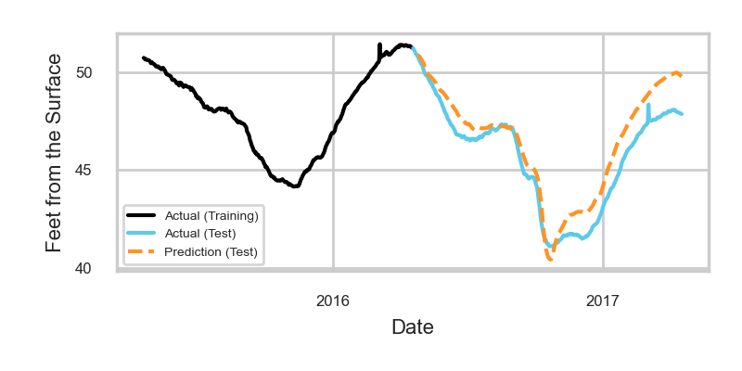
LSTM
Hyperparameters were tuned using grid search to enhance performance.
Window size
Units in the LSTM layer and each dense layer
Number of dense layers
Learning rate
APK309 | APK309
Model Structure
Input
Long Short Term Memory
Flattening
Dense
Output

Slide 11
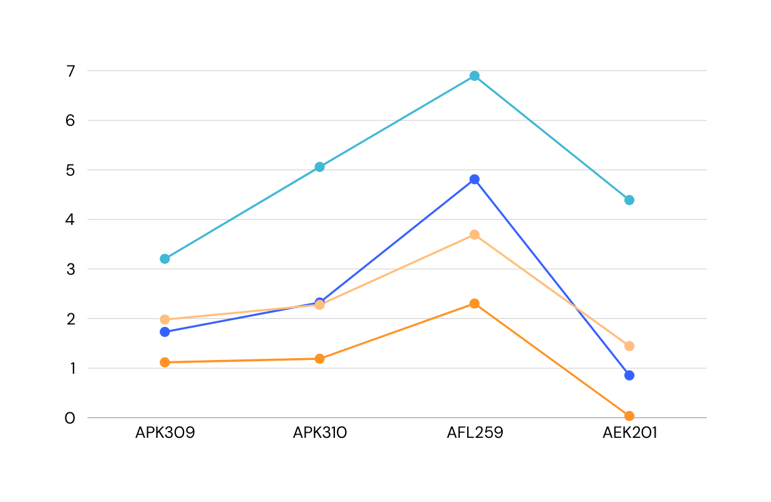
Results
We held out the last year of groundwater level data for each of our wells. This is how our models performed on that holdout set. (Lower is better.)
 | APK309 | APK309
 | RMSE | MAE
Baseline | 3.206 | 2.372
Linear Regression | 1.732 | 1.587
CNN | 1.981 | 1.756
LSTM | 1.118 | 0.914
APK309 | APK309
RMSE for Each Well | RMSE for Each Well

Slide 12
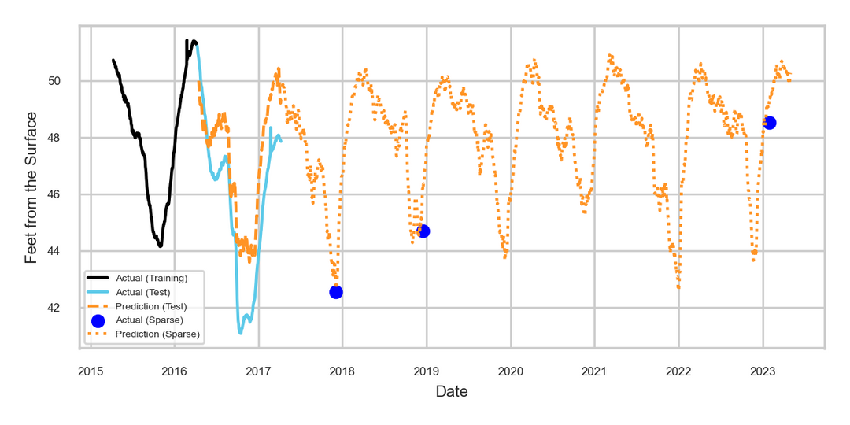
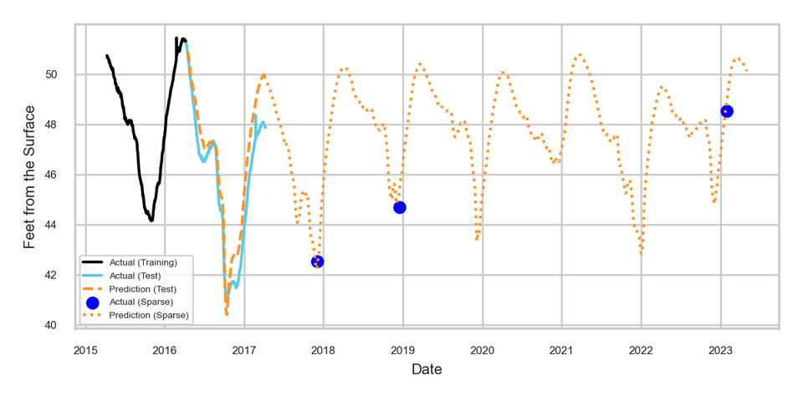
CNN | CNN
Models
Sparse Data
The availability of weather and river data allows us to make predictions beyond the continuous well data, and we can evaluate them on a limited number of data points.
End of training data
APK309 | Actual | CNN | LSTM
7-20-23 | 48.53 | 49.47 | 49.13
7 years later!
LSTM | LSTM

Slide 13

Streamlit App
We integrated our models into Streamlit to allow users interactive insights across four selected wells.
https://erdosgroundwaterforecast.streamlit.app/

Slide 14
1
Improve the web app
Future Work
2
Wells at other locations
3
Additional parameter tuning
4
Seasonal ARIMA

Slide 15

Acknowledgements
Thank you to Roman Holowinsky, Matt Osborne, Alec Clott and the Erdös Institute for their support throughout the Fall 2023 boot camp.
Thank you Gleb Zhelezov for his mentorship throughout the project.

