Slide 1
Used Car Price Prediction
Toader Ana-Maria

Slide 2
Project overview
Idea: Build a prediction model to estimate the price of used cars based on their characteristics.
Motivation: Support both buyers and sellers make informed decisions based on existing car listings available online.
Part 1 objectives:
Data collection
Feature selection
Data filtering

Slide 3
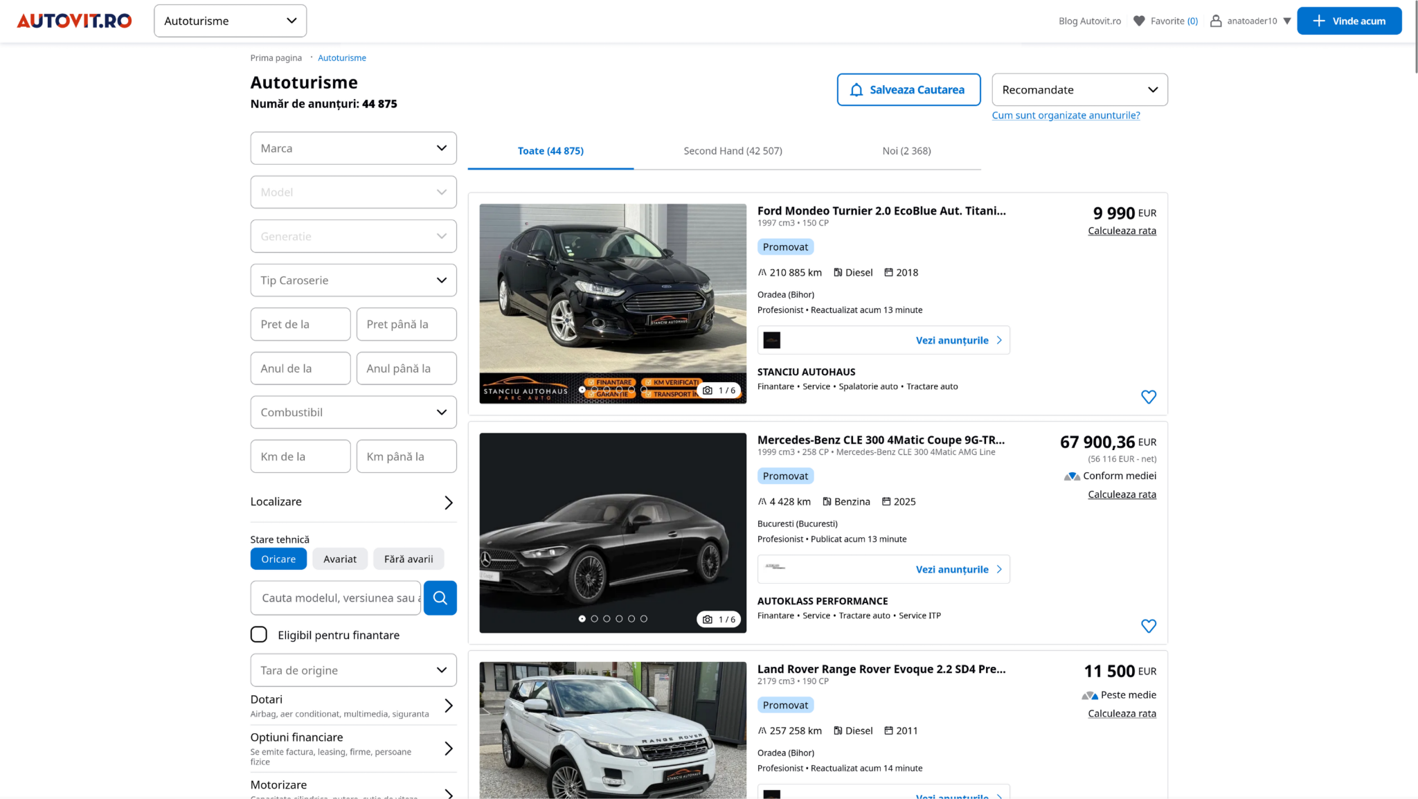
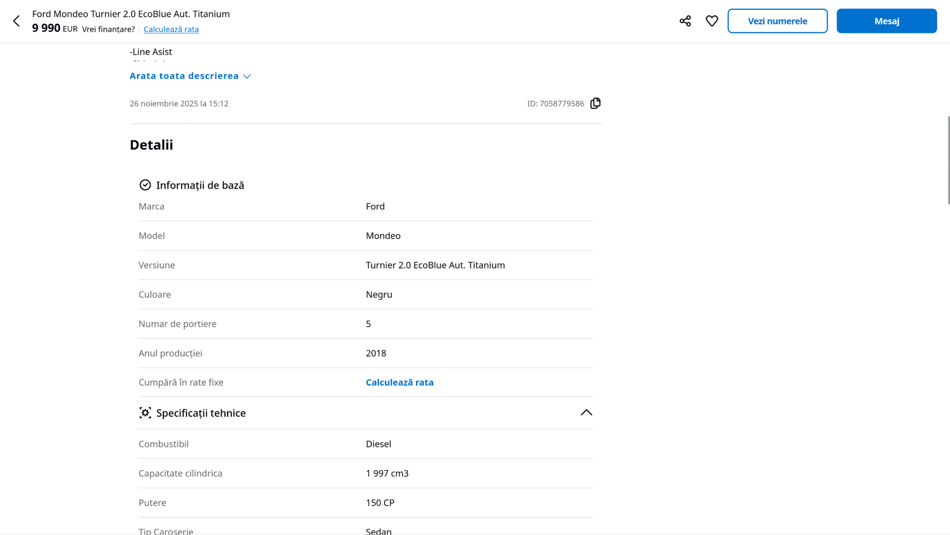
Data acquisition
Source: www.autovit.ro/autoturisme/second
Method:
built a scraper that navigates through pages of car listings
used BeautifulSoup to extract information from HTML
used rate limiting with a delay of 0.5s

Slide 4
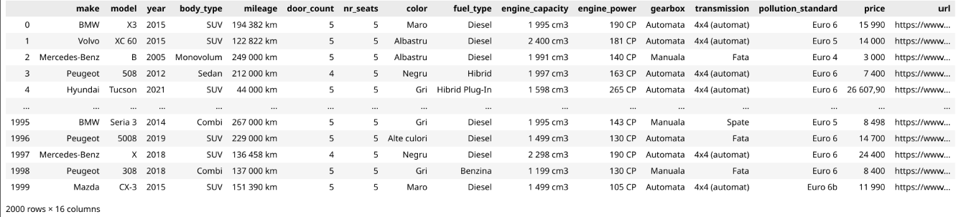
Dataset descriptives
Initially the raw collected dataset contained:
2000 entries
15 features make, model, year, body_type, mileage, door_count, nr_seats, color, fuel_type, engine_capacity, engine_power, gearbox, transmission, pollution_standard, price (target feature)
only collected listings which have values for all the features -> no missing values
Scraper CSV output:

Slide 5
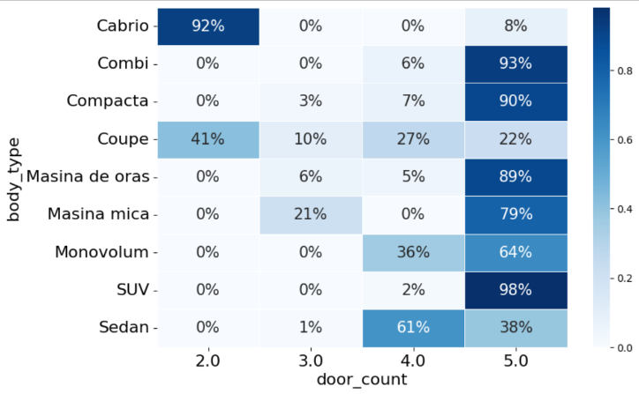
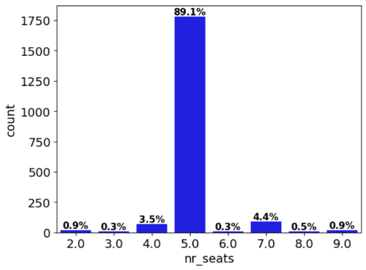
Dataset descriptives
Drop “redundant” features door_count and nr_seats.
heatmaps of contingency tables shows that, given the body_type, the values for door_count and nr_seats are highly predictable
analysed the discrete probability distributions
door_count: ~8/10 examples have door_count = 5
nr_seats: ~9/10 examples have nr_seats = 5

Slide 6
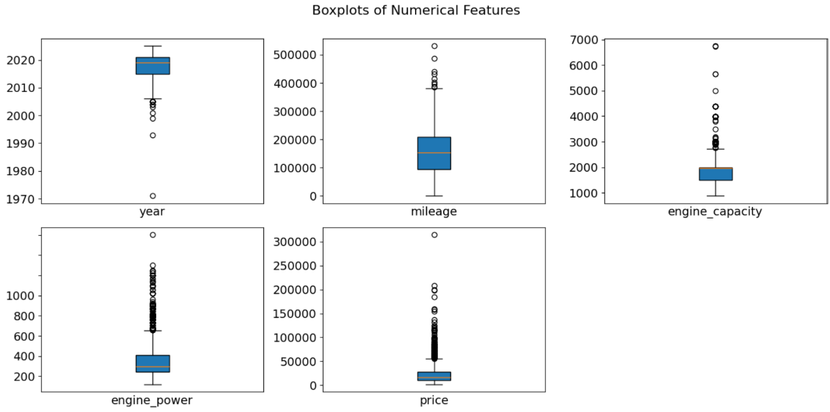
Data filtering
Features left:
numerical: year, mileage, engine_capacity, engine_power, price
categorical: make, model, body_type, color, fuel_type, gearbox, transmission, pollution_standard
Filtering decisions:
keep only cars manufactured after 2005
remove cars with mileage above 400,000km or under 1,000km (not meaningfully categorized as used cars)
remove luxury cars exceeding 100,000€

Slide 7
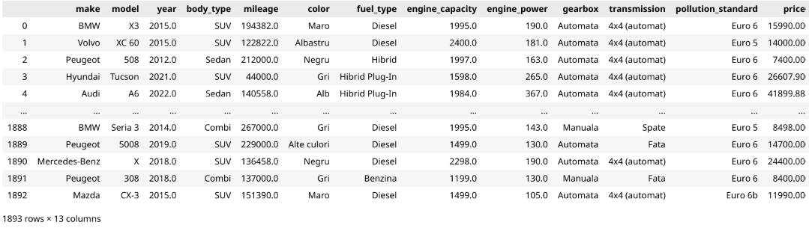
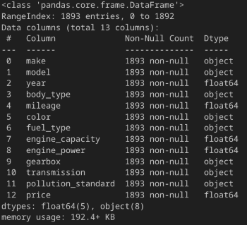
Data cleaning
remove non-numeric artifacts from (“km”, “CP”, “cm3”) from what should be numeric data
perform type conversion
1893 entries left after data filtering, with 13 features

Slide 8
Future work
Perform EDA
Train model to predict price
experiment with different architectures (Random Forest, XGBoost)
apply necessary data transformations
Understand which features impact the predicted price the most
Analyze performance using metrics such as MAE, RMSE

