Slide 1
Used Car Price Prediction
Toader Ana-Maria

Slide 2
Project overview
Idea: Build a prediction model to estimate the price of used cars based on their characteristics.
Motivation: Support both buyers and sellers make informed decisions based on existing car listings available online.
Objectives:
Part 1: data collection, feature selection, data filtering
Part 2: EDA, prediction, error analysis

Slide 3
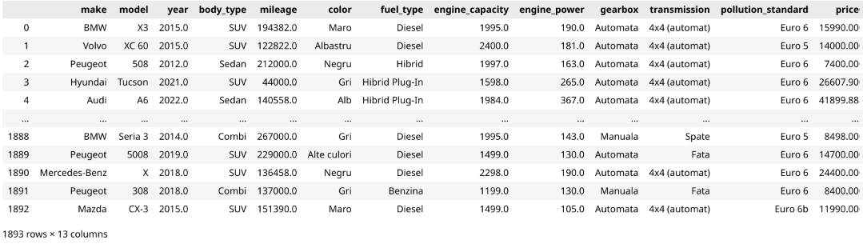
Dataset descriptives - recap
1893 entries left after data filtering
no missing values, no duplicates
13 features:
numerical: year, mileage, engine_capacity, engine_power, price
categorical: make, model, body_type, color, fuel_type, gearbox, transmission, pollution_standard
Filtering decisions:
keep only cars manufactured after 2005
remove cars with mileage above 400,000km or under 1,000km (not meaningfully categorized as used cars)
remove luxury cars exceeding 100,000€

Slide 4
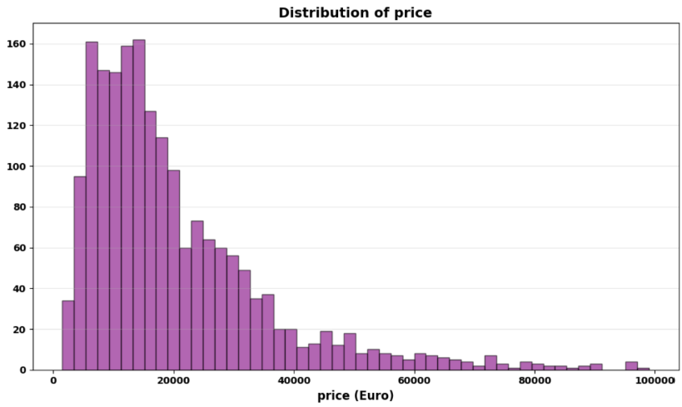
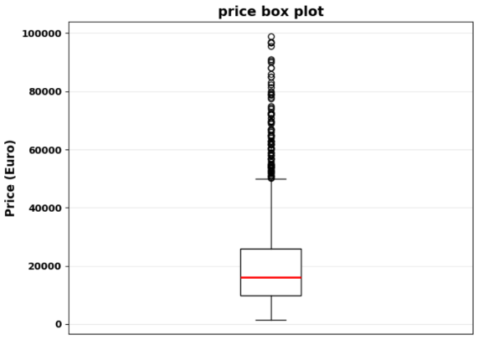
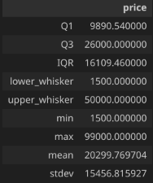
EDA
1.1 Univariate Analysis - Target variable (price)
already filtered out data with price exceeding 100,000€
the outliers in the boxplot represent real data points, not errors, we retained them to contribute to model generalization across market segments, not bias it towards a budget market segment

Slide 5
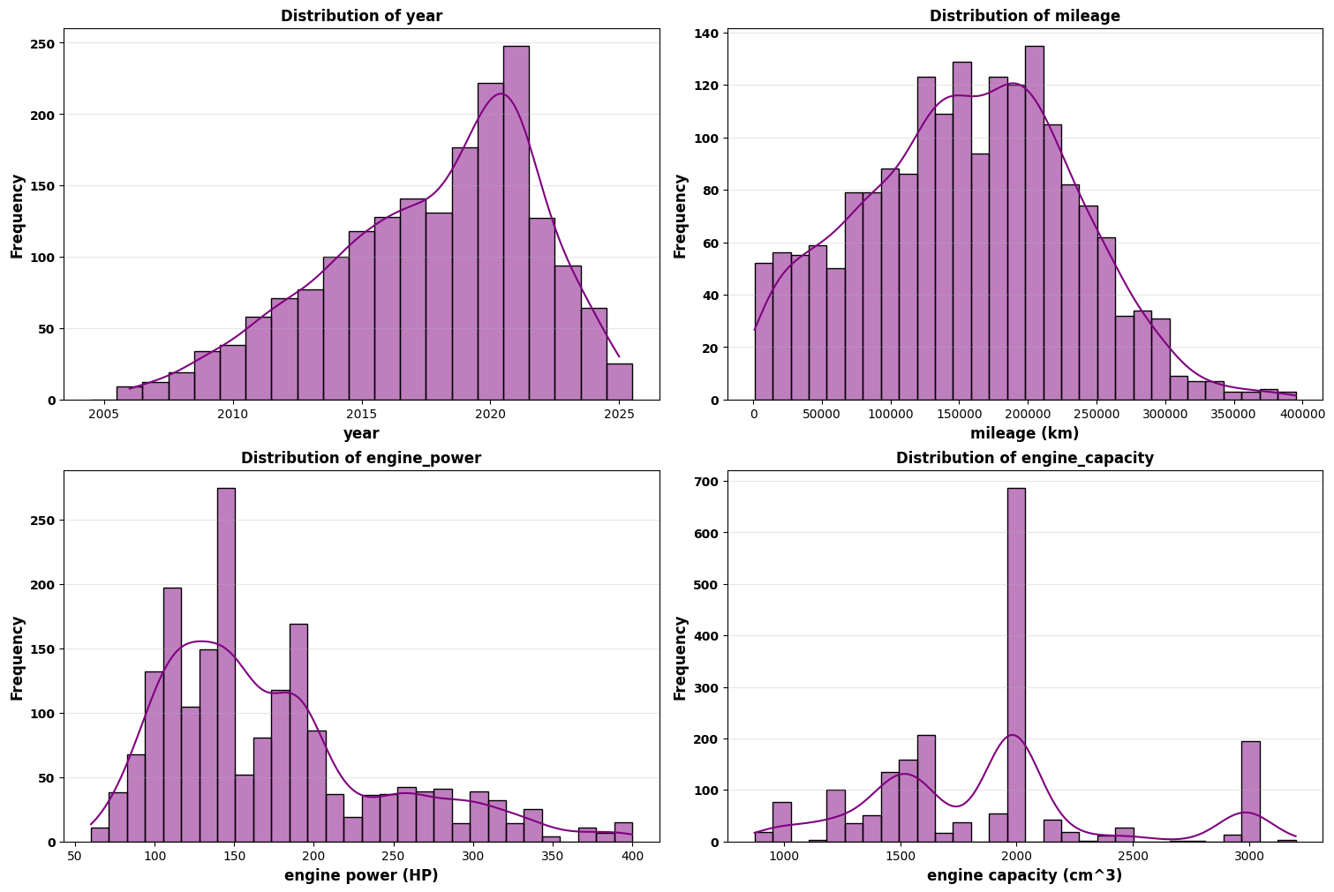
EDA
1.2 Univariate Analysis - Numerical features
Features: year, mileage, engine_power, engine_capacity
mileage distribution is nearly normal, naturally meaningful, keep as it is
engine_power and engine_capacity distributions are skewed, could apply log-transform for a Linear Regression model
tree-based models are robust to skewness, so transformation is optional

Slide 6
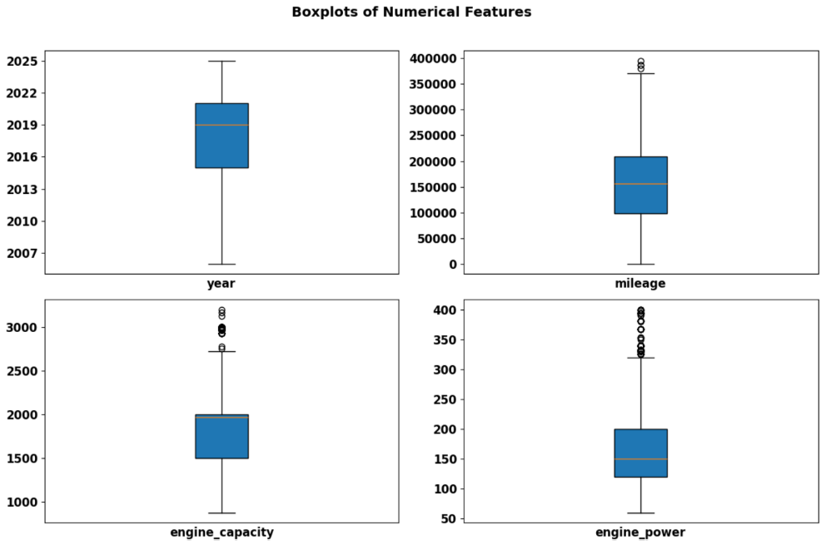
EDA
1.2 Univariate Analysis - Numerical features
Features: year, mileage, engine_power, engine_capacity
similar to the target feature, the data has also been previously filtered, keeping:
manufacturing year > 2005
mileage < 400,000km
all outliers visible in the boxplots have been kept, as they do not represent data errors, but real data representing different market segments
the goal of keeping these outliers is to contribute to the model’s generalization abilities

Slide 7
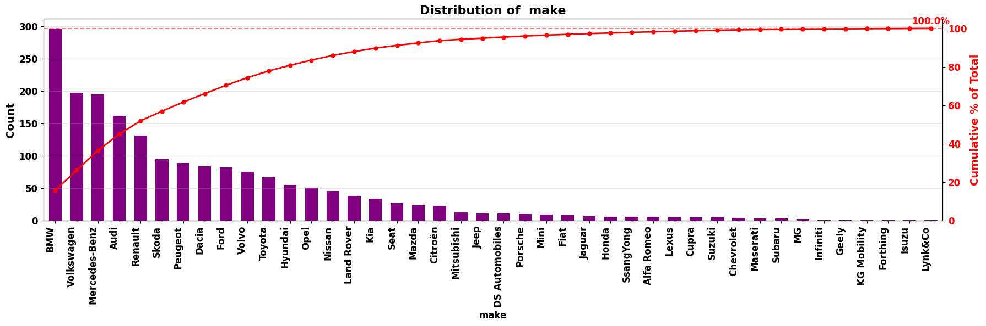
EDA
1.3 Univariate Analysis - Categorical features
Feature: make
high class imbalance: top 10 brands account for 74% of dataset (42 unique values for make)
may lead to overfitting
many niche/luxury brands with < 1% counts (idea: rare brands could be grouped into a new “Other” category)
one-hot encoding will create sparse, imbalanced features

Slide 8
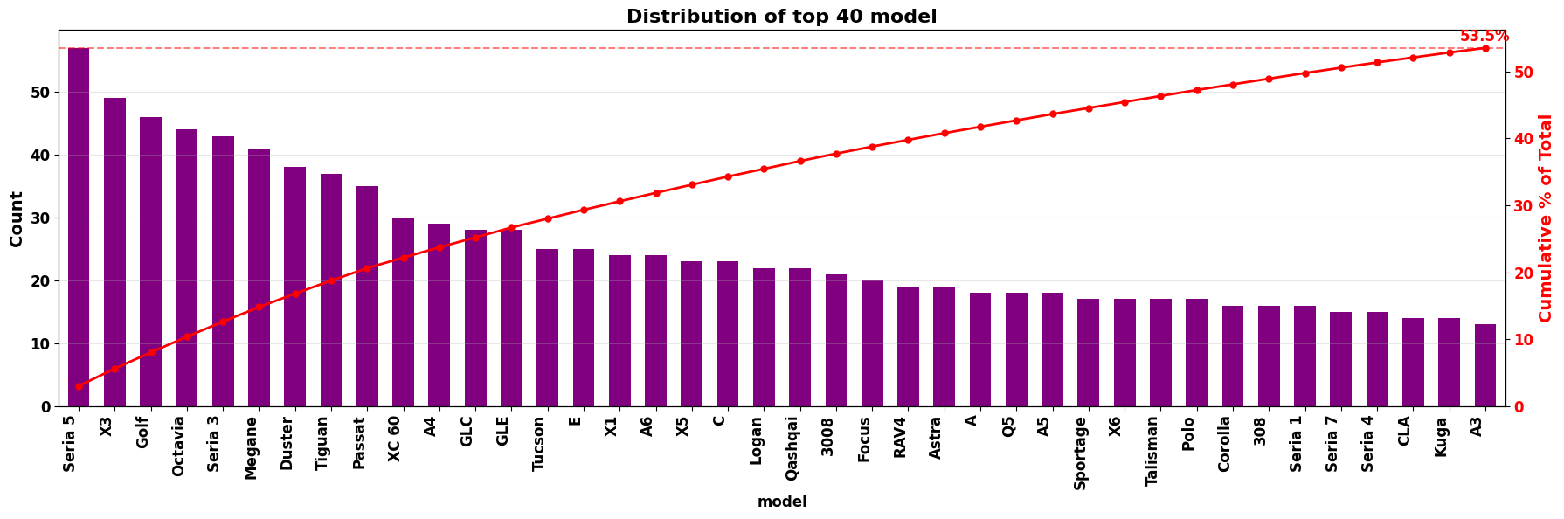
EDA
1.3 Univariate Analysis - Categorical features
Feature: model
extreme class imbalance: top 40 brands account for 53% of dataset
one-hot encoding w create extremely sparse, imbalanced features: 288 unique values for a total of 1893 samples => very high overfitting risk

Slide 9
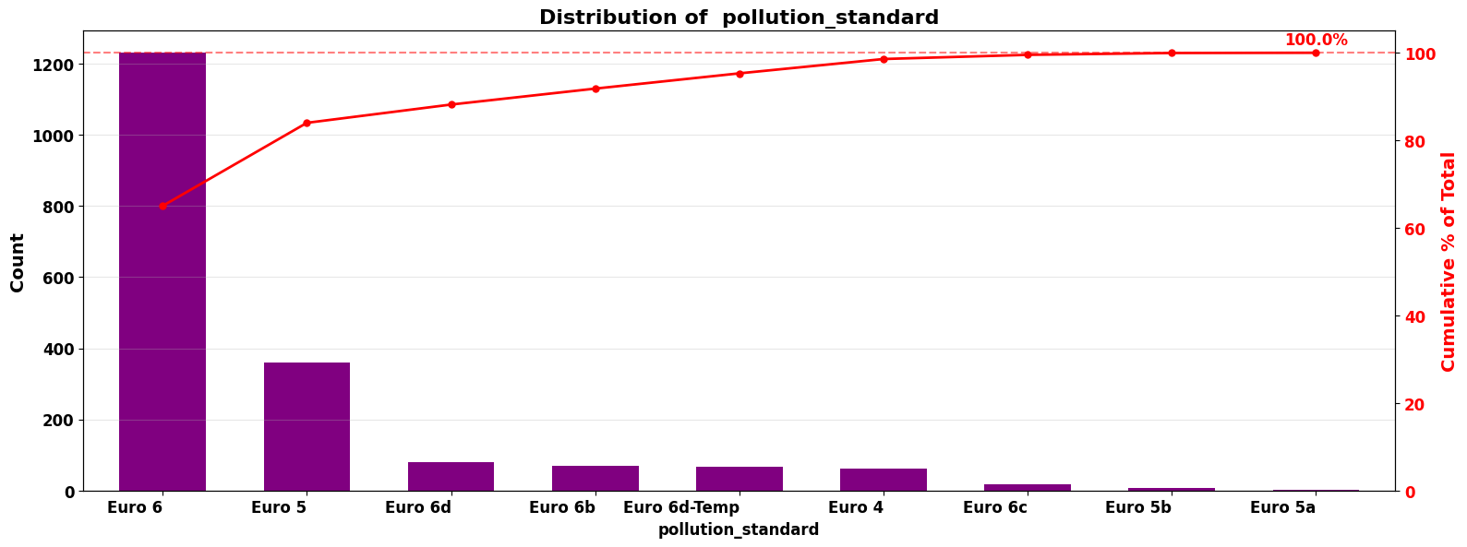
EDA
1.3 Univariate Analysis - Categorical features
Feature: pollution_standard
high class imbalance: Euro 6 + Euro 5 account for 84% of the dataset
low cardinality of values
idea: group underrepresented classes into an “Other” category

Slide 10
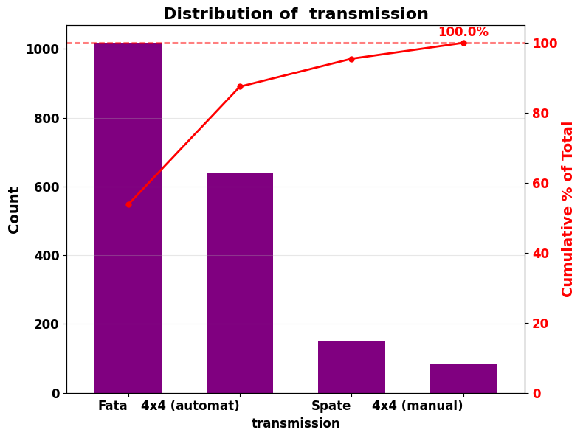
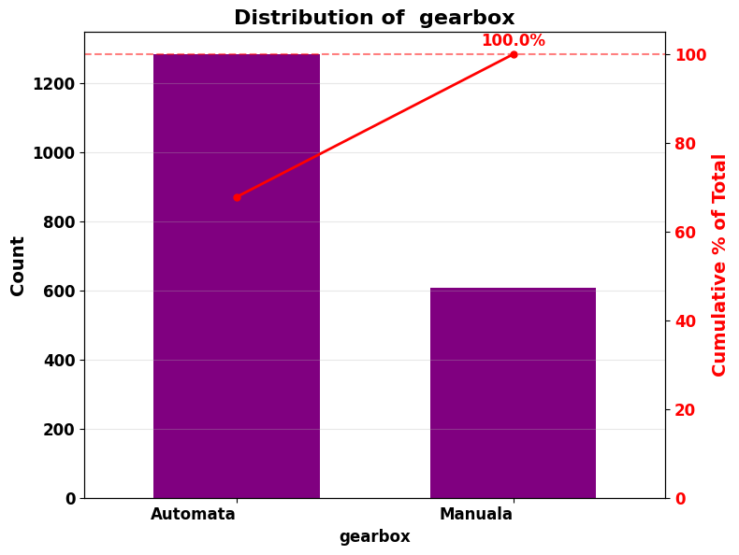
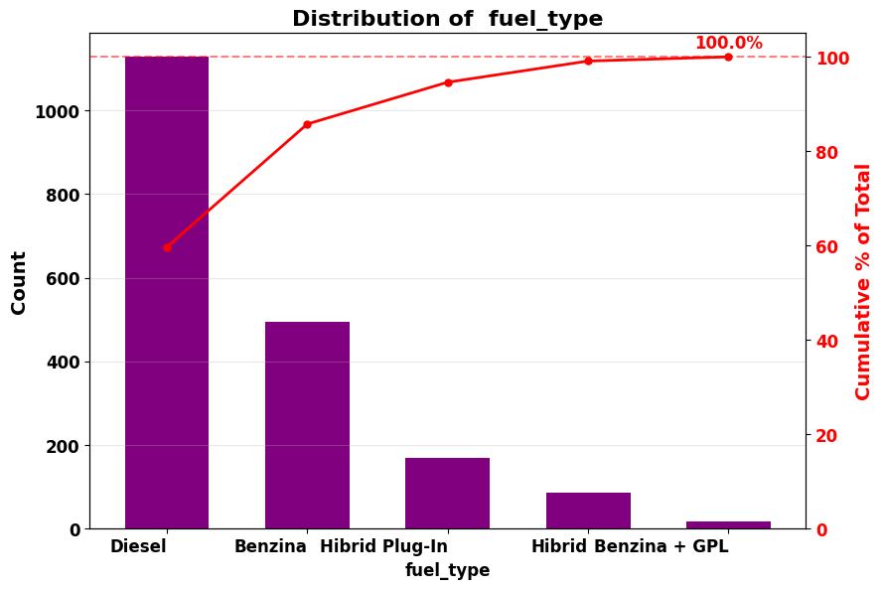
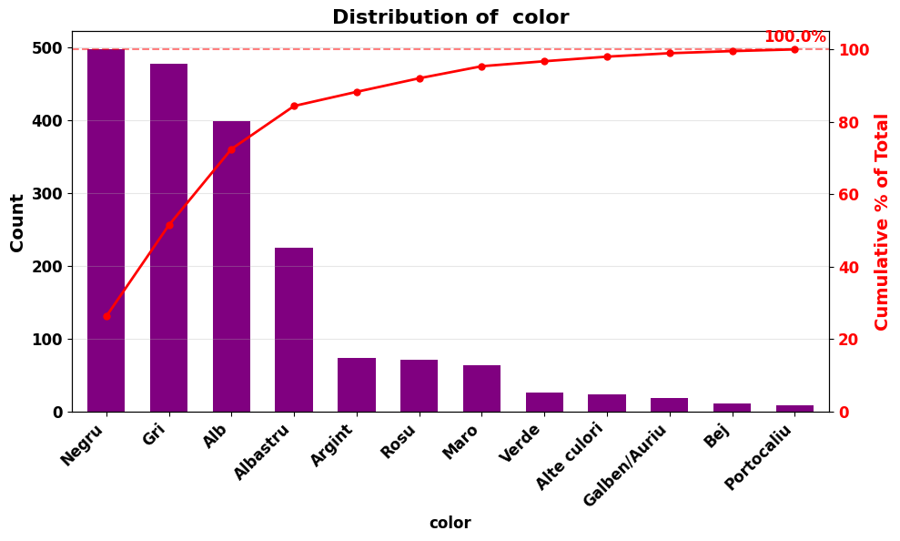
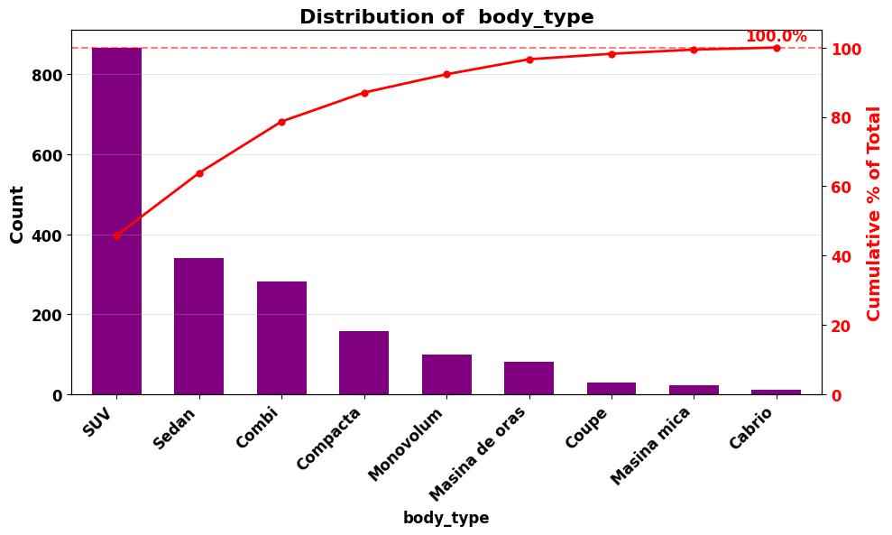
EDA
1.3 Univariate Analysis - Categorical features
Features: transmission, gearbox, fuel_type, color, body_type
low number of unique values, keep all categories, not such an extreme class imbalance

Slide 11
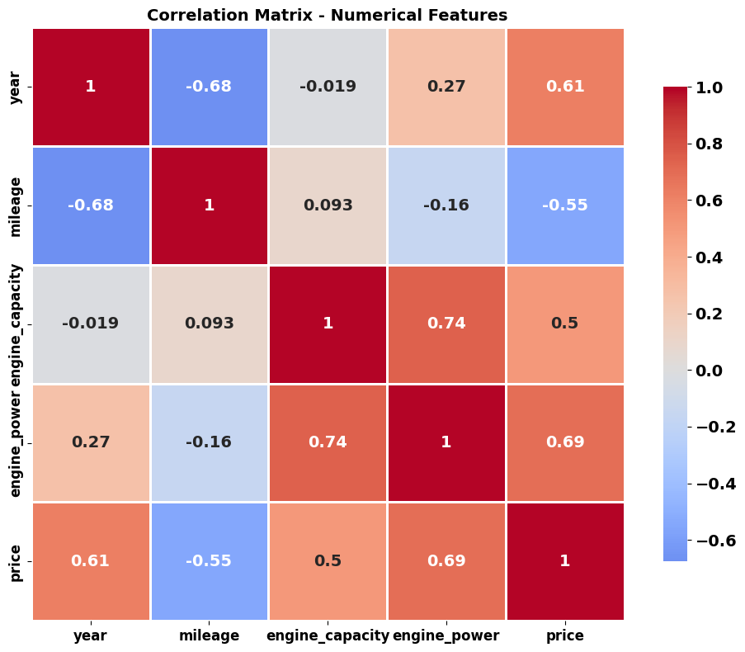
EDA
2.1 Bivariate Analysis - Correlation
engine_capacity and engine_power have a high correlation coefficient
using both might be partially redundant
using both for a Linear Regression model can cause instability
tree-based models can handle multicollinearity
engine_power has a the highest positive correlation coefficient with price
Notes:
we expect engine_power to be a good predictor

Slide 12
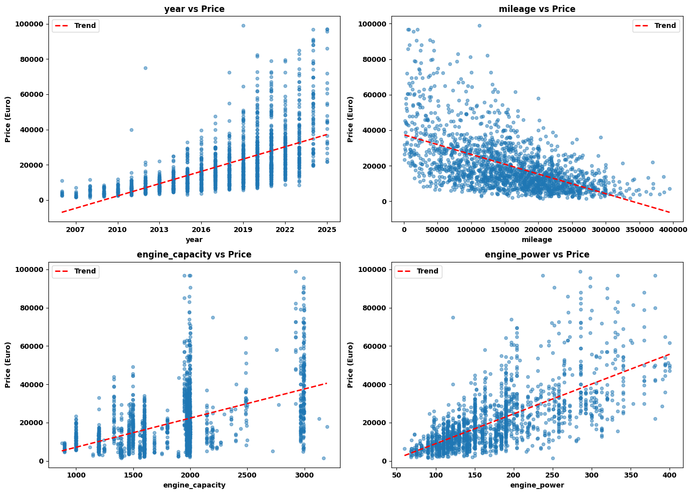
EDA
2.1 Bivariate Analysis - Numerical features vs. price
year vs price
newer cars -> more expensive
variance increases significantly with year
mileage vs price
mileage increases -> price decreases
distinctly non-linear relationship
engine_capacity vs price
vertical clusters suggest categorical grouping might be more natural
tree-based models should capture this ‘categorical’ grouping automatically
non-linear relationship
engine_power vs price
‘cleanest’ scatter, suggests this might feature might have the most linear (positive) relationship with price
Notes:
year vs price: variance increases, this suggests for newer vehicles, other factors become more important

Slide 13
Predictions
Models selection
Chose two tree-based models: Random Forest and XGBoost.
can handle the non-linear relationships
no feature scaling or transformation required (they don’t rely on distance-based calculations)
Preprocessing pipeline
numerical features pass through unchanged
use OrdinalEncoder from sklearn for categorical features
only conversion to integers is relevant, Ordinal Encoder is the simplest
do not use one-hot encoding because of the dimensionality explosion

Slide 14
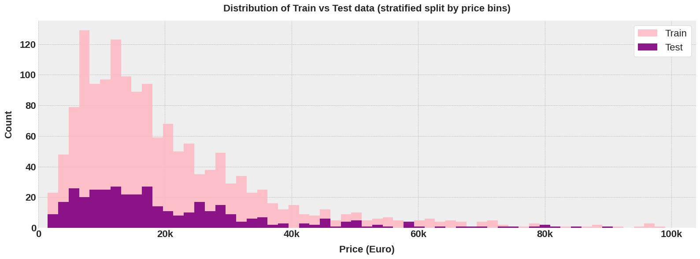
Predictions
Train-test split
80% train, 20% test
stratified split by price bins (5 quantiles)
goal: model learns from a representative dataset of all price ranges, evaluated on a similar distribution
Notes:
tried to keep a balanced distribution of prices

Slide 15
Predictions
Training
used GridSearchCV for hyperparameter tuning
Random Forest
number of estimators
maximum depth of a tree
minimum samples per split
minimum samples per leaf
bootstrap (True / False)
XGBoost
number of estimators
maximum depth of a tree
learning rate
fraction of samples used per tree
fraction of features used per tree
selected the hyperparameters that achieved the highest average cross-validation MAE score
Notes:
learning rate controls how much the tree’s predictions are scaled before adding to ensemble
gamma controls the minimum loss required to make a split

Slide 16
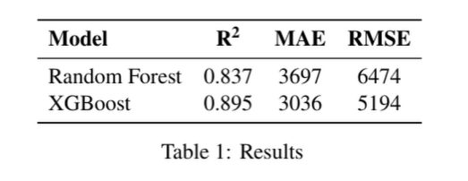
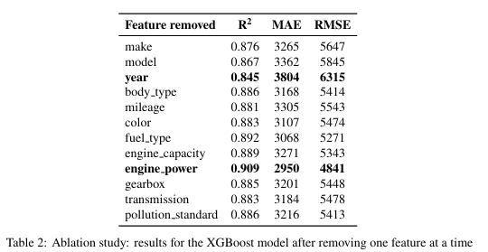
Results
Best models after grid search
XGBoost achieved higher R2 scores, lower MAE and RMSE
Feature importance
removed one feature at a time and evaluated performance of the ‘best’ model found after grid search (XGBoost)
removing year leads to the lowest R2 score, suggesting this is has a high importance
removing engine_power leads to a higher R2 score (might suggest it introduce noise, highly collinear with engine_capacity)

Slide 17
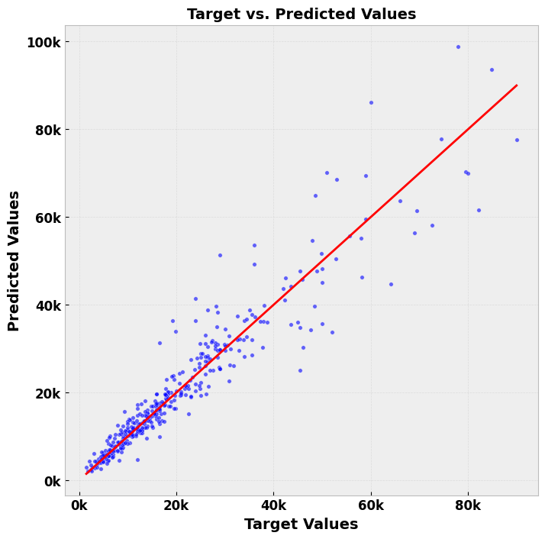
Error analysis
Interpretation:
for low/mid priced cars (< 40k Euro), the points are more tightly clustered around the diagonal, suggesting lower absolute errors
the error increases significantly above 40k Euro
tendency to undervalue expensive cars (price over 80k Euro); this is the most underrepresented price range in the dataset
Conclusion:
decent performance for mass market
for premium/luxury cars, might need additional data or features to increase performance

