Slide 1

Hadoop Infrastructure and Hosting
Internal deployment and support by GTS
Full rack deployment model setup with TFO
From Q1 2017 :
Spine/leaf architecture
Spine : standard N7k
Leaf : Top of Rack switches (N93)
10 gbps (w/ failover)
Oversubscription leaf to Spine : 2.5
(20 servers front, 80 gbps uplink)
Uplink can be upgraded to
160 gbps
PRD
Aquila
16 nodes
165 TB
DEV
Tigery
24 nodes
450 TB
Current setup
PRD
Aquila
36 nodes
780 TB
DEV + DR
Tigery
44 nodes
1 PB
2017 Q1 setup
Notes:
Nommer les 7 = 1m
We are focused on Value creation and Agility
n 30

Slide 2
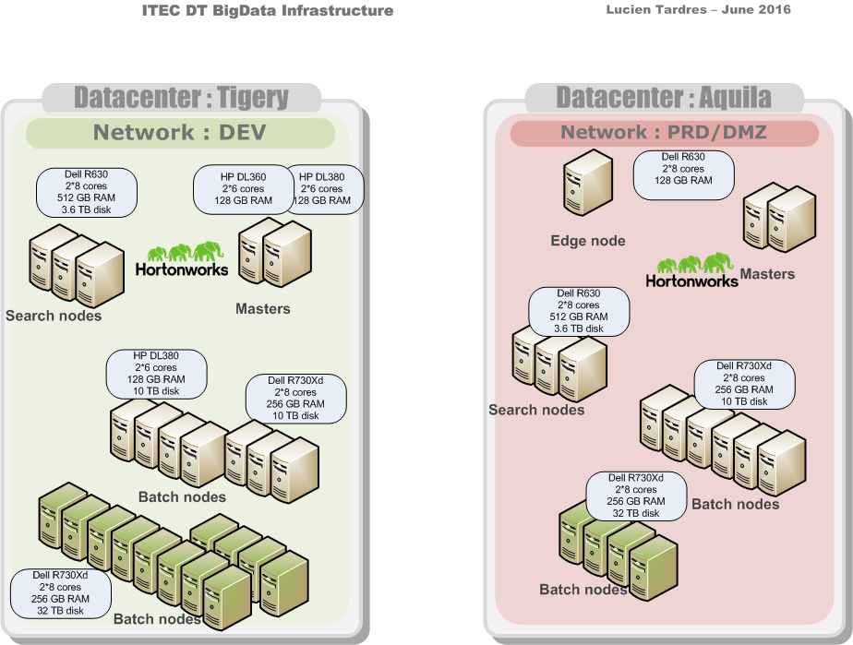
Infrastructure Nov 2016

Slide 3








GTS/MKT datalake architecture principles
Do code ! But only the minimum
(Pig, Python, but also
Scala, JS and SQL )
Stay transversal :
all technical silos, all apps
=> no sensitive data
Use standard (and free) products :
Hadoop/Spark and Elasticsearch
Use Kibana and Zeppelin for
presentation
Use Hadoop for data processing
and long-term storage
MKT Datalake:
250 Go RAM
5,5 TB Storage
on GTS Private Cloud
ITEC TMON
appX
Slower but no data
limit
Data Viz
queries
Data < 7-15 days
All data here
Data sources

Slide 4
Use cases in a nutshell (1/2) scope and value
Sponsor | Type | Name | Description | Status
GBIS | Recommend | SGM Pre-Trade (Scoring, WeakSignals…) | SG Markets: Trade Idea recommendation Research paper recommendation | Prodution
GLFI | Predict | GLFI Business Forecast | Loan forecasting for GLFI | Prodution
MACC | BI | DART | Less effort to answer the regulatory requests and better data quality for FIND/MAC/RISK address requests than cannot be answered within acceptable deadlines today | Prodution
MACC | Detect | Market Data Control (Control Next Gen) | Operational efficiency of market analyst improved (by focusing only on real discrepancies) | Prodution
OPER | Search | SGM Post-Trade Search | Client centric search engine Based on Data Lake + DB | Prodution
OPER | Search | Bridge Equity | Regulatory audit track on all database changes for the Equity post-trade. Unique source for trade versions for all GBIS. | Prodution
SAFE | Detect | Anti-Fraud | Performance improvement on existing Search engine | Prodution
DFIN | Detect | Manual Entries Dynamic Tool | anomaly detection on manual entries | Candidate for Production
GBIS | Predict | How Long Will It Take ? | Prevision of duration of each business process (KYC, Approvals, Credit Requests). Value added on time-to-market, franchise (client image) | Candidate for Production
MACC | Detect | Kepler One | Risk cartography | Candidate for Production
MARK | BI | BAM CTY | Increased Sales efficiency by centralizing all RFQ flow into one application. Improved, more efficient dialogue between Sales and Trading | Candidate for Production

Slide 5
Use cases in a nutshell (2/2) scope and value
Sponsor | Type | Name | Description | Status
MARK | Recom | SGM E-Data ( Dive ) | Productivity's improvement for sales. Offer added value services to the client. Relationship focused approach which can lead to business development | Candidate for Production
MARK | Recom | SGM Heat Map | Distribute our quantitative analytics on the "high interest" or "hot" part of the trading curve to clients Continuously use new trades done by client to enhance their profiling | Candidate for Production
SAFE | Detect | Anti-Fraud Data Science | Improve detection runs & investigation capabilities Lower costs, Improved performances | Candidate for Production
MKT | Predict | Salt & Pepper | Make sure trading activity is not impacted by a single switch failure Determine the impacts of an incident or a change on a network equipment | Production
MKT | Predict Detect | Desktop Profiler | Analyze impact of a new deployment (proactively or after deployment) Cost saving by identifying unused PC | Production
PRM | Predict | Capacity Management | Extrapolate the infra needs for the 3 coming months Avoid incident occurrence by anticipating abnormal behavior | Development
MKT | Detect | Data Foundation | Reduce the time needed to identify the assets impacted by an incident Allow Itec teams to access the information autonomously | Development
PRD | Detect | TMON | Enrich ITEC monitoring and alerting with infrastructure metrics | Production
MKT | Detect Predict | Log gathering | Ease prod troubleshooting Allow new analytics on infra logs, enabler for predictive analysis | UAT
MKT | BI | ATM dashboards | Study and trend ITaaS usage and benefits | Production
MKT | BI | Asia SSB and WIN/ENG SSB | Trend on infra evolutions (patchs…) | Production
More detailed description in Appendix

Slide 6
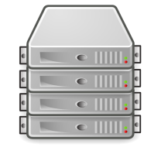
DRP Overall solution
Flume
Flume
Mirroring
Kafka
Kafka
Spark
Spark
HDFS
Distcp
HDFS
PRD
cluster
DEV + DR
Cluster (PRD)
Aquila
Tigery
Solr is out of scope now (first DR iteration is for I2R, app that does not use Solr)
no resource consumption on DEV for DR
Kafka is mirrored to ensure an RPO in minutes. Hbase replication has been abandoned for first iteration
Infrastructure does not guarantee data consistency between systems (HDFS, Kafka, Hbase….)
No partial DR
Oozie, Hive, Ranger “replications” are under ITEC responsibility for this first iteration at least. GTS can help with Oracle/Pg replication if needed. For Hive, if Hive replication is chosen it will have to be validated also on GTS side and take into account all Hive metastore usages.
API (on different DC is not included in DR solution)

