Slide 1

Machine Learning and Big Data (Hadoop) Real-Time Analysis to advance Cyber Security
R&D e-Fraud
Valkiri Stream 1
Notes:
1

Slide 2
Areas for Improvement in the Existing Solution
Existing Solution:
Detection is based on specified logs
The detection rules are set in advance and executed on demand, several times a day
Detection is based on common rules to all clients. These rules are effective in detecting known frauds, but not the unknowns.
Improvement Areas:
Raw Logs: New fraud patterns can occur via non-specified data in the logs
Real Time: The detection is done on-demand. It is difficult to conceive automatic real-time alerts/responses
Machine Learning: Rule based system is Ineffective for complex and unkown frauds detection

Slide 3
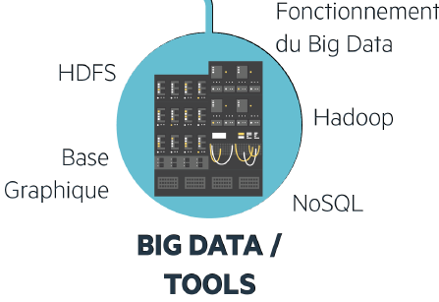
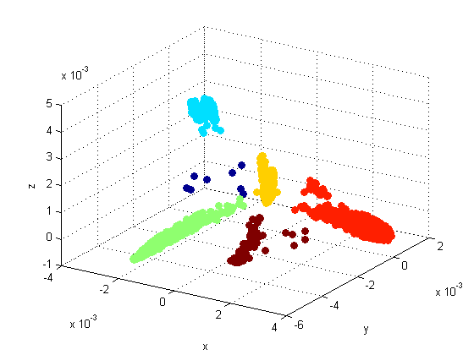

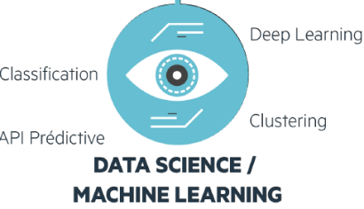


What is Machine Learning ?
The project allows to detect online banking frauds more efficiently using outlayers detection models based on the data collected by the ITIM Hadoop Big Data
1
2
The client performs operations whose logs all are collected within the ITIM Hadoop Big Data Date lake
Based on this historic, the solution creates a profile for each and every clients and keeps them updated when an operation is performed
3
4
Each operation is scored, measuring the likelihood between the operation and what is expected according to the habits of the client
Alerts and counter-measures can be triggered when an operation seems suspicious, and investigators can start to review the alert

Slide 4






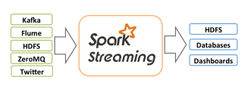


High-Level Big Data Hadoop Architecture
Sources B@D
On premises Big Data HADOOP ITIM
Raw Logs
Data collection server
Datalake
Hadoop Cluster
Short-term storage
source/date/file.des.gz
Crypting – Desensitization -Transfer
Real-time Distributed Messaging System
6 months of historical Data
Hadoop SoftLab
Hadoop DataLab
Algorithm 1:
Extractiion
Correlatiion
Aggregation
Algorithm 2:
Learning
Profiling
Client
Profiles
Week Score
Algorithm 3:
Scoring
Detecting
High Score
Alerts
Mean Score
UI: Analysis / Alerting

Slide 5
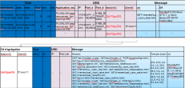
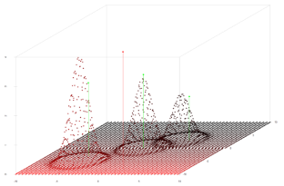

R&D e-Fraud & Big Data ITIM Collaboration
R&D e-Fraud
ITIM – BSC – GTS Big Data
Algorithms creation
Logs analysis
Alerts analysis
Logs collection
Logs storage
SoftLab and DataLab hosting, upgrade and maintenance
Architecture construction
AGILE method
2 weeks long runs

Slide 6
Statistics and Perspective
Statistics - BDDF Entreprise customers and Europeen Wire Transfer Use Case
Currently, 25 Millions events (14 GB) are precossed each day.
50 primary variables and 20 complex variables are calculated on each client connexion
≈120 dynamically updated client profiles
6 months depth profiles are sufficient to start an efficient detection
False positif rate naturally decreases with time, due to the robustness of the profiles
Perspective and Future Work
Using Spark Scala instead of RHaddop for a higher performance in real time processing
UI development for Fraud analysis
Decision making on T4, 2016: Internal SG solution vs external solution
Consider BDDF CORPORATE customers
Investigate the efficiency of Machine Learning in fraud detection for Batch wire transfers

