Slide 1
Les nouvelles fonctionnalités liées à la sécurité sur Informatica 9.6
Jean-Philippe Pramayon

Slide 2
Les fonctionnalités en 9.0 & 9.5.1
Infrastructure
TLS (Transport Layer Security) pour le Domain : communication chiffrée entre le Domain et les services (IDS/IDQ)
Verrouillage des utilisateurs Natifs & LDAP
Authentification Native & LDAP
Opérationnel
Authorisations détaillées par Privileges, Permissions, Rôles et Groupes pour PowerCenter
Amélioration de l’interface de gestion des permissions
Permissions sur les Projets IDS/IDQ

Slide 3
Les fonctionnalités en 9.6
Infrastructure
Authentification SSO par Kerberos
Communications sécurisées (PWC & IDS/IDQ)
Connectivités relationnelles – Certifiées pour Kerberos et SSL
Sécurité des outils clients
Dissimulation des informations sensibles
Clé de chiffrement améliorée
Sécurisation des fichiers sensibles de l’installation
Opérationnel
Privilèges d’accès pour l’Analyst & le Developer
Rapport d’audit sur le Domain
Verrouillages des comptes administrateurs

Slide 4
Authentification SSO par Kerberos

Slide 5


Authentification & Autorisation
Authentication
Authentication is the process of confirming the identity of a person that is attempting to access a system
Authorization
Authorization is the mechanism by which a system determines what level of access a particular authenticated user should have to secured resources controlled by the system

Slide 6
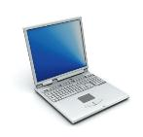
Authentification précédente
Native Authentication
Informatica natively stores all the user account information including users, passwords and groups
When user logs in, authentication is done by Informatica
Informatica Server
Core Services
Application Services
Admin
Logging
PC- IS
CRS
Monitoring
UUM
DIS
MRS
Informatica Client
Domain DB

Slide 7
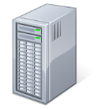
Authentification précédente
LDAP Authentication
LDAP directory stores users, passwords & groups that need access to Informatica
When a user logs in, authentication is done against the associated users in the LDAP directory service
LDAP Directory
Informatica Server
Core Services
Application Services
UUM
Logging
PC- IS
CRS
Monitoring
Admin
DIS
MRS
Informatica Client
Domain DB

Slide 8
Authentification 9.6
Provide Single Sign On (SSO) support for Informatica platform
Support for client machines that leverage Two Factor Authentication (TFA) to SSO into platform
Leverage industry standard authentication to achieve the above

Slide 9

Authentification 9.6: Kerberos
Network authentication protocol that works on the basis of tickets (passwords Not transmitted over the network)
Provides secure authentication between clients/nodes/services even on an insecure network
Requires a trusted third party i.e. Kerberos Server that is integrated with LDAP
Centralized Access control that can be used across applications
Notes:
The name Kerberos is inspired by ‘Cerberus’ – A three headed dog which guards the entrance to hades (underworld).
Kerberos protocol is inspired by this name since it’s core components are also three in number; Authentication Service, Ticket Granting Service & Key Distribution Center (KDC).

Slide 10
Authentification 9.6: Kerberos
Provide SSO support for login to all Informatica clients including PowerCenter, Developer, Analyst, Administrator, Metadata Manager, etc.
Support for client machines that have a TFA solution integrated with Windows Authentication for logging in. Once logged in, SSO into Information is via Kerberos credentials
Industry standard authentication solution for Informatica platform

Slide 11

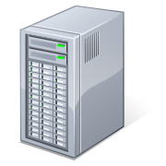



Kerberos avec Informatica - Architecture
KDC
Microsoft
Active Directory
(LDAP,KDC)
AS
TGS
2
Session Key
User Name is sent as a clear text to AS
User Name is looked-up in LDAP and user’s key is retrieved
1
Client Authenticates
with Authentication Service
3
Client - Service authentication with ticket from TGS
1
Authentication Service sends back
Ticket Granting Service (TGS) client session key
Ticket Granting Ticket (TGT)
####
####
####
Server validates the credentials sent by the client
On successful validation
Client – Server Authentication is established
Client requests service ticket from Ticket Granting Service
Service Ticket
1
Ticket Granting Service sends back
Service Ticket
Client to service session key
2
2
TGT
Client sends following to Service for Authentication
Authenticator (client id)
Client Service Ticket
#####
#####
Informatica Domain
Username
Authenticator
#######
#######
Connection Established Successfully
Client Server Ticket
##############
##############
Informatica Client Applications
Notes:
AS : Authentication Server
KDC : key distribution center
TGT : Ticket Granting Services

Slide 12
Upgrade et Compatibilitées
Enabling Kerberos as an authentication mechanism is not part of the 9.6 upgrade process
Can be enabled after upgrade
Kerberos can be chosen as an authentication mechanism during a fresh 9.6 install process
MIT Kerberos 1.11 is supported for 9.6. Only KDC (Key Distribution Center) based on Windows Active Directory is supported.
There is no cross-realm/multi-realm support within 9.6
Support for these will be considered for a future release

Slide 13
Two Factor Authentication
Two Factor Authentication Support
We support clients that have been enabled for TFA and integrated with Windows Authentication Only
Once the user logs into client, SSO into Informatica clients and server is done via Kerberos credentials that are generated from the TFA process
No additional work done by us for this
Customers can choose to use authentication factors supported by Windows Authentication such as
Smart card
USB token
RSA SecureID

Slide 14
Communication sécurisée

Slide 15
Communication sécurisée - Avant 9.6
Domain and communication to mercury services can be secured
No ability to secure communication paths between Domain & Power Center services
Communication with PC services hence open to MITM i.e. ‘man-in-the-middle’ attacks
Secure communication with DB
No ability to enable secure communication between Domain, Repository and associated DB
No INFA certified support for native relational adapters

Slide 16



Communication sécurisée - Avant 9.6 : IDS / IDQ
Analyst Service
Informatica
Analyst
I S P
Model
Repository
Service
Repository
DO Cache
Workflow
Informatica
Developer
Admin
Console
Data Integration Service
Runtime MRS
Profile Service
Mapping Service
SQL EP
WS EP
Secure via JSF (Java Service Framework)
Stats MRS
ODBC
Driver
JDBC
Driver
WS
Client
Profile
Warehouse
Being Secured in 9.6 via C++ SF
All CLI
Notes:
Notes:
CLI denotes infacmd, infasetup, infaservice
Not shown:
Inter-node communication (Secure)
DTM-Adapter communication (varies based on the data source/target)

Slide 17

Communication sécurisée - Avant 9.6 : PWC
WSH Service
WS
Client
I S P
Workflow Manager
Integration Service
Workflow Monitor
Repository Service
Mapping Designer
Admin
Console
Repository
Manager
Repository
Metadata Manager Service
Metadata
Manager
Secure
MM Warehouse
Being Secured in 9.6 via PCSF
PC CLI
infa* CLI
Notes:
Notes:
infa* CLI denotes infacmd, infasetup, infaservice
PC CLI denotes pmcmd, pmrep, mmcmd, LM API SDK
Not Shown:
BW Service
Jaspersoft
DA
Support Console (CSM)
i9Pi (Informatica 9.x pre-install check)
Inter-node communication (Secure)
DTM-Adapter communication (varies based on the data source/target)

Slide 18

Communication sécurisée - 9.6
All communication paths between
domain and PC services
(PCSF & C++SF) can be enabled for secure communication
Connection between Domain, Repository and associated DB/s can be secured via SSL
Enable secure communication among PC Workflow processes
Separate flag due to performance impact
Applicable in multi-node scenario only
Notes:
Includes screen shots for each.

Slide 19
Communication sécurisée - 9.6
Relational Source and Targets
Native connectors for Oracle, DB2 & SQL Server have been certified for SSL (Secure Sockets Layer)
Kerberos can be enabled as an authentication mechanism for Oracle, DB2, SQL Server & Sybase
Entire INFA platform can be secured

Slide 20
Sécurité des outils clients &
Dissimulation des informations sensibles

Slide 21
Sécurité des clients Web
Open Web Application Security Project (OWASP)
Open source non-profit community comprising corporations, educational org’s across the globe
Emerging standards body
Publishes Top 10 critical web application security risks every three years; 2003, 2007, 2010 & 2013
INFA thin Clients (Administrator & Analyst Tool) have been validated against these risks and identified issues fixed within 9.6
Note: Penetration tests from our clients typically also validate against risks from this list
Notes:
We use OWASP as a guideline for fixing vulnerabilities within our thin client – Need to highlight this

Slide 22
OWASP 2013 Top 10 Risks
Sécurité des clients Web
A1 Injection
A2 Broken Authentication and Session Management
A3 Cross-Site Scripting (XSS)
A4 Insecure Direct Object References
A5 Security Misconfiguration
A6 Sensitive Data Exposure
A7 Missing Function Level Access Control
A8 Cross-Site Request Forgery (CSRF)
A9 Using Components with Known Vulnerabilities
A10 Unvalidated Redirects and Forwards

Slide 23
Dissimulation d’informations sensibles PowerCenter/ Console d’administration
Passwords are treated as sensitive within our platform
Several steps taken to protect them within our clients
Stop storing passwords within the client
Not have it sent from the server to client to protect against ‘man in the middle’ attacks
Passwords can still be changed from the client as is the case today

Slide 24
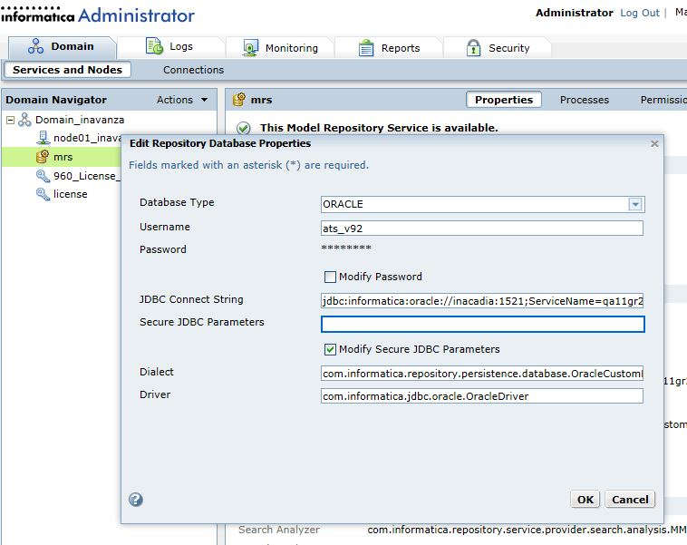
Dissimulation d’informations sensibles PowerCenter/ Console d’administration
Password field with stars (non-editable). Not retrieved from server
Can be modified from client via check-box

Slide 25
Nouvelle clé de chiffrement & Sécurité du file system

Slide 26
Nouvelle clé de chiffrement
New encryption key specific to each INFA server installation will be introduced
Will be used to encrypt sensitive data within the Domain and Repository DB’s i.e. Server environment
Generic key still used for cases where passwords are passed over the network between client and server
E.g. Password being passed form Administrator to Server for a connection object
These can be secured by leveraging Kerberos authentication along with Secure communication
Notes:
Note: Server environment has been secured
Generic key still used for encryption of passwords that travel over the network.

Slide 27
Sécurité du file system
Currently we store files with important data in secure locations within the server. Files include
Nodemeta.xml ($INFA_HOME/isp/config/)
Encryption key ($INFA_HOME/isp/config/secret/)
Keytab files ($INFA_HOME/isp/config/secret/)
Keystore ($INFA_HOME/services/shared/security/)
Access to these files are now protected by OS level security
Only specific users on the server can access (Read) these files
Refer documentation as these vary based on OS used

Slide 28
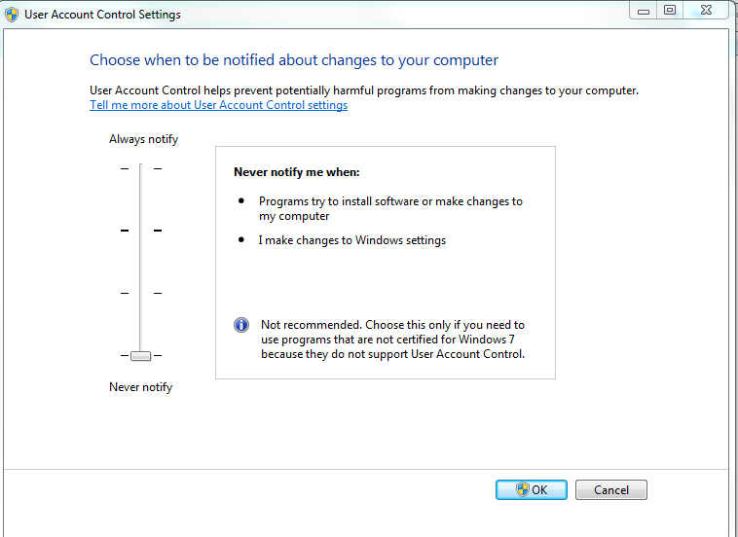
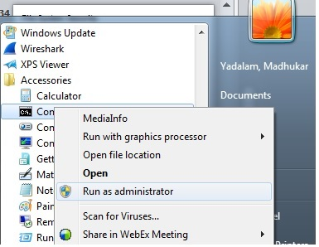
Tips & Tricks
For Windows server, if set to ‘Always Notify’ UAC (user account control) starting infaSetup commands in cmd need to be run as Administrator
infaSetup commands from cmd need to be run as administrator
Custom ‘Always notify’ setting
Default setting

Slide 29
Nouveaux Privilèges d’accès
Analyst & Developer

Slide 30
Nouveaux privilèges 9.6 : Access Analyst and Access Developer
Analyst and Developer tool users will need the Access Analyst and Access Developer privileges respectively to login and access associated MRS instance
These privileges can be assigned at a group, role or user level via the Administrator tool
These are assigned at an MRS instance level

Slide 31
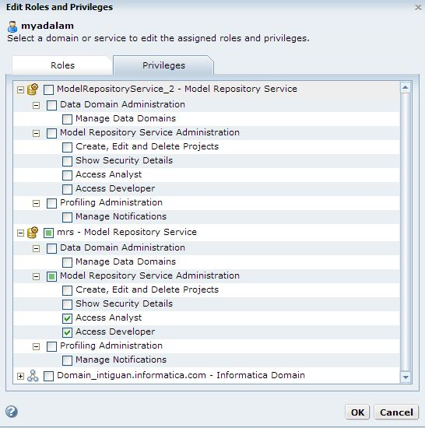
Access Analyst & Access Developer Privileges
User has been assigned Access Analyst, Developer privileges on MRS instance ‘mrs’

Slide 32
Rapports d’audit sur le Domain

Slide 33
Rapports d’audit sur le Domain
Ability to generate Audit reports based on domain data
Reports Available –
List of users and associated information
e.g. user id, name, email, phone
Group association for user/s
Role association for user/s
Privileges associated with user/s
Object Permissions with user/s
Users with Security administration privilege can generate audit reports

Slide 34
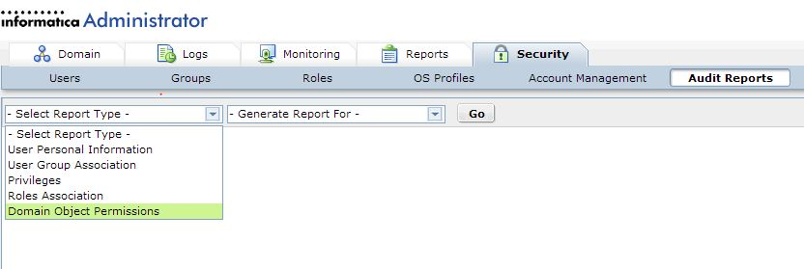
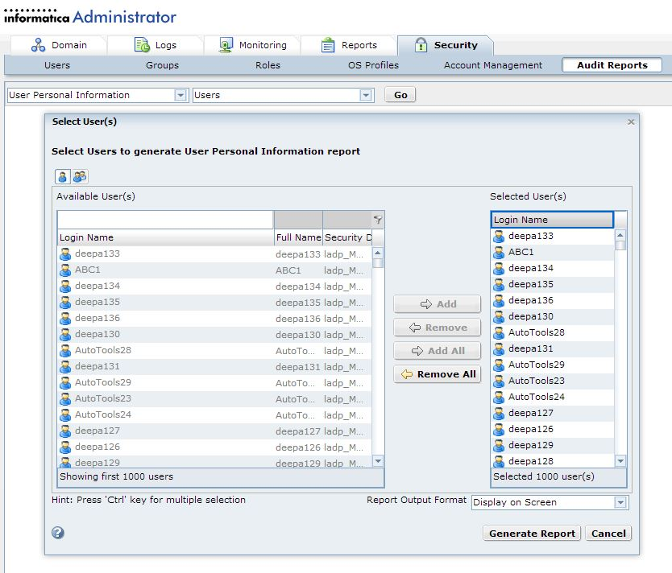
Rapports d’audit sur le Domain
Located within Security Tab
5 types of Audit reports available

Slide 35
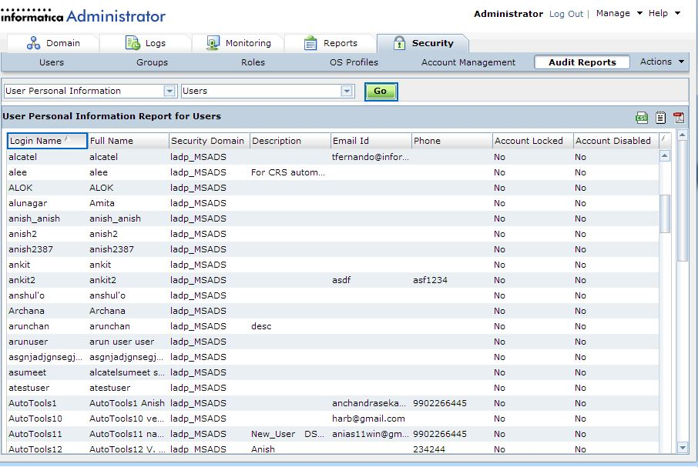
Rapports d’audit sur le Domain
Ability to export to excel, PDF & txt formats
Personal Information report

Slide 36
Verrouillage des comptes administrateurs
&
Groupe d’administrateurs

Slide 37
Verrouillage des comptes administrateurs
Account lockout feature can be enabled for the domain
Administrator account/s can be included as well
Additional option ; not enabled by default with account lockout
Controlled via Administrator tool

Slide 38
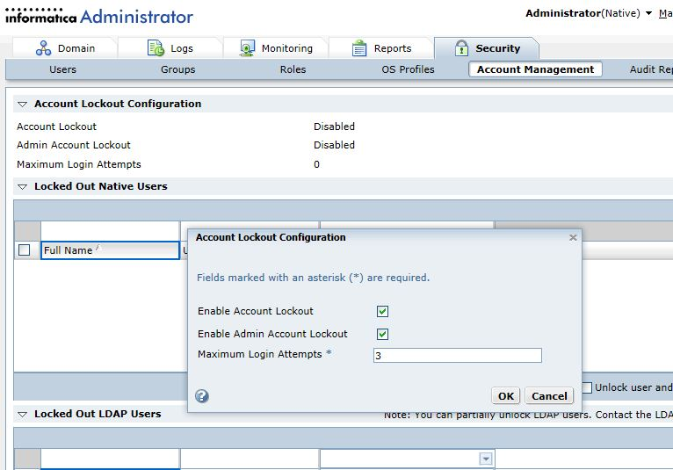
Verrouillage des comptes administrateurs
Master flag to enable Account lockout for domain
Additional flag to enable for Administrator account

Slide 39
Groupe d’administrateurs
We supported only one super user for domain – ‘Administrator’
Administrator has all privileges, permissions, roles and groups automatically applied
With 9.6 we introduce an ‘Administrator’ group with the default Administrator user within it
Additional users can be added to this group
Users added to this group become super users and get all available permissions, privileges, groups and roles available within the domain assigned to them
Only a user who is part of this group can add/remove users from the group

Slide 40
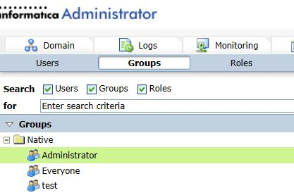
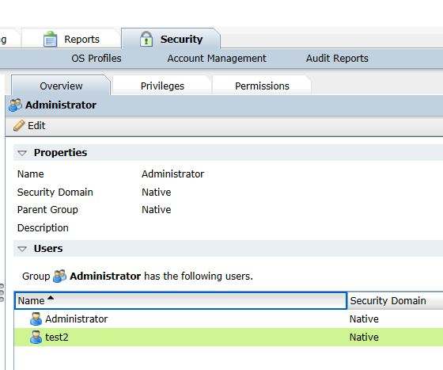
Groupe d’administrateurs
Default ‘Administrator’ group
Can have additional super users

