Slide 1

Pokemon: Panicked Painite
By: Alula A, Aryan S, Darius P, Glenn R, and James J

Slide 2
What is Pokemon?
Overworld
Battle Interface
Pokemon collection
Pokeball item system

Slide 3
Pokemon Team
Battle screen party viewer.jpg goes here

Slide 4
The Overworld
Overworld.jpg goes here

Slide 5
Battle Interface
Battle screen main menu.jpg goes here
Battle screen move select.jpg goes here

Slide 6
Backpack
Inventory.jpg goes here

Slide 7
Demo goes here

Slide 8



Design overview
Tools Used
Tiled for map design
Github and Trello for organization
Languages Used
Primarily Javascript
PHP for database interaction
HTML and CSS for visual elements

Slide 9
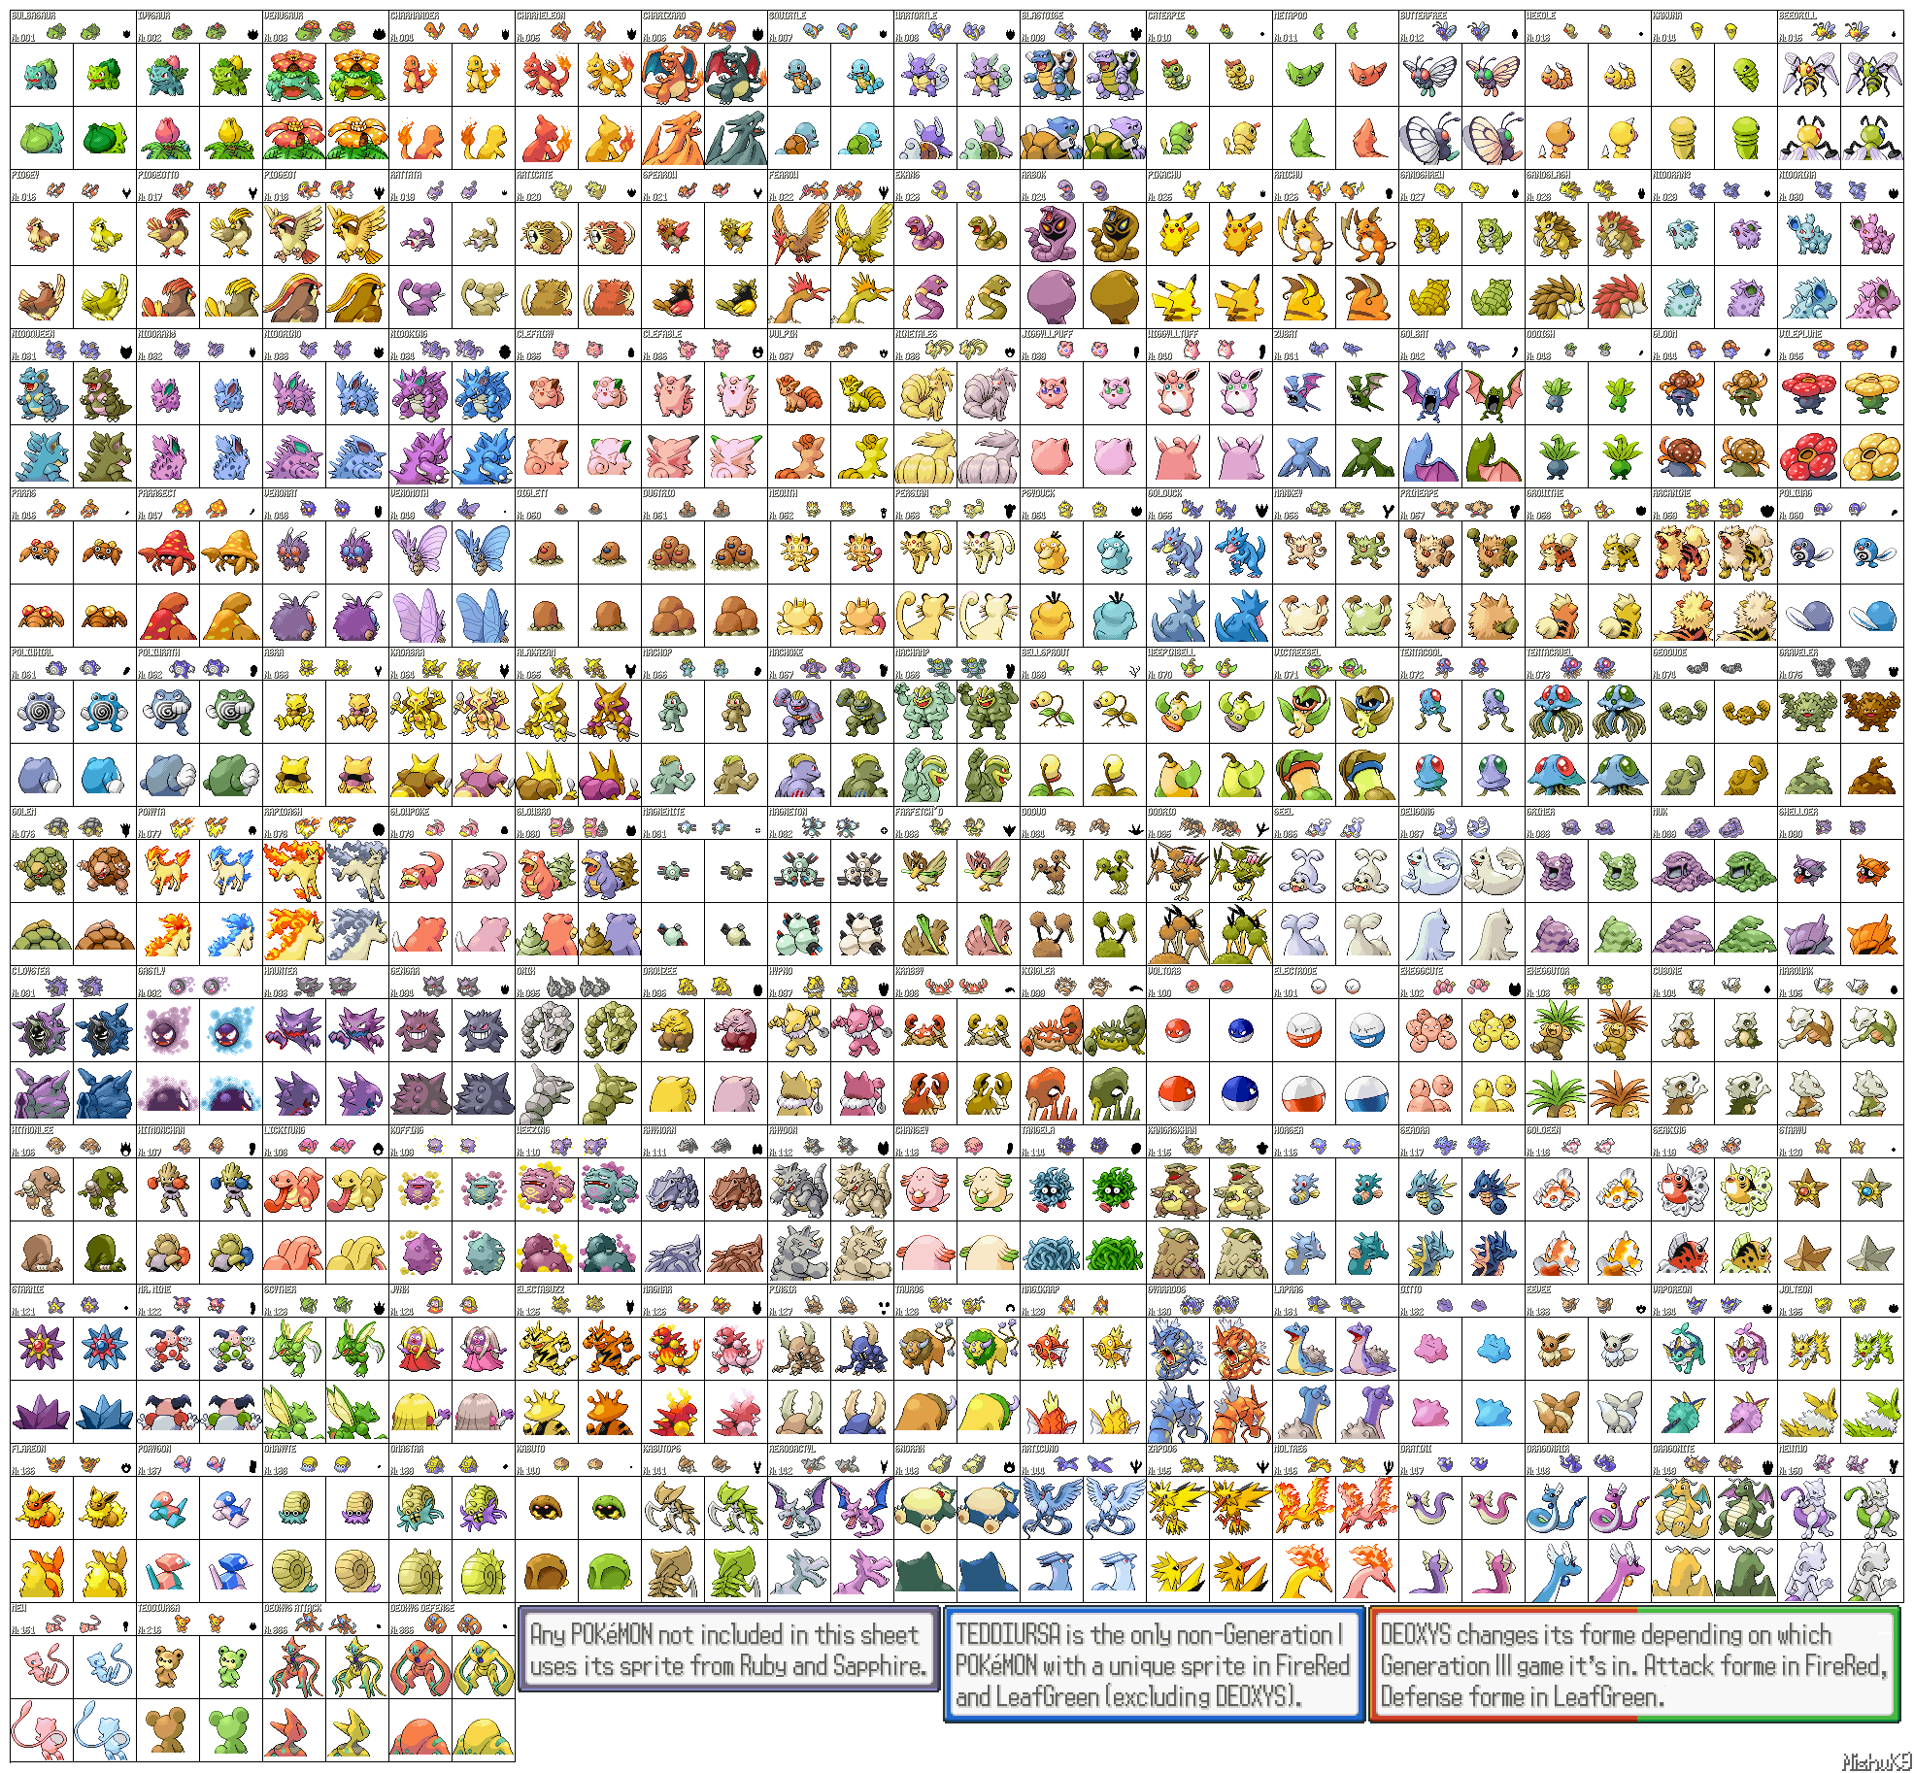
Animation Design
Stored in /img/ file
Pokedex ID value for sprite location

Slide 10
Design decisions
No TM’s
No EV’s
Special Attack used for Special stat
No field moves
Damage prioritization by AI
Narrative reason for changes
Experience using Medium-Fast distribution of level^3 for ease of calculation
Types convert to ints for 2D array crit table

Slide 11
Conclusion
Shortcuts were taken but we did it
Or not, write this before submission
!!!!!!!!!!!!!!!!!!!!!!!!!!!!!!!!!!!!

