Slide 1
Introduction to Databases
Ben Salah Meriam

Slide 2
PLAN
Popular Relational Database Management Systems:MySQL,PostgreSQL and SQL SERVER
What is a Relational Database Management System?
Comparison between the three RDBMS

Slide 3
What is RDBMS ?
RDBMS stands for Relational Databnase Management Systems.
All modern database management systems like SQL,MS SQL Server, IBM DB2,ORACLE, My-SQLand Microsoft Acess are all based on RDBMS.
It’s a program that allows you to create, update, and administer a relational database

Slide 4

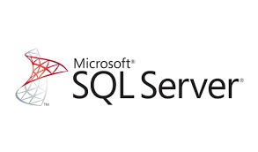

Popular Relational Database Management Systems
SQL syntax may differ slightly depending on which RDBMS you are using. Here are some of popular RDBMSs:

Slide 5
MySQL :
=> Popular open source SQL database , used for web application development, and often accessed using PHP.
Advantages disadvantages
easy to use
Inexpensive
reliable
Have a large community
poor performance when scaling
it does not include some advanced features that developers may be used to.
reliable

Slide 6
PostgreSQL
=>is an open source SQL database that is not controlled by any corporation. It is typically used for web application development.
Advantages disadvantage
It is easy to use
Inexpensive
eliable and has a large community of developers
It also provides some additional features such as foreign key support without requiring complex configuration.
it can be slower in performance than other databases such as MySQL

Slide 7
SQL Server
=>Microsoft owns SQL Server. Like Oracle DB, the code is close sourced. advantages disavantages
Large enterprise applications mostly use SQL Server.
can become very expensive as you scale your application.

