Slide 1
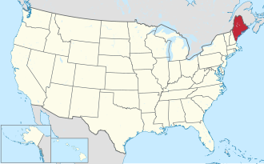
Maine Territory Sales Analysis
ME
Store sales, 2022–2025
Meric Capar
Notes:
Hi everyone, my name is Meric. For my capstone I analyzed the Maine sales territory. I'll go through five SQL questions and finish with my recommendation for next quarter.

Slide 2
Six stores in the smallest Northeast state by sales
ME
Sales Manager | Erbayne Middleton
Region | Northeast
Regional Director | Michael Jarvis
Stores | Bangor, Bar Harbor, Kennebunkport, Lewiston, Orono, South Portland
Data period | Jan 1, 2022 – Dec 31, 2025
The territory
Notes:
My territory is Maine. The sales manager is Erbayne Middleton, and Maine is in the Northeast region together with Maryland, Massachusetts and New Jersey. There are six stores, and the data covers four full years, 2022 to 2025.

Slide 3
Maine stores sold almost $1.9M in four years
Q1
Total revenue and date range
$1,877,249.75
total store revenue
Start date | End date | Stores
2022-01-01 | 2025-12-31 | 6
Notes:
Question 1: total revenue and the date range. Maine stores made 1,877,249 dollars between January 1, 2022 and December 31, 2025.

Slide 4
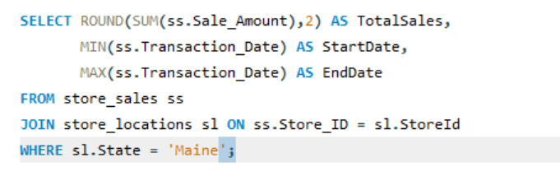

Join sales to store locations, then filter to Maine
Notes:
I joined store_sales to store_locations on the store ID so I could filter by state. SUM gives total revenue, and MIN and MAX give the first and last dates.

Slide 5
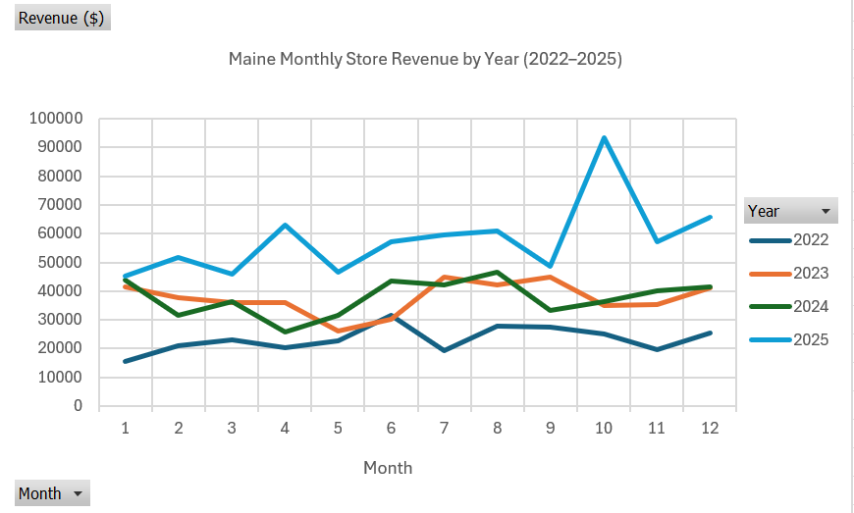
2025 was the best year by far
Q2
Revenue by year and month
Yearly revenue: $279K → $451K → $452K → $695K
Biggest month: October 2025, $93K
Notes:
Question 2: revenue by year and month. Each line is one year, and 2025 in red is above every other year, with the biggest month in October. Revenue went from 279 thousand in 2022 to 695 thousand in 2025.

Slide 6
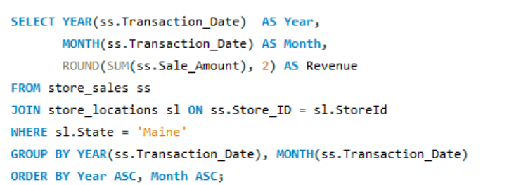
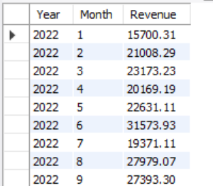
Group every sale by its year and month
Notes:
I used the YEAR and MONTH functions to group sales by month, then exported this result to Excel for the PivotChart.

Slide 7
Second half beat First half every year
Q2
Year | Jan–Jun | Jul–Dec | Best quarter
2022 | $134,256 | $144,819 | Q3
2023 | $207,405 | $243,409 | Q3
2024 | $212,368 | $240,010 | Q3
2025 | $309,521 | $385,461 | Q4
A closer look at the seasons
Q3, the back-to-school season, was the strongest quarter in 3 of 4 years.
Notes:
To check the seasons, I added quarter and half-year columns in Excel. Every year, July to December was stronger than January to June. Q3, which is back-to-school season, was the best quarter in three of four years.

Slide 8
Maine is 7.75% of Northeast sales
Q3
Maine vs. the Northeast region
Ranked 4th of 4 states.
Northeast total: $24.2M
Notes:
Question 3 compares Maine to its region. I used a window function to get each state's share of the Northeast total. Maine is 7.75 percent and ranks fourth. Maryland is almost half of the region.

Slide 9
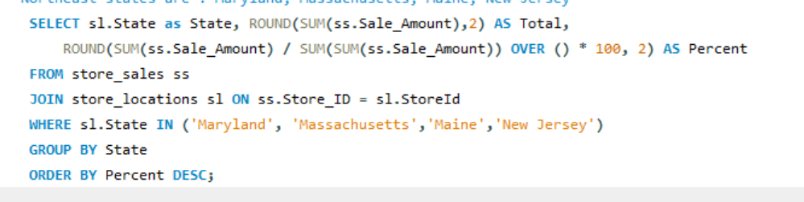
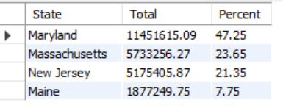
A window function finds each state's share
Notes:
SUM(SUM(...)) OVER () adds up the totals of all four states, so I can divide each state's total by the regional total and get a percentage in one query.

Slide 10
Technology & Accessories leads in both
Q4
Category | Transactions | Avg sale
Technology & Accessories | 2,848 | $477.28
Textbooks | 1,800 | $171.85
Art Supplies | 2,230 | $31.65
Apparel and Merchandise | 2,552 | $31.59
Books (General) | 1,050 | $28.31
Stationery and Supplies | 2,763 | $10.03
Transactions and average sale by category
Notes:
Question 4 looks at transactions and average sale by category. Technology & Accessories has the most transactions and by far the highest average sale, about 477 dollars, because it includes laptops.

Slide 11
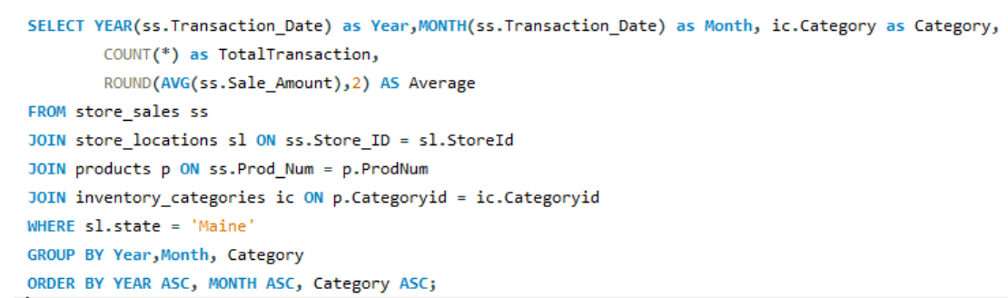
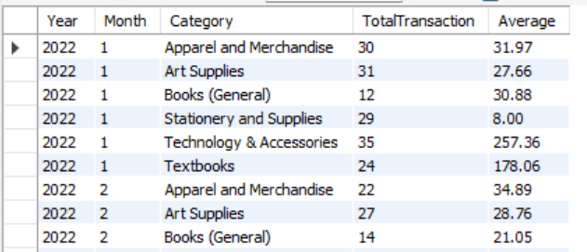
Three joins connect each sale to its product category
Notes:
Sales only have a product number, so I joined products and then inventory_categories to get the category name. COUNT gives the number of transactions and AVG gives the average sale.

Slide 12
South Portland leads, but all six stores are close
Q5
Store ranking
Notes:
Question 5 ranks the six stores. South Portland is first and Bar Harbor is last, but they are close. Orono, a college town, is a very close second.

Slide 13
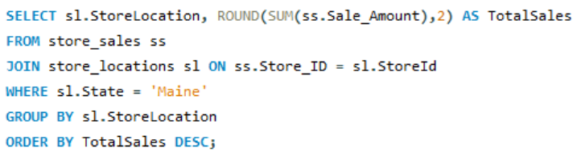
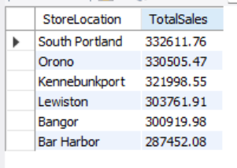
Group by store and sort from highest to lowest
Notes:
I grouped by store location and sorted by total sales in descending order to rank the six stores.

Slide 14
Three findings
Q6
01
South Portland is the top store, while Bar Harbor has the lowest sales.This is likely because South Portland is part of the Portland area, the largestmetro area in Maine, while Bar Harbor is a small town on an island with a muchsmaller population.
What the data says
02
In every year from 2022 to 2025, sales in the second half of the year(July–December) were higher than in the first half (January–June). Q3 was thestrongest quarter in 3 of 4 years, likely because it matches the back-to-schoolseason in August and September, when students buy books, supplies and technology.Q1 was the lowest quarter overall, likely because it is the slow period rightafter the holiday shopping season. Sales also grew strongly over time, with big jumps in 2023 (+62%) and 2025 (+54%).
03
Technology & Accessories has the highest average transaction amount,mainly because it includes high-priced items like laptops and tablets, comparedto lower-priced categories like stationery.
Notes:
Here are my three findings. South Portland is the strongest store. The second half of the year is always stronger, and Q1 is the weakest quarter. And Technology & Accessories brings the most value per sale.

Slide 15
RECOMMENDATION FOR Q1 2026
Use the slower first half of the year to prepare for the stronger second half, especially back-to-school in Q3.
Plan
Stock
Show up
Plan marketing campaigns and advertising for the peak months now.
Make sure South Portland has enough Technology & Accessories stock.
Show up when customers already spend the most, for the biggest revenue gain.
Notes:
My recommendation for Q1 2026: use the slower first half of the year to prepare for the stronger second half. Plan campaigns and ads early, make sure South Portland has enough Technology & Accessories stock, and be visible when customers already spend the most.

Slide 16
Thank you
ME
Questions?
capar_sales_analysis.sql · capar_territory_chart.xlsx
Notes:
Thank you for watching. My SQL file and Excel chart are in my GitHub repo.

