Slide 1
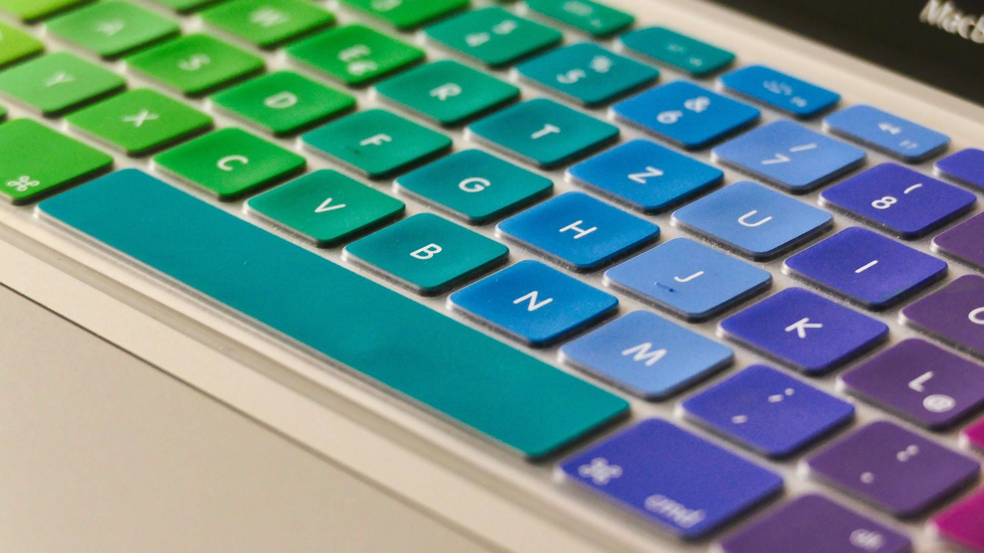
Actions and Devices
Crescent Jicol

Slide 2



From Human Actions to Computer Input
Actions – human articulation of input.
Input devices – from user action to computer input.
Controls – what does input control.
Control-Display Relationships– how input is coupled with output.
Modes – when there are more tasks than controls.

Slide 3
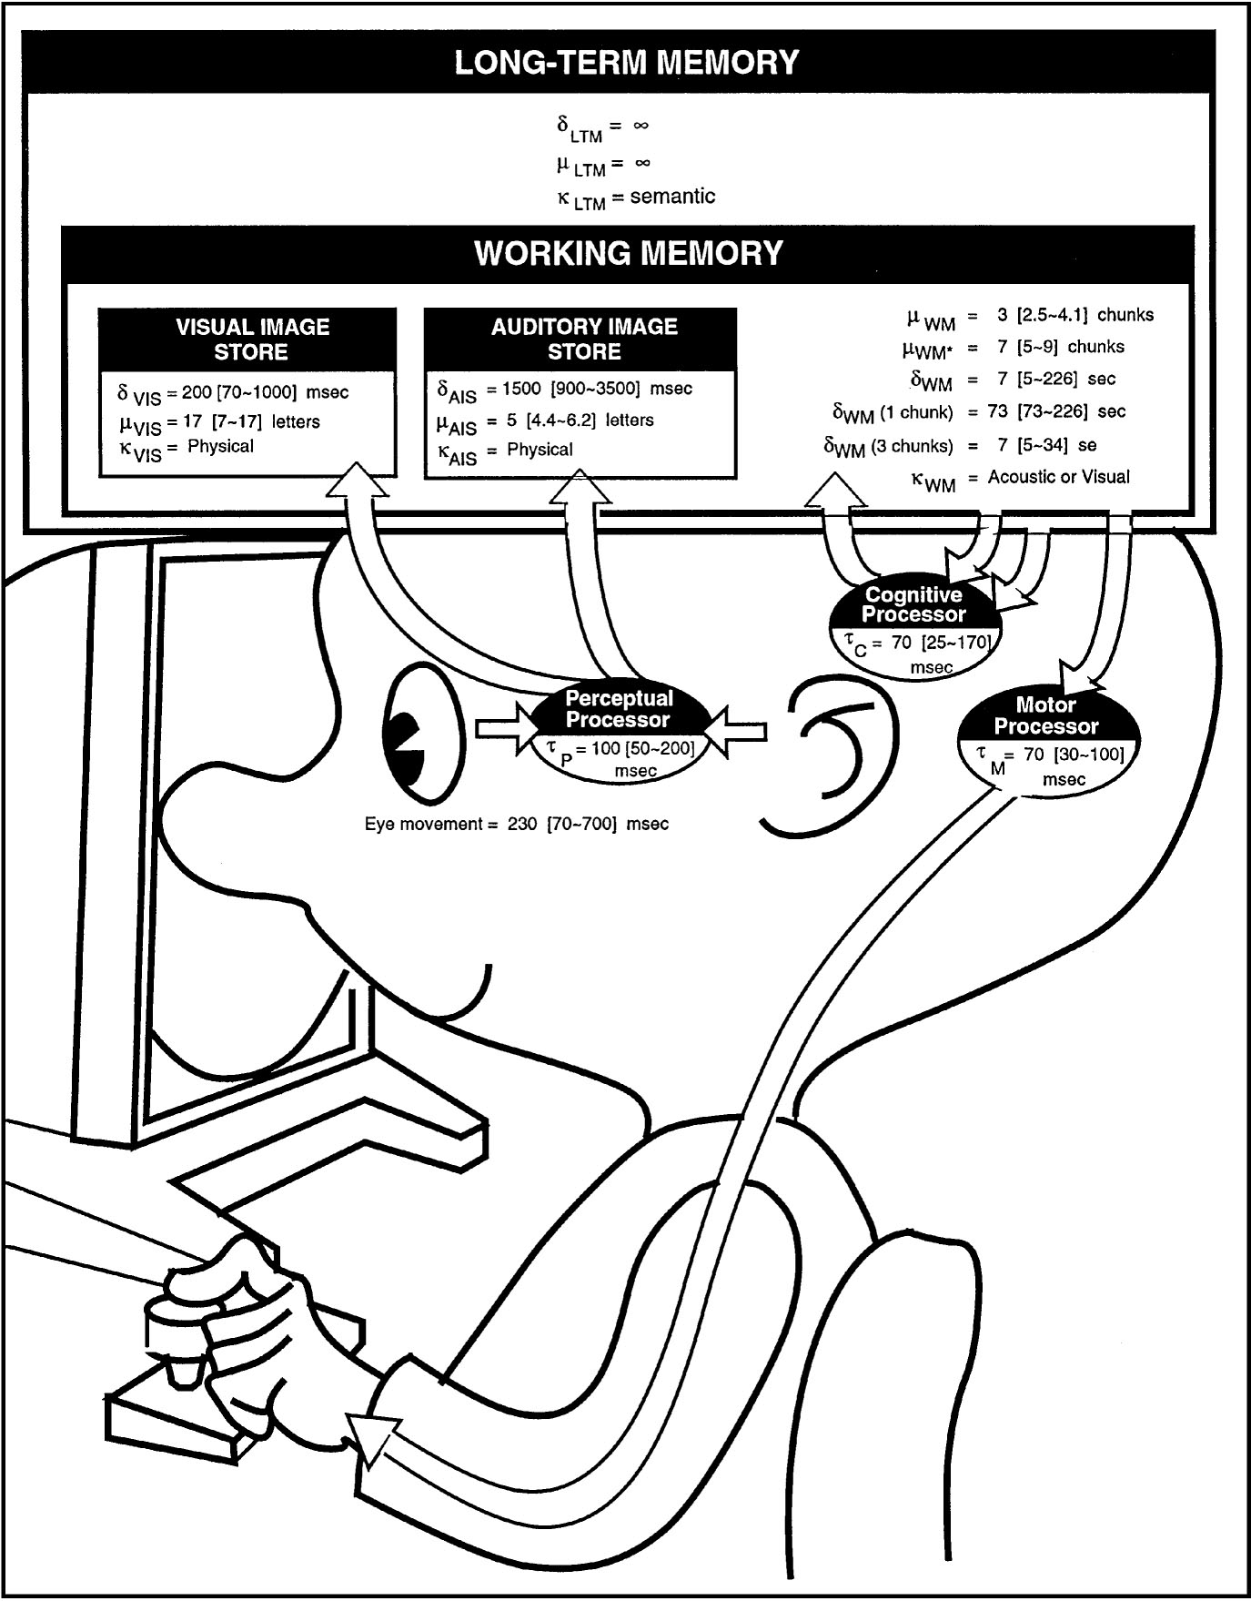
People as an “Information Processor”
Model Human Processor (MHP)
  Card, Moran & Newell, 1983
Cognitive model of the user as a computer
Three processors
  Perceptual
  Cognitive
  Motor
Hierarchical memory
  Working memory
  Long-term memory
This week

Slide 4
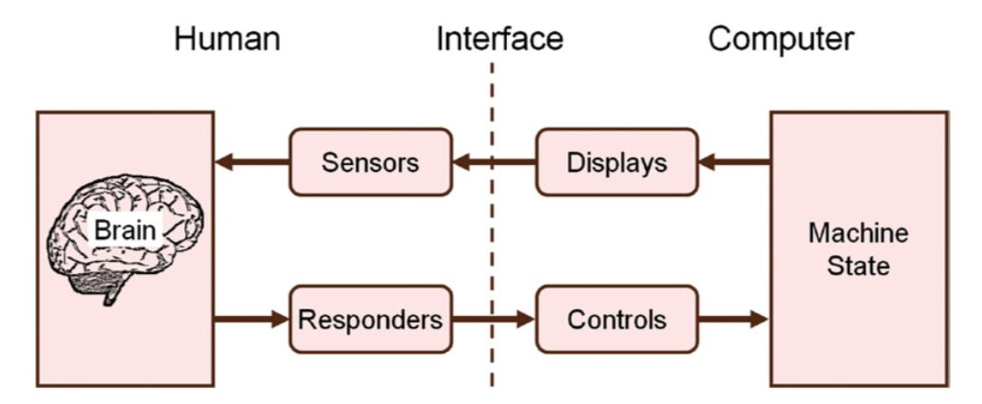
Human Factors Model of Interaction
Source: S. Mackenzie, Human-Computer Interaction
Human factors view of people working with computers:
  Sensors: vision, hearing, tactile.
  Responders: limbs (fingers, hands, arms, feet), head, face, voice, eyes.

Slide 5

Actions

Slide 6
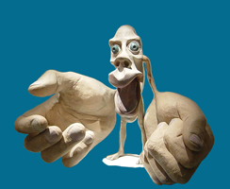
Manual Input Actions
Fingers – most HCI is “fingers to screen”:
  Discrete – type on keyboard, click buttons, tap touchscreen.
  Continuous – dragging, drawing.
  Gestures – flicking, pinching.
Hands
  Moving mouse.
  Move/tilt device in 3D.
  Freehand gestures.
Consider: handedness, reach.
Motor homunculus: a representation of the amount of the brain dedicated to processing motor actions in different parts of the body.

Slide 7
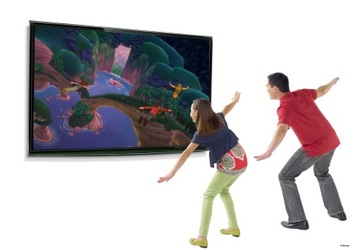
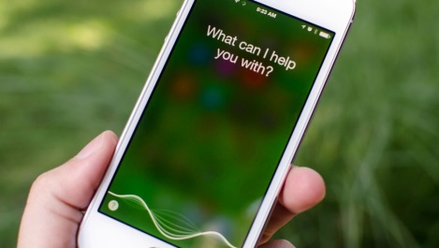
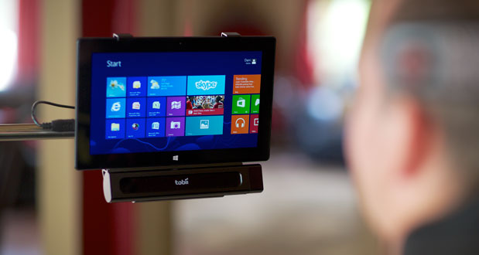
Many Other User Actions Possible ...
Feet – pedals, foot mouse.
Head – pointing.
Voice – commands, language.
Body – gestures, proxemics (relative distance and orientation).
Face – facial expression, action units (facial coding system).
Eyes – pointing, dwelling.

Slide 8
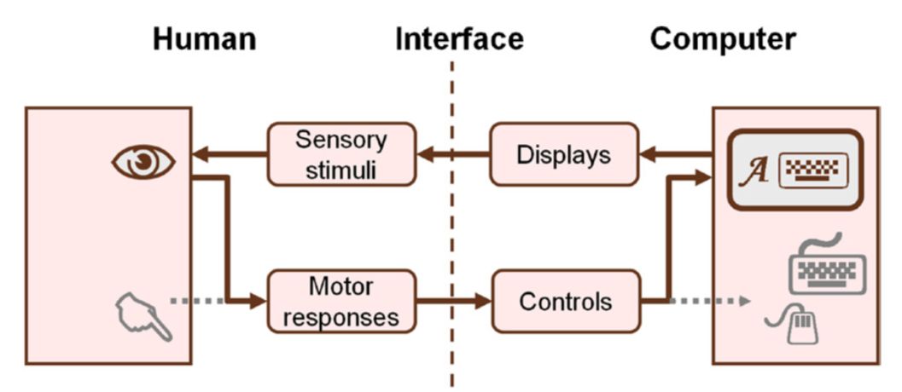
Eyes are an Interesting Case
The eyes can serve double duty:
  Active sensor – foveal and peripheral vision.
  Voluntary motor control – “what you look at is what you get”.

Slide 9

Input Devices

Slide 10

Input Devices
What’s involved in translating user action to computer input?

Slide 11
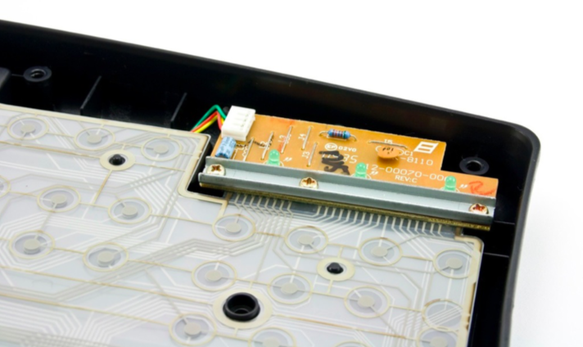
Keyboard Encoder
Key cap
Separating layer (with hole)
Top conductive layer
Equivalent Switch
Bottom conductive layer
Diagram: S. Klemmer

Slide 12
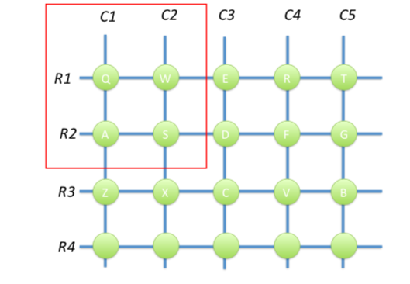
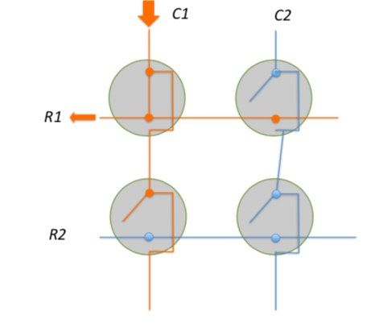
Keyboard Encoder
Source: S. Klemmer
Row/column scanning
Keys (scan codes) != characters
  Special keys, duplicated keys

Slide 13
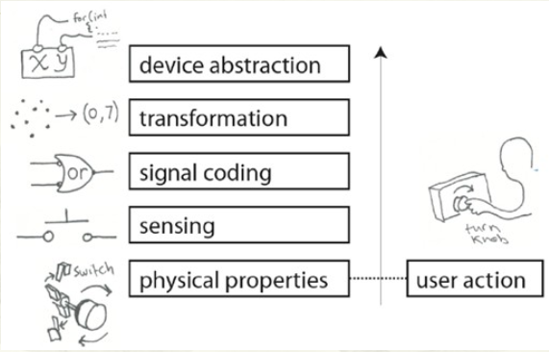
Layered Model of Input
Source: Hartmann, Follmer, Klemmer: Input Devices are Like Onions

Slide 14
Keyboard
Keyboard
Keyboard
Characters
G
Scan codes
59h 34h F0h 59h F0h F12
Switches
B7a2 b1a6
Keys
SHIFT g
Source: Hartmann, Follmer, Klemmer: Input Devices are Like Onions

Slide 15
Mouse
Move, double-click, etc
Screen cursor position
Quadrature Encoding
Rotary Encoder
Move x,y
Source: Hartmann, Follmer, Klemmer: Input Devices are Like Onions
Trackpad (and other mouse alternatives): same device abstraction but different sensing and encoding.

Slide 16
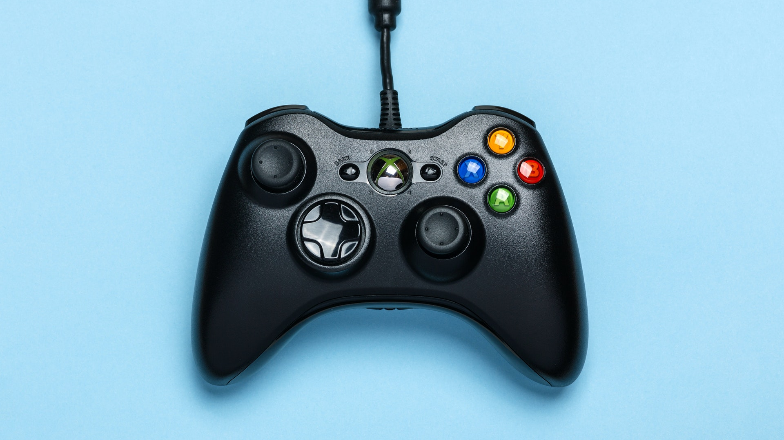
Controls and Control-Display Relationships

Slide 17

Controls

Slide 18

What does the input control?
How does the UI know what to do with the input?
How is it matched to a control?
Semantic matching:
  Pre-defined semantics of the input.
  e.g. pre-defined mapping of a button or key to a function.
  Command line input, gestures, voice commands.
Spatial matching:
  Position input.
  Matching to control based on position.
  e.g. mouse selection of objects and commands.

Slide 19
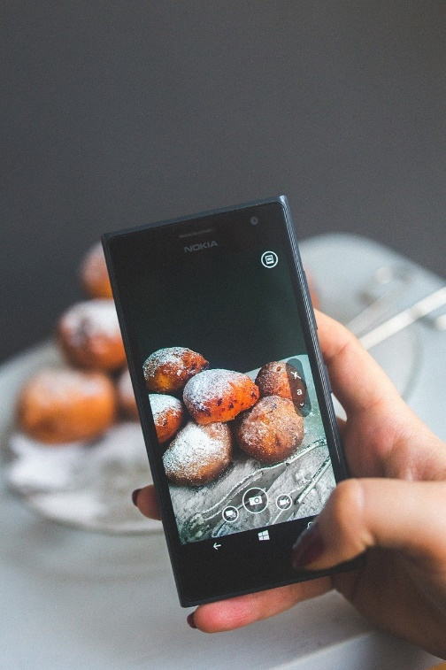
Hard Controls vs. Soft Controls
Hard controls – keys, keyboards, mouse, buttons, scroll wheel, knobs, joystick, arrays of switches, trackpad, etc.
Soft controls – any other UI element that handles input.
Distinction between control and display becomes blurred:
  Touchscreen is a hard control and a display.
  Most soft controls are rendered as widgets.
  Many widgets not only render controls visible but display state.
Each soft control is manipulated by a hard control:
  Click, double-click, drag; tap, double tap, flick, pinch etc.

Slide 20
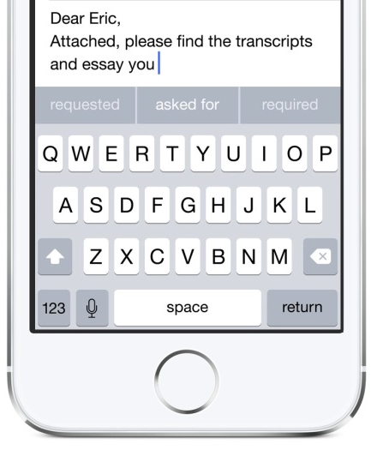
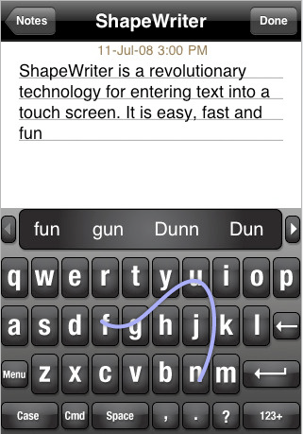
Soft/Virtual Keyboards
Same device abstraction as a ‘hard’ keyboard.
Different ergonomics of user action:
  Lack of tactile feedback.
  Resting of hands significantly compromised.
Different sensing:
  Discrete taps.
  Gestural input (e.g. ShapeWriter).
More malleable: different languages etc.
Less efficient: 45 WPM (hard keyboard: 80+).

Slide 21
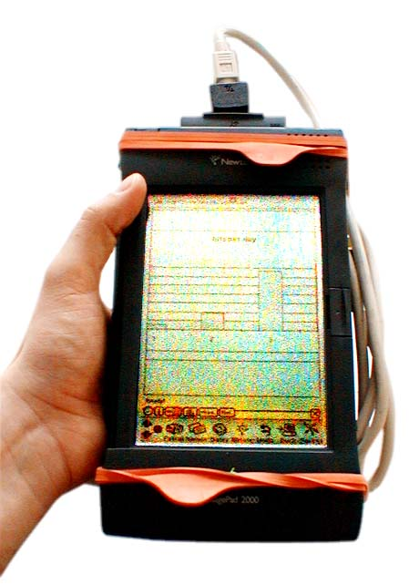
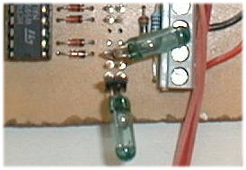
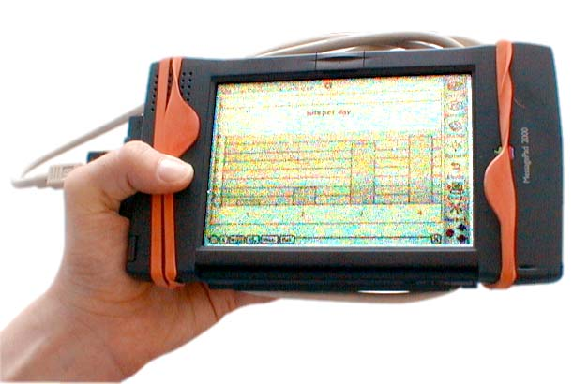
Explicit Control / Implicit Control
Explicit control – deliberate control or input action.
Implicit control – other user actions interpreted as input.
“Interaction dissolving in behaviour”
  e.g. orientation-aware display.
  Implicit: removes cognitive effort IF the control is robust.
A. Schmidt, M. Beigl, H. Gellersen. There is more to context than location. Computers and Graphics, 23(6):893--901, 1999.

Slide 22

Control-Display Relationships

Slide 23
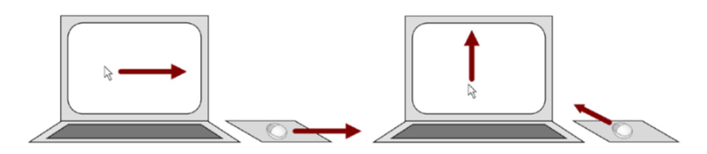
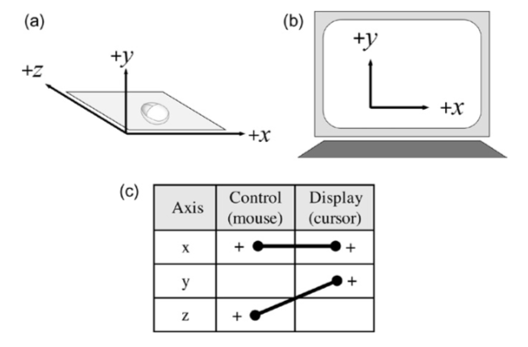
Control-Display Relationships – Spatial
Mouse-cursor mapping:
  (a) control space.
  (b) display space.
  (c) control-display mapping.
Transformed spatial mapping.
Source: S. Mackenzie, Human-Computer Interaction

Slide 24
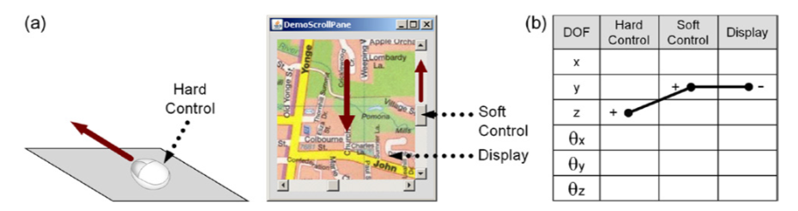
Control-Display Relationships – Spatial
Source: S. Mackenzie, Human-Computer Interaction
Example of three-tier spatial relationship
  (a) Mouse motion forward → slider control up → map view down
  (b) note +/- reversal in mapping
What if the slider-view mapping was reversed? Would that be OK?

Slide 25
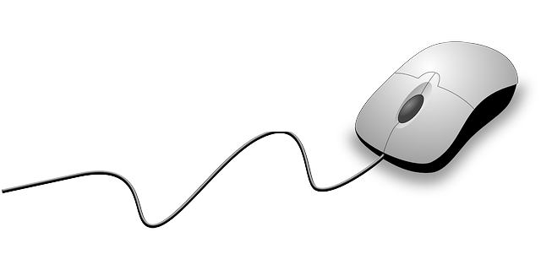
Control-Display Relationships - Gain
CD gain is a scale factor when mapping the control to the display.
Ratio of display movement to control movement, often in terms of input device velocity:
The relationship is often non-linear and uses a transfer function
  If mouse moves quickly, CD gain increases.
  If mouse moves slowly, CD gain decreases.

Slide 26
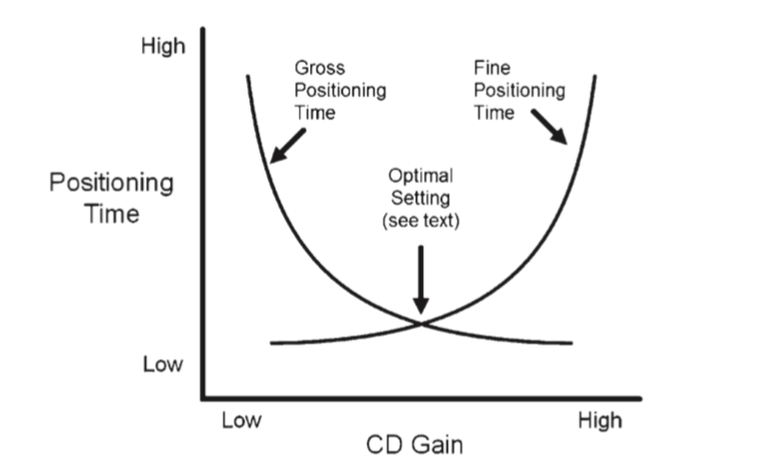
CD Gain: Speed-Accuracy Trade-off
Source: S. Mackenzie, Human-Computer Interaction

Slide 27
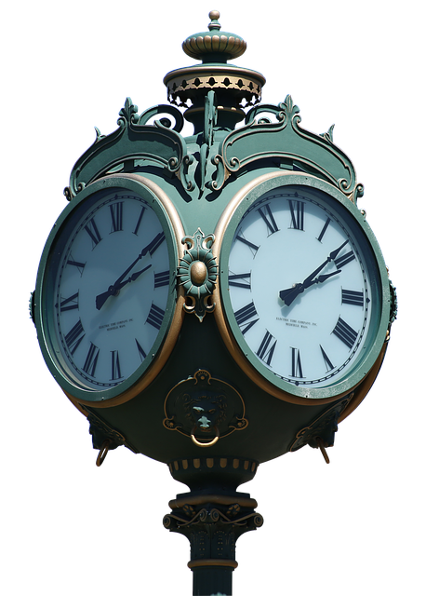
Control-Display Relationships – Latency
Latency (or lag) is the delay between an input action and the corresponding response.
  Properties of input/output devices: sampling rate, display frame rate.
  Software overhead: computation, communication.
Perception of cause-effect relationship requires response in 0.1 sec:
  E.g. render button as pressed within 100ms (does not mean the function has to be completed in that time).
  Display busy indicators within 100ms.
Perception of pen-ink lag time?

Slide 28
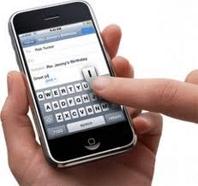
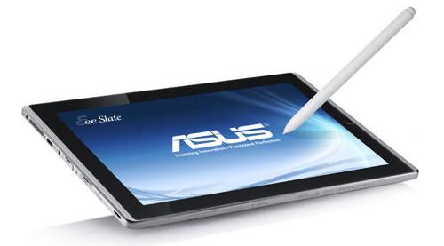
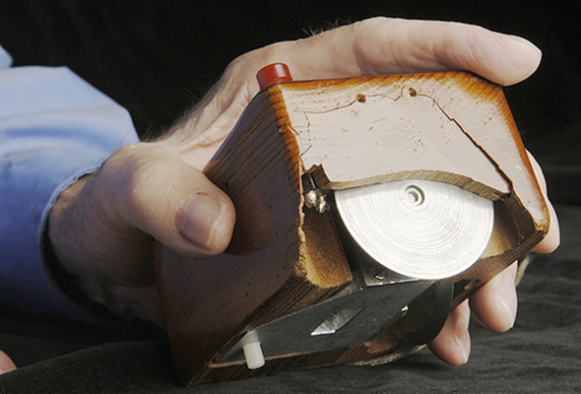
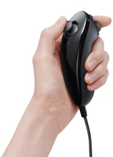
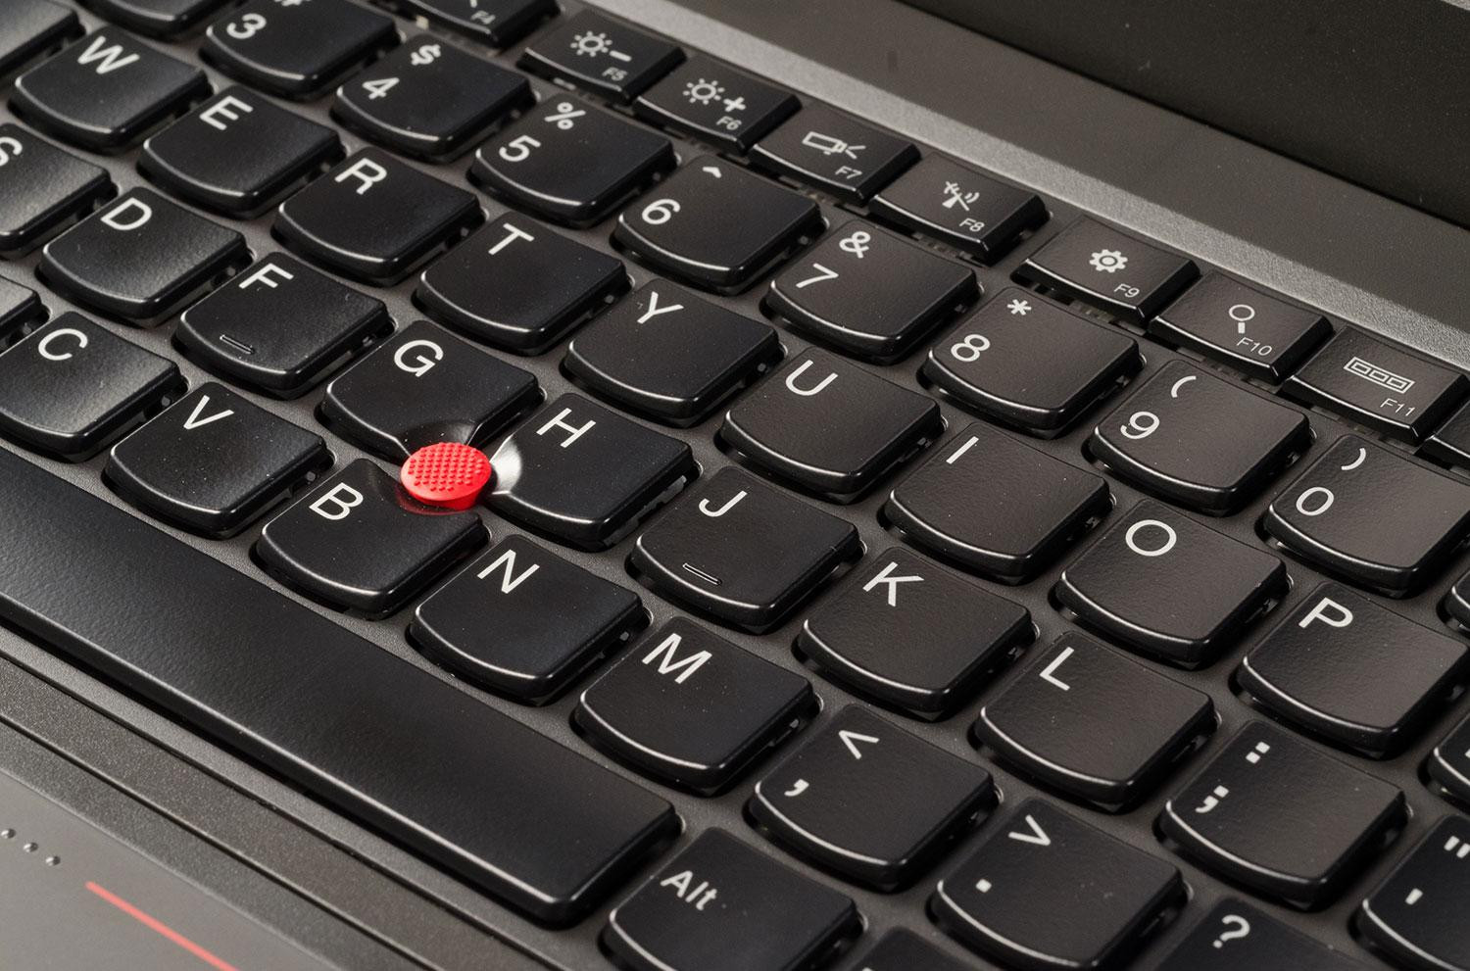
Control-Display Relationships – Properties Sensed
Position: absolute coordinate.
  e.g. touchscreen input.
Displacement: amount of movement relative to the last sample.
  e.g. mouse, trackpad, isotonic joystick.
Force: amount of force applied.
  e.g. isometric joystick.

Slide 29
Control Display Relationships – Properties Controlled
Properties controlled:
  Position
  Velocity / rate
Preferred mappings / transfer function:
  Displacement sensing (isotonic) -> position control
  Force sensing (isometric) -> rate control

Slide 30
Control Display Relationships – Properties Controlled
Sensing | Property sensed | Transfer function | Order of Control | Example
Displacement | Isotonic – no resistance | Position control | Zero-order: position
Force | Isometric – no motion | Rate control | First-order: velocity (rate control) | Pointing stick: harder to learn, but avoids clutching.

Slide 31
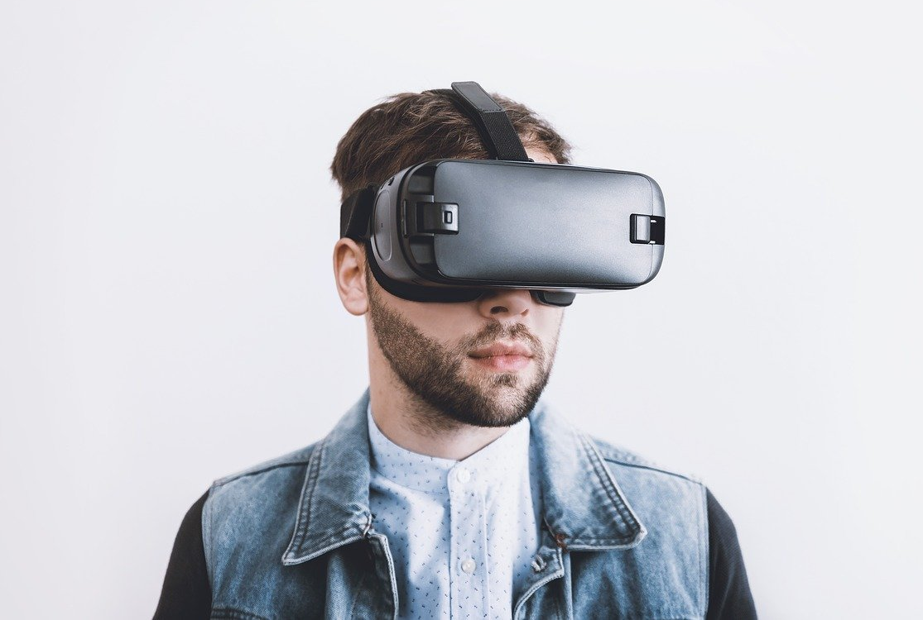
VR Headset – Isotonic? Isometric?

Slide 32
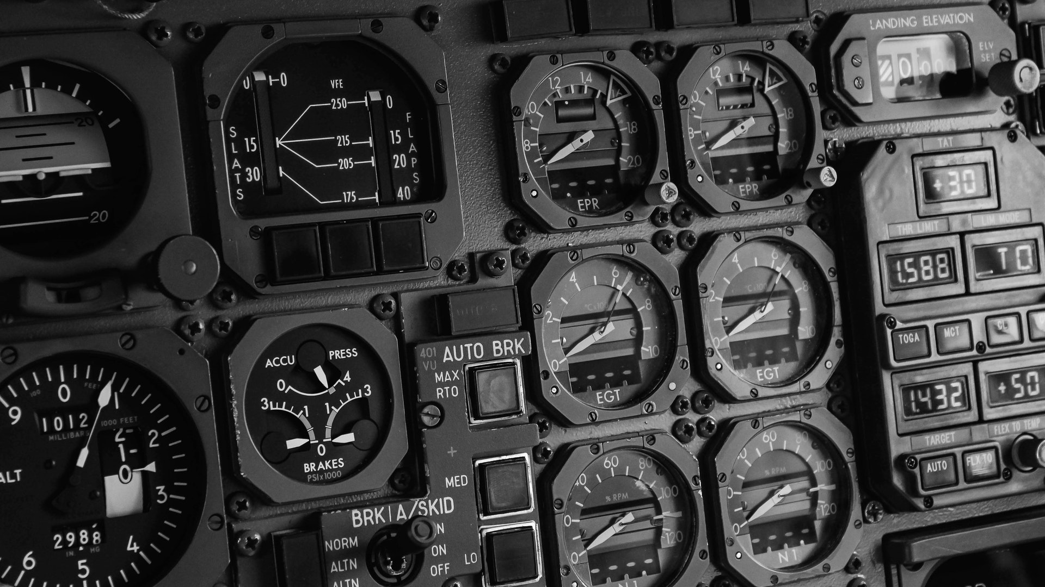
Modes

Slide 33
Modes
Modes in a UI mean that the same user action can have different effects, depending on what mode the system is in.
Modes solve the problem of supporting more functions/tasks than there are controls.
Examples:
  Keyboard keys have modes, e.g. CAPS LOCK.
  Shutter button in camera app.
  View / modify (editing) modes.

Slide 34
Mode Errors
Common problem in HCI.
Forgetting which mode a system is in:
  Not resetting to default mode after a goal is accomplished.
  Not noticing that a system returned to a default mode.
Confusion over modes:
  Feedback on system state is too subtle.
  Feedback based on different display mode.
Try to avoid modes; if you must use them make modes and their transitions obvious.

Slide 35
Mode Error Example
Air Inter Flight 148, 20 Jan, 1992. Crashed into mountains in Germany.
Pilot set descent rate – he thought it was 3.3° (3.3 on the display) for a gentle descent.
Instead, it had been set to 3,300 feet per minute (33 on the display).
Pilot read ‘3.3’ as angle of descent rather than vertical speed.
A320 used a single display for two different descent modes - Vertical Speed (VS) Mode and Flight Path Angle (FPA) mode.
FPA shown as two digits separated by a decimal point (3.3) and VS as just two digits (33).
https://blog.martindoms.com/2011/01/24/poor-ui-design-can-kill

Slide 36
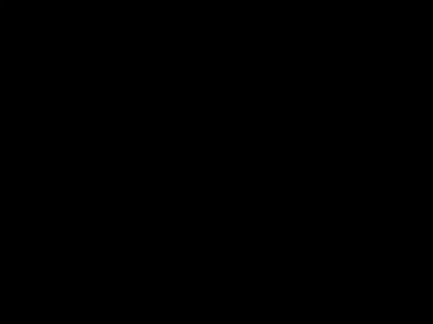
Mode Error Example: Problems with a Syringe Pump
Problems with a Syringe Pump. H. Thimbleby. https://www.youtube.com/watch?v=brNbDWnHDVs

Slide 37
Problems with a Syringe Pump
The pump has a time-out that changes the data entry mode – without telling the user.
What assumptions does this make about user action?
  How long do actions take?
  What’s reasonable to assume?
How can we model time it takes?

