Slide 1
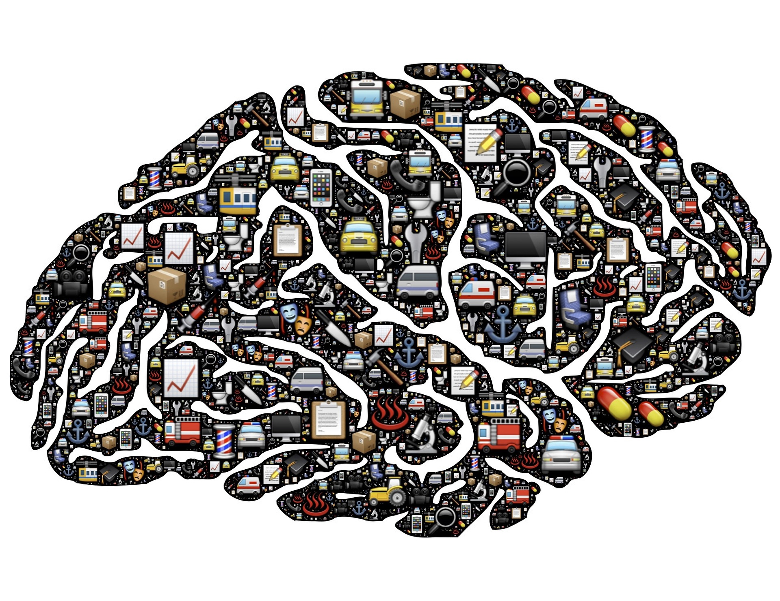
Learning and Mental Models

Slide 2

Lecture Structure
Introduction to human cognition and learning
  Gulf of execution
  Gulf of evaluation
  UI affordances
Memory and Attention
  Types of memory
    Characteristics
  Recognition and recall

Slide 3
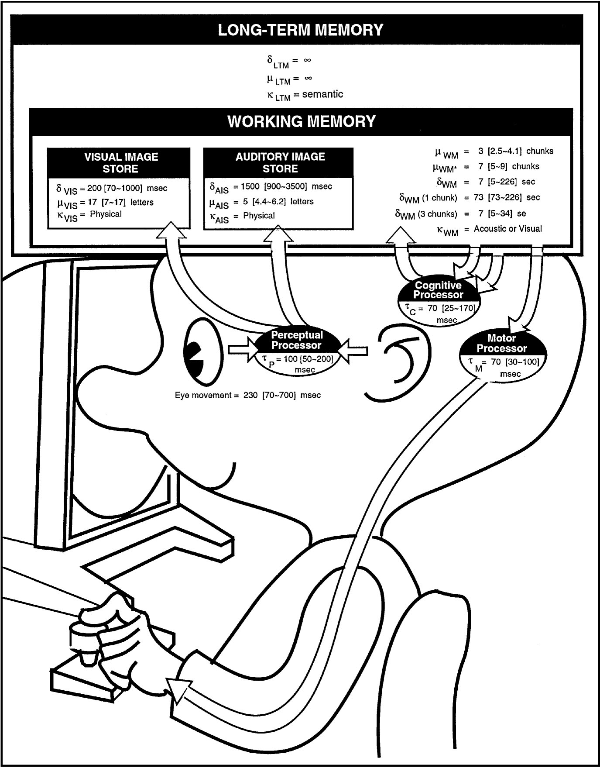
People as “Information Processors”
Model Human Processor (MHP)
  Card, Moran & Newell, 1983.
Cognitive model of the user as a computer.
Three processors:
  Perceptual.
  Cognitive.
  Motor.
Hierarchical memory:
  Working memory.
  Long-term memory.
Last week
This week

Slide 4

People are “Learning Machines”
We have many interfaces to interact with the world:
  Sensing, perception, action, language.
  Some interfaces are innate, but most are learned.
We form models of the world, use these models to interact with the world, and refine models based on experience.
  Our most profound ability – learning.
Interaction with computers and user interfaces is no different:
  Only, there is nothing natural.
  User interfaces have to be learned.
  Users build models of how they work – mental models.

Slide 5
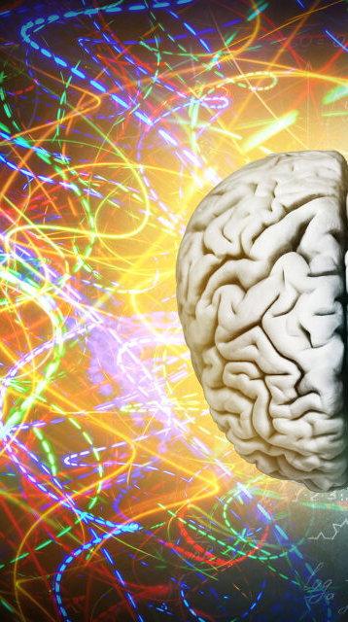
Human Cognition
Cognition – in essence anything we do with our brain.
For HCI, it’s good to know about:
  Learning and mental models:
    “Gulfs” in understanding between the human and the computer.
    User interface design concepts for bridging them.
  Memory and attention:
    Limitations of human memory and implications for design.
  Patterns of how we work on goals, and process information
    Design principles and patterns that follow.

Slide 6
Example – Voice Assistant
Think back to first time you used a
voice assistant on your phone.
What did you try to achieve with it? (what was your goal?)
What did you have to say?
What concepts did you have to learn?
How did you find out what to do?
Someone or something had to teach you what actions are possible

Slide 7
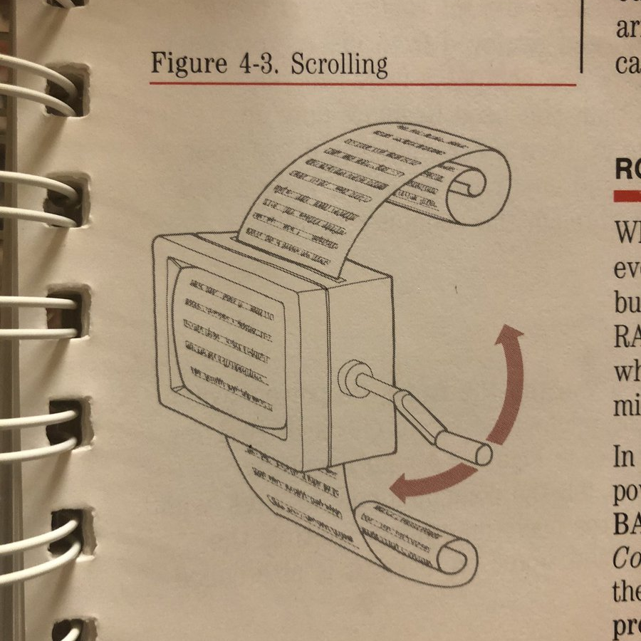
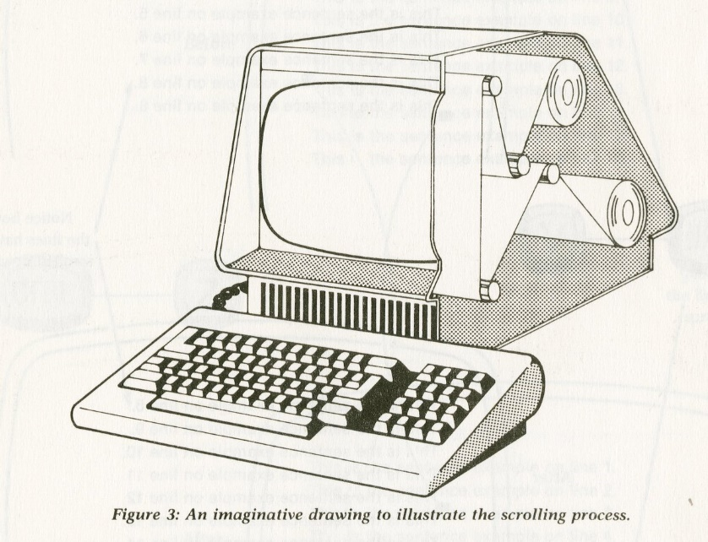
Example – Learning How To Scroll
How would you explain the concept of scrolling to someone who had never used a computer or phone?
From the Apple IIe manual (1983)

Slide 8
Gulf of Execution
Learning is at the heart of user interfaces
One central learning problem is the “gulf of execution”.
Gap between a user’s goal and knowing what actions to take.
Don Norman, “Design of Everyday Things”.
How can user interfaces help bridge the gulf?
GOAL
How do I work this?
What can
I do?
Gulf of Execution
SYSTEM

Slide 9
Affordances
Affordances are actions made possible by an object.
Users bridge the gulf of execution by learning affordances.
Affordances are a central concern in user interface design:
  Actions made possible by the user interface.
  Aspects of the UI that convey, support or enable possible actions.

Slide 10
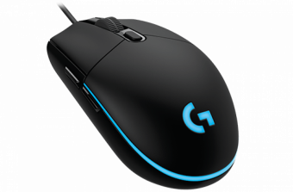
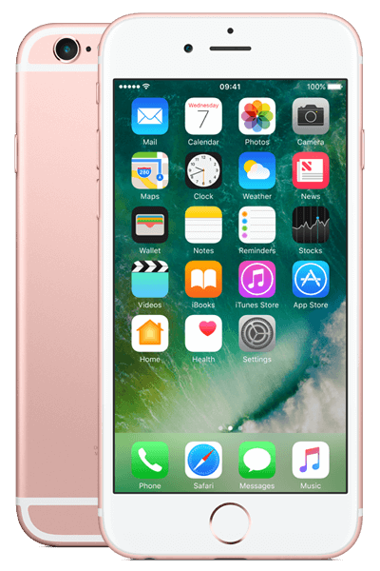
Affordances in the UI
Cognitive affordances
  Aspects of a UI that support thinking about possible actions.
  e.g. labels of buttons conveying what action clicking would trigger.
Physical affordances
  Aspects of a UI that support physical action.
  e.g. mouse with buttons and scroll wheel.
  No guarantee that anything useful will happen.
  But act as a conduit for communication.
What are the physical affordances of iPhone?

Slide 11
Affordances in the UI
Functional affordances:
  Aspects of a UI that actually respond to input to affect some outcome.
    e.g. clicking a mouse button (physical affordance).
    … within the boundaries of a ‘add to cart’ icon (cognitive affordance).
    … will add the item to your cart (functional affordance).
Sensory affordances
  Aspects of a UI that help the user sense cognitive and physical affordances.
  e.g. highlighting actions that are available.

Slide 12
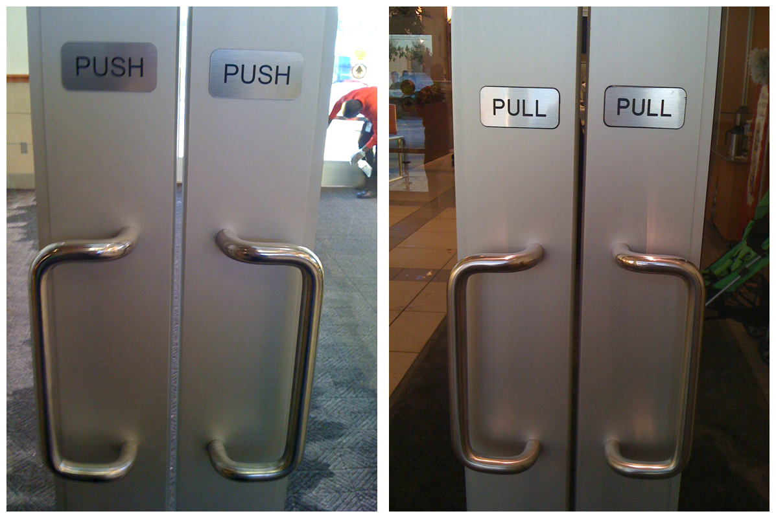
Watch out for Broken Affordances …

Slide 13
Gulf of Evaluation
GOAL
Affordances help with execution …
But there is also a “Gulf of evaluation”
After a user takes action, how do they know whether it is what they wanted?
UIs need to provide feedback to explain what effect their action had.
How do I work this?
What can
I do?
What happened?
Is this what
I wanted?
Gulf of Execution
Gulf of Evaluation
SYSTEM

Slide 14
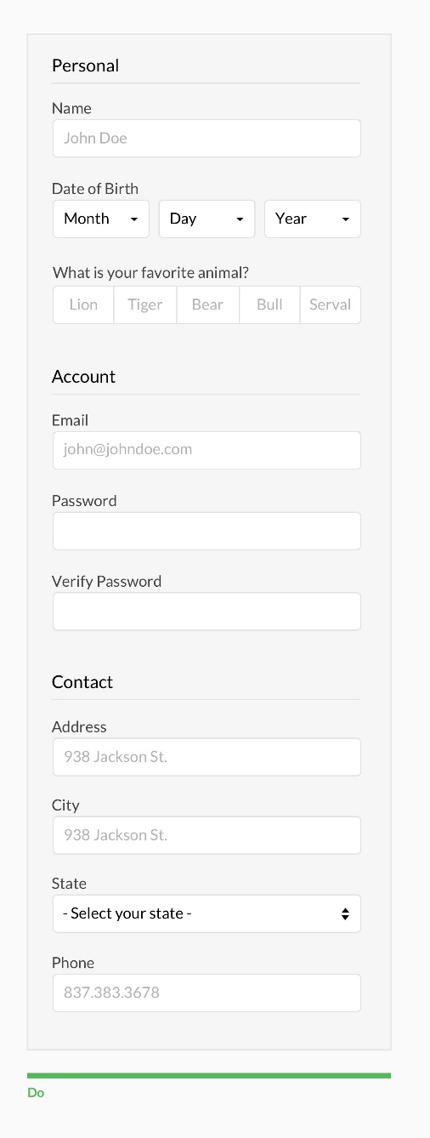
Designing “intuitive” UIs
To bridge the gulfs of execution and evaluation, users need to learn all of the affordances, and learn to understand all of the feedback.
  Perhaps somebody can teach them, or they read tutorials ….
Many designers instead strive to make UIs “self-explanatory”.
What that means is to design UIs so they do all the teaching:
  Design affordances that can be learned quickly
    e.g., by leveraging conventions – UI patterns that people already learned from using other software.
  Design feedback that teaches the user what functional affordances exist, and what their effects are.
    i.e. feedback that gives explicit instruction on outcome of an action and possible courses of action now available

Slide 15
Mental Models
The result of all that learning is a mental model in the user’s head:
  What actions/inputs are possible? What outputs do they result in?
  How inputs and outputs relate to various goals the user could have.
Mental models are
rarely perfect.
If the UI is not a very
good teacher, this can
lead to mistakes and
frustration.
Source: Amy Ko, https://faculty.washington.edu/ajko/books/uist/theory.html

Slide 16

Memory and Attention

Slide 17
Cognitive Model of the User
Model Human Processor (MHP)
  Card, Moran & Newell, 1983.
Cognitive model of the user as a computer.
Three processors:
  Perceptual.
  Cognitive.
  Motor.
Hierarchical memory:
  Working memory.
  Long-term memory.

Slide 18

Memory and Attention
When we learn something, how is it stored?
How do we access it?
Memory: “Means by which we retain, retrieve and use information after the original is no longer present”.
Attention: Selection mechanism by which we concentrate our awareness on particular information in our memory and/or our environment.

Slide 19
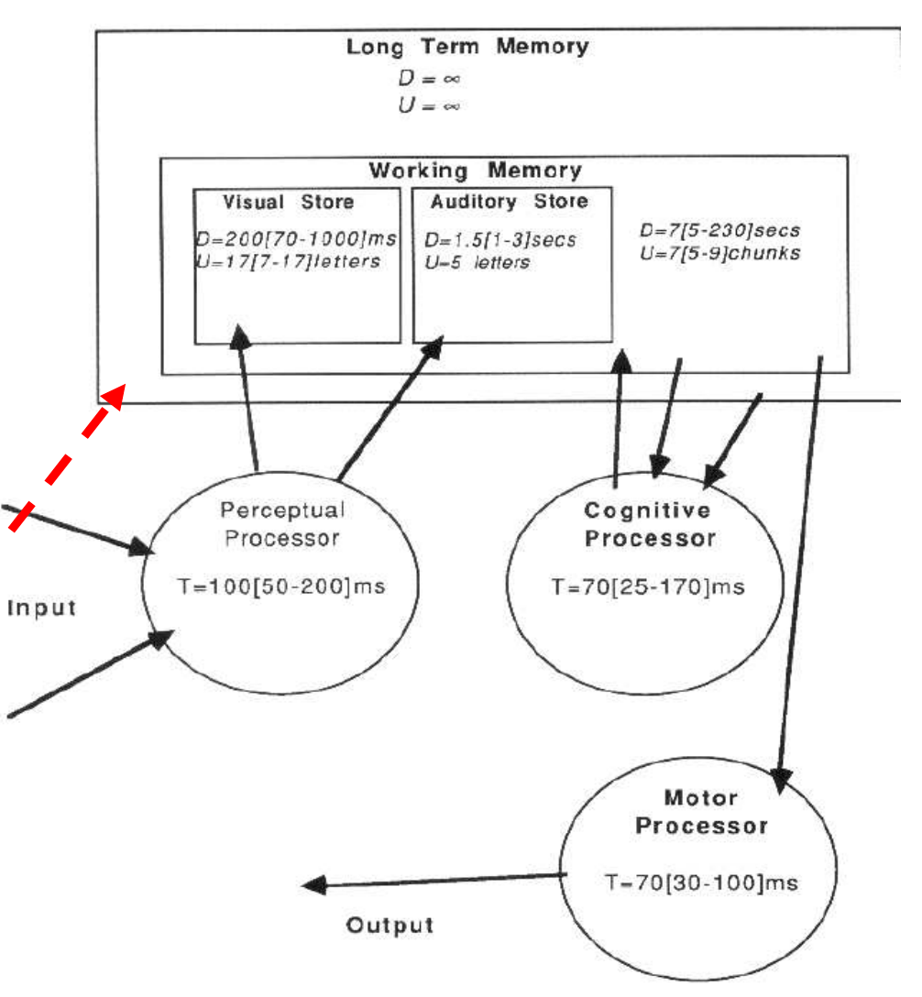
Memory in the Model Human Processor
Memory characterized by:
  Storage capacity, U.
  Decay Time, D.
Sensory memory
  Like an input buffer.
Working memory (short-term)
  Like a cache, keep few items for short time.
Long-term memory
  Unbounded.

Slide 20
Multi-Store Model (Atkinson & Shiffrin, 1968)
One of many attempts to describe how our memory works.
Rehearsal
Incoming Information
Transfer
Sensory Memory
Attention
Short-term Memory
Long-term Memory
Retrieval
Displacement (Decay)
Displacement (Decay)

Slide 21
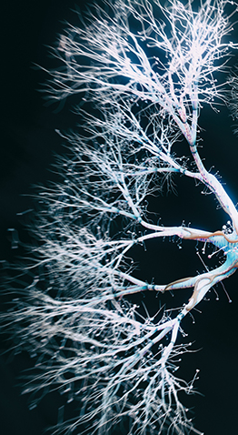
Memory Formation and Activation
Memory is formed when the brain responds to perceptions with neural activation:
  Starting in areas associated with different senses.
  Spreading to other areas, combining features and
  triggering associations, depending on context.
Memory reactivation
  Can be caused by similar perception (“recognition”),
  or by other brain activity that triggers it (“recall”).
  Strengthens the memory (“rehearsal”).

Slide 22
Short-Term and Long-Term Memory
Short-term memory (STM) is virtual:
  Tiny subset of information that’s already stored (LTR) just coming in (perceptions).
  Selected by attention, i.e. concentration on specific facet.
  Available to work with (STM is also called working memory).
Long-term memory (LTM) is a store:
  Nearly everything we have experienced is stored in LTM (doesn’t mean we can retrieve everything).

Slide 23
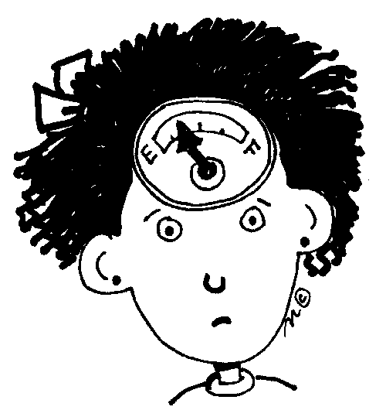
STM has Limited Capacity
We can only hold a small number of unrelated items simultaneously in working memory.
  Goals, numbers, words, dates, …
The magical number “seven, plus or minus two” (Miller, 1956)
  Later research suggests capacity is more like “four plus minus one”.
  Depends also on how different items are (overlapping features).
  Chunking, e.g. to remember phone numbers.

Slide 24

STM is Highly Volatile
Information can easily be lost
  Displaced when we focus our attention on something else.
  Distractions that break our concentration.
  Mind-wandering.

Slide 25
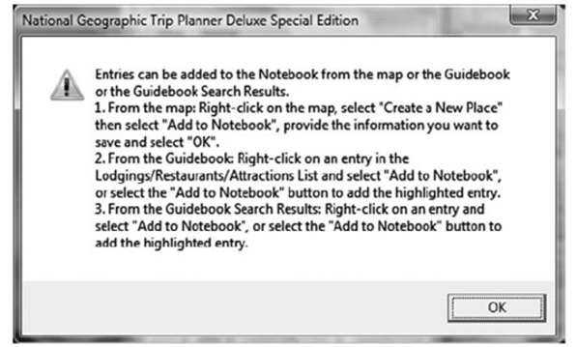
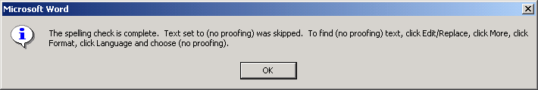
UI Example: Mission Impossible Instructions
Instructions that go away too soon.
We can’t keep multi-step instructions in our head.
Good interfaces allow people to refer to the instructions while executing them step by step.

Slide 26
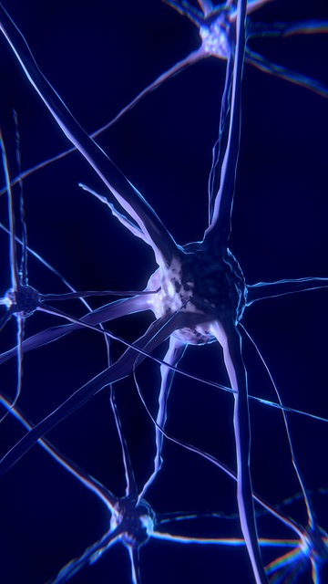
Characteristics of LTM
Long-term memory is not perfect either.
Memories are not accurate high-resolution recordings but encode experiences with more or less detail.
Features associated with an experience may not all be reinforced in the same way, e.g.
  Learning how to use a specific system operation.
  But “forgetting” through which menu it can be accessed.
Impressionist, weighted by emotion, and retroactively alterable.

Slide 27

Retrieval from Memory
Activation of a memory so we can use it in working memory.
Recognition:
  Triggered by a new perception that is similar to something that has been previously stored.
  Encountering something and remembering what it is.
  Affected by context – what we expect to encounter.
Recall:
  Retrieval triggered by other brain activity.
  Memory “look up” assisted by cues and associations (categories, imagery, semantic links).

Slide 28
Recognition is Easy, Recall is Hard
Recognition:
  Perception and long-term memory working together.
  Assessing situations quickly.
  For example, recognising faces in a fraction of a second:
    Reactivation of a pattern rather than search of LTM.
Recall:
  Reactivating a stored memory pattern without similar perceptual input.
  We can recall memories from other areas of the brain but the coordination and timing required makes that much harder.

Slide 29
Summary: Learning and Mental Models
User interfaces bridge between human goals and the functions defined in software.
To use interfaces successfully, people must learn their affordances and how they map onto goals.
This learning must come from somewhere, either instruction by people or documentation or instruction by the user interface itself.
Most user interfaces have large gulfs of execution and evaluation, requiring substantial learning.
The mental models people develop are rarely perfect, and UIs must anticipate and handle errors.

Slide 30
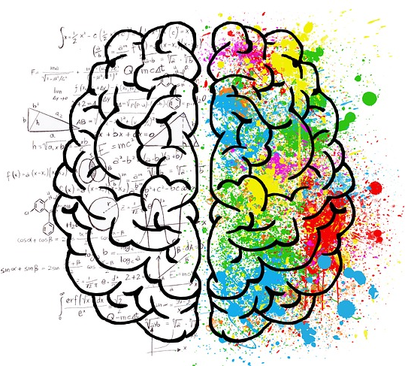
Summary: Memory and Attention
Demand of a UI on cognitive resources – attention and memory.
Minimize cognitive load in UI design: “Don’t Make Think”
Have the system remember, not the user.
Anticipate what users need in working memory and make it visible – anything you can see is like an extension to working memory.
Support recognition when possible – show options, icons, thumbnails.

Slide 31


