Slide 1

Attentive Processing and Pre-Attentive Features
Crescent Jicol
Jason Alexander

Slide 2
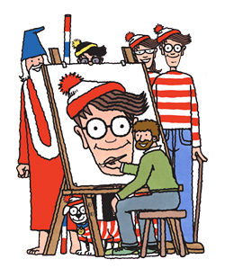
How do we find information?
In principle, a complex task:
  Do we need to look at all objects in the scene/image?
  Then recognize each attended object?
  Finally evaluate set of recognized objects against our goals?
For example, Where’s Wally?

Slide 3
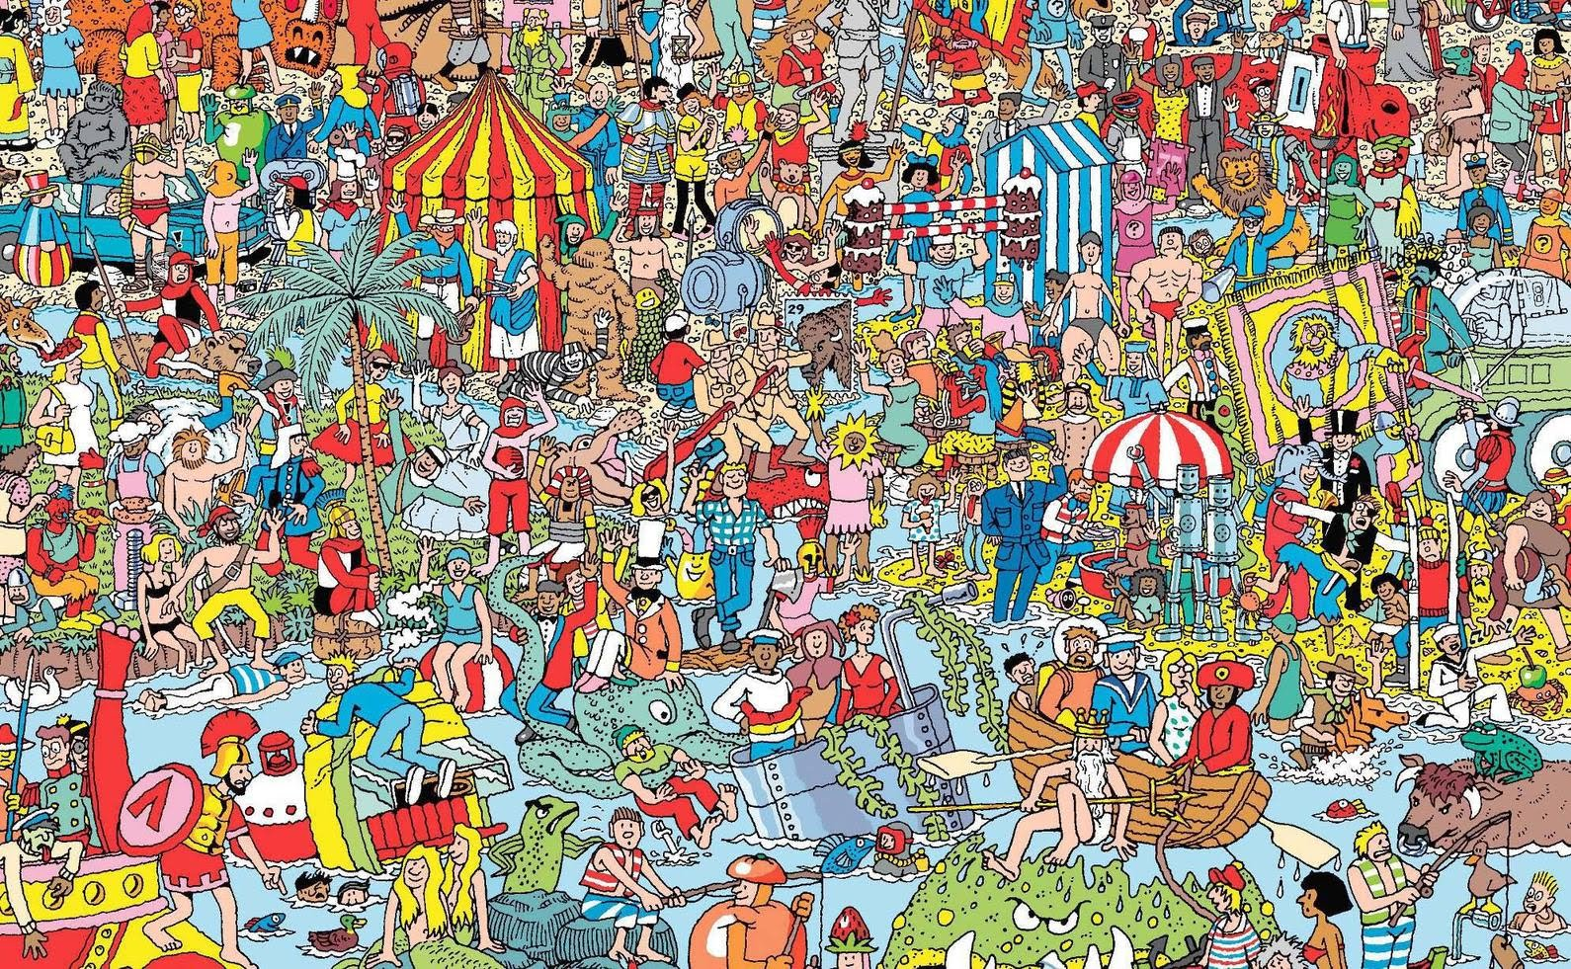

Slide 4
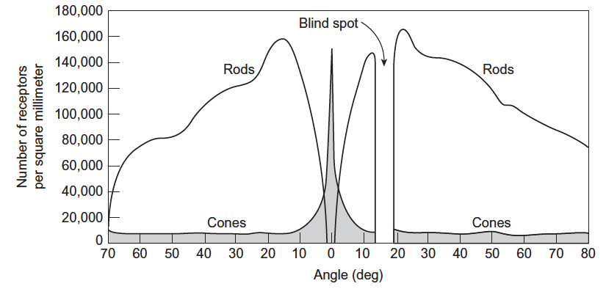
How do we find Information?
Each eye has approx. 6 million cone cells – much more tightly packed in the centre (the fovea).
Way too much information to process ...
foveal vision solves the problem.
Concentrate visual processing in a small area to extract detail:
  Fovea covers 1% of visual field, but collects 50% of the visual data.
  Move the eyes to align with object of interest for sufficient time (fixation, ~200ms).
In parallel, process the wider visual field for cues:
  Massive parallel sensing, but at low resolution.

Slide 5

Foveal vs. Peripheral Vision

Slide 6
Foveal vs. Peripheral Vision
Foveal vision: responsible for most ‘active’ sight functions, e.g. reading, driving, recognising shapes – anything detail oriented.
Peripheral vision: processes spatial information and part of our ‘fight or flight’ instincts.

Slide 7

Structure Helps to Direct our Foveal Vision …

Slide 8




UI Blur Test – Test for Good Structure
Don’t make the user think!
Is it possible to understand the structure or intent of your UI/screen/content when it’s blurred?
Choice
Success/Failure
Importance
Structure
https://uxdesign.cc/the-blurry-eye-test-1bd12bc6c3f8

Slide 9
Recap: How do we find Information?
Using peripheral vision:
  Looking for low-resolution cues to guide our eye movements.
  Massively parallel processing, in real-time across the entire scene.
  Preattentive detection of cues that draw attention.
Attentive processing:
  Eye movement in response.
  Detailed processing of fixated area/object with high spatial resolution.

Slide 10
Representations Matter …
Some things we can only ‘decode’ with foveal vision, e.g. text.
They require attentive processing:
  Requiring eye movement.
  Time to extract and process detail.
  Cognitive effort / thinking.
But there are also things we can process faster and with less effort: preattentive features.

Slide 11
How many 3’s ?
1281768756138976546984506985604982826762
9809858458224509856458945098450980943585
9091030209905959595772564675050678904567
8845789809821677654876364908560912949686

Slide 12
How many 3’s ?
1281768756138976546984506985604982826762
9809858458224509856458945098450980943585
9091030209905959595772564675050678904567
8845789809821677654876364908560912949686

Slide 13

Preattentive Features
Certain visual properties are detected by the low-level visual system:
  In the visual cortex (sensor memory).
  Detected without cognitive effort (without focussing attention).
  Without actively looking for them.
  Preattentive processing.
Pop-out from massively parallel sensing, instead of serial search:
  Anything we can detect in less than 200-250ms is considered preattentive (it takes at least 200ms to move our eyes).
Four basic types : colour, form, movement, position.

Slide 14
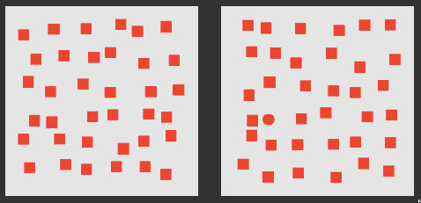
#2 Form
Shape pops out – but not as strongly as colour

Slide 15
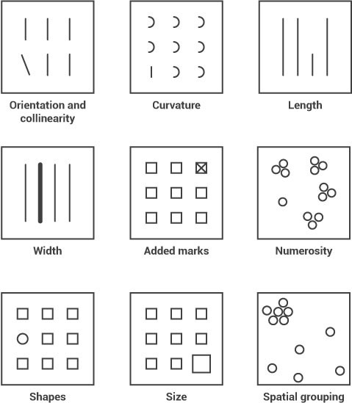
Form attributes
Attributes that are instantly noticeable.
Detecting outliers.
Manipulating attributes to draw attention.

Slide 16
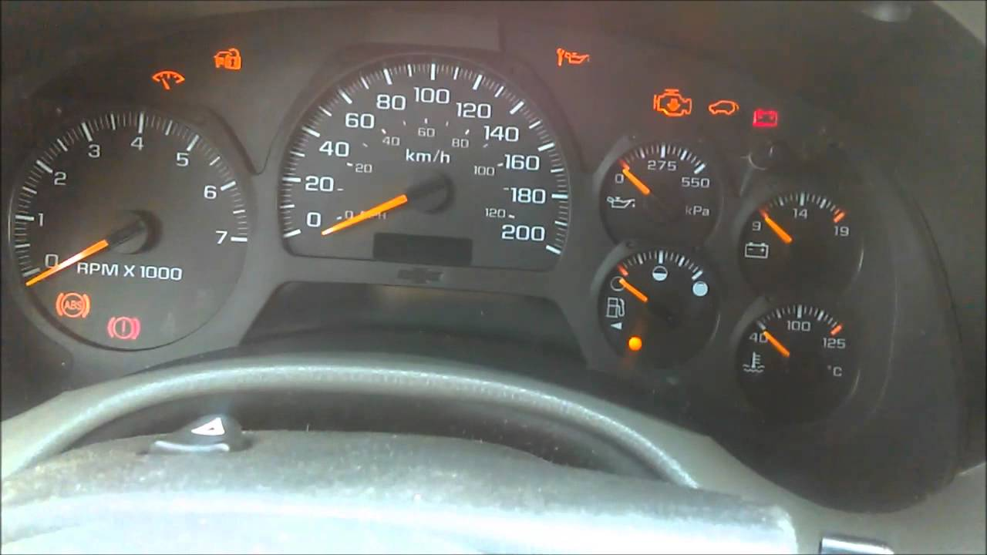
#3 Movement
Attributes:
  Flicker (blink).
  Motion.
Powerful in drawing attention.
  System warnings.
Tackle change-blindness.
Use cautiously:
  Easily becomes annoying.
  Can be too distracting.

Slide 17

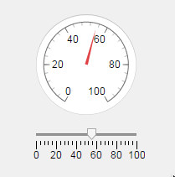
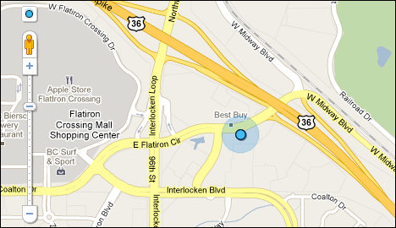
#4 Positioning
Position in a reference system (scale, map, coordinates)
Conveying quantitative data at a glance.
Position on a map.

Slide 18
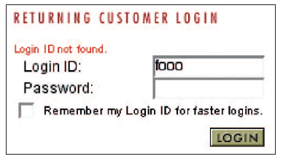
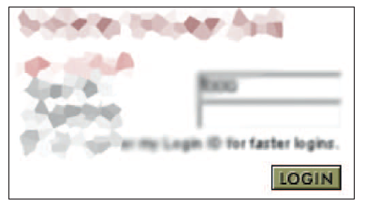
UI Design Implications
Placing important information where the user’s attention is, e.g. error messages.
Design to provide low-resolution cues to guide attention:
  Structure “at a glance”.
  Blur test.
Use of pre-attentive visual properties:
  Drawing attention.
  Providing information that can be sampled without eye movement.
Error message not in foveal region, and not standing out in periphery.

Slide 19

Data Visualisation

Slide 20

Data Visualisation
How can we use pre-attentive features for data visualization?
Encoding different types of data:
  Nominal (categorical).
  Ordinal data (categorical data with order).
  Quantitative data (measured data).
Goals
  Identifying: labeling data.
  Differentiation/association: contrast and analogy.
  Comparing quantities: estimate relative magnitude.

Slide 21

Graphical Perception
Graphical perception: the ability of viewers to interpret visual encodings of data and thereby decode information in graphs.
What visual encodings can we use?
  Colour attributes – brightness, hue.
  Form attributes – length, size, angle, texture, shape, etc.
  Position.
How effective are different visual encodings?
  How easily/accurately do we perceive different form attributes?
  How do we perceive colour?

Slide 22
Example: Compare Area of Circles

Slide 23
Example: Compare Length of Bars

Slide 24
Example: Compare Length of Bars

Slide 25
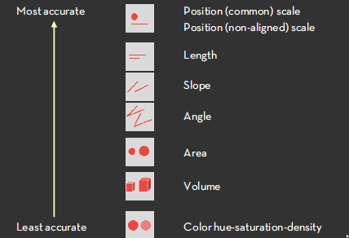
Relative Magnitude Estimation

Slide 26
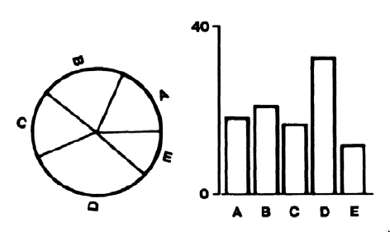
Example: Sort Quantities by Size

Slide 27
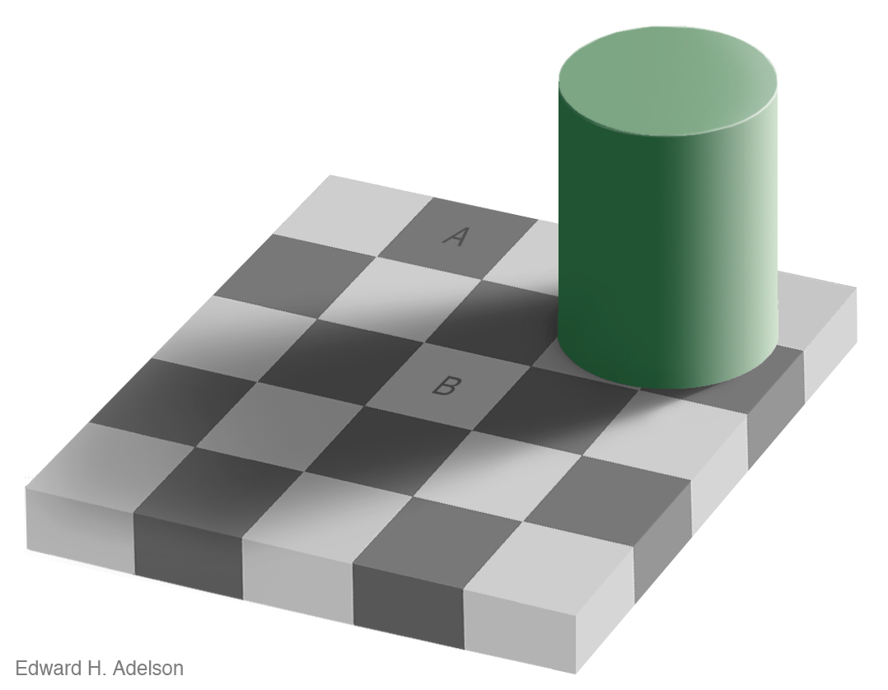
Adelson Checkerboard

Slide 28
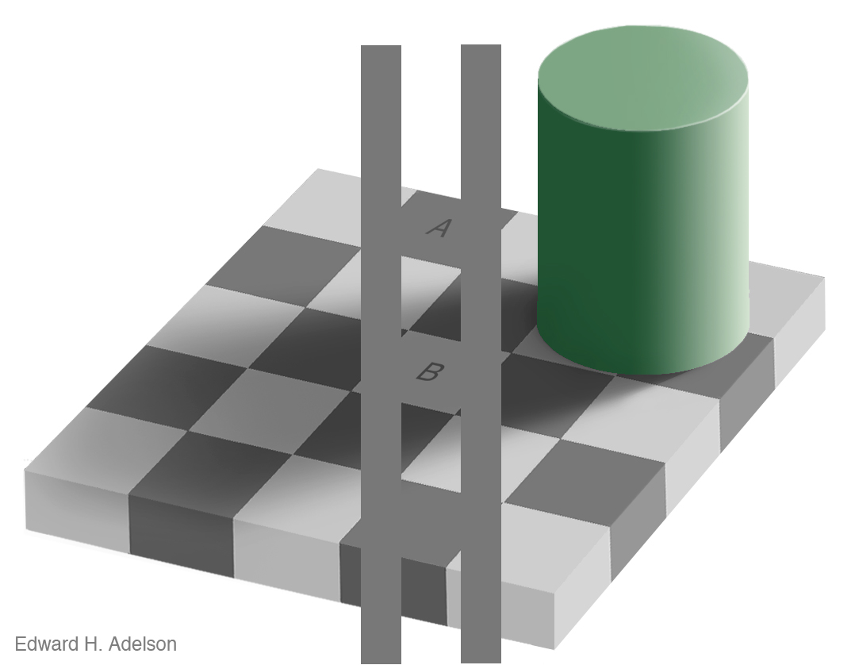
Adelson Checkerboard
A and B are perceived differently based on the surrounding colours and shadows.

Slide 29

Colour Perception

Slide 30
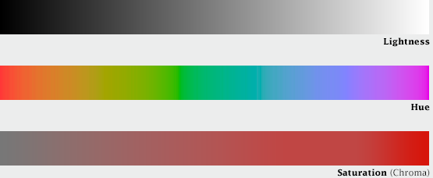
Colour 101
Our eyes see colour through retinal cells that detect red (R), green (G), and blue (B) light.
However, we don’t think about colour in terms of RGB, instead we think about:
  Lightness (black to white).
  Hue (red, orange, yellow, green,
  blue, indigo, violet).
  Saturation (dull to brilliant).
Computers (and programmers) do think in terms of RGB – but watch out, these are different to the RGB our eyes perceive! (computer screens have narrower frequency bands and linear scales, our eyes are exponential).
Source: https://earthobservatory.nasa.gov/blogs/elegantfigures/2013/08/05/subtleties-of-color-part-1-of-6/

Slide 31



Colour Encoding – Categorical
Human vision is optimised for edge contrast, not brightness.
We are less sensitive to absolute brightness levels.
Limitations to representation of data by colours.
Most easily recognizable colours (physiologically):

Slide 32
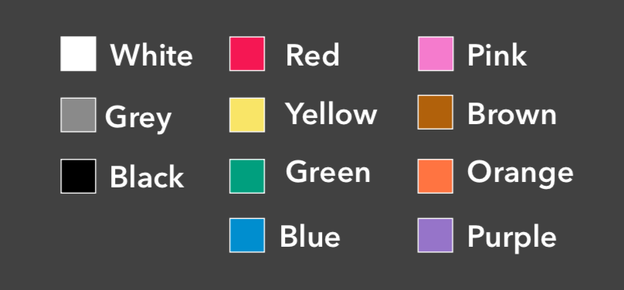
Colour Encoding – Categorical
Colour terms that recur across languages:
No problem using less defined colours but might help the user if they can identify them / talk about them.

Slide 33
Know the Limits of Categorical Colour

Slide 34

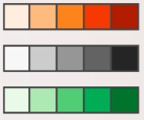
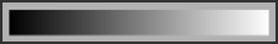
Colour Encoding – Scales
Colour is normally perceived as unordered:
  Encode nominal variables.
  Categories.
Brightness is perceived as ordered
  Encode ordinal data.
  Colour differentiation / association.
But not great for encoding continuous data.

Slide 35
Colour Scales – Examples

Slide 36
Don’t Rainbow!
Colourblind users can interpret them.
The divisions between hues create artificial ‘edges’ in the data.
The spectural order of hues has no inherent meaning.
Yellow is ‘special’ – it appears brighter than other colours as it activities both red and green cones in our eyes.
More info: https://en.rockcontent.com/blog/rainbow-color-scales/

Slide 37
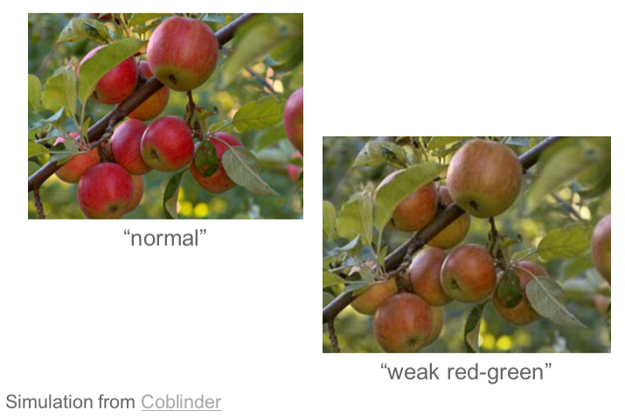
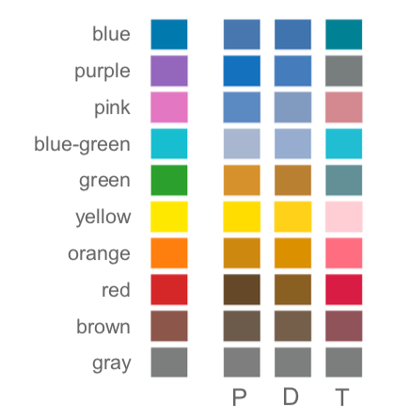
Colour Vision Deficiency (CVD)
Inability to distinguish certain shades of colour (‘colour blindness’):
  Particular shades of reds and greens (most common).
  Blues and yellows (less common)
Affects 1 in 12 (8%) males and 1 in 200 (0.5%) females.
Protanopia
Deuteranopia
Tritanopia

Slide 38
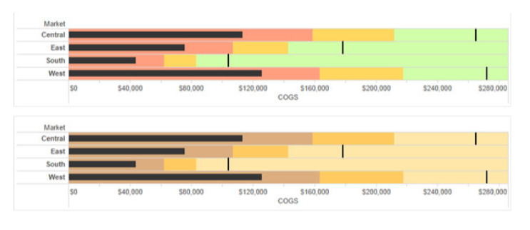
Avoid Encoding by Colour Alone
Use redundant coding.
Shape.
Brightness.
Test your design.
Check it in greyscale.
Use CVD simulators.
e.g. Vischeck:
http://www.vischeck.com/

