Slide 1
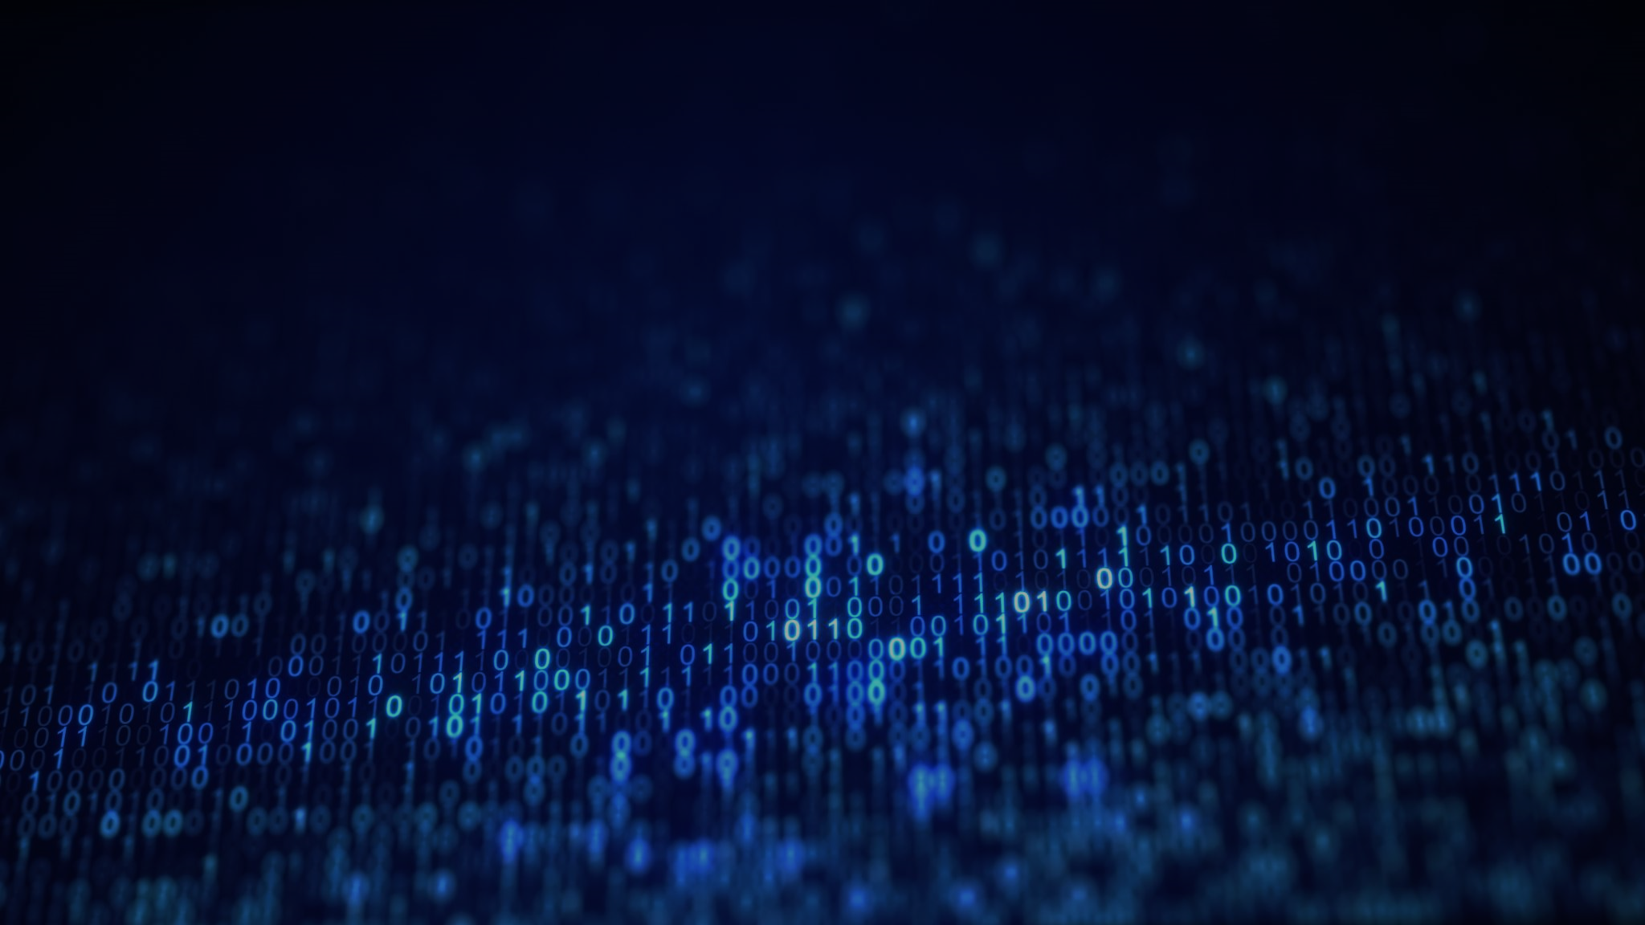

Software Engineering
CM22007
Fundamental Challenges II
Neil Langmead and John Benardis
CM22007 (W02, L01) - Fundamental Challenges II

Slide 2



Last time
What is software engineering?
Fundamental challenges
Some problems with requirements
Today
Fundamental challenges
Requirements can change
Software is intrinsically complex
Defects are inevitable
2

Slide 3
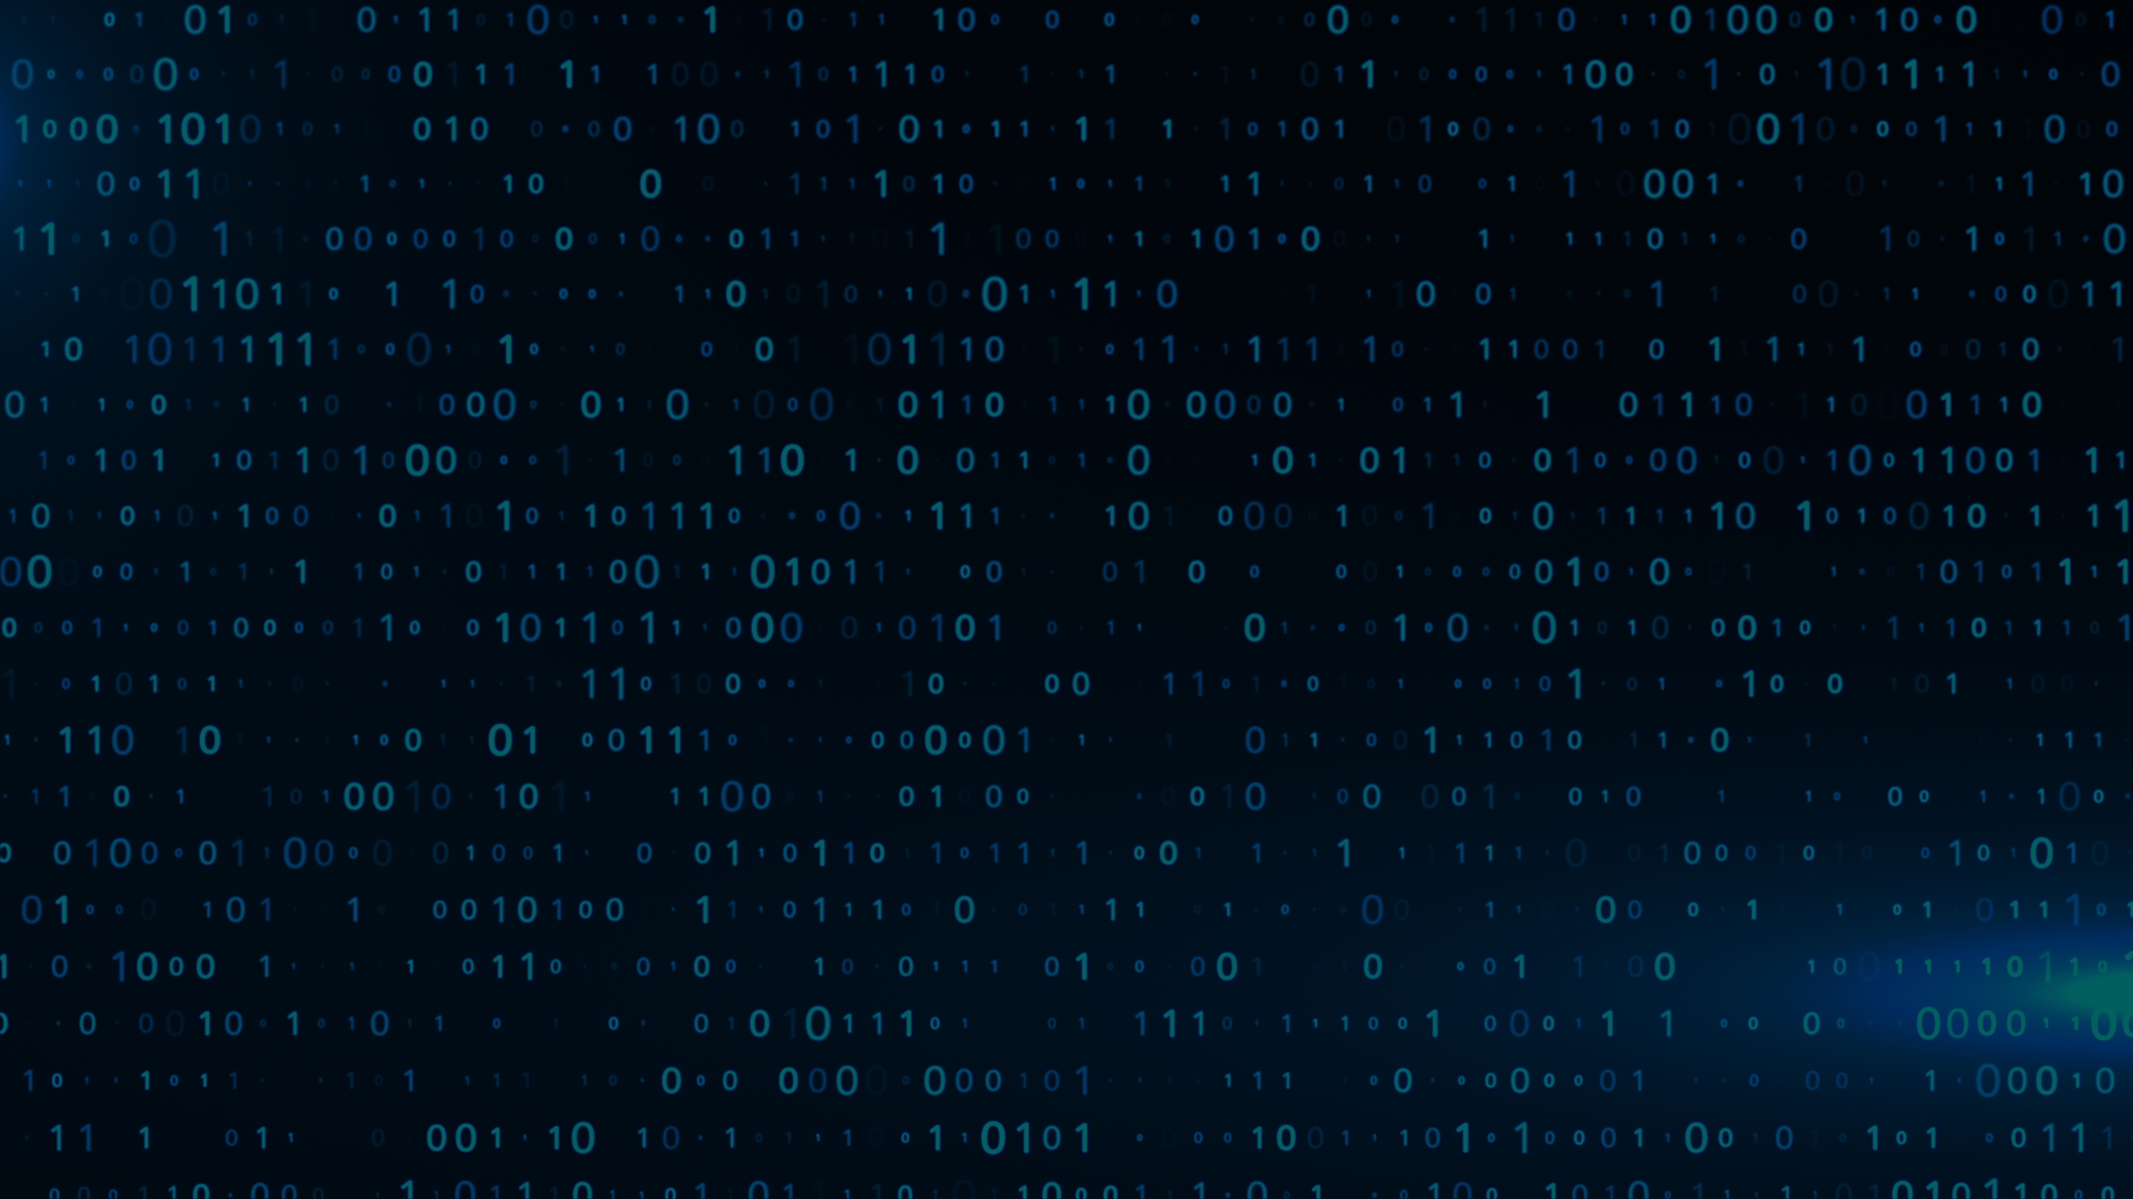
Requirements can change
(A user requirement describes a user need, want, or goal)
3

Slide 4
A Scenario
Developers talk to customers and write user requirements
Which they use to design and build a product
But the completed product fails to meet user expectations!
Customer Needs
drive
build
Process
Product
4
4

Slide 5

The Scenario: What Went Wrong?
Why do you think the product did not meet customer expectations?
How would you fix the problem?
Customer Needs
drive
build
Process
Product
Discuss with the person next to you for a couple of minutes.
5

Slide 6
A Plan-then-Build Scenario: What Went Wrong?
Either the written requirements did not match the real user needs
Or, user needs changed while the product was being built
Customer Needs
drive
build
Process
Product
6

Slide 7
Stakeholders: External and Internal
A stakeholder is anyone with a stake in the project
  External stakeholders include customers, users, IT operations staff, etc.
  Internal stakeholders include developers, managers, marketers, etc.
Unless otherwise stated, ”stakeholders” are external
7

Slide 8
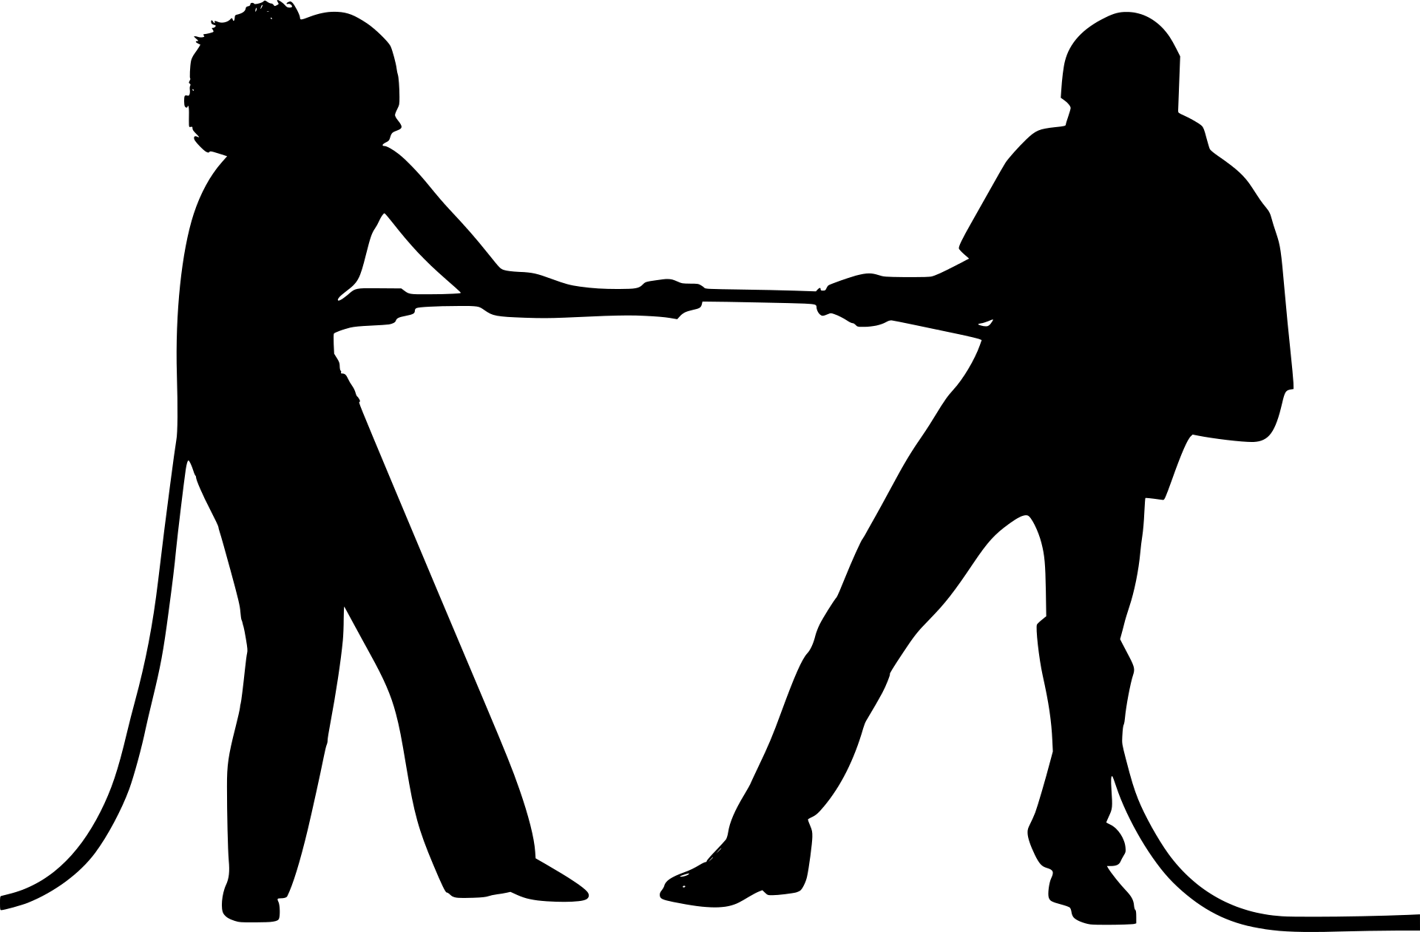
Possible Reasons for Requirements “Changes”
Multiple stakeholders, with differing, perhaps conflicting needs
  Any missed stakeholders?
Mismatch between the real user needs and the written user requirements
  What users say can differ from what they do, use, and feel
Unexpected changes
  In the customer’s business, technology, competitive products, etc.
8

Slide 9
Example: Multiple Stakeholders
Parents wanted a speech-therapy app for their children
  But, they found it too hard to use
Children had no problems using it, but couldn’t be bothered
  It was too much like a lesson
Developers changed the app to satisfy both stakeholders
  Made it easier to use for parents
  Made it like a game for children
9

Slide 10

Example: Mismatch Between Words and Actions
What Netflix customers ask for from the recommender system:
  Maximum choice, comprehensive search and navigation
But what actually works:
  A few compelling recommendations, simply presented
10

Slide 11
Iterate-and-Grow: Use Iterative Methods
The product grows in functionality, its evolution guided by user feedback
Development consists of a sequence of cycles; see diagram below
Each iteration produces a working, potentially deliverable, product
Customer Needs
drive
meets
build
Process
Product
11

Slide 12
Software is Intrinsically Complex
12

Slide 13
Why is Software Complex?
Let us say software is complex if it is hard to understand and modify
Accidental (or Incidental) complexity is tied to an implementation
  It can be removed by cleaning up the code, changing the language, etc.
Intrinsic complexity remains even if all accidental complexity is removed
  It can be managed by designing run-time behaviour to be more predictable
13

Slide 14
Intrinsic Complexity: Run-Time Behaviour is Invisible
The static (compile time) source text is visible
  We can read and write code
But, the dynamic (run-time) behaviour is invisible
  We have to imagine what the code does when it runs
The primary source of intrinsic complexity
  The predictability (or not) of system behaviour from the source code
  In short, the invisibility of behaviour is the primary source
14

Slide 15
Does the following loop terminate cleanly?
do j++; while ( a[j] < pivot );
Think about it for a few moments.
15

Slide 16
Example: Clean Loop Termination
Does the following loop terminate cleanly?
  do j++; while ( a[j] < pivot );
Answer: depends on the values of j, pivot, and the array elements
  For clean termination, the loop must reach a[k]>=pivot
Conclusion
  The same code can have a potentially infinite number of outcomes
16

Slide 17
Dealing with Complexity
Avoid Accidental (or Incidental) complexity
  Use the right languages, frameworks, and tools for the job
  Avoid technical debt, which accumulates and makes code brittle
  Technical debt is the conceptual cost of cleaning up a “quick fix”
Manage Intrinsic complexity
  Design modular systems, with relatively independent parts
17

Slide 18
Defects are Inevitable
18

Slide 19
Why are Defects Inevitable?
From George Miller’s Experiments in the 1950s
  People can keep track of bout 7 units: bits, words, colours, tastes, tomes
  Beyond about 7 chunks of information, confusion and errors set in
To err is human
19

Slide 20
Faults versus Failures
Faults are in the static source code or in documents
  Defect, bug, and anomaly are synonyms for faults
Failures are triggered at run time (dynamically)
  A failure is unexpected behaviour, with crashes being dramatic failures
Example: When an app crashes some of the time
  There must be a fault or faults in the app’s code
  But, failures occur only some of the time; e.g., when there is a crash
20

Slide 21
Testing: Context
Test
Inputs
Software
under test
Output Response
Environment
21

Slide 22
Defining a Test Strategy
What is the software under test?
  White-box tests are based on knowledge of the code
  Black-box tests are based only on inputs and outputs
What does the software need from its environment before it can run?
  The software is typically not self-standing. It needs values or functions.
How will test inputs be selected? What is a good test set?
How will the output be evaluated? That is, did a test pass or fail?
22

Slide 23
Select Tests for Coverage
Coverage is the fraction of constructs touched by a set of tests
Select white-box tests for code coverage
  Statement coverage is a typical code-coverage criterion
  Decision or Branch coverage is a stronger criterion
Select black-box tests for input-domain coverage
  Select test inputs so they are a representative sample of all inputs
23

Slide 24
Testing Terminology
Unit testing is named after units of implementation
Regression testing runs all known tests to verify that nothing broke
A test suite is a set of test inputs
24

Slide 25
Lecture Summary
Principles and practices for dealing with fundamental challenges:​
  Requirements can change​
  Software is intrinsically complex​
  Defects are inevitable​
These challenges have implications for what to build and how to build it​
25

Slide 26
Thank you!
Questions?

