Slide 1
FINAL PROJECT
For Big Data and Business Analytics Specialization Certificate Program (ITÜ) Name Surname : Meriç Utku Sokat

Slide 2
MY PROJECT
I will choose User Behavior Dataset because this dataset includes a variety of features collected from users of different mobile devices, capturing both device usage metrics and demographic information. The goal is to identify potential relationships among these variables to gain insights into user behavior patterns.

Slide 3
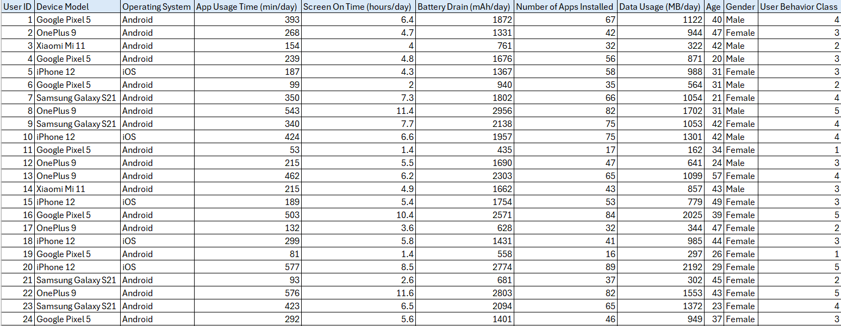
EXCEL SPREADSHEET

Slide 4
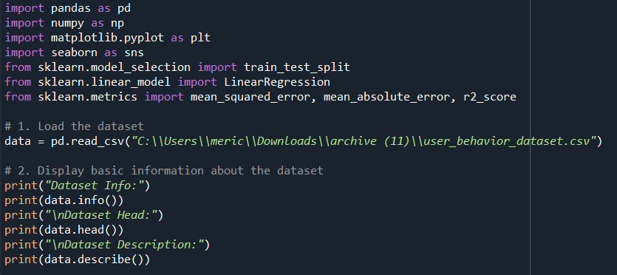
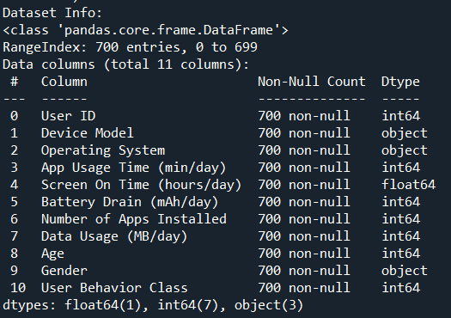
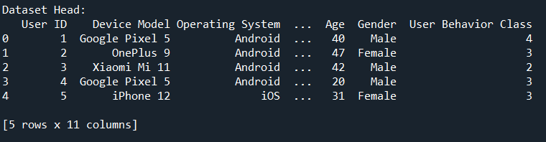
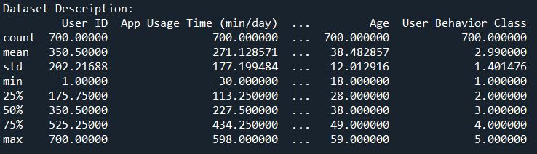
The dataset includes 700 entries with 11 fully complete columns, capturing user behavior on mobile devices. It covers app usage, screen time, battery drain, and demographic details, making it suitable for linear regression analysis to explore user behavior patterns.

Slide 5

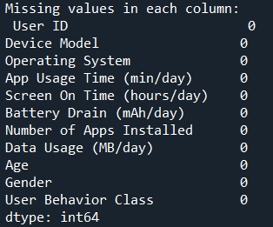
In this step, we performed a data quality check to ensure that there are no missing values in our dataset, which is crucial for reliable analysis. The summary here confirms that each column has 0 missing values. This guarantees that our dataset is complete and ready for analysis without the need for additional data imputation or cleaning steps.

Slide 6
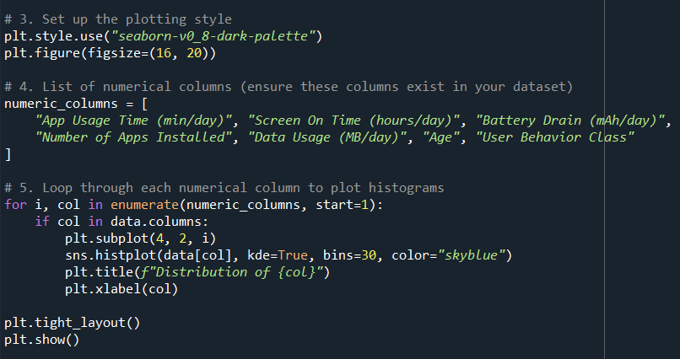
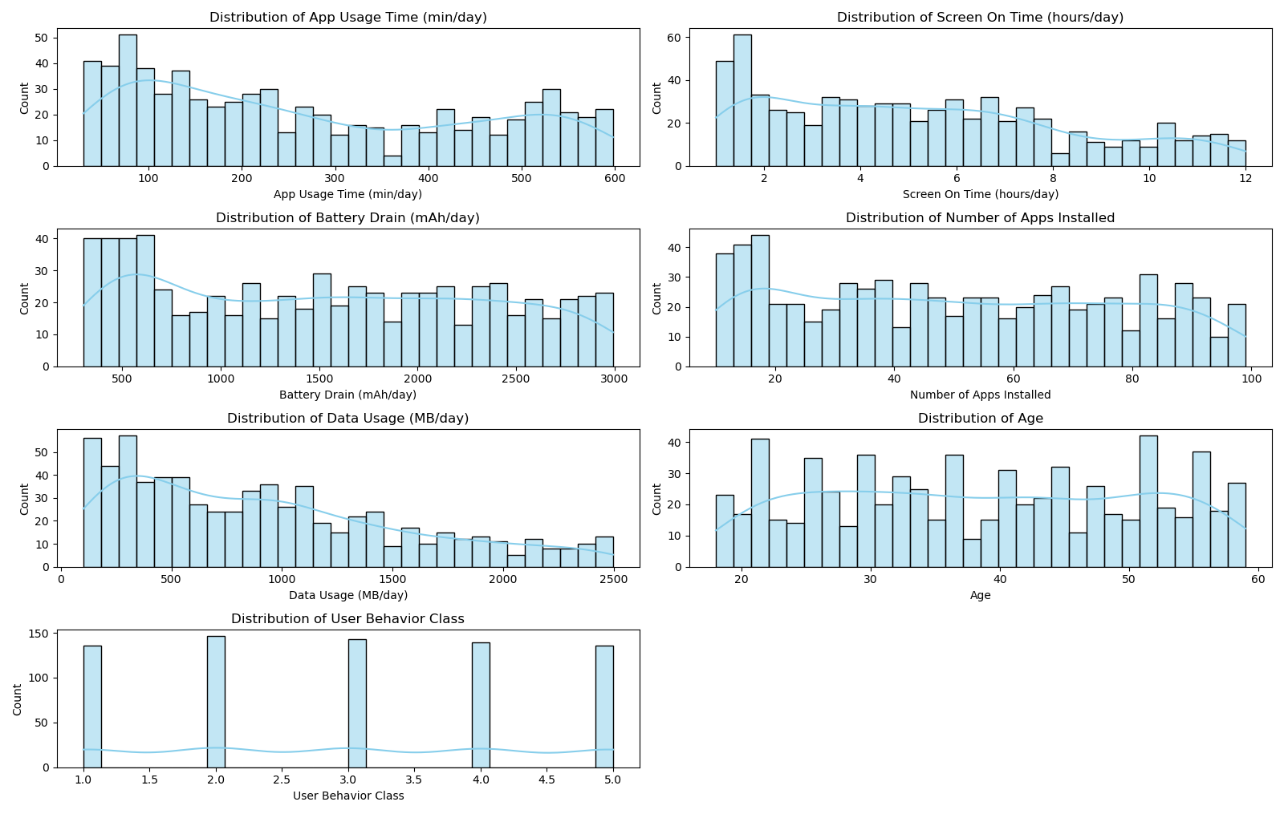
HISTOGRAM
The data reveals important insights into user habits and preferences, which can inform strategies for app development and user engagement. Overall, this visual representation allows for a clear understanding of user behavior patterns that can be leveraged for targeted interventions and improvements.

Slide 7
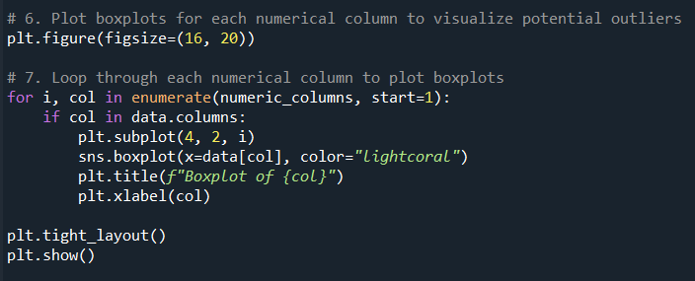
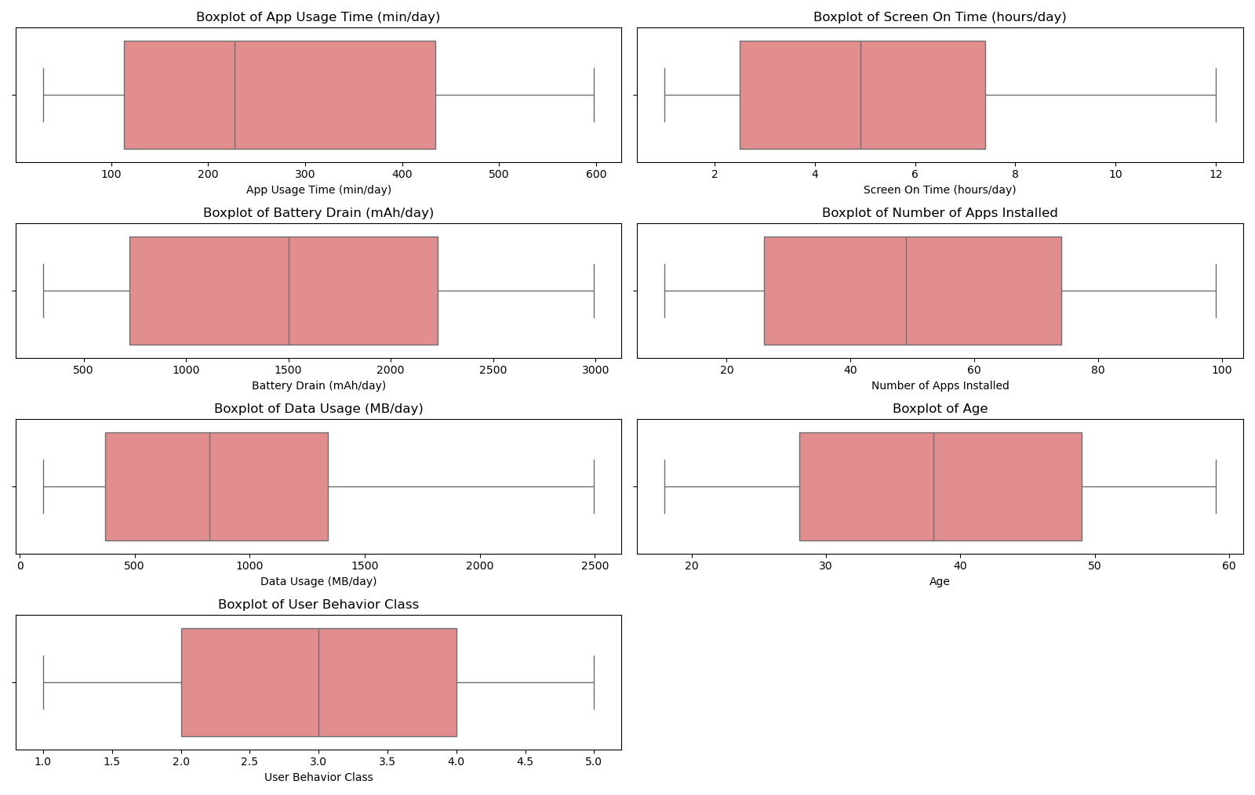
BOXPLOT
This series of boxplots provides a visual summary of user behavior metrics, including app usage time, battery drain, data usage, number of apps installed, age, and user behavior class. The plots highlight the distributions and central tendencies of these metrics, offering valuable insights into user habits and preferences.

Slide 8
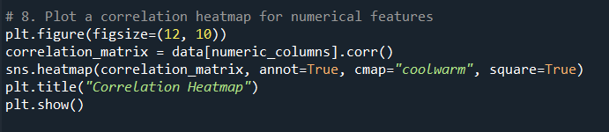
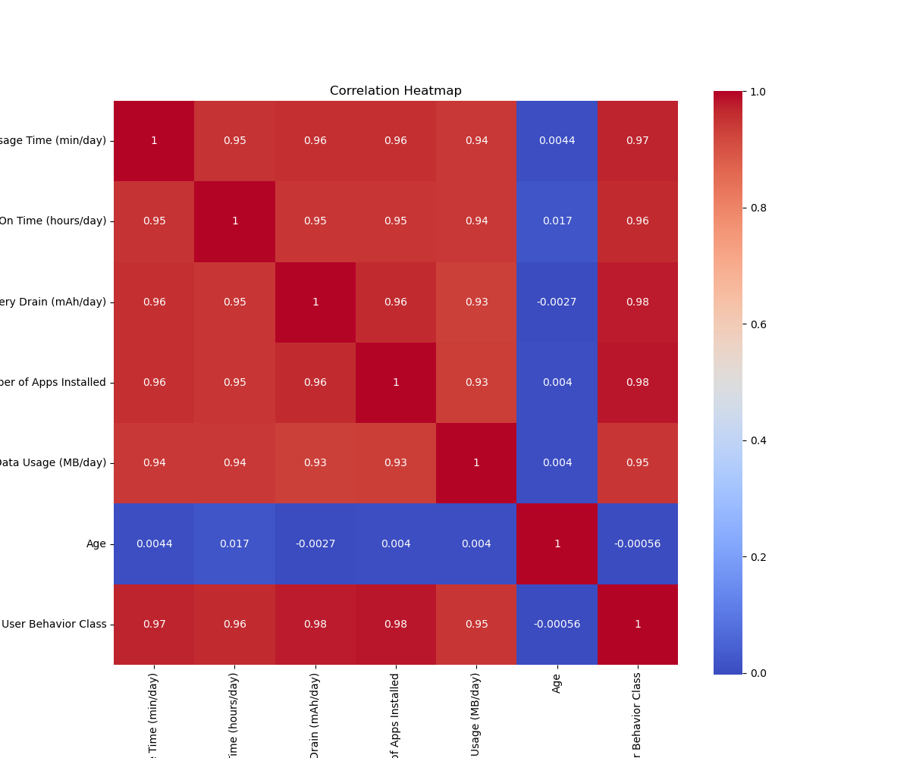
CORRELATION HEATMAP
The correlation heatmap reveals strong positive relationships among user behavior metrics, particularly between app usage time, screen on time, and battery drain, with correlations ranging from 0.95 to 0.96. Increased app usage also correlates with higher data consumption and a greater number of apps installed. In contrast, age shows minimal correlation with these variables, indicating that it has little impact on user behavior metrics. Overall, the findings suggest that user engagement strategies should focus on app usage and battery management rather than age-related factors.

Slide 9
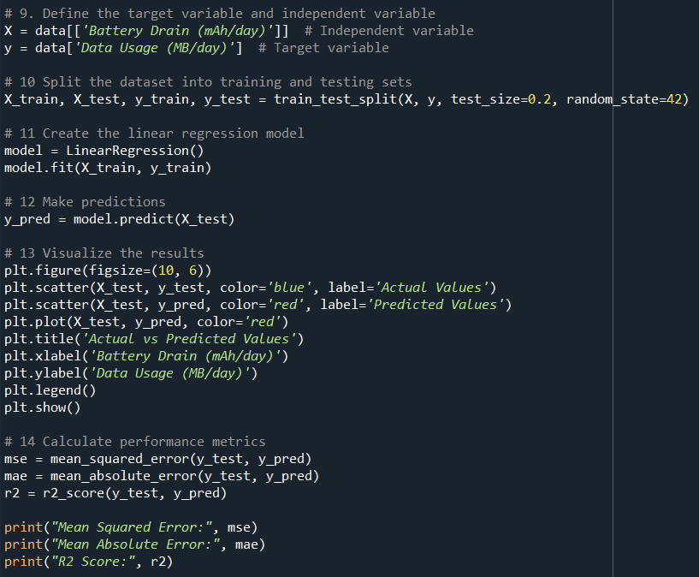
LINEAR REGRESSION
Linear regression is used for predicting the dependent variable based on independent variables, providing insights into how one variable affects another. Its simplicity and interpretability make it easy to understand, with coefficients indicating the strength and direction of relationships. Performance metrics like Mean Squared Error (MSE) and R² Score help assess the model's accuracy. Additionally, linear regression serves as a foundation for more complex statistical methods and machine learning models.

Slide 10
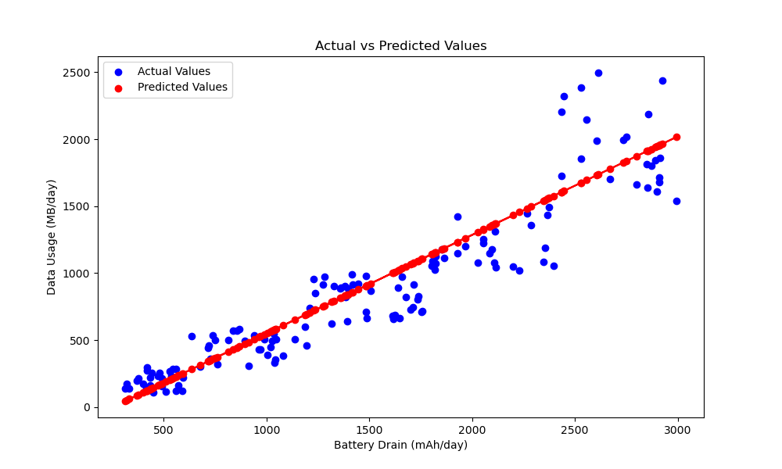

LINEAR REGRESSION
It illustrates the relationship between actual data usage (MB/day) and predicted values based on battery drain (mAh/day). The upward trend demonstrates a strong positive correlation: as battery drain increases, data usage also rises. This suggests that higher engagement with data-intensive applications leads to faster battery consumption. Understanding this relationship can help optimize device performance and manage battery life effectively.

