Slide 1
Y COMBINATOR // STARTUP FINANCE GUIDE
SPEAKER: KIRSTY NATHOO (CFO)
6 Financial Mistakes That Cause Startups to Run Out of Cash
Practical lessons from nearly 2,000 Y Combinator companies on cash flow management, cost control, hiring, and critical fundraising timing.
CORE PRINCIPLE
Cash is the lifeblood of a business — when the cash runs out, it’s over

Slide 2
CONTEXT & ROADMAP
Why Do Startups Die When They Run Out of Cash?
GROUP 1 // EARLY STAGE
1. Unclear Metrics • 2. Failure to Monitor • 3. Underestimating Costs
2.000+
Understand your cash flow health directly from your bank statements.
Startups Through a CFO’s Eyes
GROUP 2 // FUNDRAISING & SCALING
Most startups realize they are running out of cash only when it is too late to turn things around.
4. Blindly Delegating Accounting • 5. Scaling Too Quickly • 6. Fundraising Too Late
Maintain capital discipline before and after achieving Product-Market Fit.

Slide 3
MISTAKE 01 // PART A: THE BASIC NUMBERS
Not Understanding Key Financial Metrics
You only need your online bank statement and three figures: current balance, money in, and money out.
1. BURN RATE
2. RUNWAY
3. GROWTH RATE
$15K/month
10 months
+20%/month
$25K spent minus $10K received. Use a three-month average if expenses fluctuate sharply.
A $150K balance divided by a $15K burn rate. Never distort the numbers to reassure yourself.
From $10K in Month 7 to $12K in Month 8. Consistent growth creates a J-curve.
Kirsty Nathoo’s warning: Pretending your burn rate is $10K instead of $15K will not change the day you run out of money.
DON’T FOOL YOURSELF

Slide 4
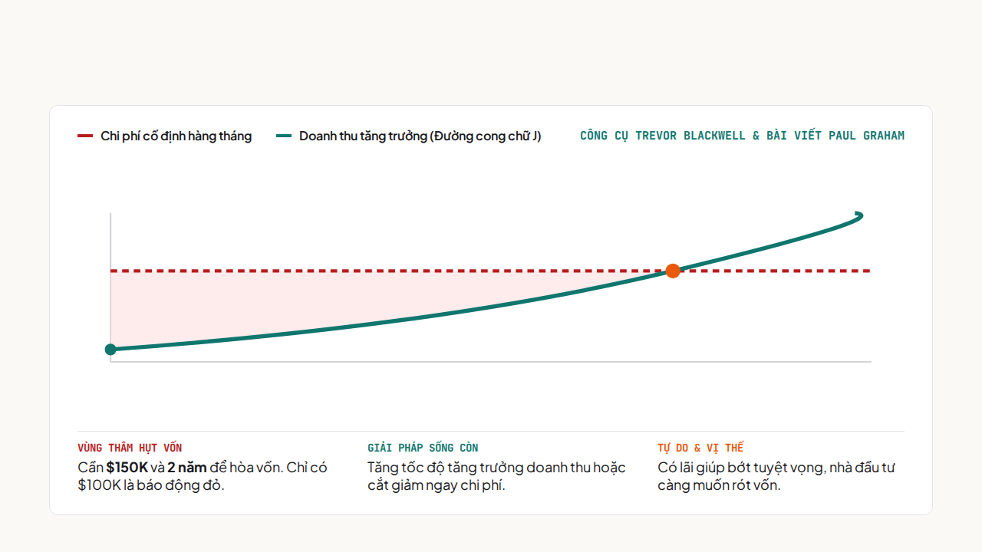
MISTAKE 01 // PART B: DEFAULT ALIVE OR DEFAULT DEAD?
Default Alive: Can You Reach Break-Even Before Running Out of Cash?

Slide 5
MISTAKE 02 // CHECK-IN FREQUENCY
Not Monitoring Finances Frequently Enough
Calculating the numbers once and then forgetting them prevents founders from responding when cash flow changes.
LEVEL 01 // COMMON MISTAKE
LEVEL 02 // YC RECOMMENDATION
LEVEL 03 // WHEN RUNWAY IS LOW
Quarterly / Monthly
At Least Weekly
Check Daily
Know your balance and runway whenever someone asks.
Essential when cash is low or expenses fluctuate significantly.
Too late to detect spending that is getting out of control.
YC’s spot check: Do you know your exact account balance and how many months of runway you have right now?

Slide 6
MISTAKE 03 // COSTS INCREASE OVER TIME
Underestimating Future Real Costs
01 // FOUNDER’S TIME
02 // EMPLOYEE COSTS
03 // PAID MARKETING
Undervaluing Time
Add Another 25% to 50%
Acquisition Costs Rise
Paying yourself the minimum creates an artificially low customer acquisition cost.
A $100K salary costs $125K–$150K+ when equipment and insurance are included.
New customers become increasingly harder to find than the first group.
A prudent rule: Always calculate runway using the worst-case scenario (8 realistic months is better than 10 optimistic months).
RUNWAY ISN’T FOR SHOWING OFF

Slide 7
PART 02 // FUNDRAISING & GROWTH STAGE
3 Traps to Avoid When You Have Cash in the Bank and Start Hiring
Manage the books, control headcount before Product-Market Fit, and choose the right time for your next fundraise.

Slide 8
MISTAKE 04 // BLIND DELEGATION
Handing All Financial Responsibility to Someone Else
CEO & FOUNDER RESPONSIBILITIES
DISTINGUISHING FINANCE ROLES (FROM Q&A)
You Can’t Hire Someone to Take Your Responsibility
Who Does What in a Startup?
Bookkeeper: Hire one soon after fundraising to enter bank statements; it is easy to misinterpret the nature of transactions.
Review monthly reports: Never check them off as complete without examining them carefully.
CPA (tax accountant): Hire one annually to prepare and file tax returns.
Ask questions immediately: Investigate any revenue or expense figures that differ from expectations.
Full-time CFO: Usually needed much later, after a Series A, for strategic planning.
Build your own spreadsheet: Do it yourself to deeply understand your cash flow model.

Slide 9
MISTAKE 05 // PART A: THE HEADCOUNT TRAP
Hiring Too Quickly Because of Comparison Pressure
Ignore the Headcount Obsession (25 People vs. 10)
A MEANINGFUL PERFORMANCE METRIC
More employees do not mean greater success, and there is no need to rush to hire a data scientist.
Revenue per Employee
Measure the ROI of Every New Hire
Sales staff must generate revenue that exceeds their cost; operations roles must increase company value.
The best companies consistently create more value with fewer employees.
Be Ready to Let People Go Quickly (Fire Fast)
Act decisively when employees underperform to protect your capital.

Slide 10



MISTAKE 05 // PART B: PRODUCT-MARKET FIT (PMF)
Scaling Before Achieving Product-Market Fit
The Myth That More Salespeople Will Help
The Myth That More Engineers Will Help
The Responsibility to Multiply Capital 10x–100x
Adding salespeople cannot save a product that lacks market appeal.
With PMF, customers are willing to buy even a rough MVP.
Conserve cash as much as possible before PMF to give yourself time to find the right product.

Slide 11
MISTAKE 06 // THE FATAL, IRREVERSIBLE MISTAKE
Waiting Until You’re Nearly Out of Cash to Start Fundraising
Golden rule: Always plan as if your current funding will be the last money you ever raise.
RUNWAY / FUNDING STAGE | POSITION & CHARACTERISTICS | REQUIRED ACTION
12 Months of Runway Remaining | Strong negotiating position; fully in control | Start planning a fundraise or work toward break-even
6 Months of Runway Remaining | Closing a deal takes 3 months, weakening your negotiating position | There may not be enough time to become profitable if fundraising fails
Seed Round | Raise funds based on the idea and market size | No need to include monthly growth forecasts in the pitch deck
Series A and Beyond | Requires PMF and sustainable growth | Needs a clear financial plan and predefined cost-cutting levers

Slide 12
KEY TAKEAWAYS FROM KIRSTY NATHOO // Y COMBINATOR
Thank You & Discussion!
4 core principles to help startups control cash flow and never be caught unexpectedly running out of money:
01 // CASH FLOW
02 // COSTS
03 // PERFORMANCE
04 // PROACTIVITY
Know Your Balance & Runway Every Week
Forecast the Actual Pace of Cost Increases
Optimize Revenue per Employee
Always Have a Plan to Reach Break-Even

